Slide 1
Small TSP

Slide 2
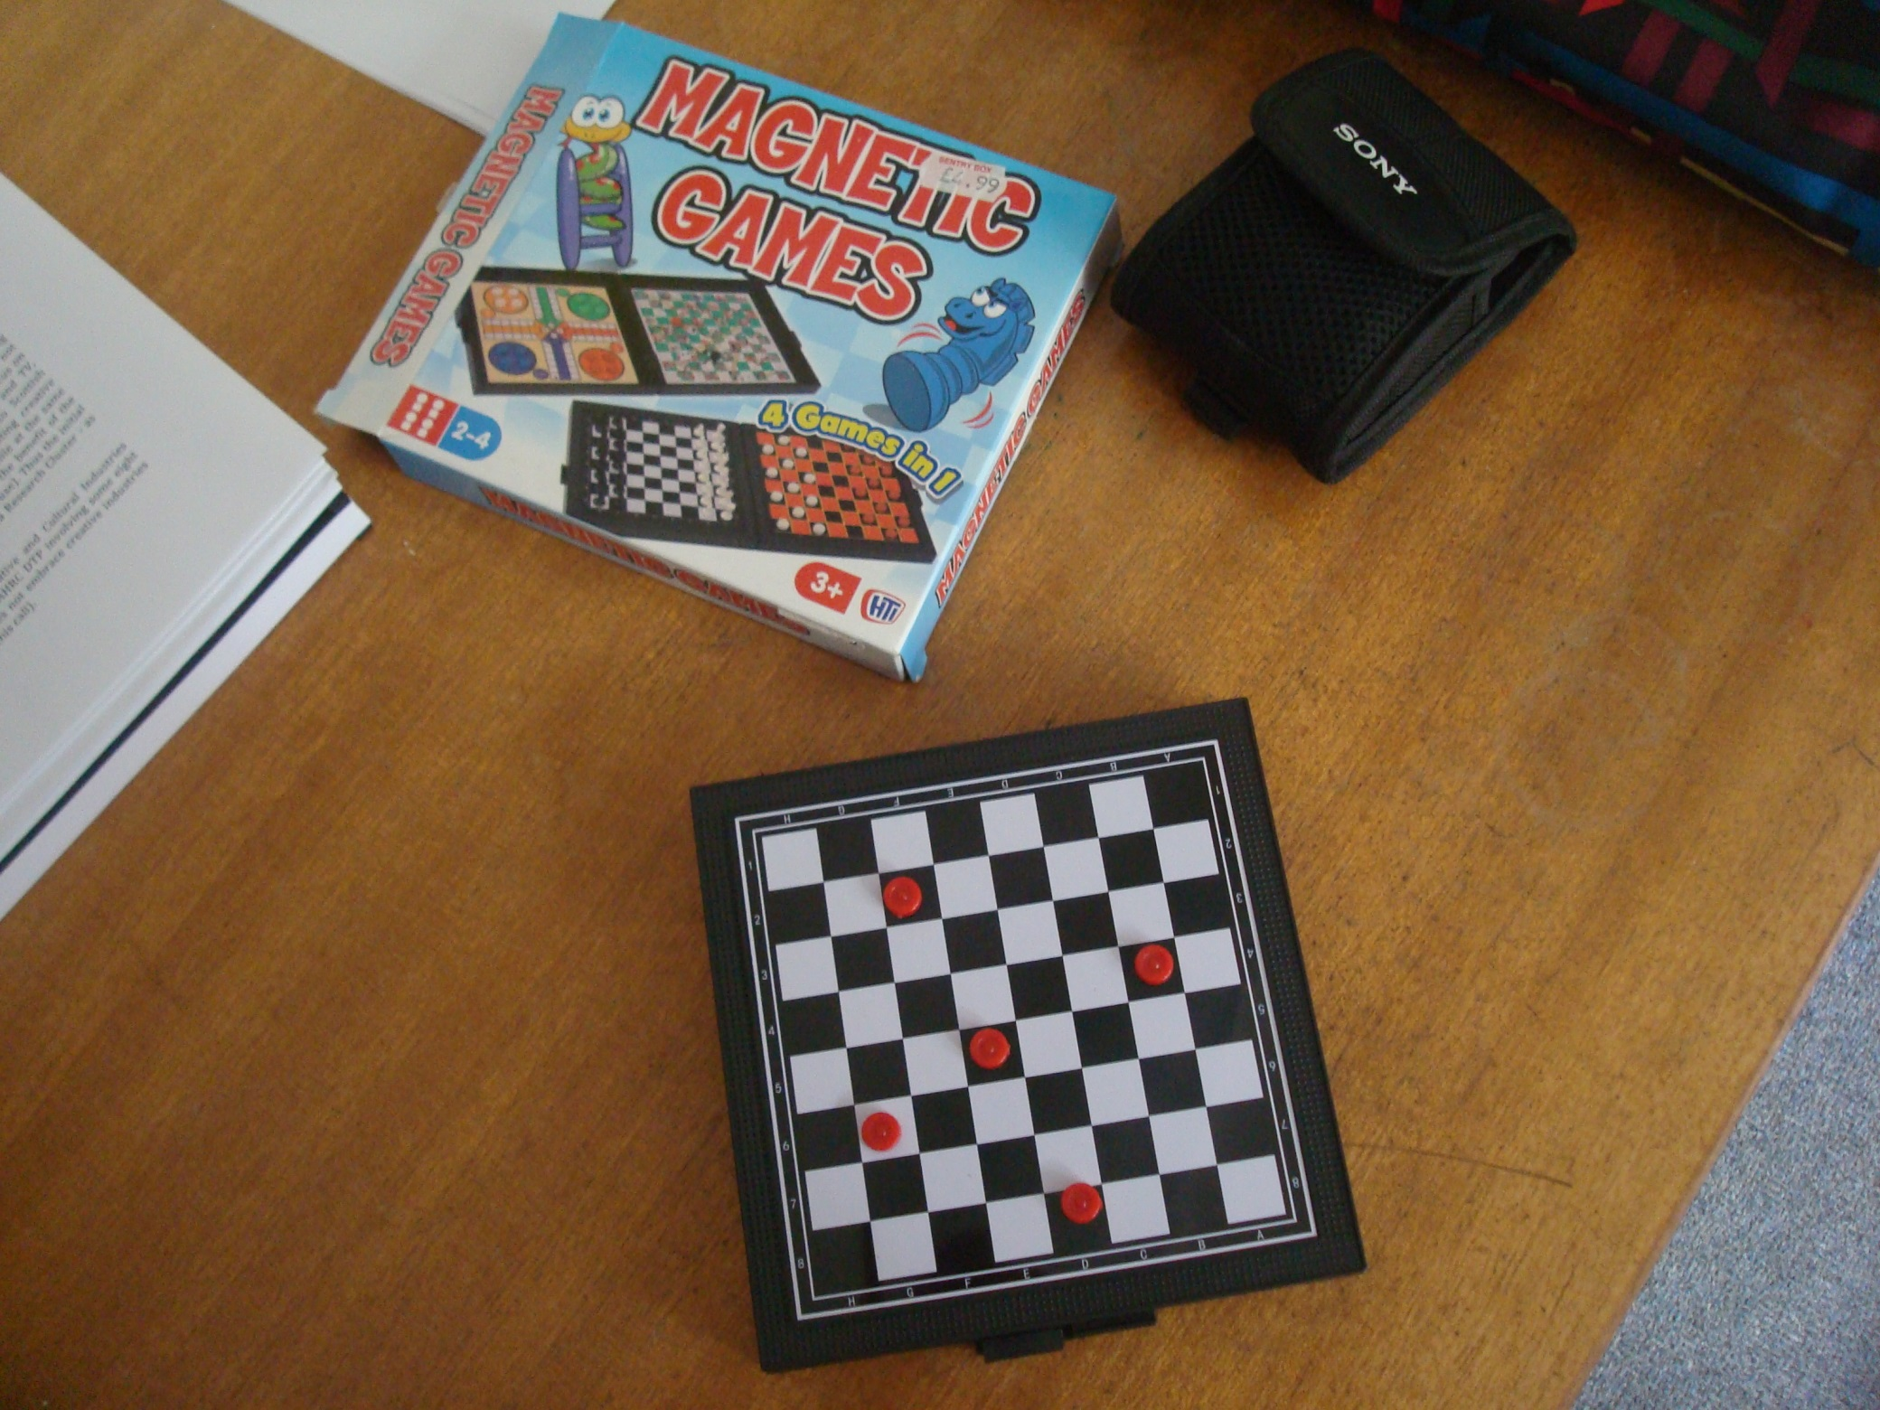

Slide 3
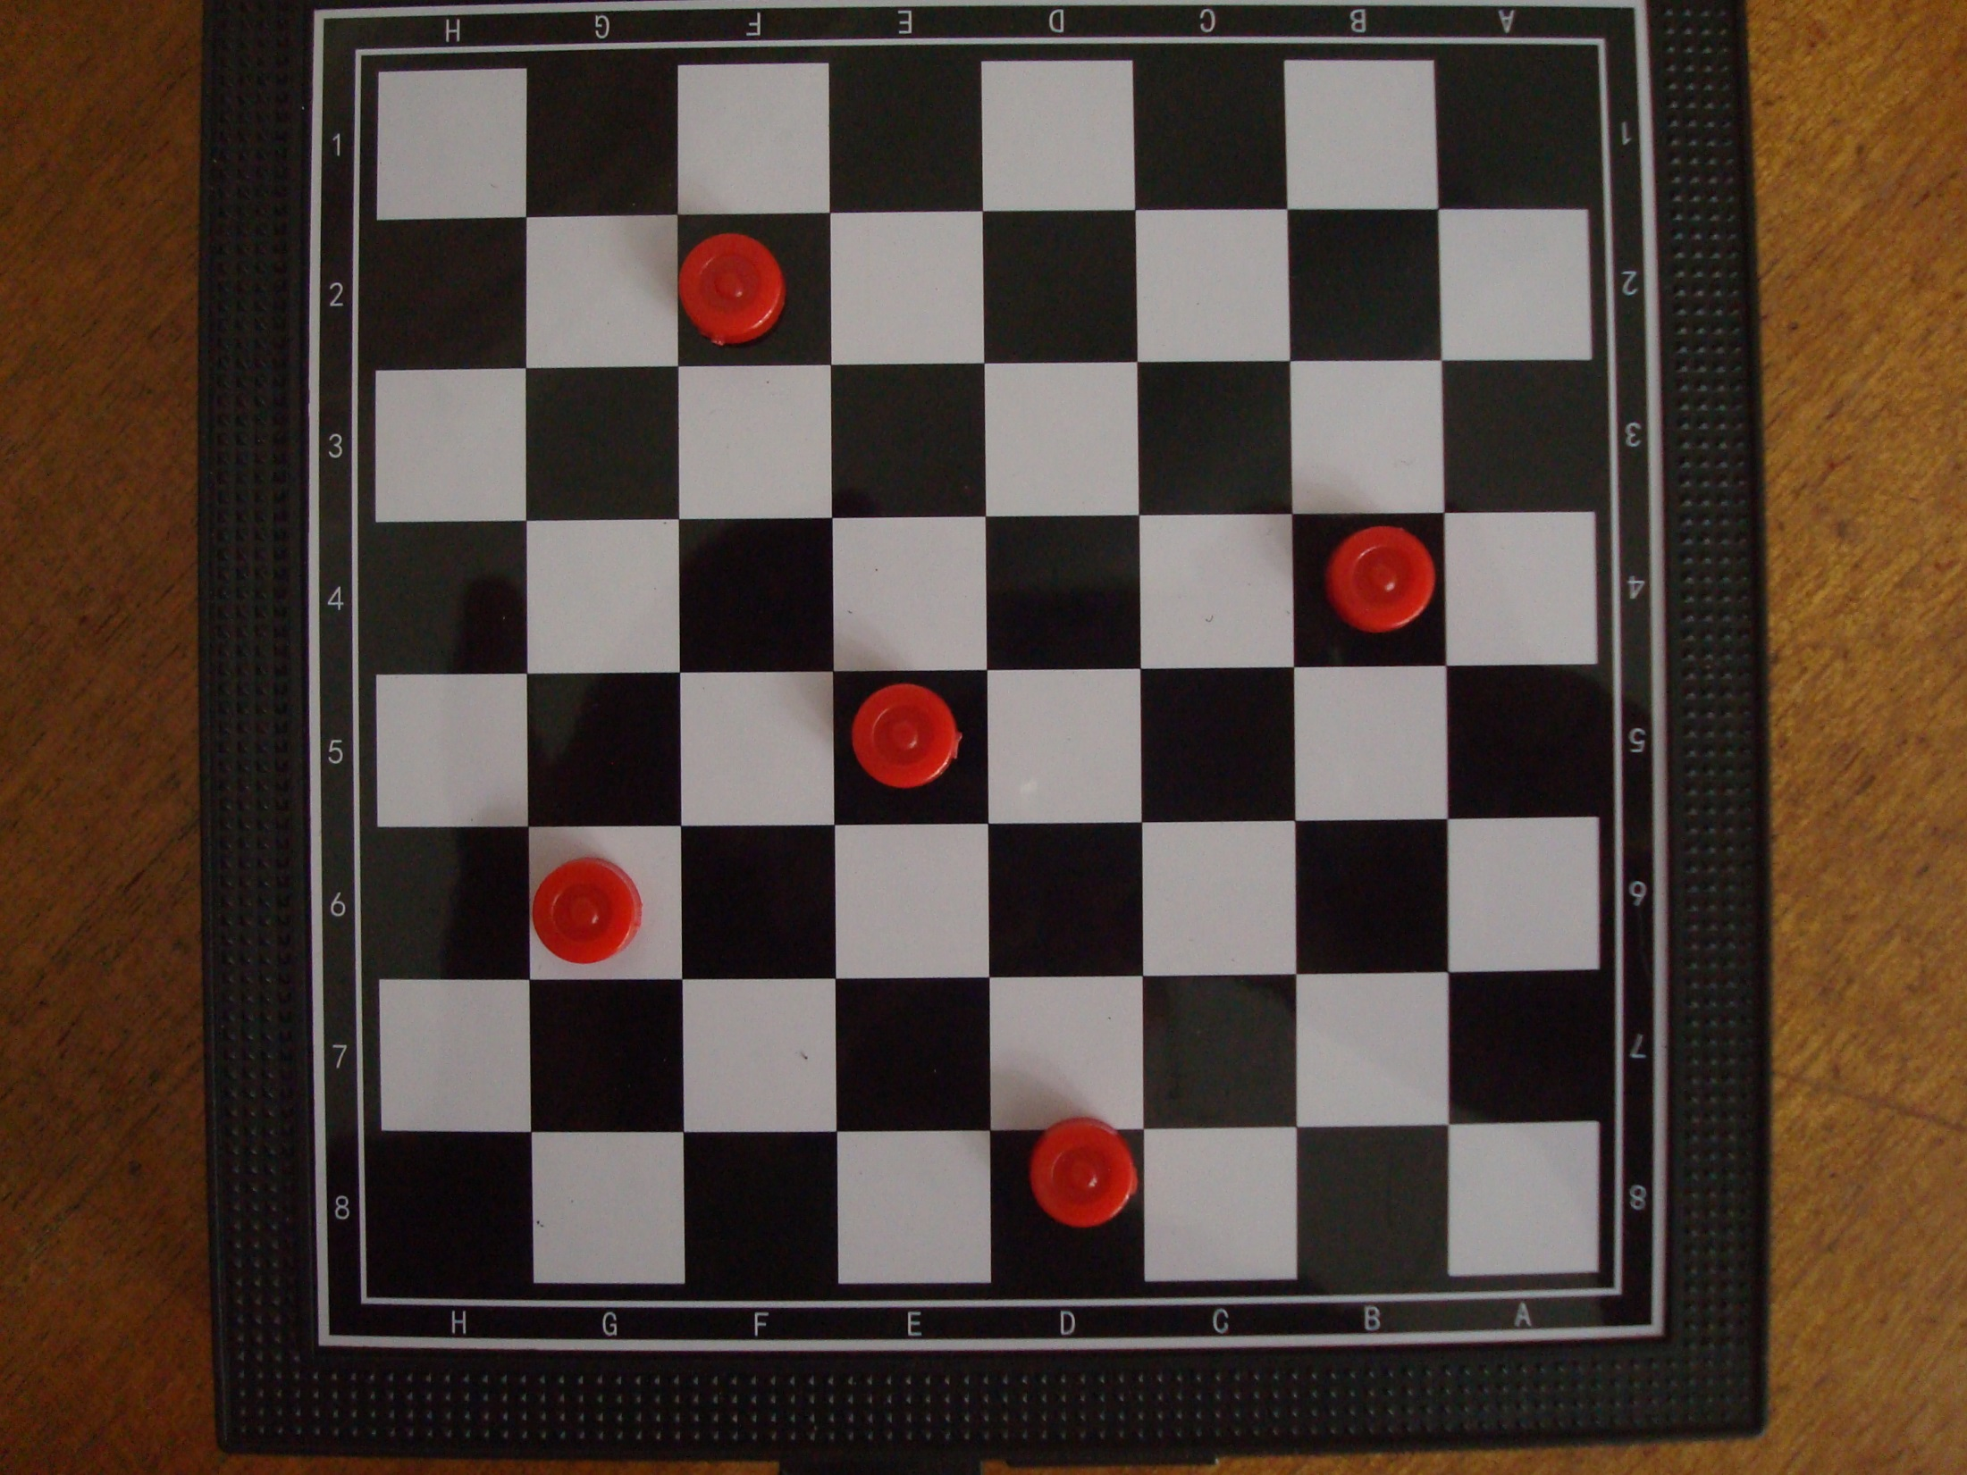

Slide 4
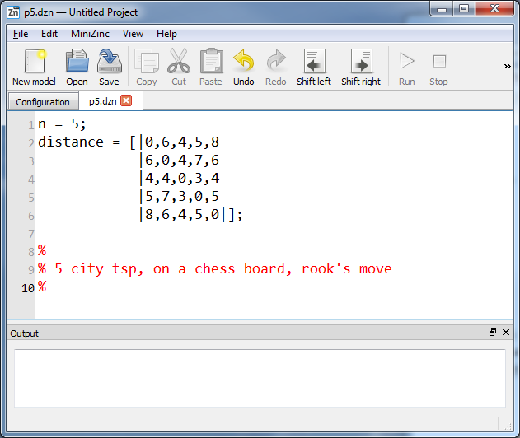

Slide 5
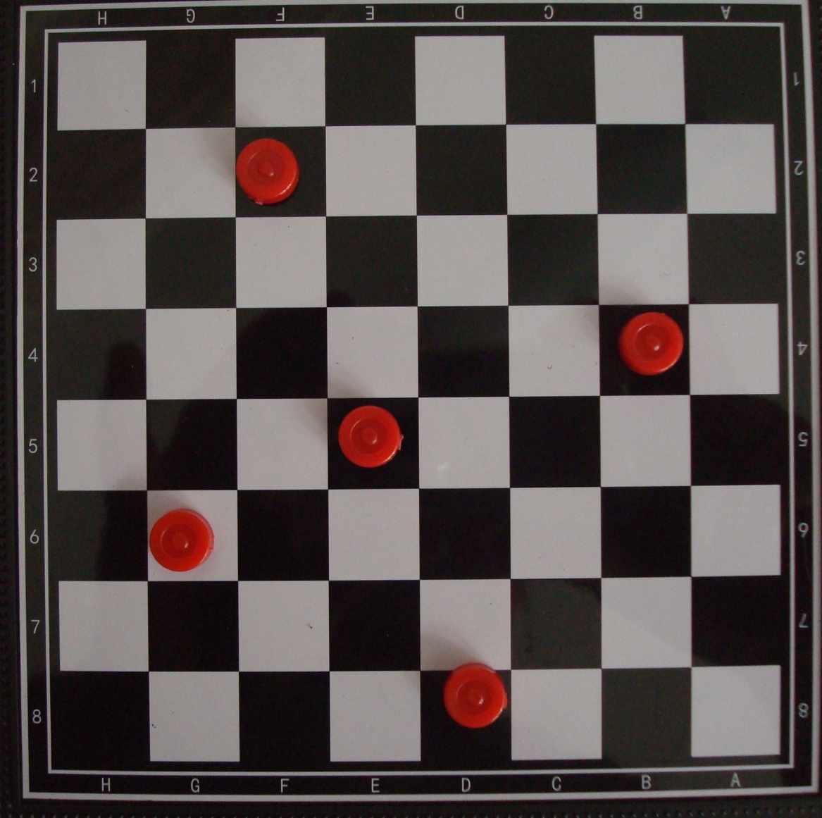

Slide 6
Single successor model
next[i] = j means “visit city j immediately after city i”

Slide 7
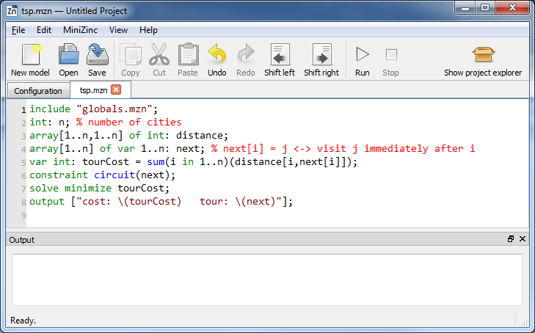

Slide 8
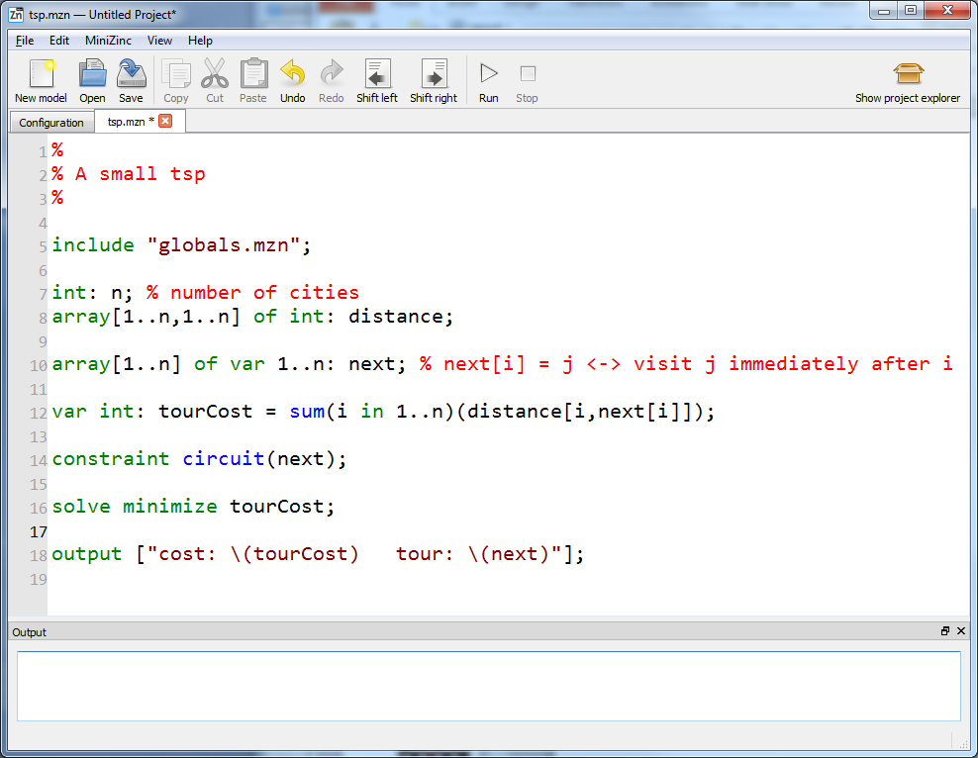

Slide 13
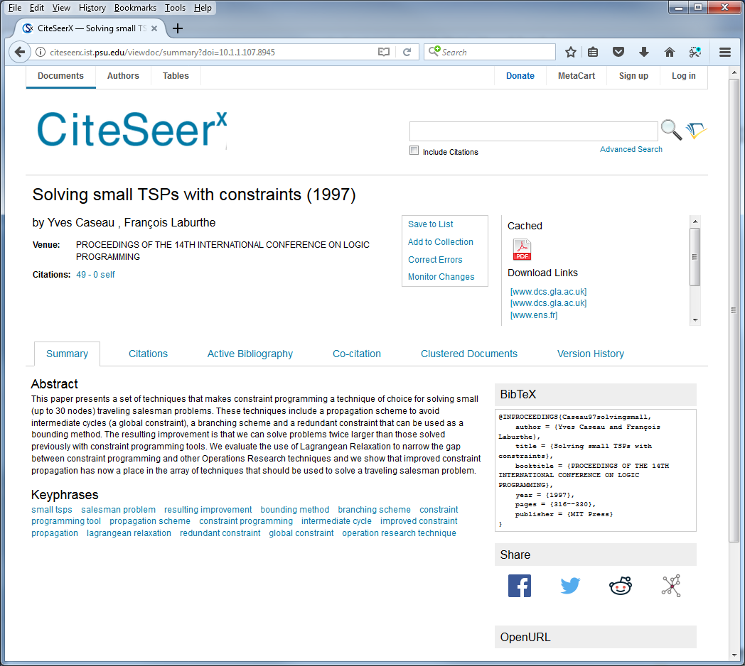

Slide 14
The single successor model
NOT A TOUR!
1
2
3
0
5
6
7
4
0
1
2
3
4
5
6
7
We need subtour elimination

Slide 15
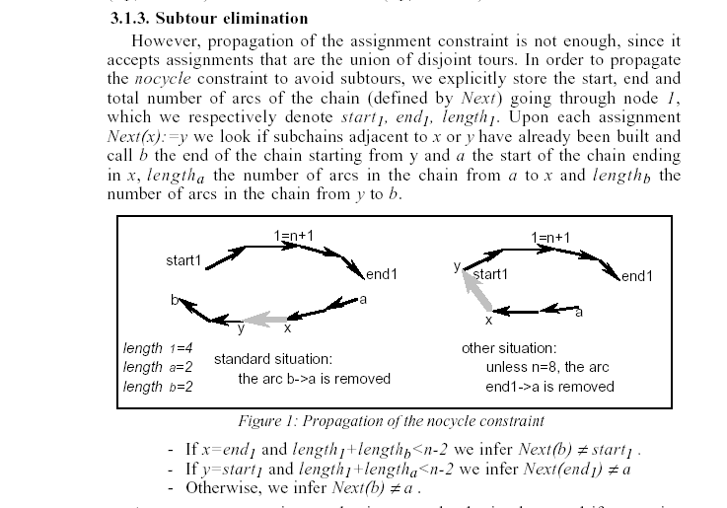

Slide 19
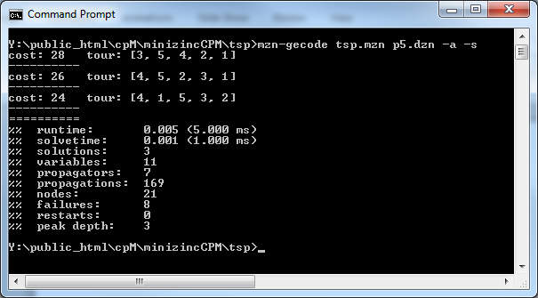

Slide 20
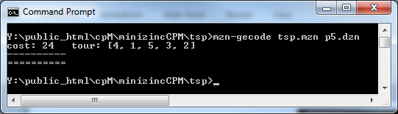

Slide 21
1 goes to 4

Slide 22
2 goes to 1

Slide 23
3 goes to 5

Slide 24
4 goes to 3

Slide 25
5 goes to 2

Slide 26
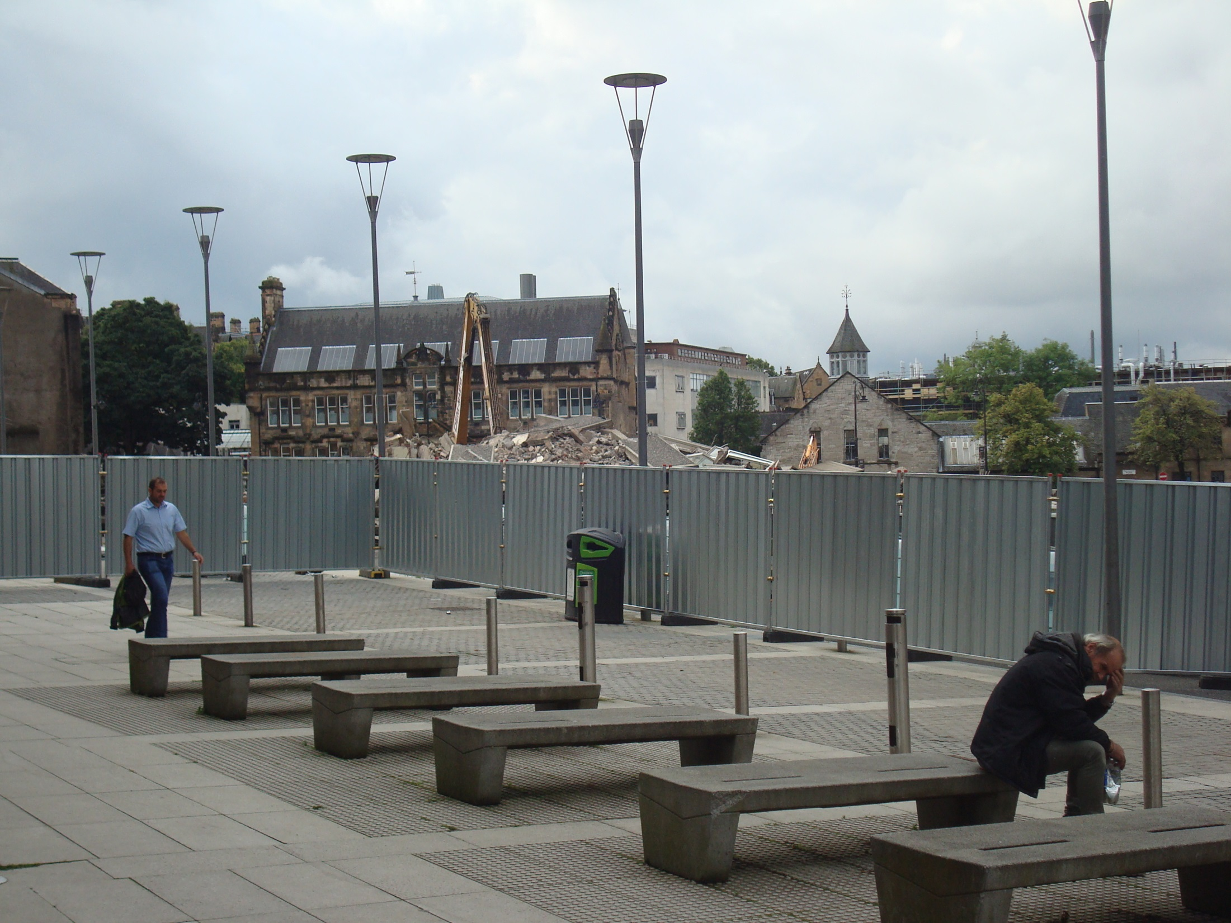

Slide 27
Feic!

