Slide 1


Content, Connection & Context Towards a Knowledge-driven City
Pol Mac Aonghusa
IBM Research

Slide 2

A City Data Ecosystem: Example Dublinked
Factual & summary data about place
Locations of things, e.g. assets, infrastructure, services.
Basic mapping data to allow simple geo-location, mapping and visualisation.
Statistical facts, e.g. demographics, economics.
Outcomes
Attracts 'hobby' or 'citizen' developers creating simple, repetitive and often short-lived apps.
Aids development of more accurate business plans for new ventures.
Non-sensitive operational data
Released by domain based on user requests and city priorities.
E.g. non real-time traffic, planning applications.
Low latency / not time sensitive so can be curated semi-manually.
Outcomes
Initial set of start-up companies emerging using this data operationally.
Filtered views of near real-time data
Time-delayed access to examples of real-time streams from sensors.
Traffic data e.g. trip times across the City updated each minute.
Water-meter telemetry.
Weather station data.
Outcomes
Enables free exploration of operational data prior to negotiation of commercial terms to access unrestricted data to a defined service level.
Sensitive data
Can’t be made wholly open but can be securely shared according to appropriate protocols.
Citizen data e.g. social programs, schools, health. City financial performance data.
Overlaps with data gathered by national bodies.
Outcomes
Enables cross-agency collaboration and 3rd party service delivery and innovation; but with significant privacy and legal challenges

Slide 3

Cities reflect a changing ecosystem
Contextual interaction has become the norm for a global community of virtual consumers … who expect to achieve outcomes matching their needs …. not ‘use systems’
Open & Collaborative Content is becoming a core, strategic, economic resource – it is unlike traditional data sources - being uncertain, lacking of common structure and of vast scale & dynamic nature
Global access to technology is changing how we engage – models are already here based on shared content, collaboration and connection
Mobility, Openness & Connection will matter more than Presence & Rigid Structures – where user context enables intuitive interaction without overload
‘Needs to Outcomes’ driven business opportunities imply a new information lifecycle where users who best engage with non-traditional, heterogeneous data sources will prosper
Applications will synergize traditional data resources with uncertain, untrusted, semi-structured internet-scale data resources – that are often moving and evolving at speed
Content, Connection & Context are Key

Slide 4
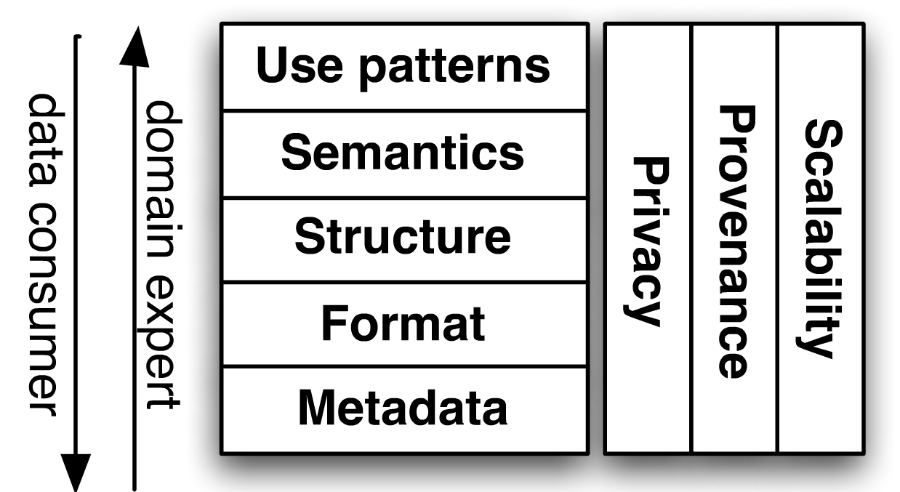
Research impact: what we have learned so far
There are plenty of interesting challenges!!
Data
  100’s of datasets, 1000’s of sources
  Very open domain(s)
  Very expensive to normalize
  Scaling complexity from high dimensionality
Approach
  Pay-as-you go approach, only process what you need
  Do not stick to a common model, use any you can find
  Generate interesting views and feed them to “analytics”
Lessons learned
  Multiple models, depending on context
  Need to do things incrementally
  Lightweight generally better than heavyweight
Documents +
Metadata
Structure
Entities
Links
Views
Insight
…. Pay-as-you-go, Gain-as-you-go

Slide 5
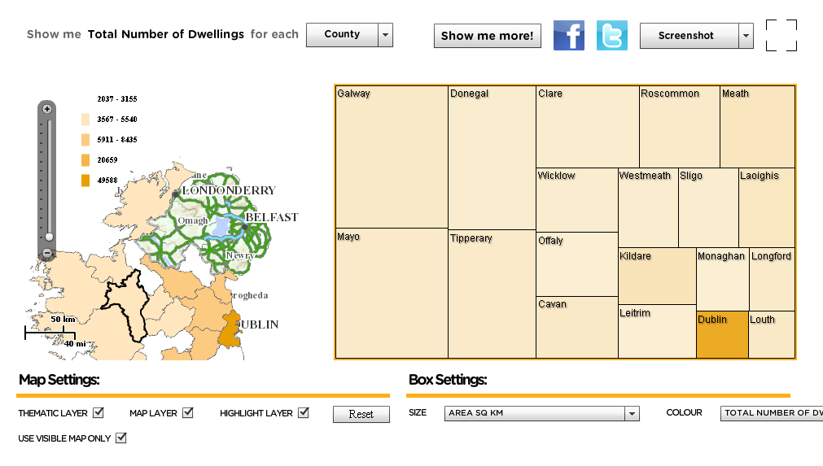
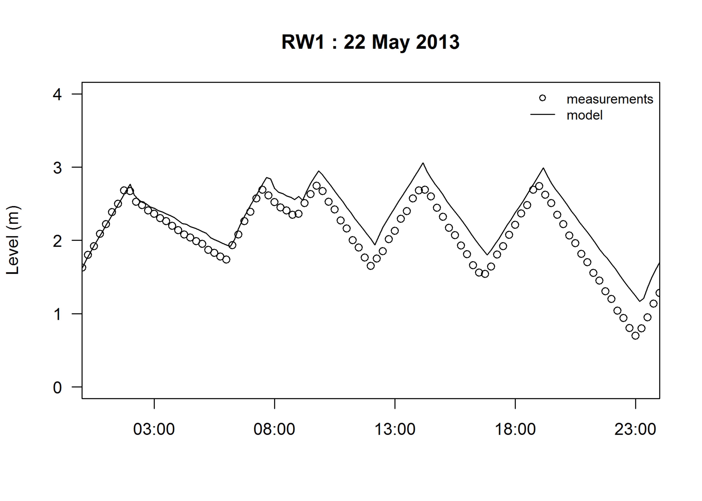
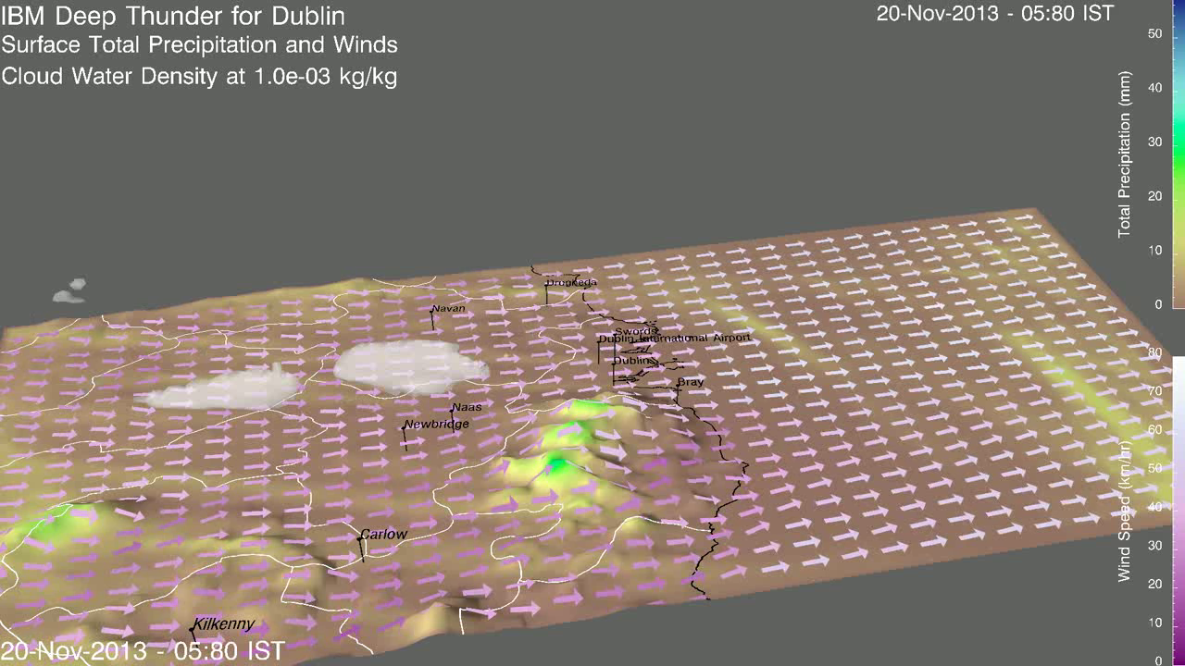
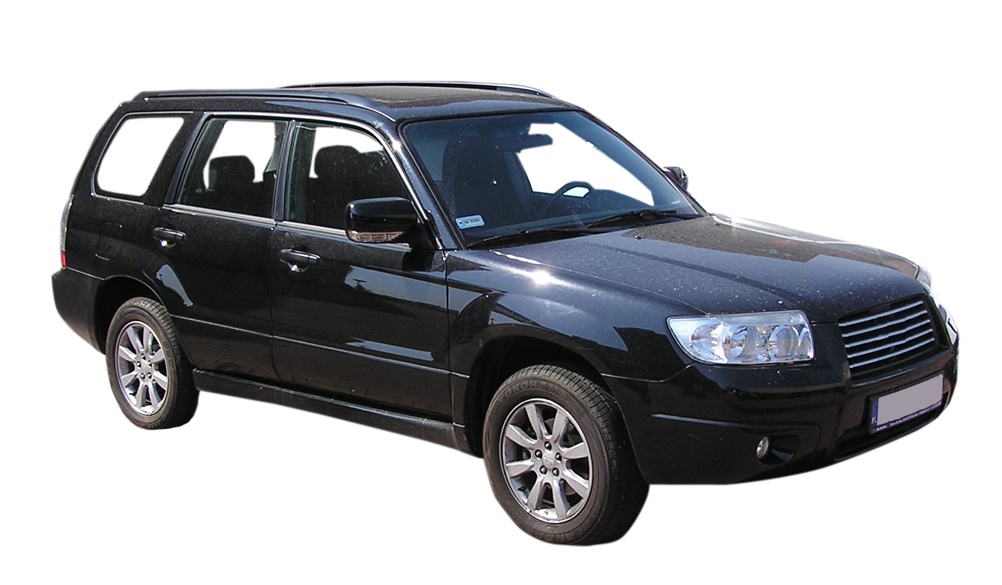
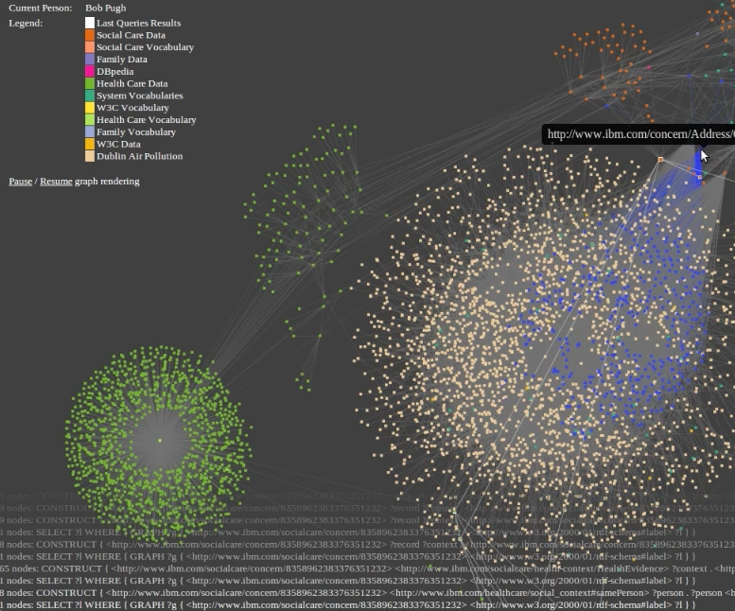
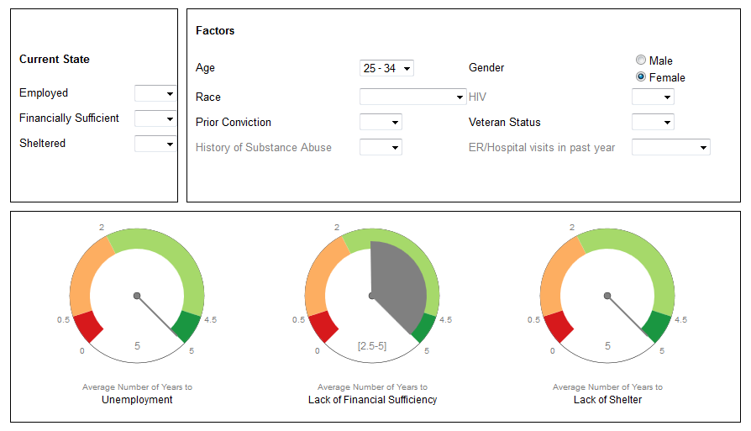
Example Use Cases
Social Listening
Big Data Sensing
Noisy ‘social’ chatter
Emergent Events
Country Scale Data
De-noise & Align
in Real-time
Collaborative consumption model of services
Semantic Graphs and Reasoning for Contextual Care
Security
Element Detection
Localization and tracking
of pedestrians
Information Monitoring
Work Offloading
Collaborative Parking
Communities & Behaviours
Social Signal Filtering
Dynamic integration of heterogeneous data
Highly contextual retrieval

Slide 6
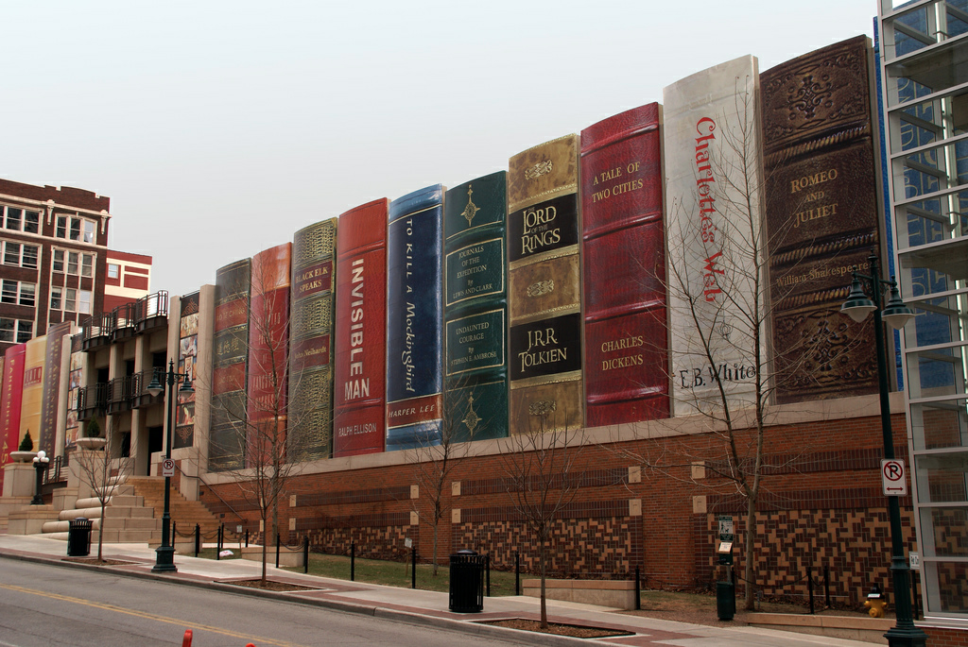
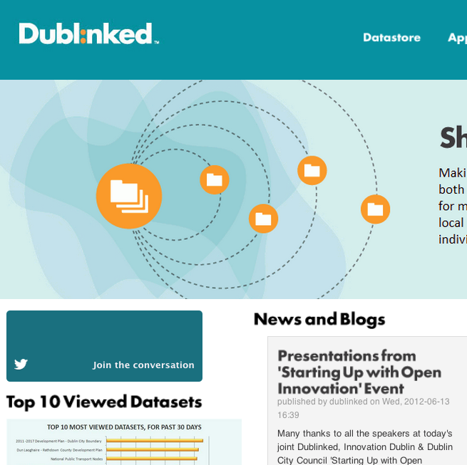
What we do: Unlocking information at scale
Problem
QuerioCity focuses on Information Management. Explore and consume relevant information from multiple systems, on demand, in intuitive ways … filtering for context
Challenges
Domain. The domain of the information is very open. As such, modelling it and mapping data to a single model is complex and expensive.
Global integration of internal and external data-sources in an open environment
Scale. The data in a city is large, dynamic (streams), and interlinked with an open set of external data.
Fitness-for-use by the non-expert
Goals
Lower the entry threshold in producing, consuming and managing Urban Information.
Querying/Reasoning mechanisms for search space reduction, relevant data fusion while ensuring consumability
Open, collaborative management of large numbers of datasets, applicable both to public and enterprise environments.
Dublinked
Use-case for research results. Enterprise-scale government data portal.
100’s datasets, 4 Public Authorities, 1 University partner

Slide 7
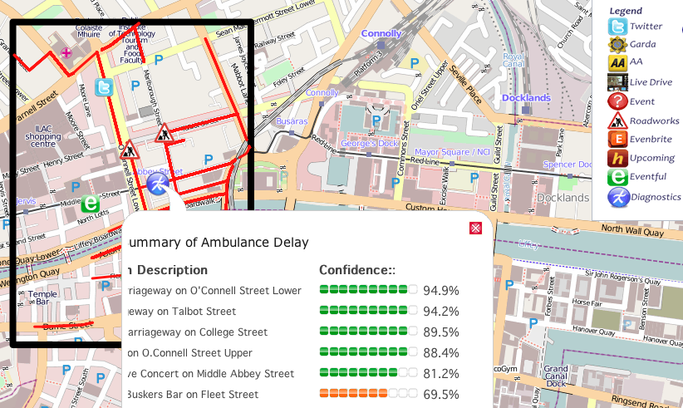
What we do: Diagnosing anomalies in the City
Anomaly Detected: Delayed buses, congested roads
Problem
How can we provide City decision makers predict and diagnose events and anomalies in real-time from massive, rich, complex, heterogeneous and dynamic urban data?
Approach
A system that identifies the nature and cause of changes and explain logical connection of knowledge across space and time
  Identify a common (semantic) representation layer for causality detection and analysis
  Develop a reasoning engine that interprets causality for diagnosis
  Demonstrate the prototype with DCC Data
  Improve the flexibility of causality detection (through ML techniques)
Detection to Diagnosis
Research Challenges
  Identifying relevant data and information
  Capturing and representing time-evolving knowledge
  Combining and correlating time-evolving knowledge from heterogeneous data sources
  Advanced fusion of data
EU FP7 - SimpliCity

Slide 8
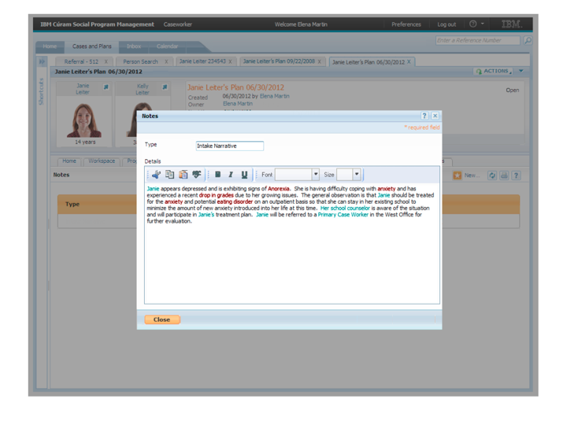

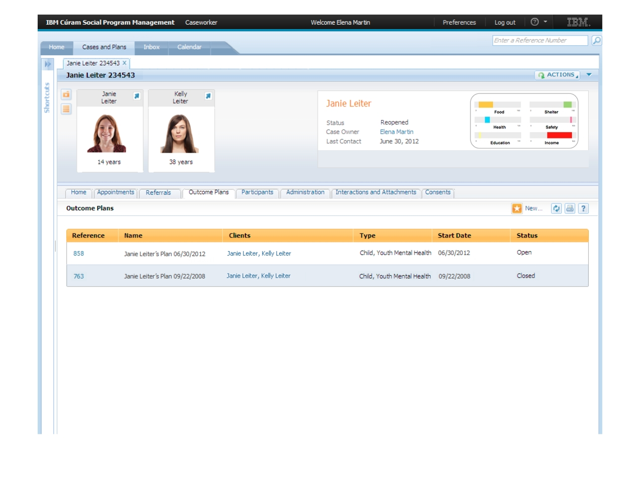
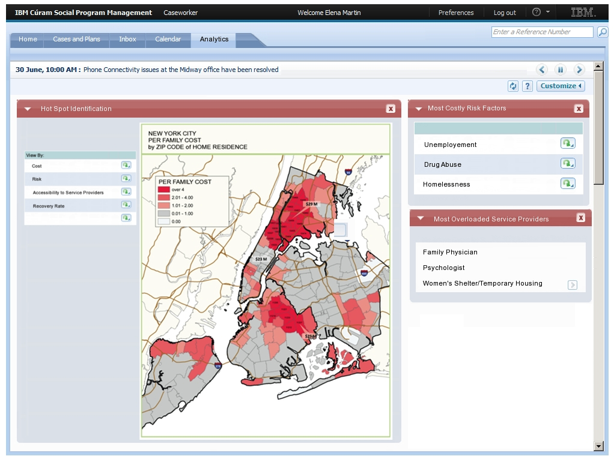
What we do: Delivering Integrated Care for Citizens
Challenge
Objectives
Social programs need to move away from episodic transactions to differential outcome management
Social context, a multi-faceted view of the citizens extending beyond the individual, is key to create analytics support and to reduce the burden from current and future high cost high need patients
Million Dollar Murray
Extracting context
Analysis of text narratives to extract information and sentiment and generation of alerts
Leveraging context
Development of vulnerability (risk) index
Spatial Analytics for recommenders and on boarding
Analytics for understanding current state and identifying emerging ‘hot spots’
"It cost us one million dollars not to do something about Murray,"
Photo by Michael Maggs, Wikimedia Commons
Research challenges:
Integration: beyond individual context – relies on a broad characterization of community and group behaviors
User Experience: Adaptive to the information needs of multi-domain users (MDs, Teachers,
Analytics: provide cross-domain insight – without disturbing normal operation
Notes:
8
“There is also a need to increase access to services by locating primary care in targeted locations that increase the likelihood that patients will utilize them. For example, co-locating primary care services in Emergency Departments, supportive housing or mental health programs.”
By harnessing outputs of forecasting and hotspot analysis, and including an analysis of patients, their locations, their needs and the location of their required service providers can be used to:
Identify areas in the city where specific services our unavailable do to cost of travel, or travel time
Identify particular users who require services that are unaccessible, potentially to recommend intervention or new recommendations
Take into account capacity for given service providers and idenitify overloaded locations and recommend other service providers
An area that is a ‘hot spot’ and a service ‘hole’ are likely to be areas that will result in a high number of high cost/ high need patients.

Slide 9
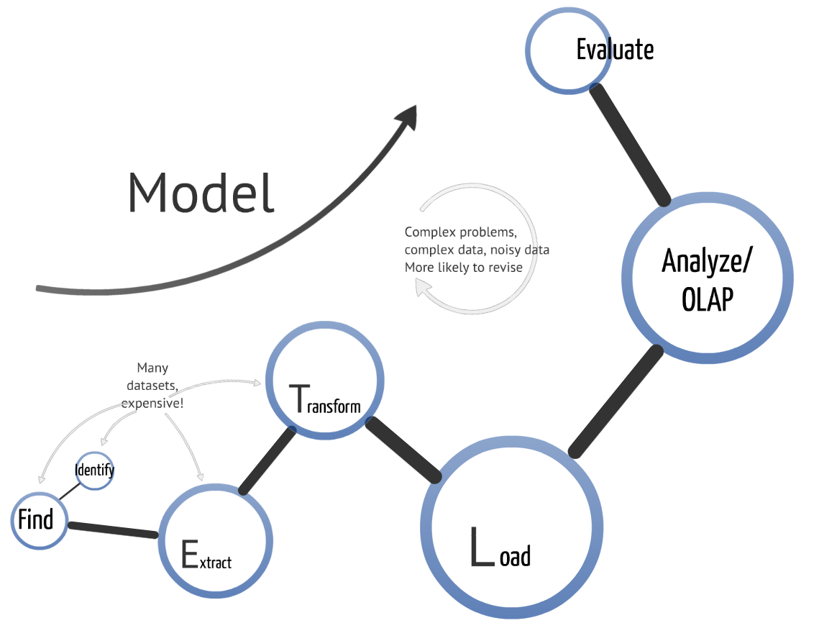
High level challenges: towards ‘City.IR.’
Continuous feedback from usage
Adaptive schema incorporating semantics and knowledge for data fusion
Tools for intuitive cross domain exploration without overload
Privacy &
Anonymisation
Fast, scalable search to find the right data sources
De-noising, robust selection based on veracity & provenance
Fast, scalable semantic lift and linkage at human concept level
Fast, scalable data ingestion

Slide 10
Thank You!

