Slide 1
Programming Languages 3
2013–14
David Watt (Glasgow) Steven Wong (Singapore)
Moodle : Computing Science → Level 3 → Programming Languages 3
© 2012 David A Watt, University of Glasgow

Slide 2
Aims
Syntax: To show you how the syntax of a programming language can be formalized.
Concepts: To provide a conceptual framework that will enable you to understand familiar programming languages more deeply and learn new languages more efficiently.
Implementation: To explain the functions of compilers and interpreters, how they interact, how they work, and how they can be constructed using suitable tools.

Slide 3
Prerequisites
Knowledge and experience of Java
essential.
Knowledge and experience of other programming languages such as Python and C
highly desirable.
Understanding of elementary discrete mathematics, particularly sets and functions
highly desirable.

Slide 4
Contents (1)
Syntax (wk1)
Values and types (wk2)
Compilers and interpreters (wk3)
Interpretation (wk4)
Compilation (wk4)
Syntactic analysis (wk5)
Contextual analysis (wk6)
VM code generation (wk7)
Syntax
Concepts
Implementation

Slide 5
Contents (2)
Variables and lifetime (wk8)
Bindings and scope (wk8)
Procedural abstraction (wk9)
Data abstraction (wk9)
Generic abstraction (wk9)
Run-time organization (wk10)
Native code generation (wk10)
Concepts (continued)
Implementation (continued)

Slide 6
Coursework and assessment
Tutorial exercises (self-assessed)
Coursework assignment (summative, 20%)
extensions to a small compiler, using a compiler generation tool
Examination (summative, 80%)
syntax (10 marks)
concepts (20 marks)
implementation (30 marks)

Slide 7
Programming languages
In this course we study programming languages (PLs).
Each PL has its own syntax and semantics.
PLs must be expressive enough to express all computations.
Computing scientists can design, specify, and implement new PLs.
in much the same way as linguists study natural languages (NLs)
like an NL
but much less expressive than NLs
whereas linguists are limited to studying existing NLs

Slide 8
What is a programming language? (1)
A PL must be universal – capable of expressing any computation.
A language without iteration or recursion would not be universal.
The lambda calculus – a language of recursive functions and nothing else – is universal.
A PL should be reasonably natural for expressing computations in its intended area.
C is natural for systems programming.
Java is natural for applications.
Python is natural for scripting.

Slide 9
What is a programming language? (2)
A PL must be implementable:
it must be possible to run every program in that PL on a computer
as long as the computer has enough memory.
A PL should be capable of reasonably efficient implementation.
Running a program should not require an unreasonable amount of time or memory.
What is reasonable depends on the context. E.g., Python is slow, but acceptable for scripting applications; it would not be acceptable for systems.

Slide 10
Syntax and semantics
The syntax of a PL is concerned with the form of programs: how expressions, commands, declarations, and other constructs must be arranged to make a well-formed program.
The semantics of a PL is concerned with the meaning of well-formed programs: how a program may be expected to behave when run on a machine.
Semantics underlies all programming, and language implementation. Syntax provides a structure on which semantics can be defined.

Slide 11
Design concepts (1)
Design concepts are the building blocks of PLs:
values and types
variables and storage
bindings and scope
procedural abstraction
data abstraction
generic abstraction
processes and communication (not covered here).

Slide 12
Design concepts (2)
A paradigm is a style of programming, characterized by a selection of key concepts.
Functional programming focuses on values, expressions, and functions.
Imperative programming focuses on variables, commands (“statements”), and procedures.
Object-oriented (OO) programming focuses on objects, methods, and classes.
Concurrent programming focuses on processes and communication.
Understanding of design concepts and paradigms enables us to select PLs for a project.

Slide 13
Implementation
A program expressed in a PL cannot be run directly by a machine. Instead it must be processed by an interpreter or compiler.
An interpreter runs the given program by fetching, analysing, and executing its ‘instructions’, one at a time.
A compiler translates the given program from the PL to lower-level code
Understanding of how PLs are implemented enables us to be more skilful programmers.

Slide 14
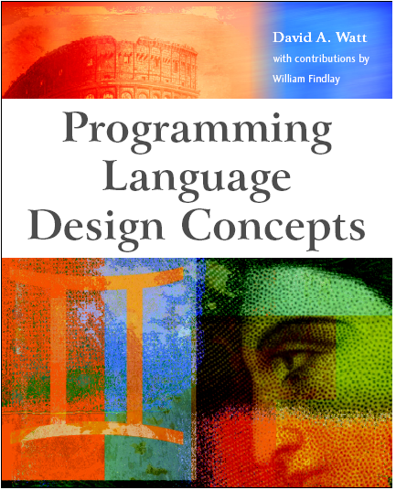
Reading (1)
David Watt Programming Language Design Concepts Wiley 2004 ISBN 0-470-853204
recommended reading for the Concepts part of this course (particularly Chapters 2–7).

Slide 15
Reading (2)
David Watt and Deryck Brown Programming Language Processors in Java Prentice Hall 2000 ISBN 0-130-25786-9
background reading for the Implementation part of this course.
Andrew Appel Modern Compiler Implementation in Java Cambridge 1998 ISBN 0-521-58388-8
additional reading
covers all aspects of compilation in detail, including native code generation and optimization.

Slide 16
History of programming languages (1)
OO
imperative
concurrent
functional
scripting
1955
Fortran
Lisp
Algol60
Cobol
1960
1965
Simula
PL/I
Algol68
Unix
Pascal
1970
Smalltalk
C
1975
Modula
ML
1980
Ada83
C++
1985
Perl

Slide 17
History of programming languages (2)
1980
Ada83
C++
1985
Perl
Haskell
1990
Python
Ada95
1995
Java
C#
2000
Java5
2005
2010
OO
imperative
concurrent
functional
scripting

