Slide 1
random

Slide 2
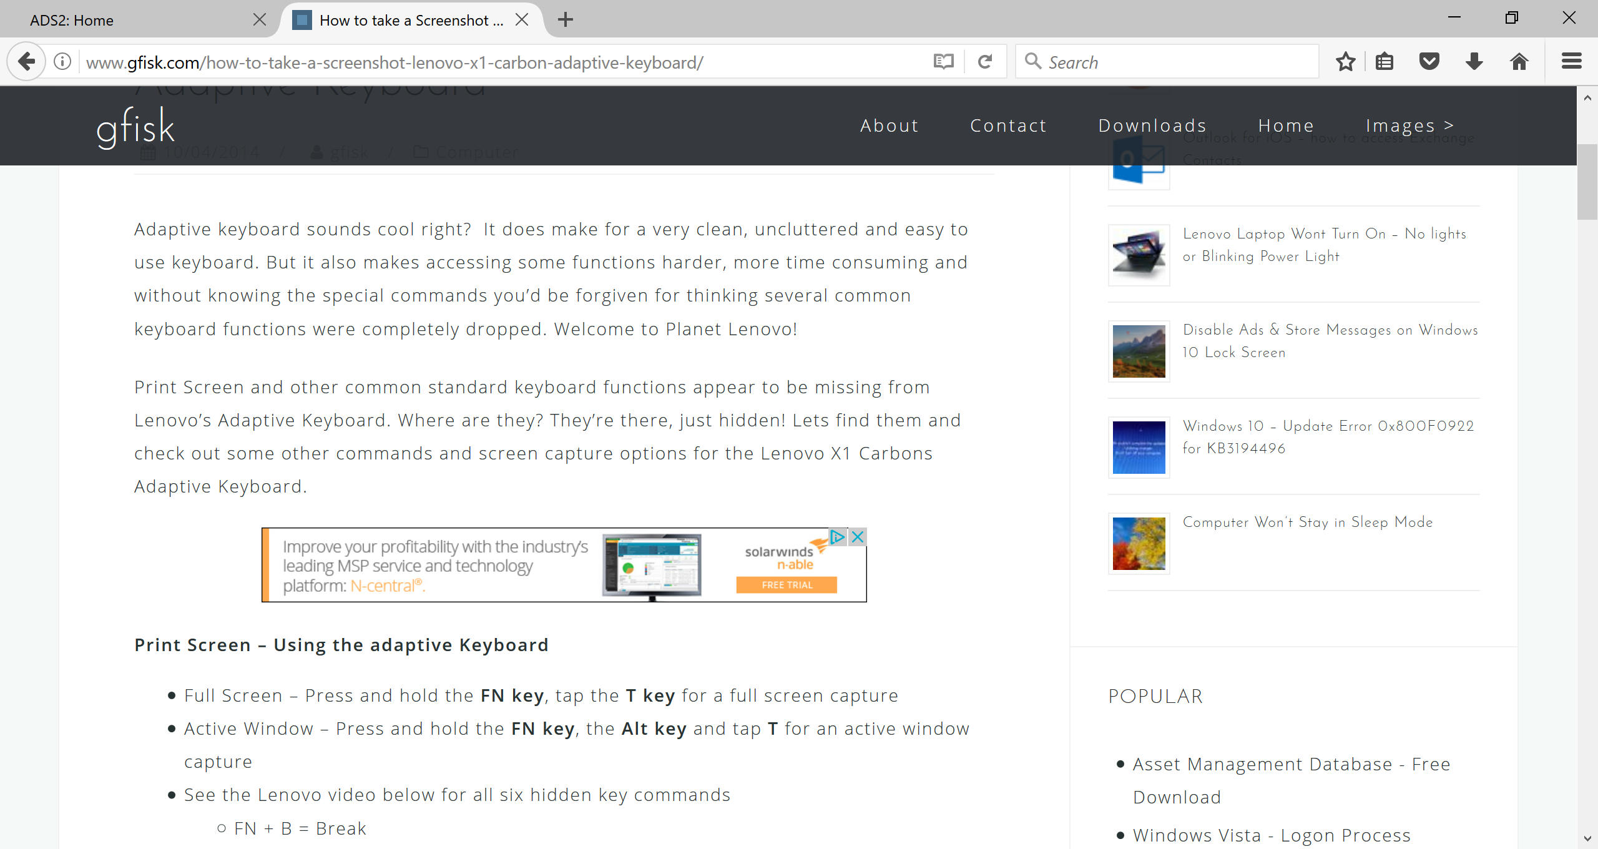

Slide 3
Generating random integers
Shuffle the deck
Physical demos (3 of)
Code
Complexity

Slide 9
Complexity?

