Slide 1
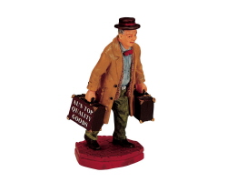
The Glasgow TSP Challenge

Slide 2
“Find the shortest tour that covers the 348 locations in the file g7k.tsp”

Slide 3
g7k.tsp …
348 locations drawn for Glasgow postal codes, taking George Square as centre, in a 7k radius.

Slide 4
In chronological order

Slide 5
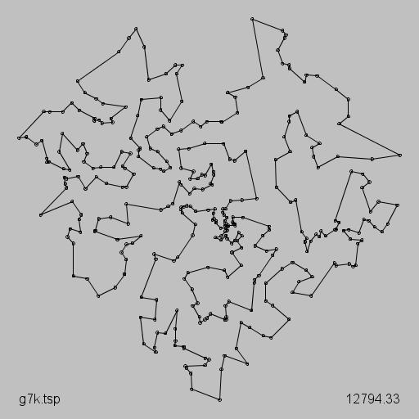
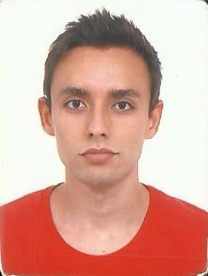
Andre Perez: 12794 (29/02/2016)

Slide 6
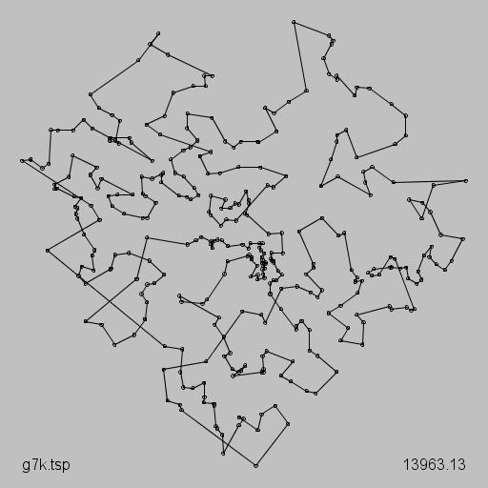
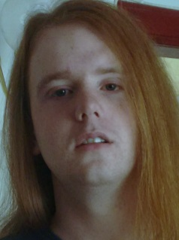
Stephen Brown: 13963 (01/03/2016)

Slide 7
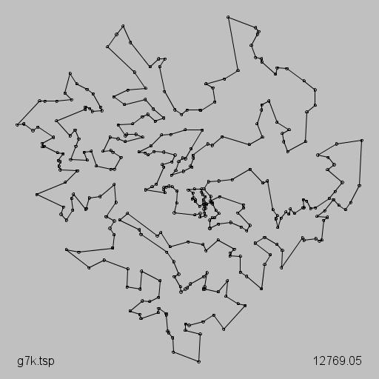
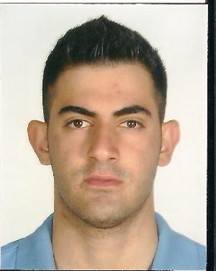
Antreas Pogiatzis: 12769 (07/03/2016)

Slide 8
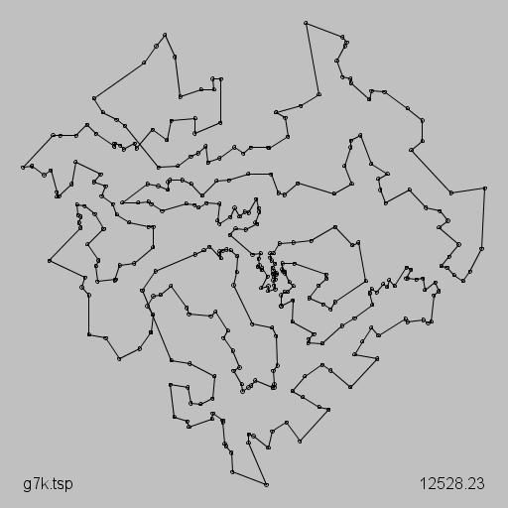
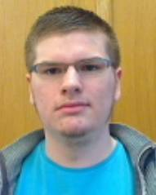
David Robertson: 12528 (09/03/2016)

Slide 9
David Robertson: 12397 (10/03/2016)

Slide 10
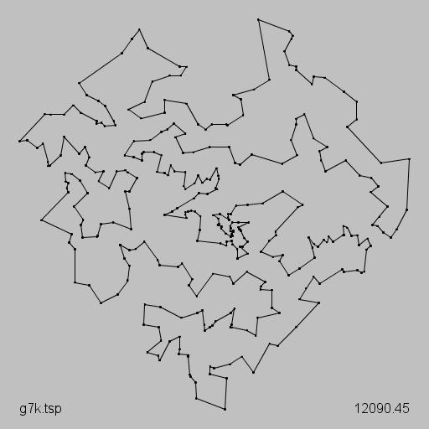
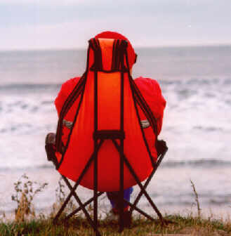
Patrick Prosser: 12090 (11/03/2016 @ 16:06)

Slide 11
Patrick Prosser: 12085 (11/03/2016 @ 16:50)

Slide 12
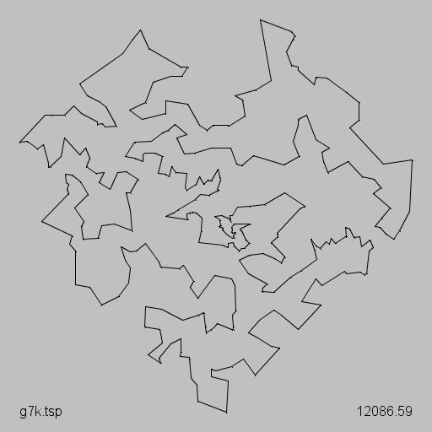
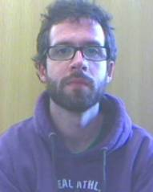
James Trimble: 12086 (17/03/2016 @ 15:42)

Slide 13
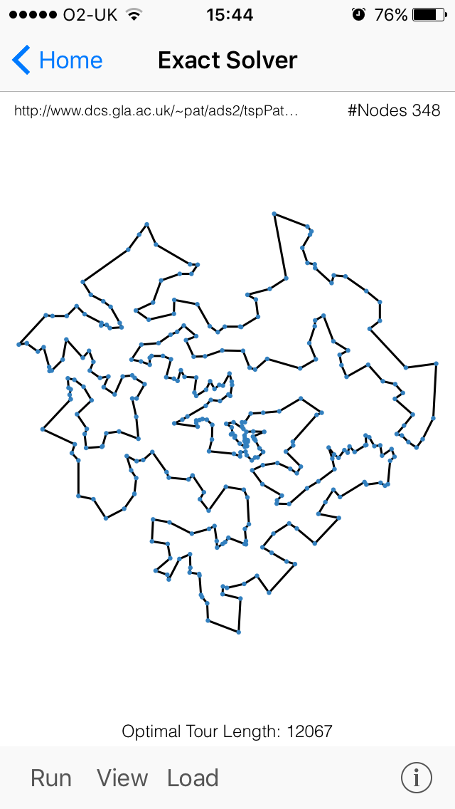
James Trimble: 12067 (17/03/2016 @ 15:44 on an iPhone)

Slide 14
James Trimble: 12086 (18/03/2016 @ 17:09)

Slide 15
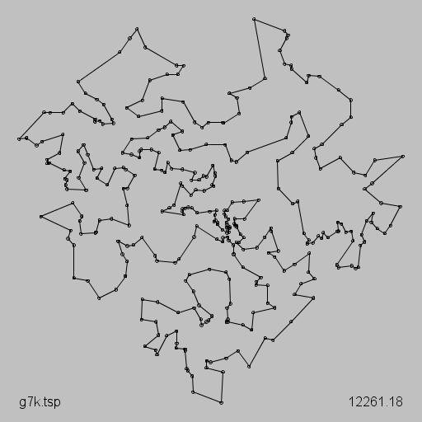
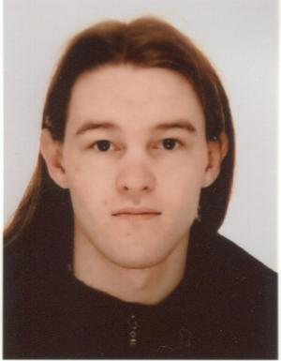
Michelle Dove: 12261 (21/03/2016)

Slide 16
Stephen Brown 13963
Andre Perez 12794
Antreas Pogiatzis 12769
David Robertson 12397
Michelle Dove 12261
James Trimble 12086
Patrick Prosser 12085

Slide 17
Our Eligible Competitors
Stephen Brown 13963
Andre Perez 12794
Antreas Pogiatzis 12769
David Robertson 12397
Michelle Dove 12261

Slide 18
Special prize for “best newcomer”

