Slide 1
Red Black Trees

Slide 2
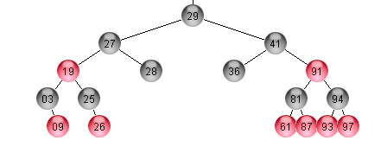

Slide 3
Properties

Slide 4
Properties
the root is black

Slide 5
Properties
the root is black
every external node is black

Slide 6
Properties
the root is black
every external node is black
children of a red node are black

Slide 7
Properties
the root is black
every external node is black
children of a red node are black
all external nodes have the same black depth

Slide 8
Properties
the root is black
every external node is black
children of a red node are black
all external nodes have the same black depth
Black Depth: the number of black ancestors minus one

Slide 9
Properties
the root is black
every external node is black
children of a red node are black
all external nodes have the same black depth
Black Depth: the number of black ancestors minus one
It is assumed external nodes are empty place holders (null nodes)

Slide 10
Properties
the root is black
every external node is black
children of a red node are black
all external nodes have the same black depth
The height of a red-black tree with n nodes is O(log n)
Black Depth: the number of black ancestors minus one
It is assumed external nodes are empty place holders (null nodes)

Slide 11
We can convert a red black tree to a (2,4) tree

Slide 12
We can convert a red black tree to a (2,4) tree
Merge every red node into its parent

Slide 13
We can convert a red black tree to a (2,4) tree
Merge every red node into its parent

Slide 14
We can convert a red black tree to a (2,4) tree
03,09
Merge every red node into its parent

Slide 15
We can convert a red black tree to a (2,4) tree
03,09
25,26
Merge every red node into its parent

Slide 16
We can convert a red black tree to a (2,4) tree
19,27
03,09
25,26
28
Merge every red node into its parent

Slide 17
We can convert a red black tree to a (2,4) tree
19,27
03,09
25,26
28
Merge every red node into its parent

Slide 18
We can convert a red black tree to a (2,4) tree
19,27
03,09
25,26
28
61,81
Merge every red node into its parent

Slide 19
We can convert a red black tree to a (2,4) tree
19,27
03,09
25,26
28
61,81,87
Merge every red node into its parent

Slide 20
We can convert a red black tree to a (2,4) tree
19,27
03,09
25,26
28
61,81,87
93,94
Merge every red node into its parent

Slide 21
We can convert a red black tree to a (2,4) tree
19,27
03,09
25,26
28
61,81,87
93,94,97
Merge every red node into its parent

Slide 22
We can convert a red black tree to a (2,4) tree
41,91
19,27
03,09
25,26
28
61,81,87
93,94,97
Merge every red node into its parent

Slide 23
We can convert a red black tree to a (2,4) tree
41,91
19,27
03,09
25,26
28
36
61,81,87
93,94,97
Merge every red node into its parent

Slide 24
We can convert a red black tree to a (2,4) tree
28
41,91
19,27
03,09
25,26
28
36
61,81,87
93,94,97
Merge every red node into its parent

Slide 25
28
41,91
19,27
03,09
25,26
28
36
61,81,87
93,94,97
We can convert a (2,4) tree into a red black tree

Slide 26
28
41,91
19,27
03,09
25,26
28
36
61,81,87
93,94,97
if v is a 2-node keep the (black) children of v as is
We can convert a (2,4) tree into a red black tree

Slide 27
28
41,91
19,27
03,09
25,26
28
36
61,81,87
93,94,97
if v is a 2-node keep the (black) children of v as is
if v is a 3-node
We can convert a (2,4) tree into a red black tree

Slide 28
28
41,91
19,27
03,09
25,26
28
36
61,81,87
93,94,97
if v is a 2-node keep the (black) children of v as is
if v is a 3-node
  create a new red node w
We can convert a (2,4) tree into a red black tree

Slide 29
28
41,91
19,27
03,09
25,26
28
36
61,81,87
93,94,97
if v is a 2-node keep the (black) children of v as is
if v is a 3-node
  create a new red node w
  give v’s first two (black) children to w
We can convert a (2,4) tree into a red black tree

Slide 30
28
41,91
19,27
03,09
25,26
28
36
61,81,87
93,94,97
if v is a 2-node keep the (black) children of v as is
if v is a 3-node
  create a new red node w
  give v’s first two (black) children to w
  w and v’s third child be the two children of v
We can convert a (2,4) tree into a red black tree

Slide 31
28
41,91
19,27
03,09
25,26
28
36
61,81,87
93,94,97
if v is a 2-node keep the (black) children of v as is
if v is a 3-node
  create a new red node w
  give v’s first two (black) children to w
  w and v’s third child be the two children of v
if v is a 4-node
We can convert a (2,4) tree into a red black tree

Slide 32
28
41,91
19,27
03,09
25,26
28
36
61,81,87
93,94,97
if v is a 2-node keep the (black) children of v as is
if v is a 3-node
  create a new red node w
  give v’s first two (black) children to w
  w and v’s third child be the two children of v
if v is a 4-node
  create red nodes w and z
We can convert a (2,4) tree into a red black tree

Slide 33
28
41,91
19,27
03,09
25,26
28
36
61,81,87
93,94,97
if v is a 2-node keep the (black) children of v as is
if v is a 3-node
  create a new red node w
  give v’s first two (black) children to w
  w and v’s third child be the two children of v
if v is a 4-node
  create red nodes w and z
  give v’s first two (black) children to w
We can convert a (2,4) tree into a red black tree

Slide 34
28
41,91
19,27
03,09
25,26
28
36
61,81,87
93,94,97
if v is a 2-node keep the (black) children of v as is
if v is a 3-node
  create a new red node w
  give v’s first two (black) children to w
  w and v’s third child be the two children of v
if v is a 4-node
  create red nodes w and z
  give v’s first two (black) children to w
  give v’s last two (black) children to z
We can convert a (2,4) tree into a red black tree

Slide 35
28
41,91
19,27
03,09
25,26
28
36
61,81,87
93,94,97
if v is a 2-node keep the (black) children of v as is
if v is a 3-node
  create a new red node w
  give v’s first two (black) children to w
  w and v’s third child be the two children of v
if v is a 4-node
  create red nodes w and z
  give v’s first two (black) children to w
  give v’s last two (black) children to z
  make w and z the two children of v
We can convert a (2,4) tree into a red black tree

Slide 36
28
41,91
19,27
03,09
25,26
28
36
61,81,87
93,94,97
if v is a 2-node keep the (black) children of v as is
if v is a 3-node
  create a new red node w
  give v’s first two (black) children to w
  w and v’s third child be the two children of v
if v is a 4-node
  create red nodes w and z
  give v’s first two (black) children to w
  give v’s last two (black) children to z
  make w and z the two children of v

Slide 37
28
41,91
19,27
03,09
25,26
28
36
61,81,87
93,94,97
if v is a 2-node keep the (black) children of v as is
if v is a 3-node
  create a new red node w
  give v’s first two (black) children to w
  w and v’s third child be the two children of v
if v is a 4-node
  create red nodes w and z
  give v’s first two (black) children to w
  give v’s last two (black) children to z
  make w and z the two children of v

Slide 38
28
41,91
19,27
03,09
25,26
28
36
61,81,87
93,94,97
if v is a 2-node keep the (black) children of v as is
if v is a 3-node
  create a new red node w
  give v’s first two (black) children to w
  w and v’s third child be the two children of v
if v is a 4-node
  create red nodes w and z
  give v’s first two (black) children to w
  give v’s last two (black) children to z
  make w and z the two children of v
03
09

Slide 39
28
41,91
19,27
03,09
25,26
28
36
61,81,87
93,94,97
if v is a 2-node keep the (black) children of v as is
if v is a 3-node
  create a new red node w
  give v’s first two (black) children to w
  w and v’s third child be the two children of v
if v is a 4-node
  create red nodes w and z
  give v’s first two (black) children to w
  give v’s last two (black) children to z
  make w and z the two children of v
OR
09
03

Slide 40
28
41,91
19,27
03,09
25,26
28
36
61,81,87
93,94,97
if v is a 2-node keep the (black) children of v as is
if v is a 3-node
  create a new red node w
  give v’s first two (black) children to w
  w and v’s third child be the two children of v
if v is a 4-node
  create red nodes w and z
  give v’s first two (black) children to w
  give v’s last two (black) children to z
  make w and z the two children of v

Slide 41
28
41,91
19,27
03,09
25,26
28
36
61,81,87
93,94,97
if v is a 2-node keep the (black) children of v as is
if v is a 3-node
  create a new red node w
  give v’s first two (black) children to w
  w and v’s third child be the two children of v
if v is a 4-node
  create red nodes w and z
  give v’s first two (black) children to w
  give v’s last two (black) children to z
  make w and z the two children of v
94
93
97

Slide 42
Insertion and deletion involve rotations, somewhat of an AVL-flavour

Slide 43
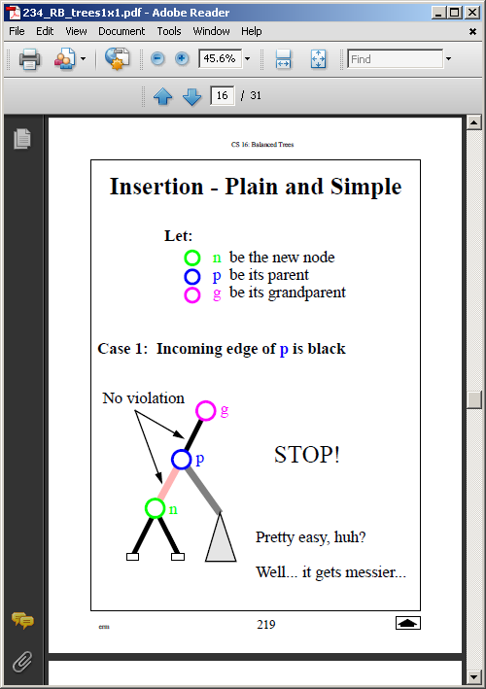

Slide 44
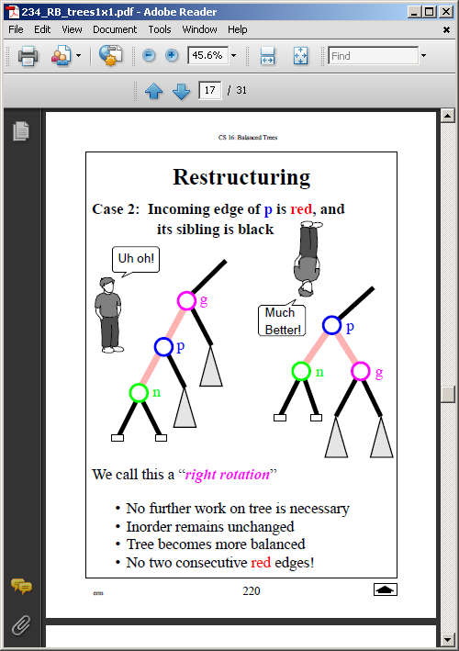

Slide 45
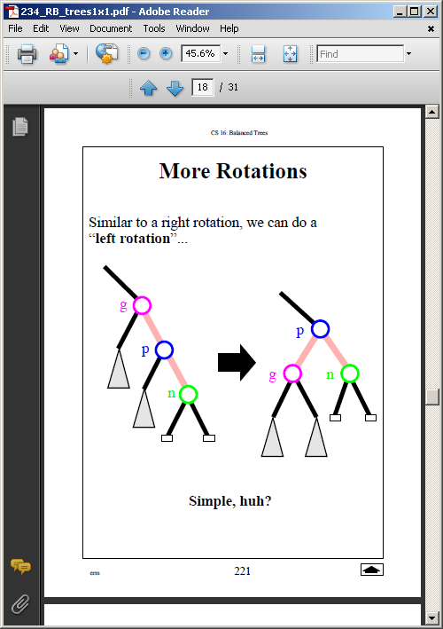

Slide 46
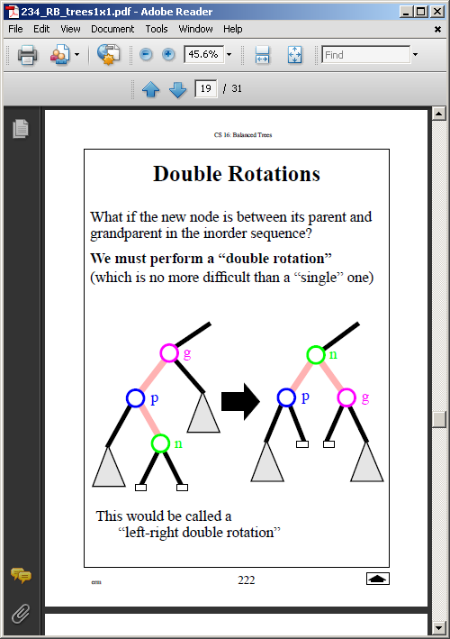

Slide 47
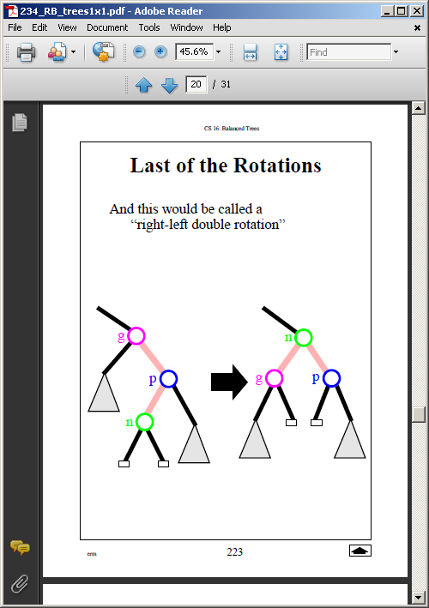

Slide 48
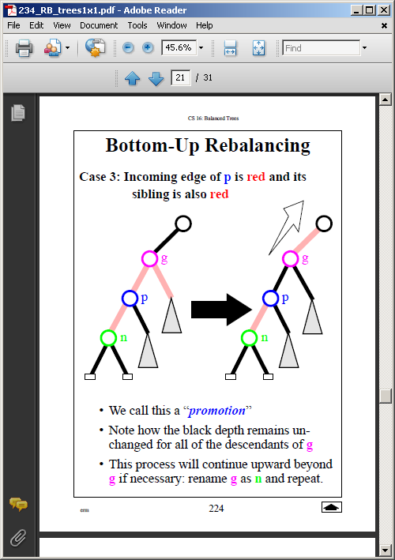

Slide 49
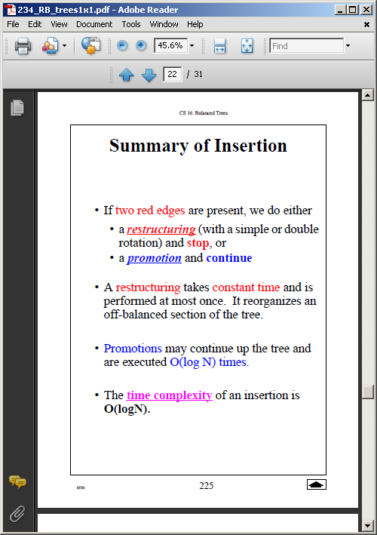

Slide 50
See G&T 10.5 and demo

Slide 51
fin

