Slide 1
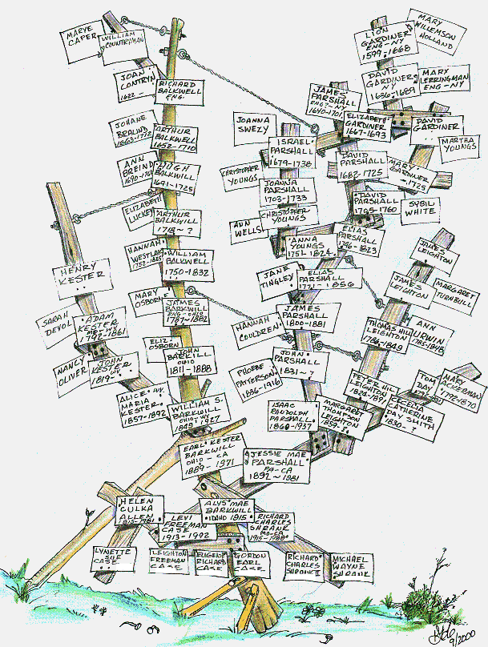
Multiway trees & B trees & 2_4 trees
Go&Ta Chap 10

Slide 2
Multi-way Search Trees of order m
(m-way search trees)
m-way trees
Generalization of BSTs
Each node has at most m children
If k is number of values at a node, then node has at most k+1 children (actually exactly m references, but some may be null)
Tree is ordered
BST is a 2-way search tree
v₁
v₂
v₃
v₄
v₅
keys<v₁
v₂< keys<v₃
keys>v₅
. . .
. . .

Slide 3
Examples
M = 3
A 3-way tree
10 44
3 7
22
55 70
50
60 68

Slide 4
Examples
M = 4
50 60 80
30 35
58 59
63 70 73
100
A 4-way tree
52 54
61 62
57
55 56
4
ADS2 Lecture17

Slide 5
Searching in an m-way tree
m-way trees
Similar to that for BST
To search for value x in node (pointed to by) V containing values (v₁,…,v_{k}) :
  if V=null, we are done (x is not in the tree)
  if x<v₁, search in V’s left-most subtree
  if x>v_{k}, search in V’s right-most subtree,
  if x=v_{i}, for some 1≤i≤k, we are done (x has been found)
  if v_{i}≤x≤v_{i+1} for some 1≤i≤k-1, search the subtree between v_{i} and v_{i+1}
V
v₁ v₂ …v_{i} v_{i+1} … v_{k}

Slide 6
Example
m-way trees
search for
68
69
23
10 44
3 7
22
55 70
50
60 68

Slide 7
m-way trees
NOTE: inorder traversal is appropriate/defined

Slide 8
Insertion for an m-way tree
m-way trees
Similar to insertion for BST
Remember, for an m-way tree can have at most m-1 values at each node
To add value x, continue as for search until we reach a node (pointed to by V) containing (v₁,…,v_{k}) (where k≤ m-1) and can’t continue
If V is not full then add x to V so that values of V remain ordered.
If V is full and x<v₁ then the left subtree must be empty, so create
a new (left-most) child for V and place x as its first value.
If V is full and v_{i} < x < v_{i+1} then the subtree between v_{i} and v_{i+1} must
be empty, so create a new child for V between v_{i} and v_{i+1} and place x as its first value.
If V is full and x>v_{k}then the right subtree must be empty, so create
a new (right-most) child for V and place x as its first value

Slide 9
Examples
m-way trees
Create the 4-way tree formed by inserting the values
12, 11, 8, 14, 9, 3, 2, 10, 5, 16 in order

Slide 10
Insert 12, 11, 8, 14, 9, 3, 2, 10, 5, 16
M=4

Slide 11
Insert 12, 11, 8, 14, 9, 3, 2, 10, 5, 16
M=4
12

Slide 12
Insert 12, 11, 8, 14, 9, 3, 2, 10, 5, 16
M=4
11,12

Slide 13
Insert 12, 11, 8, 14, 9, 3, 2, 10, 5, 16
M=4
8,11,12

Slide 14
Insert 12, 11, 8, 14, 9, 3, 2, 10, 5, 16
M=4
8,11,12
14

Slide 15
Insert 12, 11, 8, 14, 9, 3, 2, 10, 5, 16
M=4
8,11,12
9
14

Slide 16
Insert 12, 11, 8, 14, 9, 3, 2, 10, 5, 16
M=4
8,11,12
3
9
14

Slide 17
Insert 12, 11, 8, 14, 9, 3, 2, 10, 5, 16
M=4
8,11,12
2,3
9
14

Slide 18
Insert 12, 11, 8, 14, 9, 3, 2, 10, 5, 16
M=4
8,11,12
2,3
9,10
14

Slide 19
Insert 12, 11, 8, 14, 9, 3, 2, 10, 5, 16
M=4
8,11,12
2,3,5
9,10
14

Slide 20
Insert 12, 11, 8, 14, 9, 3, 2, 10, 5, 16
M=4
8,11,12
2,3,5
9,10
14,16

Slide 21
Node of an m-way tree
m-way trees
Each node contains
Integer size (indicating how many values present)
A reference to the left-most child
A sequence of m-1 value/reference pairs
v
v
v
v
v
v
v
v
v
v
3
3
4
4
5
2
5
1
2
1
keys<v
keys<v
keys>v
keys<v
. . .
v
. . .
v
< keys<v
. . .
< keys<v
. . .
5
1
5
1
2
2
3
3
Inorder Traversal
Left subtree traversal, first value, first right subtree traversal, next value, next right subtree traversal etc.
ADS2 Lecture17

Slide 22
m-way trees
m could be really big
a node could contain a tree (a bstree or an avl tree)
we might search within node using binary search
nodes might correspond to large regions of disc space
  we want to minimise slooooow disc access
think BIG

Slide 23
balanced m-way trees

Slide 24
Balanced m-way trees (B-trees)
Like BSTs, m-way trees can become very unbalanced
Here we need to check 5 nodes to find value 55 but only 2 to find value 35
Of particular importance when we want to use trees to process data on secondary storage like disks where access is costly
We use a special type of m-way tree (B-tree) which ensures balance: all leaves are at the same depth

Slide 25
B-Trees Motivation
If we want to store large amounts of data, may need to store it on disk
Number of times we have to access disk to retrieve data becomes important
A disk access is very expensive compared to a typical computer instruction
Number of disk accesses dominates running time
Secondary memory (disk) divided into equal-sized blocks (e.g. 512, 2048, 4096 or 8192 bytes)
Basic I/O operation transfers contents of one disk block to/from main memory
Our goal: to devise m-way search tree which minimises disk access (and exploits disk block read)

Slide 26

10 years old!

Slide 27

A B-trees is:
An m-way search tree designed to conserve space and be reasonably well balanced
Each node still has at most m children but:
  Root is either a leaf or has between 2 and m children, and contains at least one value
  All nonleaf nodes (except root) have at least
    m/2 if even,
    at least (m-1)/2 if odd
  All leaves are same depth
values

Slide 28
Comparison of B-Trees with binary search trees
Comparison with binary search trees:
(1) Multi-branched so depth is smaller.
Search is faster because there are fewer nodes on a path from root to leaf.
(2) Well balanced so the performance of search etc is about optimum.
Complexity is logarithmic (like AVL trees..)
(3) processing a node takes longer because it has more values.

Slide 29
Examples
A B-tree of order 5:
6 11 21 29
3 5
7 9
12 14 17 19
22 26
30 31 33

Slide 30
Examples
50
A B-tree of order 3:
10
66
3 7
22 44
55
68 70
30
ADS2 Lecture17

Slide 31
Examples
Not a B-tree
10 44
3 7
22
55 70
50
60 68
All leaves must be at same depth

Slide 32
Insertion
Like insertion for general m-way search tree, but need to preserve balance condition
To add value x, continue as for search until we reach a node (pointed to by ) V containing (v₁,…,v_{k}) (where k≤ m-1) and can’t continue. If we were to add x to V in order.
If V would not overflow, go ahead and add x
If V would overflow, add x and split V into 3 parts:
Left: first (m-1)/2 values
Middle: (m-1)/2 +1 th value
Right: last (m-1)/2 values
Promote Middle to parent node, with children Left and Right
Nb. Assume m is odd. Otherwise
Left: first m/2 values
Right: last m-2/2 values
“Middle”: m/2 +1 th value.

Slide 33
Example
71 79
61 64 67
73 75 77 78
81 83
To add 74 to this B Tree of order 5

Slide 34
Example
To add 74 to this B-Tree of order 5, would reach node V. Adding 74 would give (ordered) values
73 74 75 77 78
Causing V to overflow.
71 79
V
61 64 67
73 75 77 78
81 83
34
ADS2 Lecture17

Slide 35
Example
To add 74 to this B-Tree of order 5, would reach node V. Adding 74 would give (ordered) values
73 74 75 77 78
Causing V to overflow.
71 79
V
61 64 67
73 75 77 78
81 83
split
71 75 79
Promote median to parent node, with children containing 73,74 and 77,78 respectively
61 64 67
73 74
77 78
81 83
35
ADS2 Lecture17

Slide 36
But what if the parent overflows?
overflow
If the parent overflows, repeat the procedure (upwards)
If the root overflows, create a new root with Middle its only value and Left and Right as its children

Slide 37
Example
overflow
6 11 21 29
add 18 would cause V to overflow: 12 14 17 18 19
V
3 5
7 9
12 14 17 19
22 26
30 31 33

Slide 38
Example
overflow
6 11 21 29
add 18 would cause V to overflow: 12 14 17 18 19
V
3 5
7 9
12 14 17 19
22 26
30 31 33
6 11 21 29
split v
produce L and R
elevate 17 to parent
17
3 5
7 9
12 14
18 19
22 26
30 31 33
L
R
ADS2 Lecture17

Slide 39
Example
overflow
6 11 21 29
add 18 would cause V to overflow: 12 14 17 18 19
V
3 5
7 9
12 14 17 19
22 26
30 31 33
6 11 21 29
split v
produce L and R
elevate 17 to parent
17
3 5
7 9
12 14
18 19
22 26
30 31 33
L
R
split parent
6 11
21 29
17
3 5
7 9
12 14
18 19
22 26
30 31 33
cont. overleaf
L
R
39
ADS2 Lecture17

Slide 40
Example contd.
overflow
6 11
21 29
17
3 5
7 9
12 14
18 19
22 26
30 31 33
L
R
17
6 11
21 29
3 5
7 9
12 14
18 19
22 26
30 31 33
L
R

Slide 41
2-4 trees
A B-tree guarantees that insertion, membership and deletion take logarithmic time.
For storing a set it is best to use a B-tree of small order to minimise work at each node (assuming memory resident)
Commonly used are 2-4 B-trees (order 4)
In general, a 2-m tree has order m
(all non-root nodes have 2,3,..,m children)

Slide 42
2_m Tree
An implementation
and
An example with m=3
X
A
B
C

Slide 43
2_m tree (m=3)
X
A
B
C
m = 3
a node contains at most 2 pieces of data
  and then branches 3 ways
a node contains at least one piece of data
  and then branches 2 ways
it is a 2-3 tree
m = 4
a node contains at most 3 pieces of data
  an then branches 4 ways
a node contains at least one piece of data
  and then branches 2 ways
it is a 2-4 tree

Slide 44
2_m tree (m=3)
X
A
B
C
This is null
m = 3
a node contains at most 2 pieces of data
  and then branches 3 ways
a node contains at least one piece of data
  and then branches 2 ways
it is a 2-3 tree
m = 4
a node contains at most 3 pieces of data
  an then branches 4 ways
a node contains at least one piece of data
  and then branches 2 ways
it is a 2-4 tree

Slide 45

2_m tree (m=3)
X
A
B
C
data (the top row in the picture) an ArrayList
actually contains the stuff that’s in a node

Slide 46
2_m tree (m=3)
X
A
B
C
This is null
left (the bottom row in the picture) an ArrayList
pointers to children

Slide 47
2_m tree (m=3)
X
A
B
C
This is null
left (the bottom row in the picture) an ArrayList
pointers to children
Oops! Should have 4 blocks!

Slide 48
2_m tree (m=3)
X
A
B
C
NOTE:
we do not show parent link
m is the maximum branching factor

Slide 49
2_m tree (m=3)
X
A
B
C
Note:
There are m+1 data and left entries
m data entries used
m+1 left entries used
A null data entry is treated as ∞
this simplifies overflow

Slide 50
2_m tree (m=3)
X
4
7
Less than 4
Less than 7
Greater than 7
A
B
C
1
2
5
6
8
9
left.get(i) points to a child with values less that data.get(i)
let n = data.size()
  data.get(n-1) == null
  left.get(n-1) points to a node with all entries greater than this node
  consider data.get(n-1) as infinity

Slide 51
2_m tree (m=3)
X
4
7
Less than 4
Less than 7
Less than ∞
A
B
C
1
2
5
6
8
9
left.get(i) points to a child with values less that data.get(i)
let n = data.size()
  data.get(n-1) == null
  left.get(n-1) points to a node with all entries greater than this node
  consider data.get(n)-1 as infinity

Slide 52
2_m tree (m=3)
X
4
7
Less than 4
Less than 7
Greater than 7
A
B
C
1
2
5
6
8
9
NOTE: a node is a leaf if data[0] == null

Slide 53
2_m tree (m=3)
X
A
B
C
Another view

Slide 54
2_m tree (m=3)
X
A
B
C
Another other view
(bracket notation)

Slide 55
Split A
An example of an insertion leading to a split

Slide 56
Split A
X
A
B
C
An example of an insertion leading to a split

Slide 57
Split A
X
A
B
C
Insertion resulting in overflow
Node contains 3 entries (only 2 allowed)

Slide 58
Split A
X
A
B
C
Create a new node A’
X
A
A’
B
C

Slide 59
Split A
X
A
B
C
Create a new node A’
insert largest element in A into A’
X
A
A’
B
C

Slide 60
Split A
X
A
B
C
Create a new node A’
insert largest element in A to A’
insert largest element in A into parent
X
A
A’
B
C

Slide 61
Split A
X
A
B
C
Create a new node A’
insert largest element in A to A’
insert largest element in A into parent
update left & parent pointers inorder
X
A
A’
B
C

Slide 62
Split A
Another view (post split)

Slide 63
Split A
Another other view

Slide 64
Split X
We should of course now split the parent!
See following code

Slide 65

Code & Demo

Slide 66


Slide 67
Download and run

Slide 68
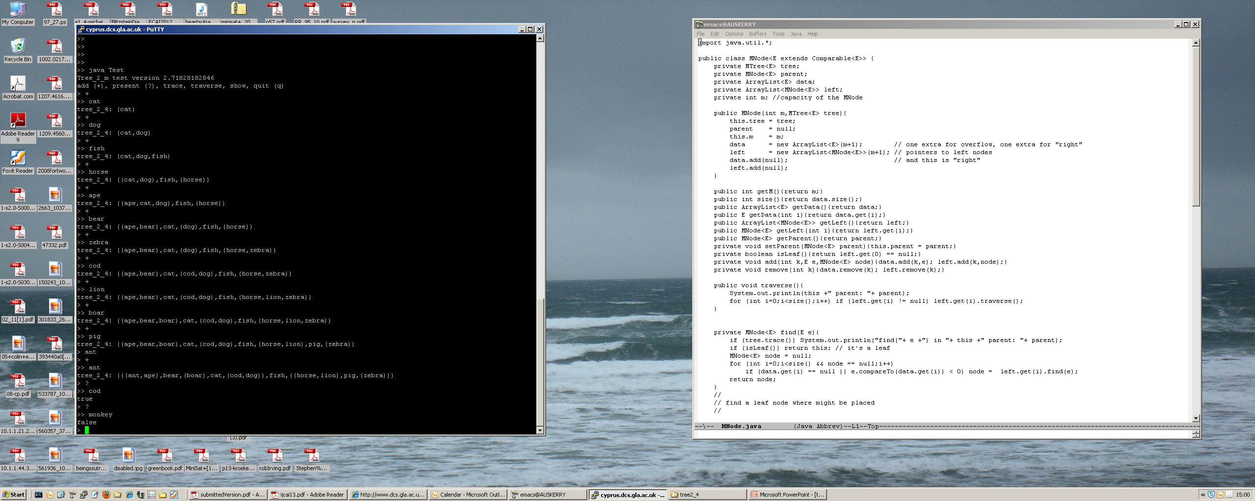

Slide 70


Slide 71
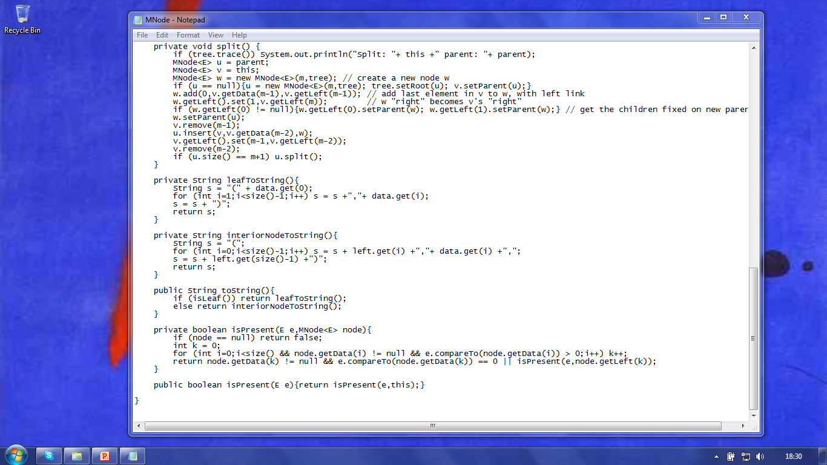
EXAMPLE:
Method toString is an inorder traversal

Slide 72
EXAMPLE:
Method isPresent … like in a bstree

Slide 73

split() … by example, overflow in an interior node

Slide 74
2_m tree (m=3)
U
V
split() … we have added data to V (interior node), have an overflow and must split

Slide 75
2_m tree (m=3)
U
V
U is the parent of V

Slide 76
2_m tree (m=3)
U
V
V is this node

Slide 77
2_m tree (m=3)
U
V
W
Create new node W

Slide 78
2_m tree (m=3)
U
V
W
If V has no parent U then create one and make it the root

Slide 79
2_m tree (m=3)
U
V
W
Add last (largest) element in V into W and carry over left pointers (note: no longer a tree!)

Slide 80
2_m tree (m=3)
U
V
W
If V isn’t a leaf then update parents of children passed over to W (not shown)

Slide 81
2_m tree (m=3)
U
V
W
New node W’s parent is U (not shown)

Slide 82
2_m tree (m=3)
U
V
W
Remove from V the data passed to W

Slide 83
2_m tree (m=3)
U
V
W
Insert largest element in V into its parent U

Slide 84
2_m tree (m=3)
U
V
W
V’s largest child is then its second largest element (a bit of a hack to simplify next step)

Slide 85
2_m tree (m=3)
U
V
W
Remove from V the element passed up to U

Slide 86
2_m tree (m=3)
U
V
W
If parent of V (that is U) has overflowed … then split U

Slide 87
2_m tree deletion
Removal from a 2_m tree
See Goodrich & Tamassia Chapter 10, pages 460 to 463

Slide 88


Slide 89
Download the code ☺
http://www.dcs.gla.ac.uk/~pat/ads2/java/tree2_4/

Slide 90
fin

