Slide 1
clique and colour
Part 1: introduction to two core problems
Part 2: a study of branch and bound

Slide 2
Part 1: colour & clique

Slide 3
gCol

Slide 4
Graph Colouring
gCol: Given a graph G = (V,E) and an integer k, can the graph be coloured with k colours such that adjacent vertices take different colours?

Slide 5
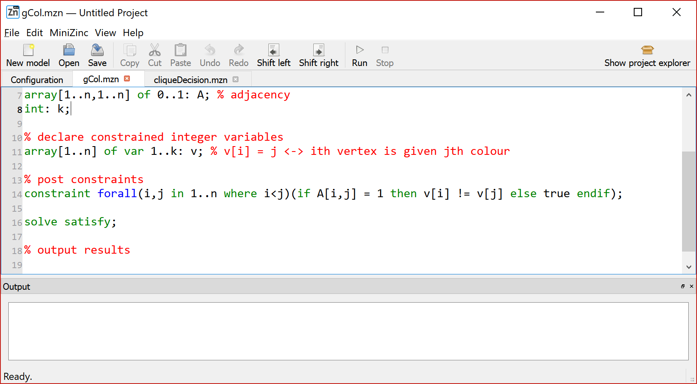
Graph Colouring

Slide 6
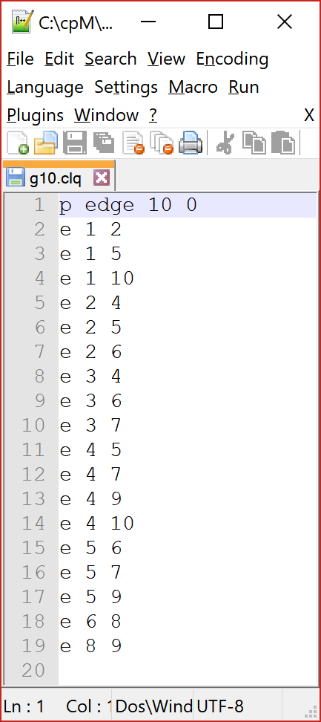
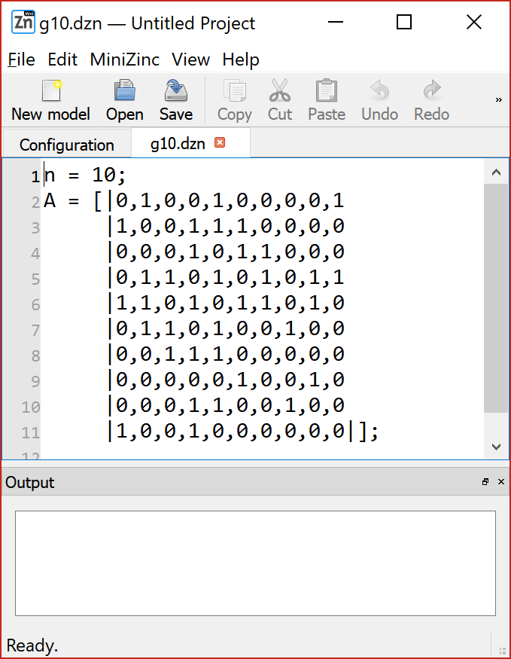
g10

Slide 7
1
g10
2
10
3
9
4
8
5
7
6

Slide 8
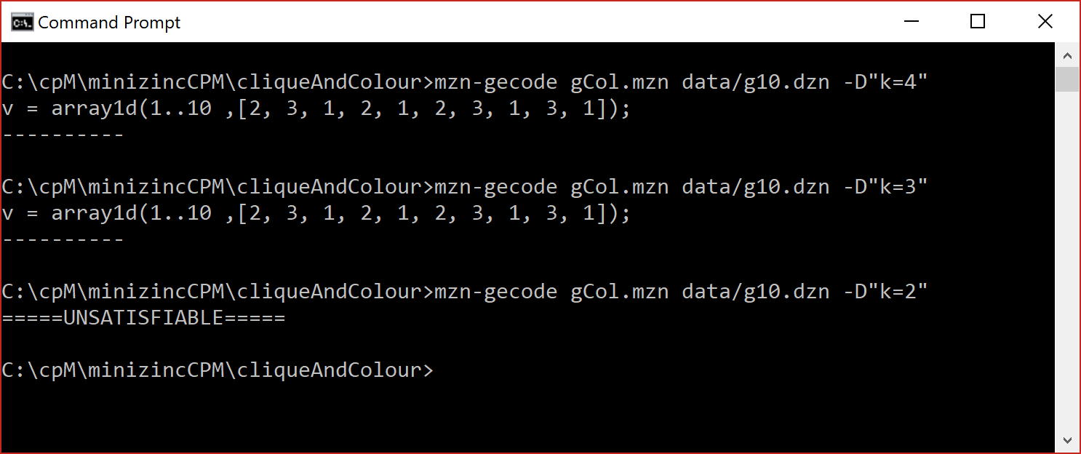
Graph Colouring

Slide 9
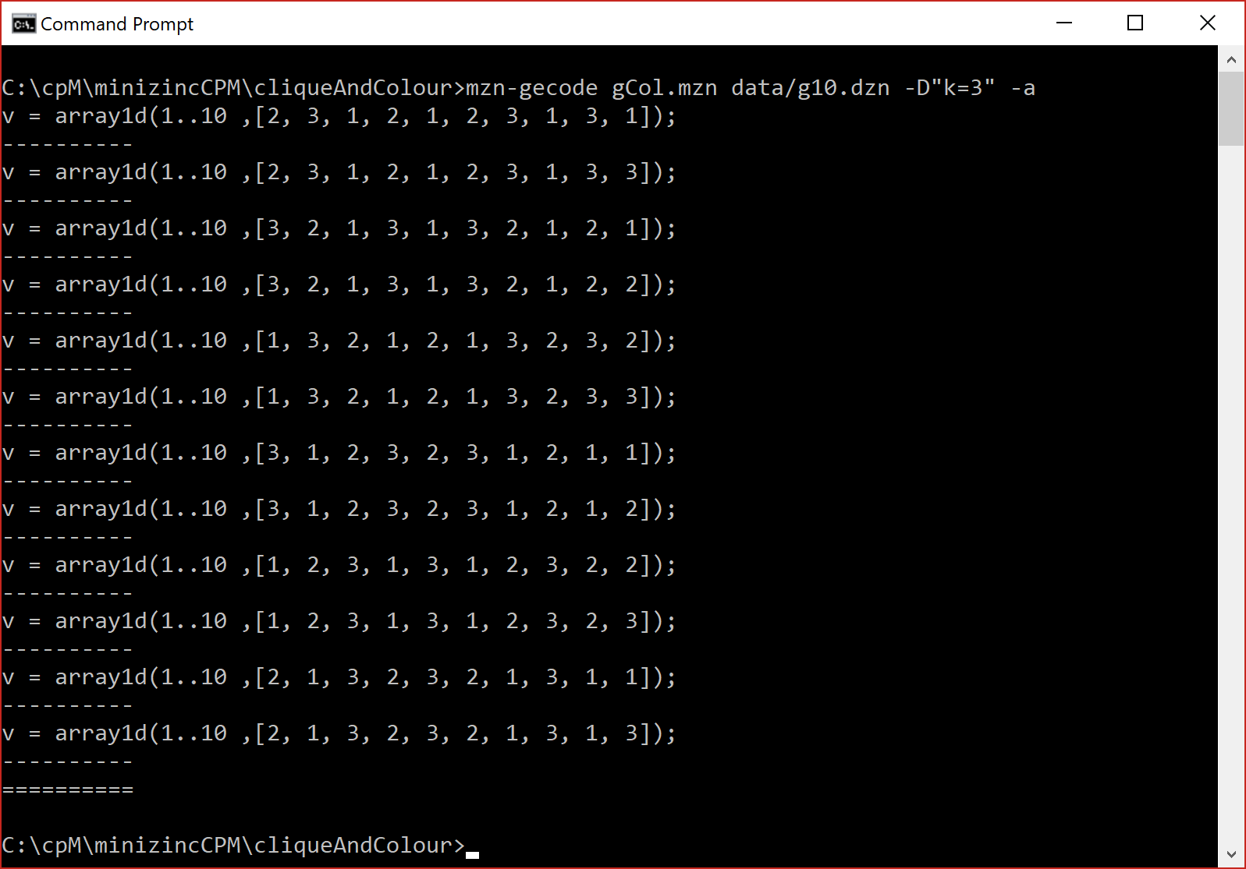
Graph Colouring

Slide 10
1
g10
10
2
3
9
4
8
5
7
6

Slide 11
1
g10
10
2
3
9
4
8
5
7
6

Slide 12
optimisation

Slide 13
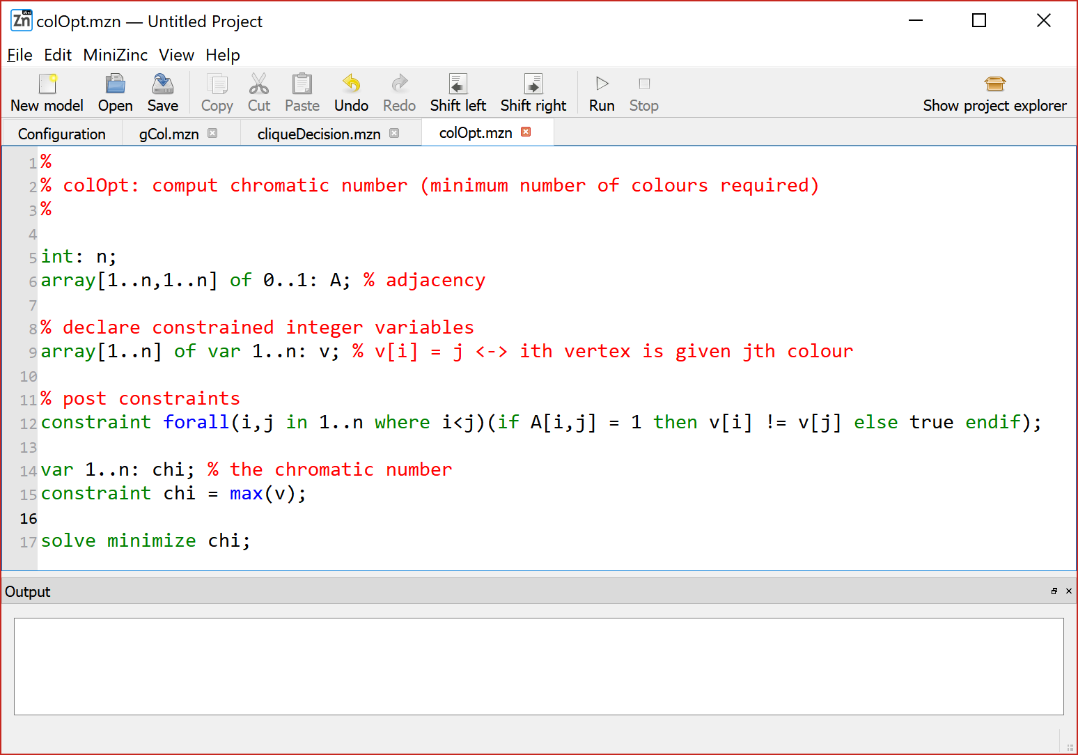
chromatic number (chi)

Slide 14
chromatic number (chi)

Slide 15
chromatic number (chi)

Slide 16
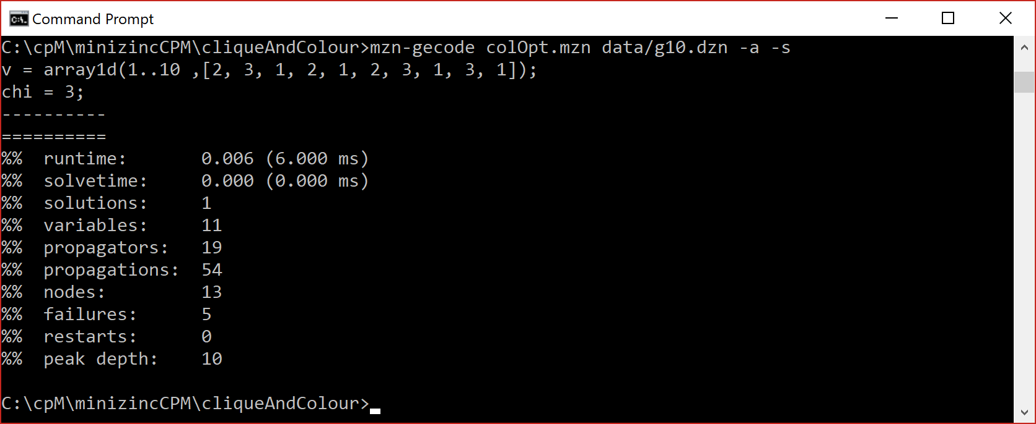
chromatic number (chi)

Slide 17
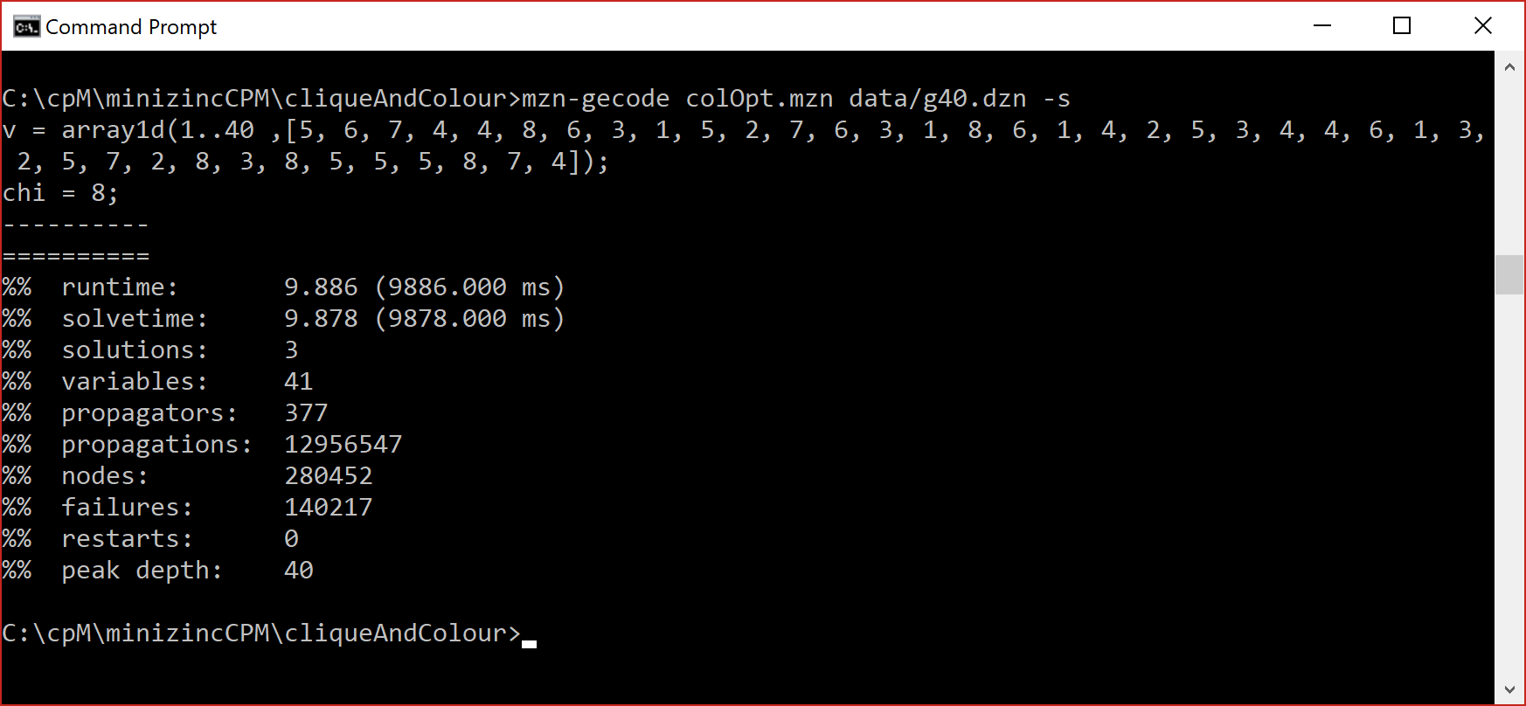
g40.dzn

Slide 18
g50.dzn
Don’t hold your breath

Slide 19
Think on this … will all gCol instances be hard? What will affect difficulty?
Number of vertices (the order of the graph)?
Number of edges (the size of the graph)?
The number of colours allowed?

Slide 20
Think on this … are there things we can do to help tackle gCol?
Symmetry breaking?
The order we choose to colour vertices?
Problem reductions?

Slide 21
Isolation Ordering of Vertices

Slide 22
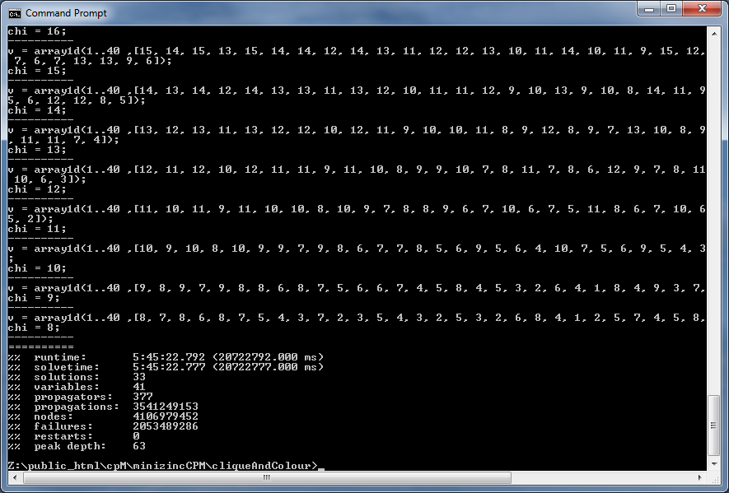
G40 isolation ordering

Slide 23
Warning: graph colouring can take over your life.

Slide 24
clique

Slide 25
Clique
clique: Given a graph G = (V,E) and an integer k, is there a subset of the vertices, of size k, such that all vertices in that set are pair-wise adjacent

Slide 26
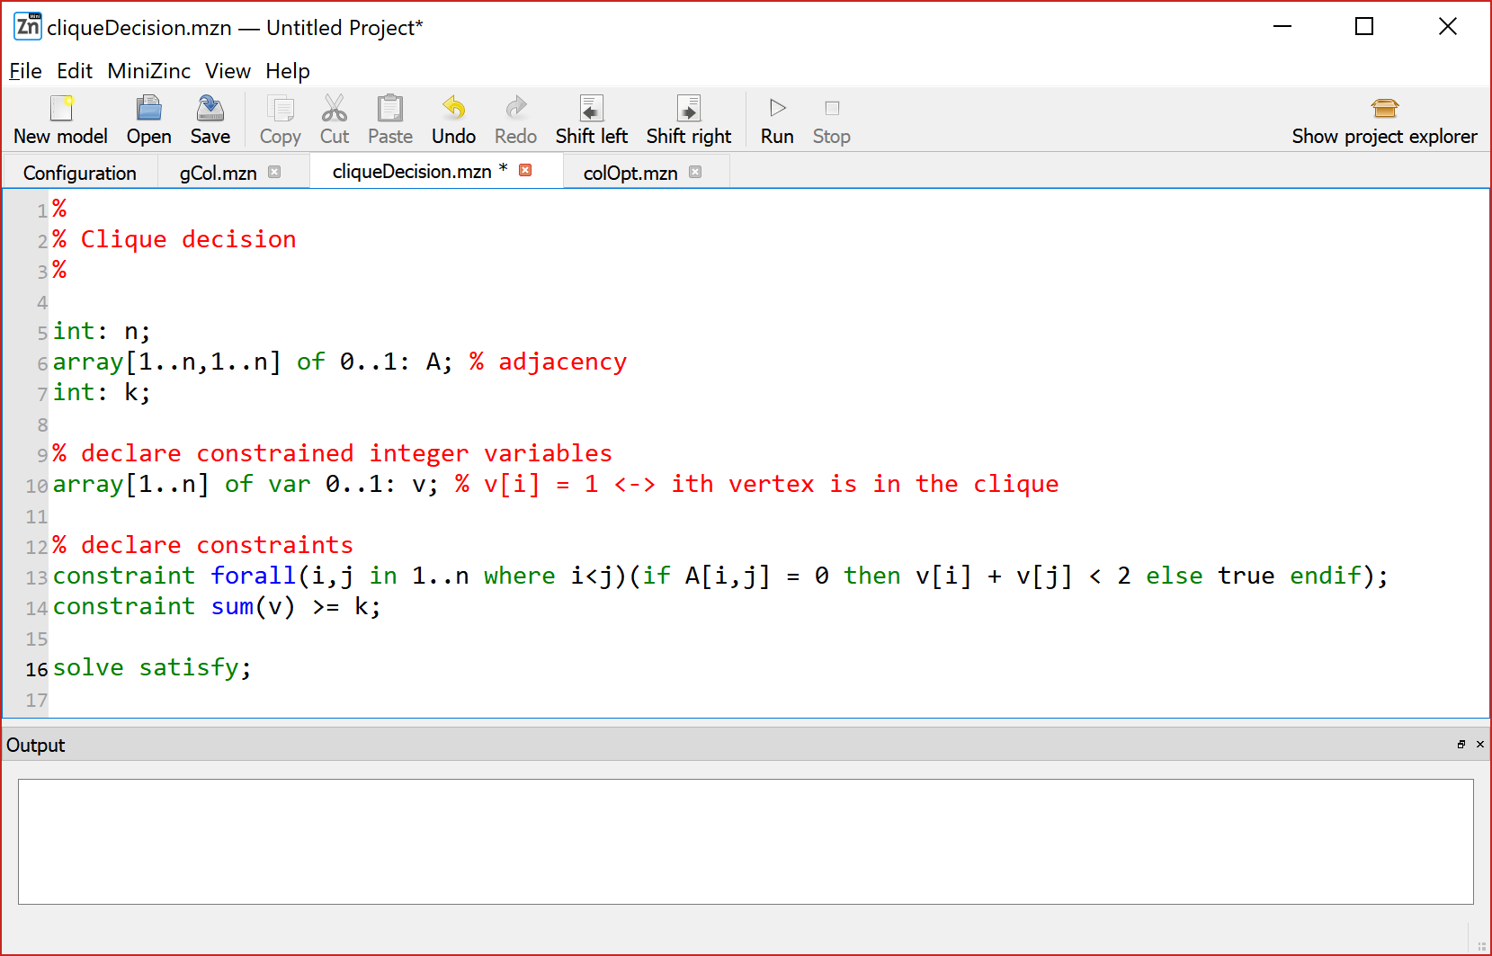
Clique

Slide 27
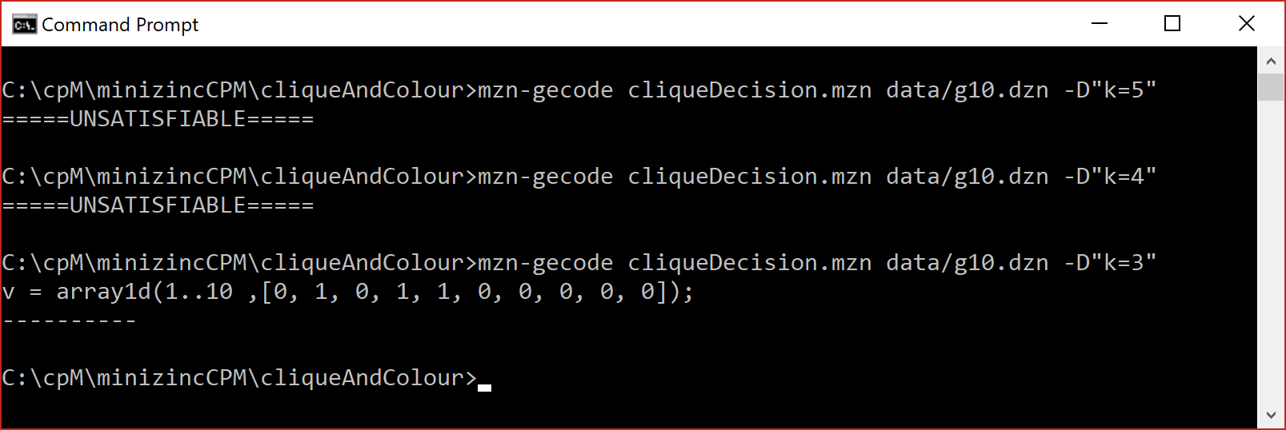
Clique
g10.dzn

Slide 28
1
g10
10
2
3
9
4
8
5
7
6

Slide 29
1
g10
10
2
3
9
4
8
5
7
6

Slide 30
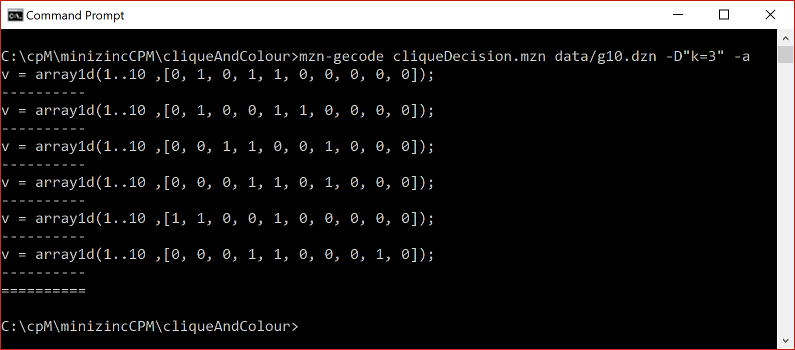
Solution is not unique

Slide 31
optimisation

Slide 32
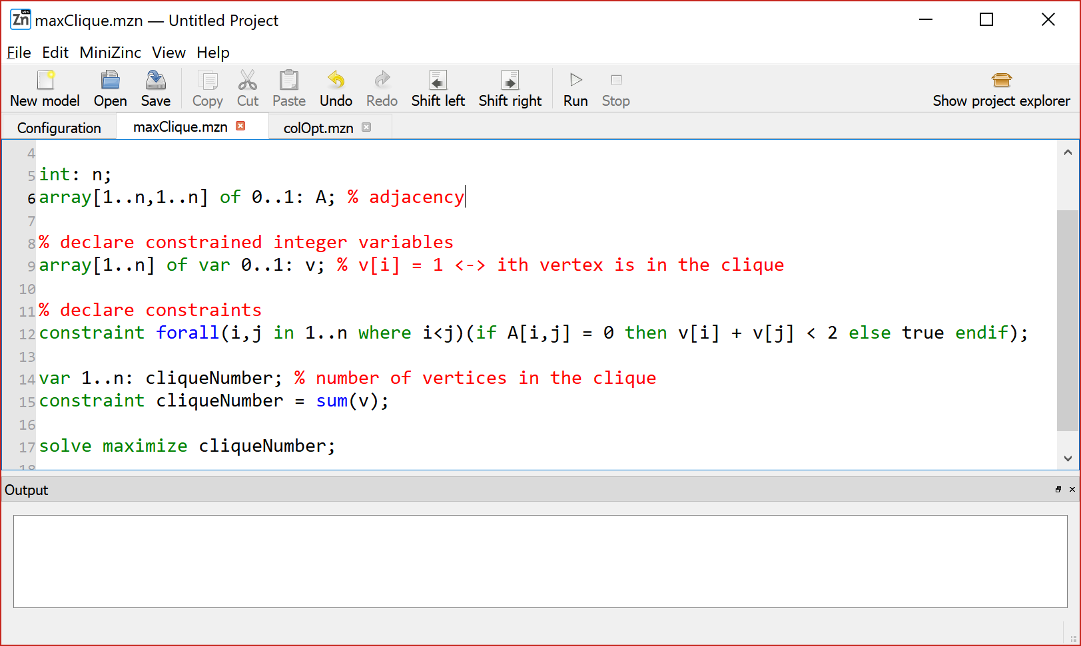

Slide 34
g10.dzn

Slide 35
g40.dzn

Slide 36
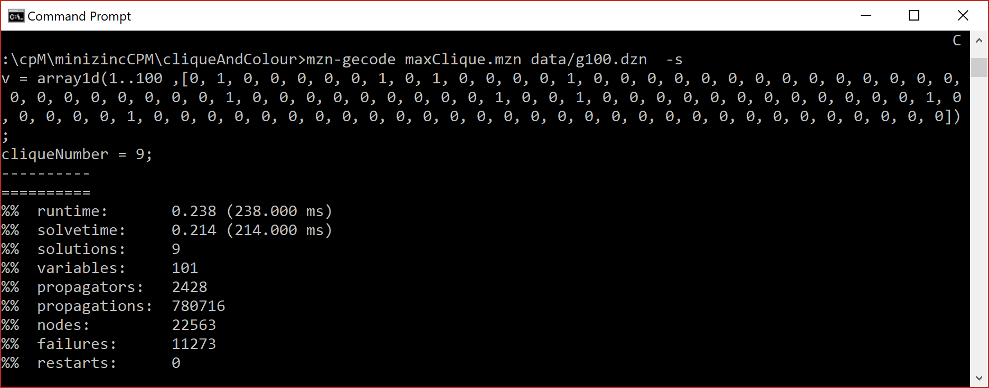
g100.dzn

Slide 37
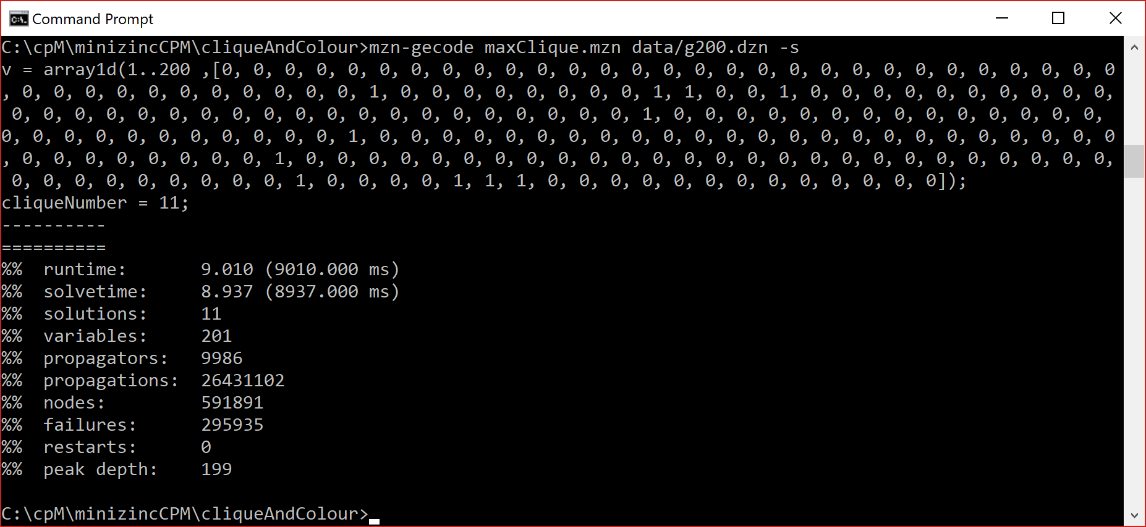
g200.dzn

Slide 38
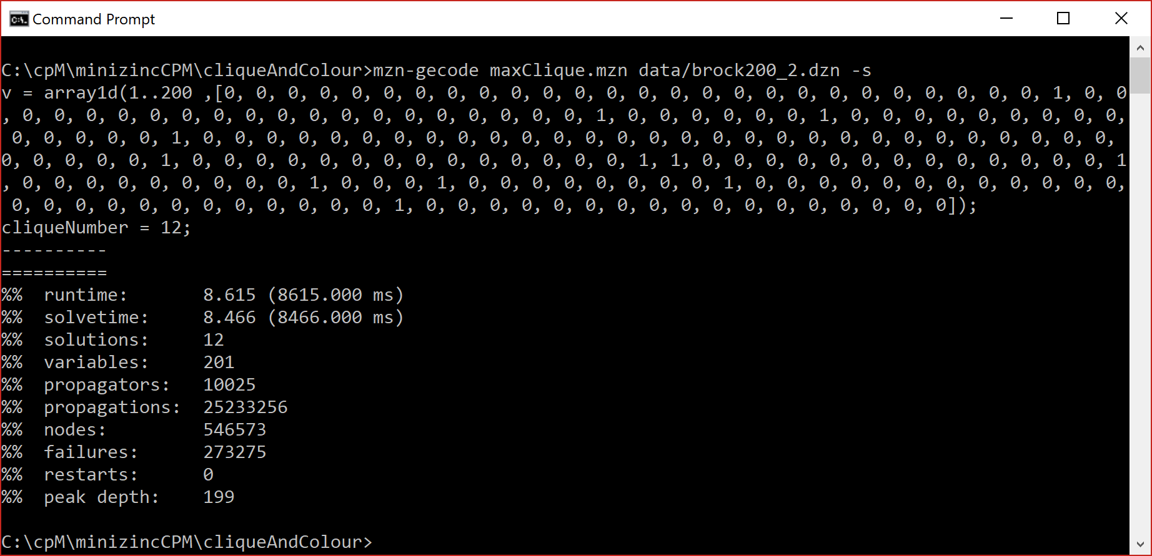
brock200_2.dzn

Slide 39
graph colouring and clique … are they related?

Slide 40
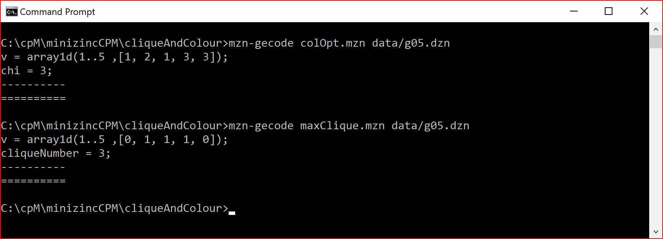
g05

Slide 41
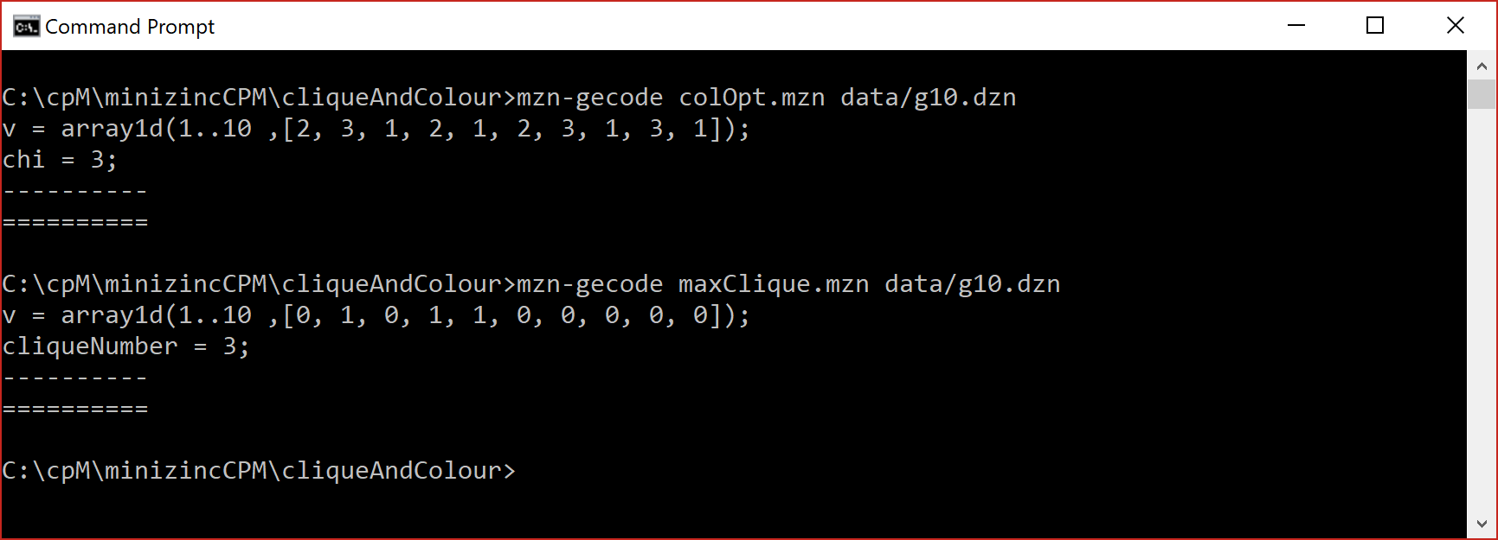
g10

Slide 42
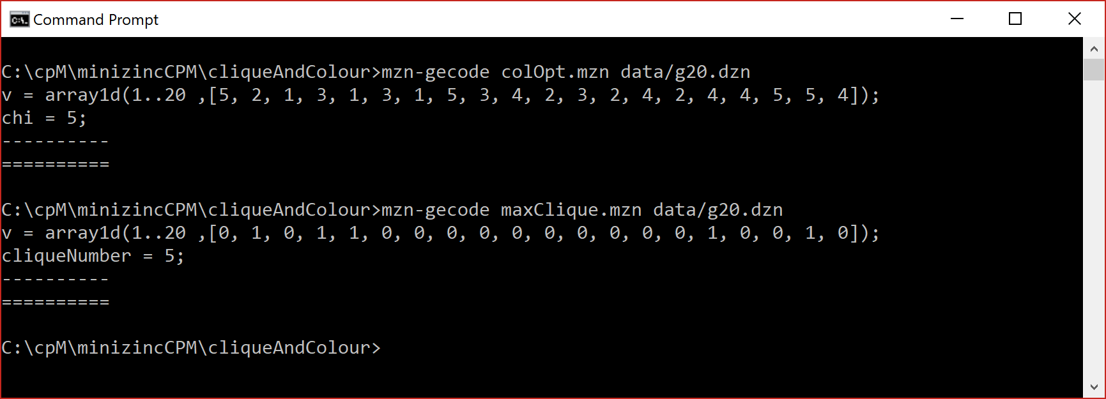
g20

Slide 43
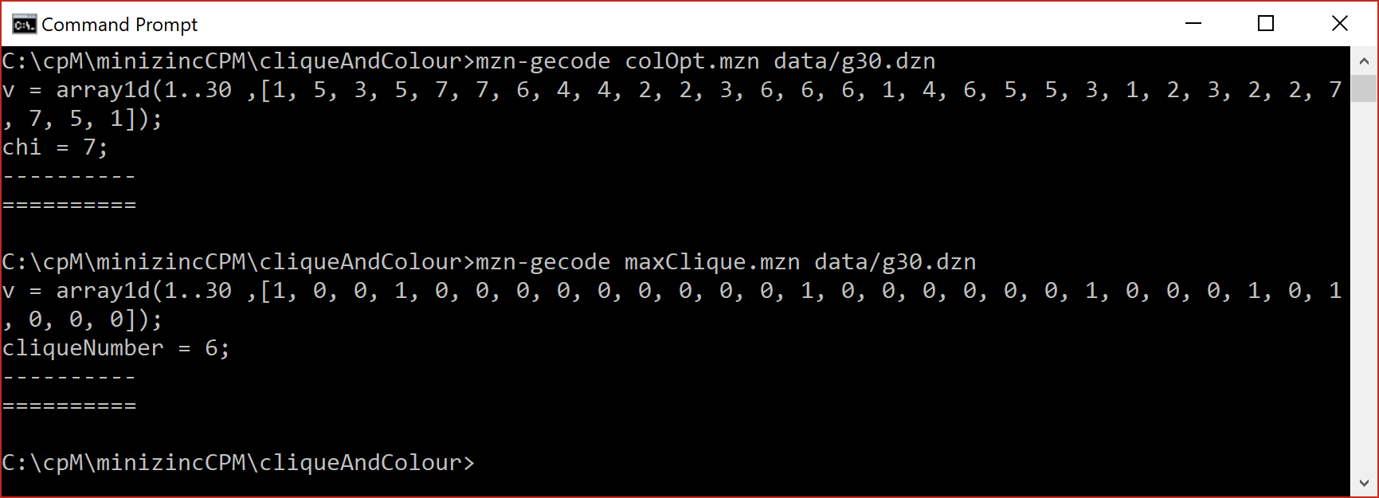
g30

Slide 44
What is clique number and what is colour number?

Slide 45
What is clique number and what is colour number?

Slide 46
What is clique number and what is colour number?

Slide 47
☹
What is clique number and what is colour number?

Slide 48
Part 2: branch and bound (BnB) using max clique (MC) as motivation

Slide 49
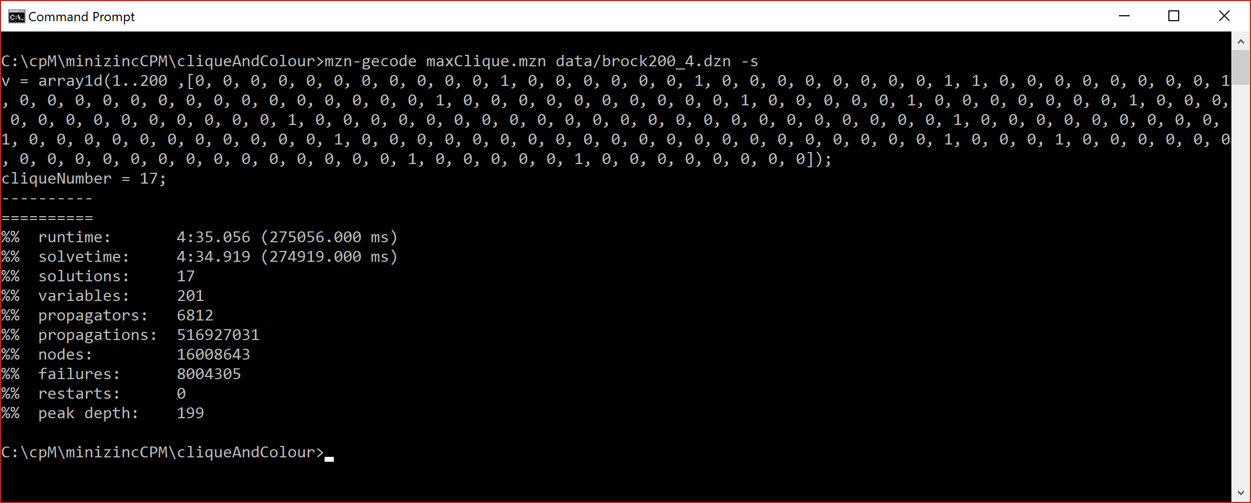
A sample of what’s to come
MiniZinc
brock200_4
274,919 milliseconds
16,008,643 nodes

Slide 50
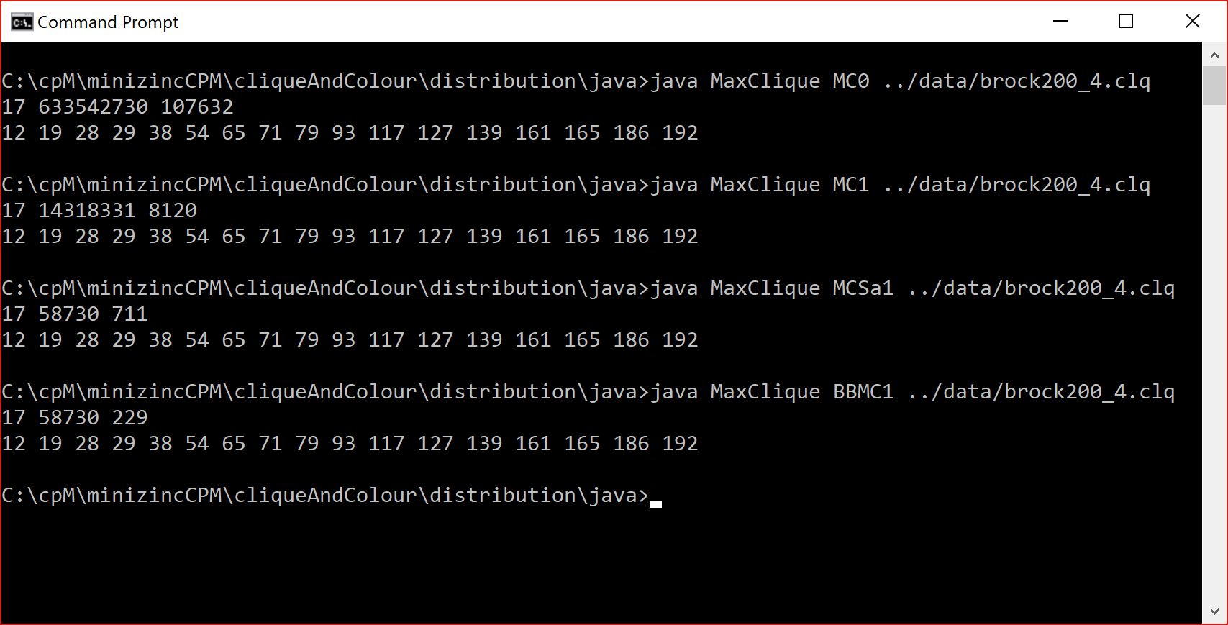
A sample of what’s to come
BnB
brock200_4
mzn: 274,919 ms
java: 229 ms
speedup: 1,200
Small scale statistics
How did we do that?

Slide 51
algorithmic sketch
staring with MC0
heading to BBMC

Slide 52
We have two sets …
C: is the growing clique, a set of vertices
P: is the candidate set, i.e. set of vertices that we might add to C
The largest clique found so far is called the incumbent and has a size maxSize

Slide 53
MC0

Slide 54
1
10
2
3
9
4
8
5
7
6
C = {}
P = {1,2,3,4,5,6,7,8,9,10}
maxSize = 0
incumbent = {}
Top of search

Slide 55
1
10
2
3
9
4
8
5
7
6
C = {1}
P = {2,5,10}
maxSize = 0
incumbent = {}
Select vertex 1

Slide 56
1
10
2
3
9
4
8
5
7
6
C = {1,2}
P = {5}
maxSize = 0
incumbent = {}
Select vertex 2

Slide 57
1
10
2
3
9
4
8
5
7
6
C = {1,2,5}
P = {}
maxSize = 0
incumbent = {}
Select vertex 5

Slide 58
1
10
2
3
9
4
8
5
7
6
C = {1,2,5}
P = {}
maxSize = 3
incumbent = {1,2,5}
Save as incumbent

Slide 59
1
10
2
3
9
4
8
5
7
6
C = {1,2,5}
P = {}
maxSize = 3
incumbent = {1,2,5}
backtrack

Slide 60
1
10
2
3
9
4
8
5
7
6
C = {1}
P = {5,10}
maxSize = 3
incumbent = {1,2,5}
Remove 2 from P

Slide 61
1
10
2
3
9
4
8
5
7
6
C = {1,5}
P = {}
maxSize = 3
incumbent = {1,2,5}
Select vertex 5

Slide 62
1
10
2
3
9
4
8
5
7
6
C = {1,5}
P = {}
maxSize = 3
incumbent = {1,2,5}
backtrack

Slide 63
1
10
2
3
9
4
8
5
7
6
C = {1}
P = {10}
maxSize = 3
incumbent = {1,2,5}
Remove 5 from P

Slide 64
1
10
2
3
9
4
8
5
7
6
C = {1,10}
P = {}
maxSize = 3
incumbent = {1,2,5}
Select vertex 10

Slide 65
1
10
2
3
9
4
8
5
7
6
C = {1,10}
P = {}
maxSize = 3
incumbent = {1,2,5}
backtrack

Slide 66
1
10
2
3
9
4
8
5
7
6
C = {}
P = {2,3,4,5,6,7,8,9,10}
maxSize = 3
incumbent = {1,2,5}
Remove 1 from P

Slide 67
1
10
2
3
9
4
8
5
7
6
C = {2}
P = {4,5,6}
maxSize = 3
incumbent = {1,2,5}
Select vertex 2

Slide 68
… and so on

Slide 69
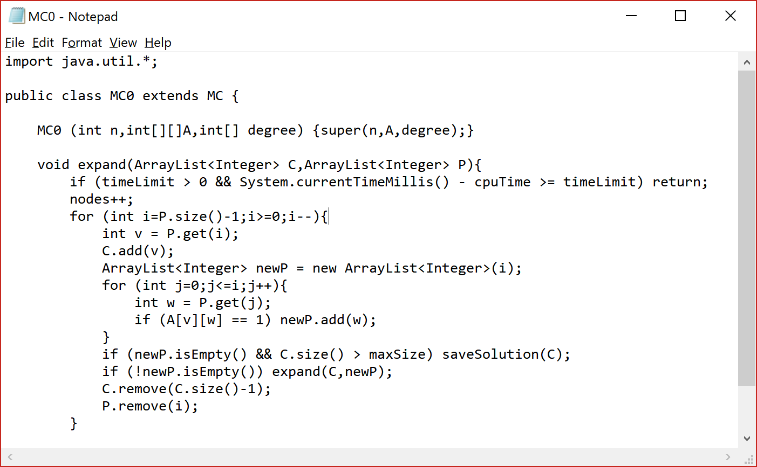

Slide 70
MC0 blindly moves forwards whenever newP is not empty

Slide 71
Assume we have an incumbent and that |P| + |C| ≤ maxSize

Slide 72
Assume we have an incumbent and that |P| + |C| ≤ maxSize
We can cut off search and backtrack

Slide 73
Assume we have an incumbent and that |P| + |C| ≤ maxSize
We can cut off search and backtrack
|P| + |C| is a bound and when |P| + |C| ≤ maxSize we can abandon search in this branch

Slide 74
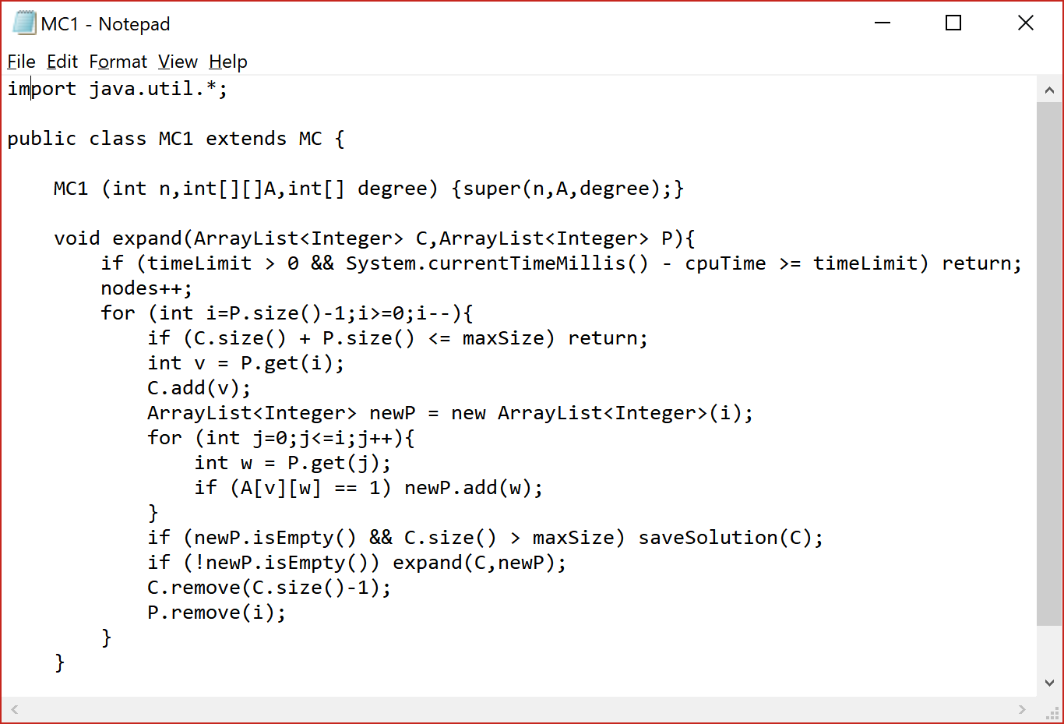

Slide 75
Small scale statistics
MC0 v MC1
brock200_4
MC0: 107,632 ms
MC1: 8,120 ms
speedup: 13
Our first bound

Slide 76
Assume we have an incumbent and that |P| + |C| ≤ maxSize
We can cut off search and backtrack
|P| + |C| is a bound and when |P| + |C| ≤ maxSize we can abandon search in this branch
Can we think of other bounds that we might compute?

Slide 77
Can we think of other bounds that we might compute?
Degree of vertices in P
All vertices in P are adjacent to all vertices in C
The degree between vertices in P may be an measure
Is this costly to compute?
Does it pay off in runtime (i.e. economical)?
If in P we have k vertices with degree ≥ k-1 … ?
See Torsten Fahle for menu of filters and bounds

Slide 78
Can we think of other bounds that we might compute?
The chromatic number of P?
The chromatic number is greater than or equal to the clique number
Therefore it is a safe bound (does not excessively prune search)
But that’s NP-hard to compute!
Is it economical?
Can we make good use of colour?

Slide 79
Colour Classes
Assume we have a set of vertices P, we can greedely place these in colour classes

Slide 80
Colour Classes
Assume we have a set of vertices P, we can greedely place these in colour classes
k = 1
Create an empty colour class C_k
Select and remove a vertex v from P and add v to C_k
For all vertices w in P
4.1 if w is not adjacent to all vertices in C_k
4.2 then add w to C_k and remove w from P
If P is not empty then increment k and go to 2
k is an upper bound of the chromatic number of P

Slide 81
Colour Classes
Assume we have a set of vertices P, we can greedly place these in colour classes
k = 1
Create an empty colour class C_k
Select and remove a vertex v from P and add v to C_k
For all vertices w in P
4.1 if w is not adjacent to all vertices in C_k
4.2 then add w to C_k and remove w from P
If P is not empty then increment k and go to 2
k is an upper bound of the chromatic number of P
NOTE:
colour classes are independent sets
We can select at most one vertex from each colour class

Slide 82
1
Greedy colouring
10
2
3
9
4
8
5
7
6
P = {1,2,3,4,5,6,7,8,9,10}

Slide 83
1
Greedy colouring
10
2
3
9
4
8
5
7
6
P = {1,2,3,4,5,6,7,8,9,10}
C_1 = {1,3,8}

Slide 84
1
Greedy colouring
10
2
3
9
4
8
5
7
6
P = {2,4,5,6,7,9,10}
C_1 = {1,3,8}
C_2 = {2,7,9,10}

Slide 85
1
Greedy colouring
10
2
3
9
4
8
5
7
6
P = {4,5,6}
C_1 = {1,3,8}
C_2 = {2,7,9,10}
C_3 = {4,6}

Slide 86
1
Greedy colouring
10
2
3
9
4
8
5
7
6
P = {5}
C_1 = {1,3,8}
C_2 = {2,7,9,10}
C_3 = {4,6}
C_4 = {5}

Slide 87
1
Greedy colouring
10
2
3
9
4
8
5
7
6
We get a greedy estimate (k) of chromatic number of candidate set P
We can do this in every call to expand …
If |C| + k ≤ maxSize we can abandon current branch

Slide 88
1
Greedy colouring
10
2
3
9
4
8
5
7
6
We get a greedy estimate (k) of chromatic number of candidate set P
We can do this in every call to expand …
If |C| + k ≤ maxSize we can abandon current branch
And we can get smart!

Slide 89
1
Order vertices for colouring
10
2
3
9
4
8
5
7
6
Non-increasing degree order {4,5,6,2,1,3,7,9,8,10}

Slide 90
1
Order vertices for colouring
10
2
3
9
4
8
5
7
6
Non-increasing degree order {4,5,6,2,1,3,7,9,8,10}
C_1 = {1,4,6}
C_2 = {3,5,8,10}
C_3 = {2,7,9}
k = 3
A tighter bound!

Slide 91
1
Order vertices for colouring
10
2
3
9
4
8
5
7
6
There are other orderings
a Brelaz ordering
Minimum width ordering
…
Non-increasing degree order {4,5,6,2,1,3,7,9,8,10}
C_1 = {1,4,6}
C_2 = {3,5,8,10}
C_3 = {2,7,9}
k = 3
A tighter bound!

Slide 92
Can we do something with the colour classes, not just the value k?

Slide 93
1
Visiting colour classes
10
2
3
9
4
8
5
7
6
In expand, iterate over vertices in colour classes from colour class C_k down to C_1
i.e. start with {2,7,9} then {3,5,8,10} finally {1,4,6}.

Slide 94
1
Visiting colour classes
10
2
3
9
4
8
5
7
6
In expand, iterate over vertices in colour classes from colour class C_k down to C_1
i.e. start with {2,7,9} then {3,5,8,10} finally {1,4,6}.
If |C| + index of current colour class ≤ maxSize then backtrack …

Slide 95
1
Visiting colour classes
10
2
3
9
4
8
5
7
6
In expand, iterate over vertices in colour classes from colour class C_k down to C_1
i.e. start with {2,7,9} then {3,5,8,10} finally {1,4,6}.
If |C| + index of current colour class ≤ maxSize then backtrack …
… because we can only pick one vertex from each of the k colour classes (independent sets)

Slide 96
Small scale statistics
MC1 v MCSa1
brock200_4
MC1: 8,120 ms
MCSa1: 711 ms
speedup: 11
Our second, smartly used, bound

Slide 97
To a man with a hammer everything looks like a nail
We can only select one vertex from a colour class
Can we consider a colour class as a variable with a domain?
If so, what colour class should we pick first?

Slide 98
Algorithmic Engineering
Having selected v from the candidate set P we create the new candidate set P’ as follows:
P’ = {}
forall w in P
2.1 w is adjacent to v then add w to P’

Slide 99
Algorithmic Engineering
We might have P and P’ as BitSet and each row of the adjacency matrix a BitSet
such that having selected vertex v we can compute P’ as follows
P’ = P and A[v]
… that is, give me all vertices in P that are adjacent to vertex v.
This exploits in-processor parallelism, and the resultant algorithm is BBMC

Slide 100
Small scale statistics
MCSa1 v BBMC1
brock200_4
MCSa1: 711 ms
BBMC1: 229 ms
speedup: 3
Good engineering

Slide 101
Algorithmic Engineering
Rewrite everything in C++

Slide 102
Algorithmic Engineering
Rewrite everything in C++
Go parallel

Slide 103
Want to know more?
Look at Patrick Prosser and Ciaran McCreesh on dblp

Slide 104
TSP
In TSP, as the current tour is being extended we have a set of cities yet to be visited
Assume we have an incumbent and the cost of that tour, minCost
Assume we have cost of current partial tour
Assume we have set N of cities not yet visited
Compute a MST for N
If cost of partial tour plus cost of MST is ≥ minCost then backtrack

Slide 105
Generally
In most all optimisation problems where we use exact search there is considerable effort to come up with sharp and economical bounds.

Slide 106
Generally
In most all optimisation problems where we use exact search there is considerable effort to come up with sharp and economical bounds.
I have only presented Max Clique because that’s what I’ve
recently been working on with Ciaran

Slide 107
Generally
In most all optimisation problems where we use exact search there is considerable effort to come up with sharp and economical bounds.
I have only presented Max Clique because that’s what I’ve
recently been working on with Ciaran …
… and maybe because this is all that I know

Slide 108
