Slide 1
Small TSP

Slide 2
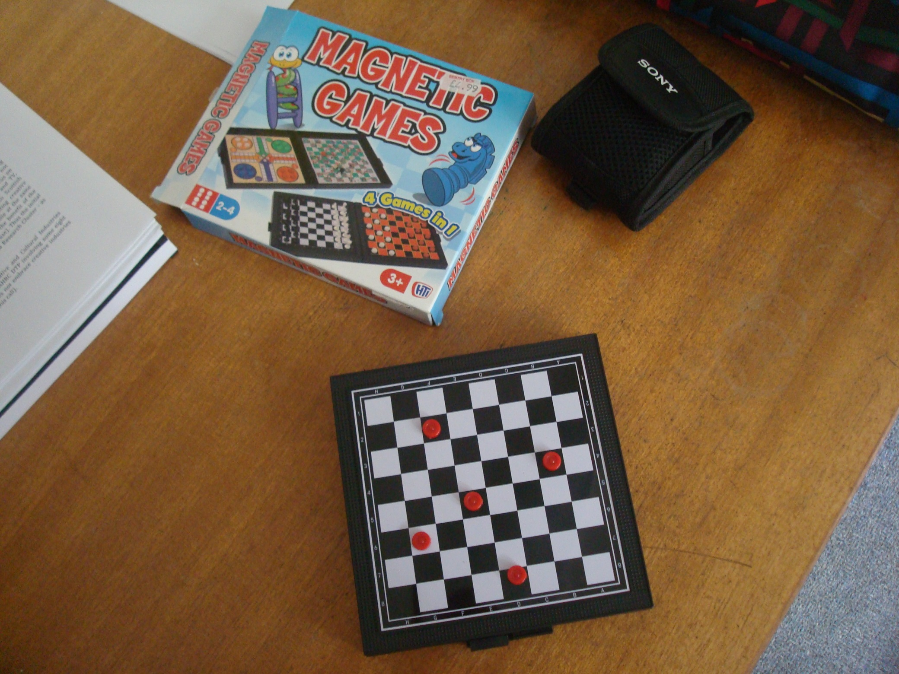

Slide 3
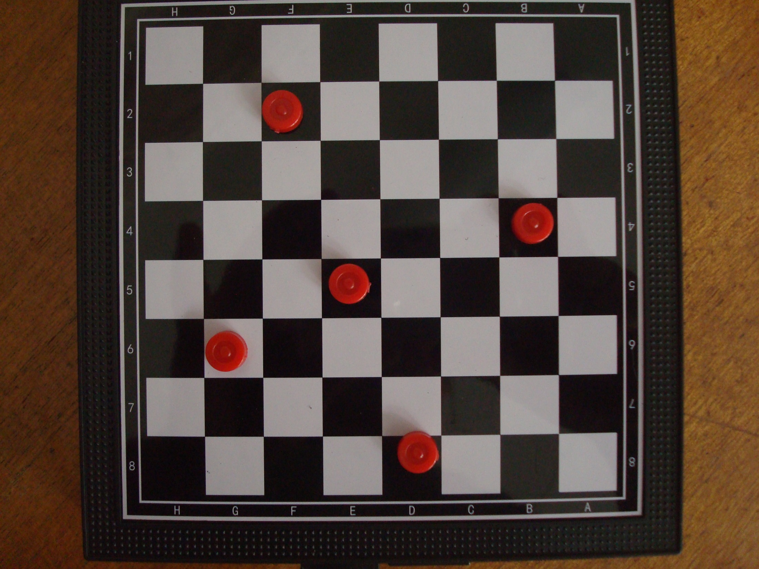

Slide 4
1
2
3
4
5

Slide 5
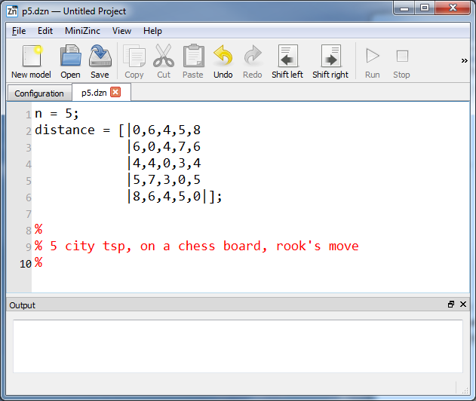

Slide 8
Single successor model
next[i] = j means “visit city j immediately after city i”

Slide 9
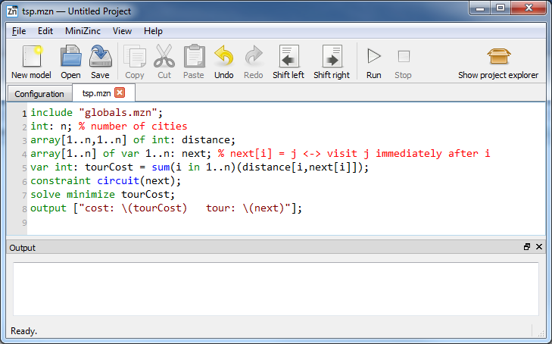

Slide 10
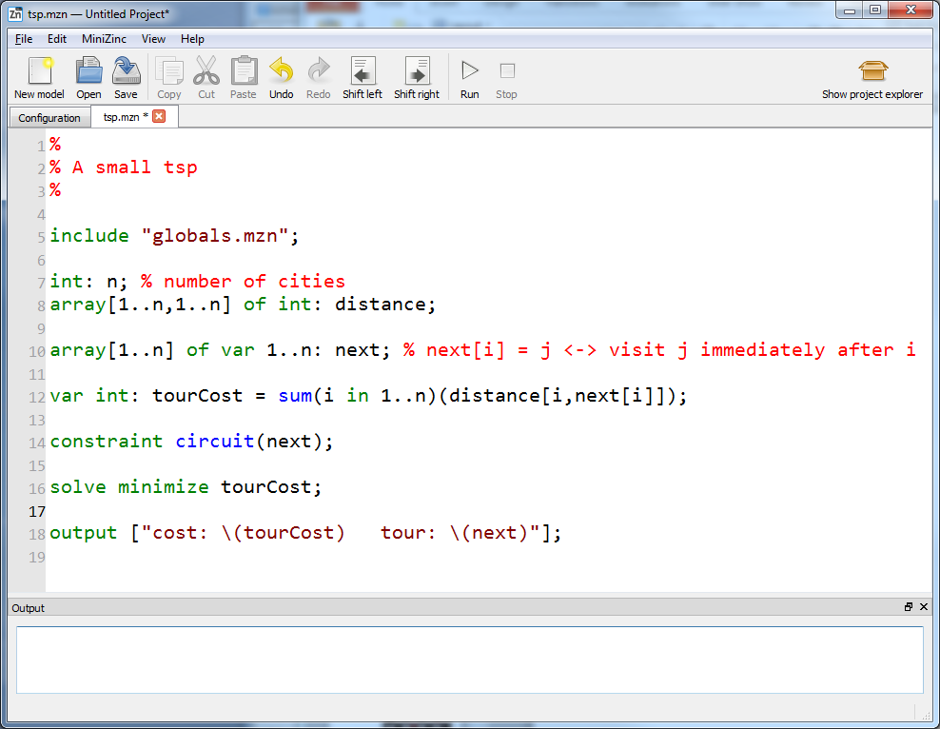

Slide 15
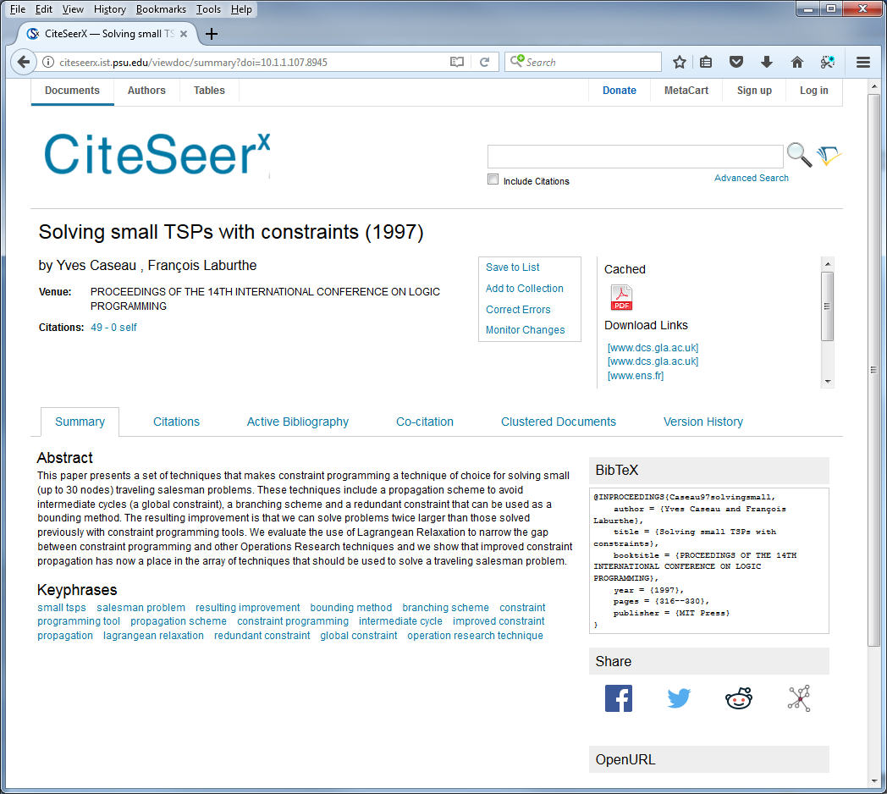

Slide 16
The single successor model
NOT A TOUR!
1
2
3
0
5
6
7
4
0
1
2
3
4
5
6
7
We need subtour elimination

Slide 21
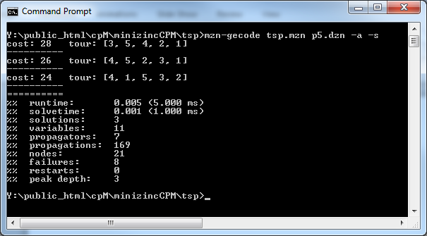

Slide 23
1 goes to 4

Slide 24
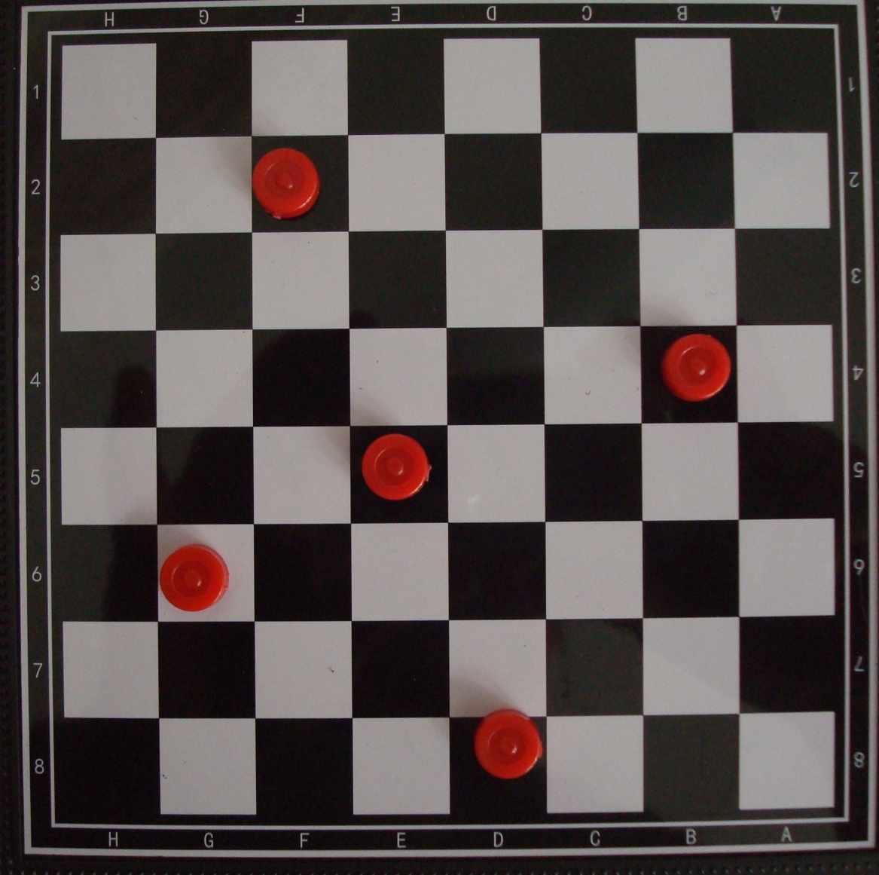
2 goes to 1

Slide 25
3 goes to 5

Slide 26
4 goes to 3

Slide 27
5 goes to 2

Slide 28
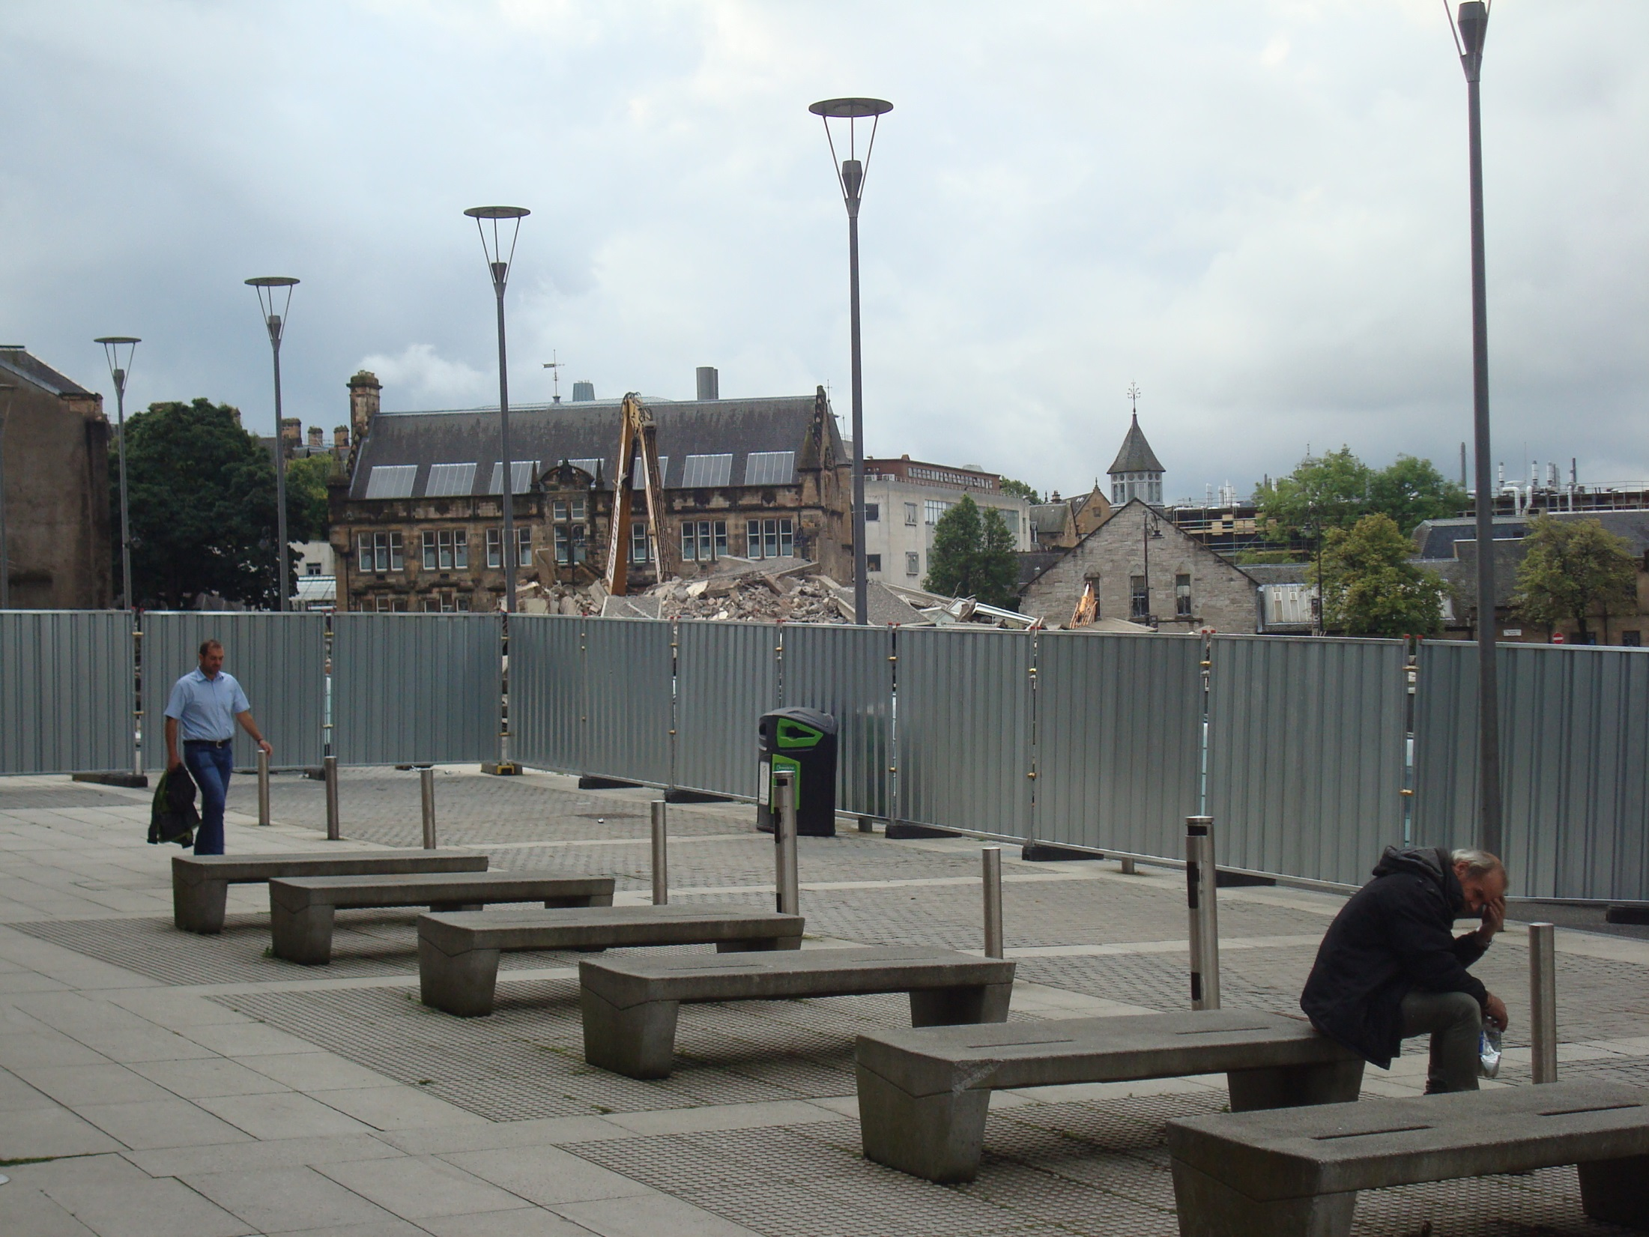

Slide 29
Feic!

