Slide 1
Graphs

Slide 2
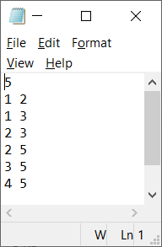
g0
1
2
5
4
3

Slide 3
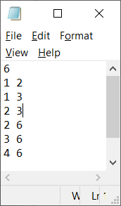
g1
1
6
2
5
3
4

Slide 4
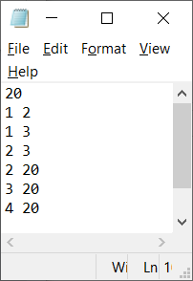
1
g2
19
20
18
17
2
16
15
3
14
4
13
12
5
11
6
10
9
8
7

