Slide 1
Abarth Paint Shop

Slide 2
In the Abarth paint shop cars can be :
grey
red
white
yellow
blue … or
black

Slide 3
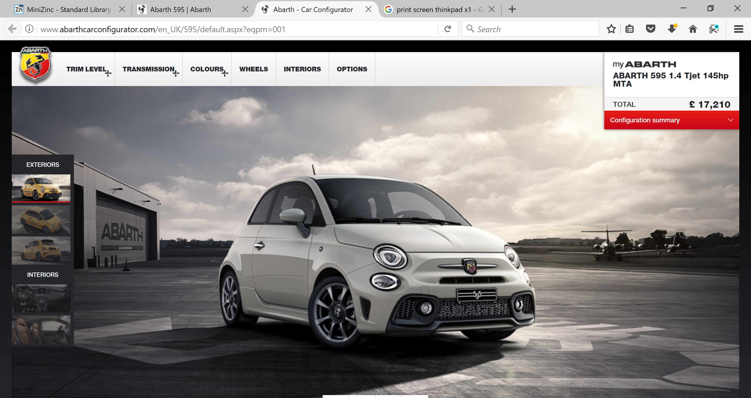

Slide 4
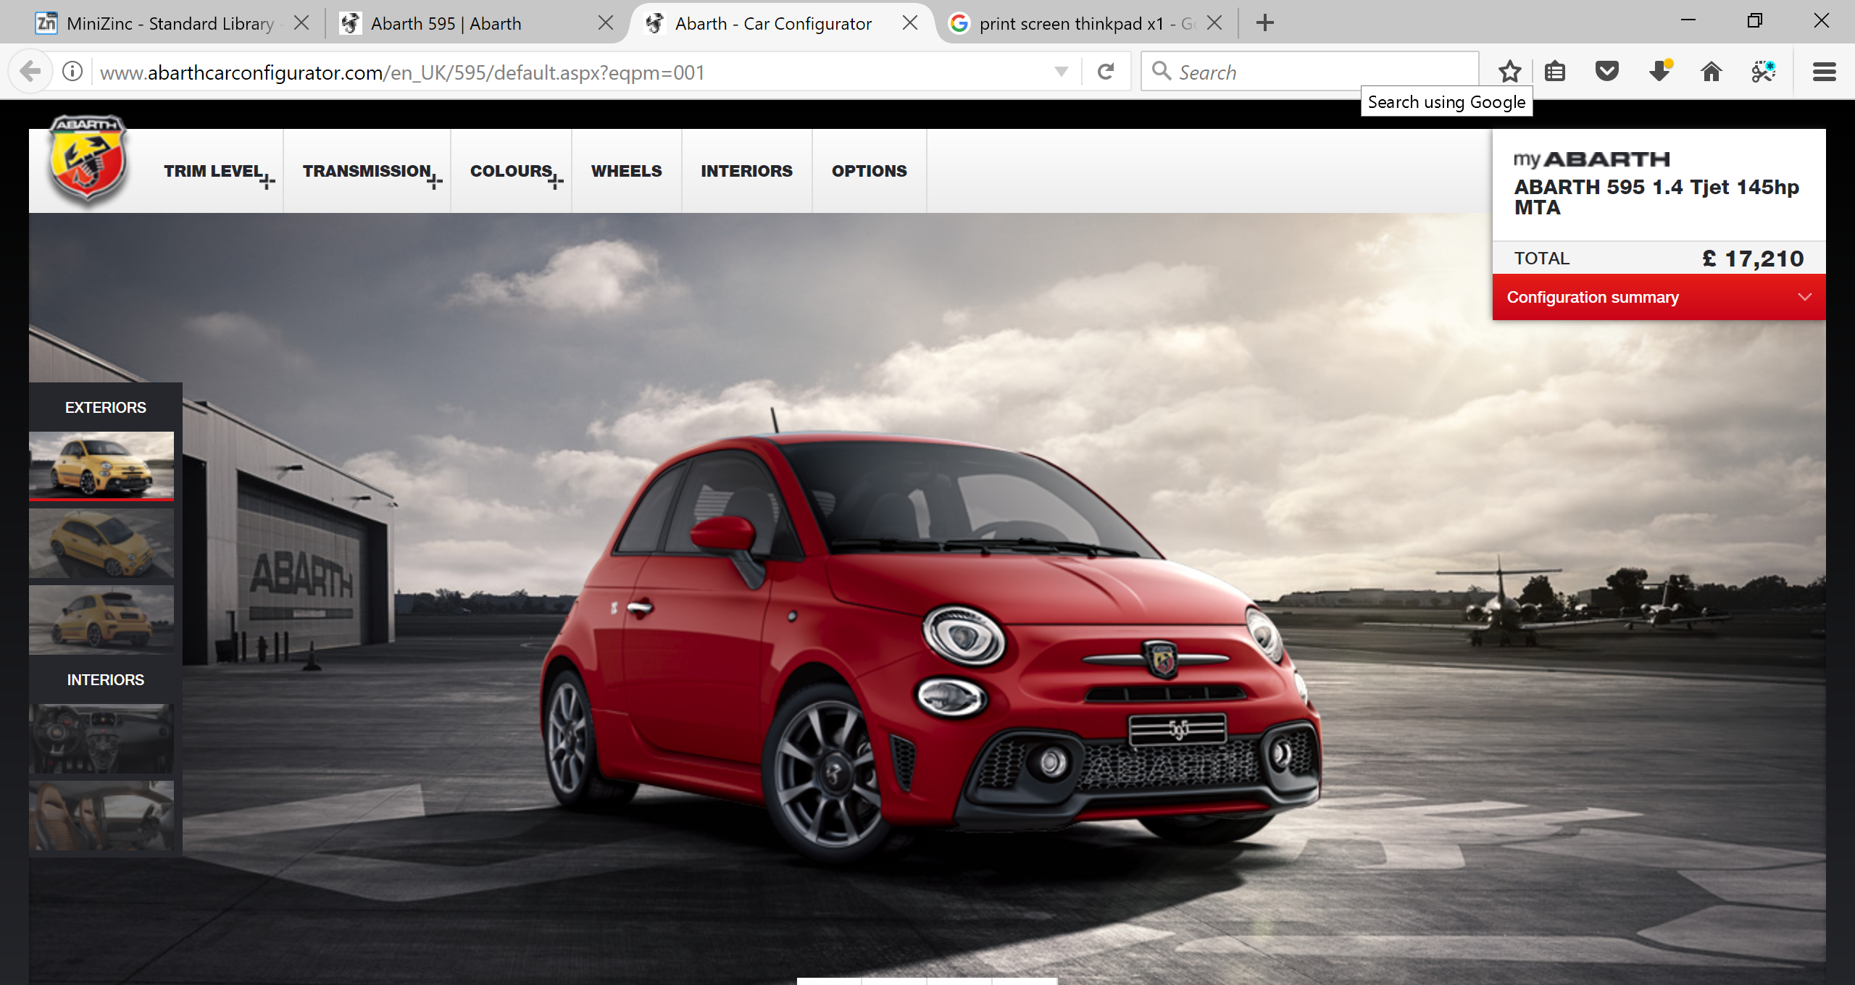

Slide 5
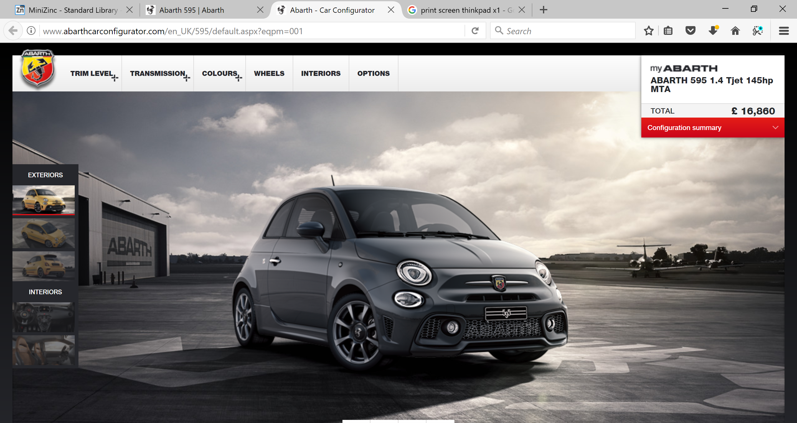

Slide 6
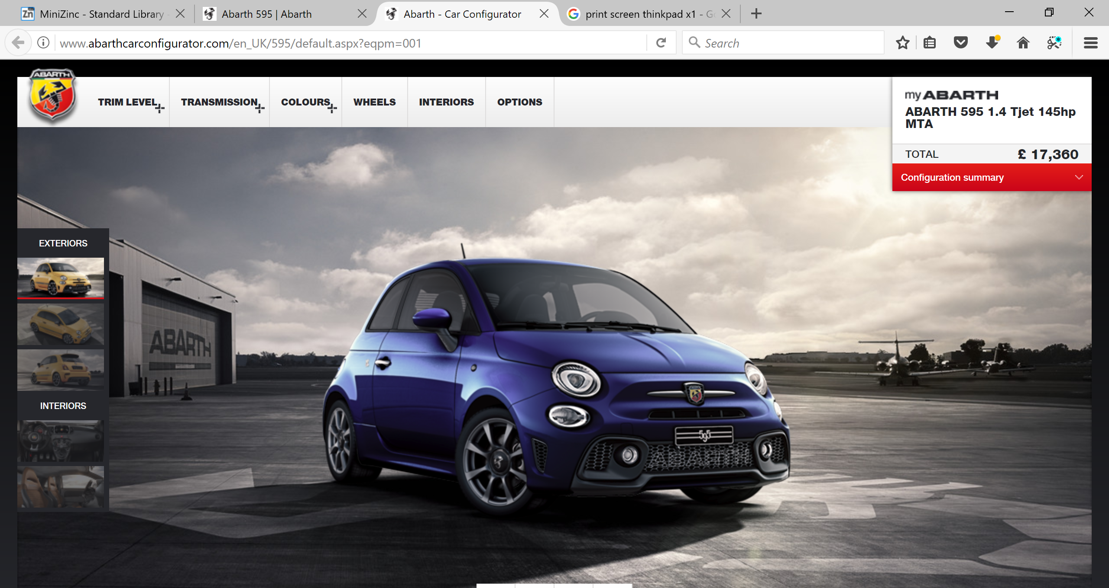

Slide 7
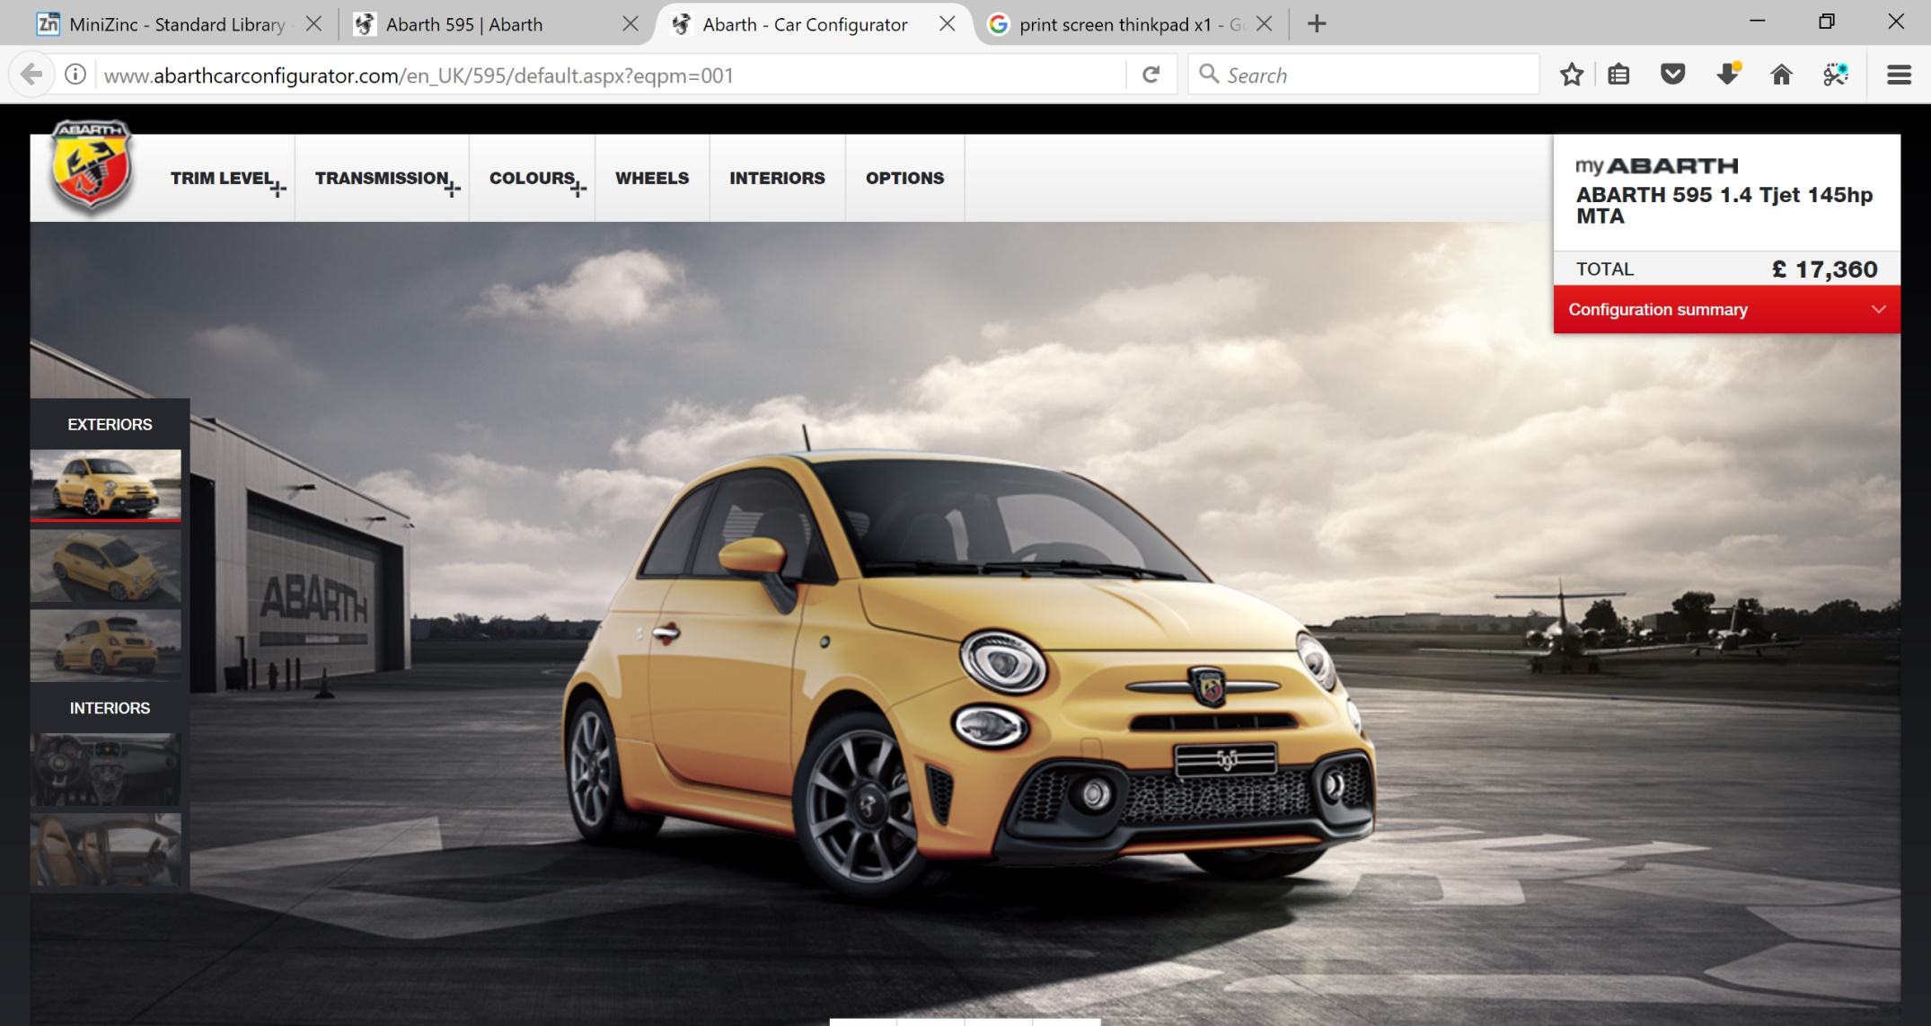

Slide 8
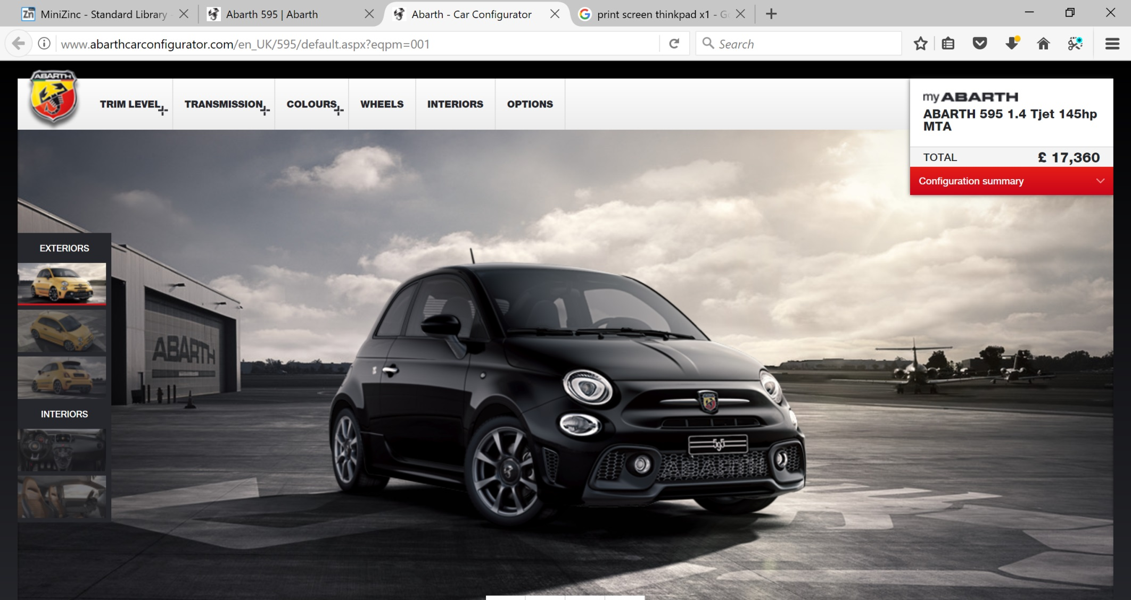

Slide 9
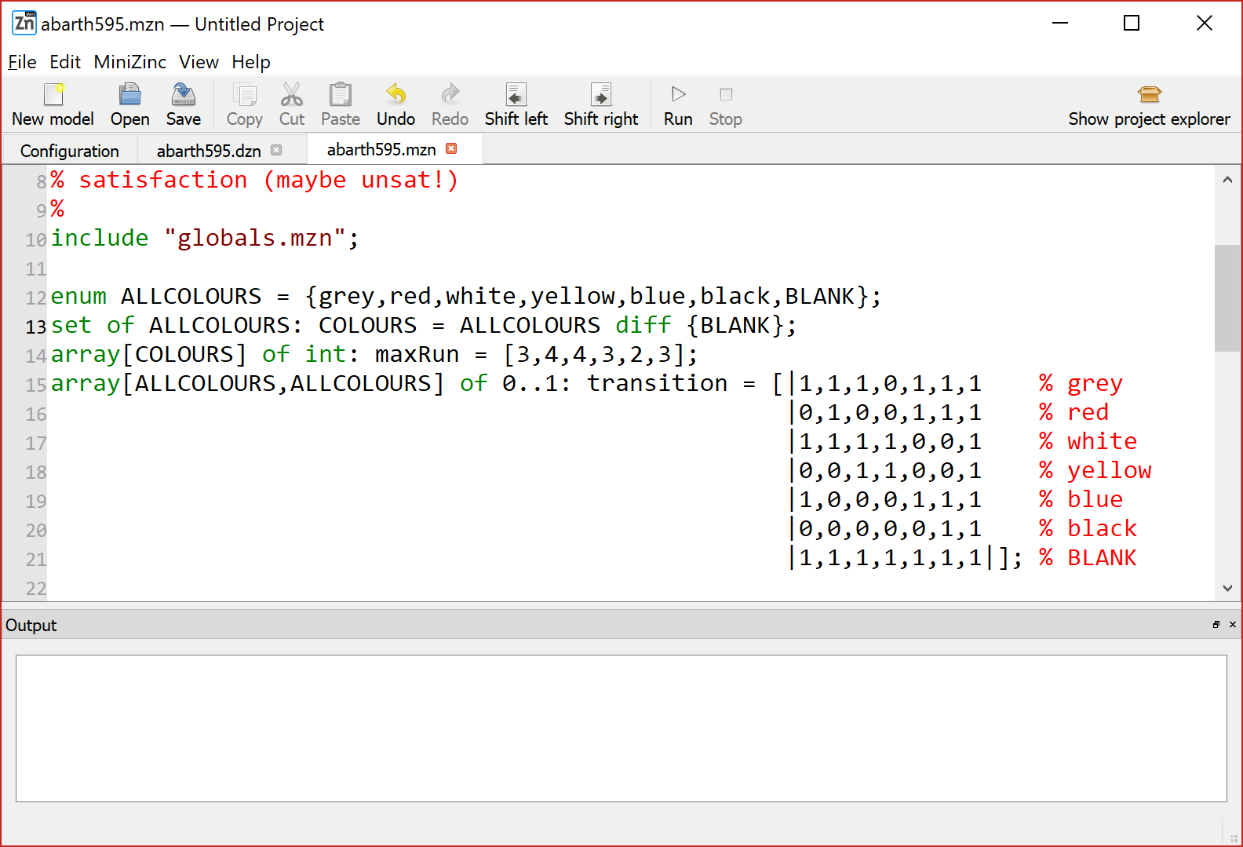

Slide 10
When painting cars …
3 grey cars can be painted one after the other
4 red can be painted one after the other
4 white can be painted one after the other
3 yellow one after the other
2 blue one after the other
3 black one after the other

Slide 12
When changing colours …
After grey we can paint grey, red, white, blue, black or BLANK
After red we can paint red, blue, black or BLANK
After white we can paint white, grey, red, yellow or BLANK
After yellow we can paint yellow, white or BLANK
After blue we can paint blue, black or BLANK
After black we can paint black or BLANK
After BLANK we have clean paint guns and can paint any colour

Slide 14
Demand …
We have a demand for cars of these colours
and an allowed time to paint them …

Slide 15
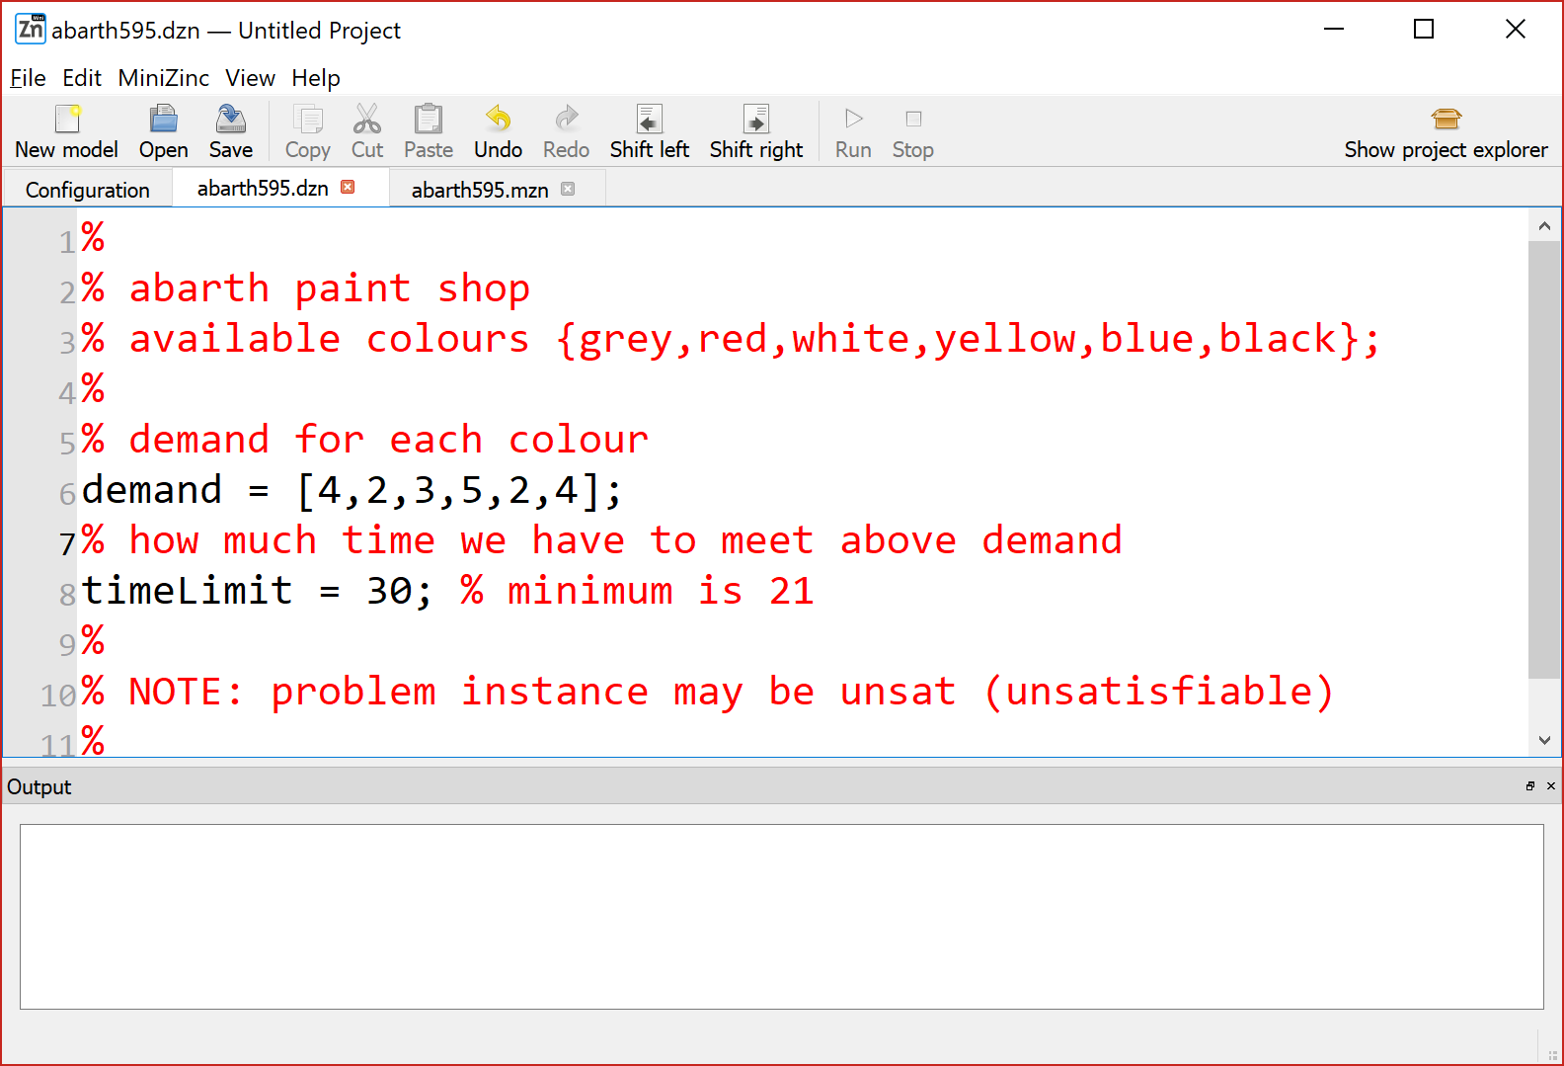

Slide 16
Decision variables …
Given a time line, at each time slot, what colour of car will we paint?

Slide 17
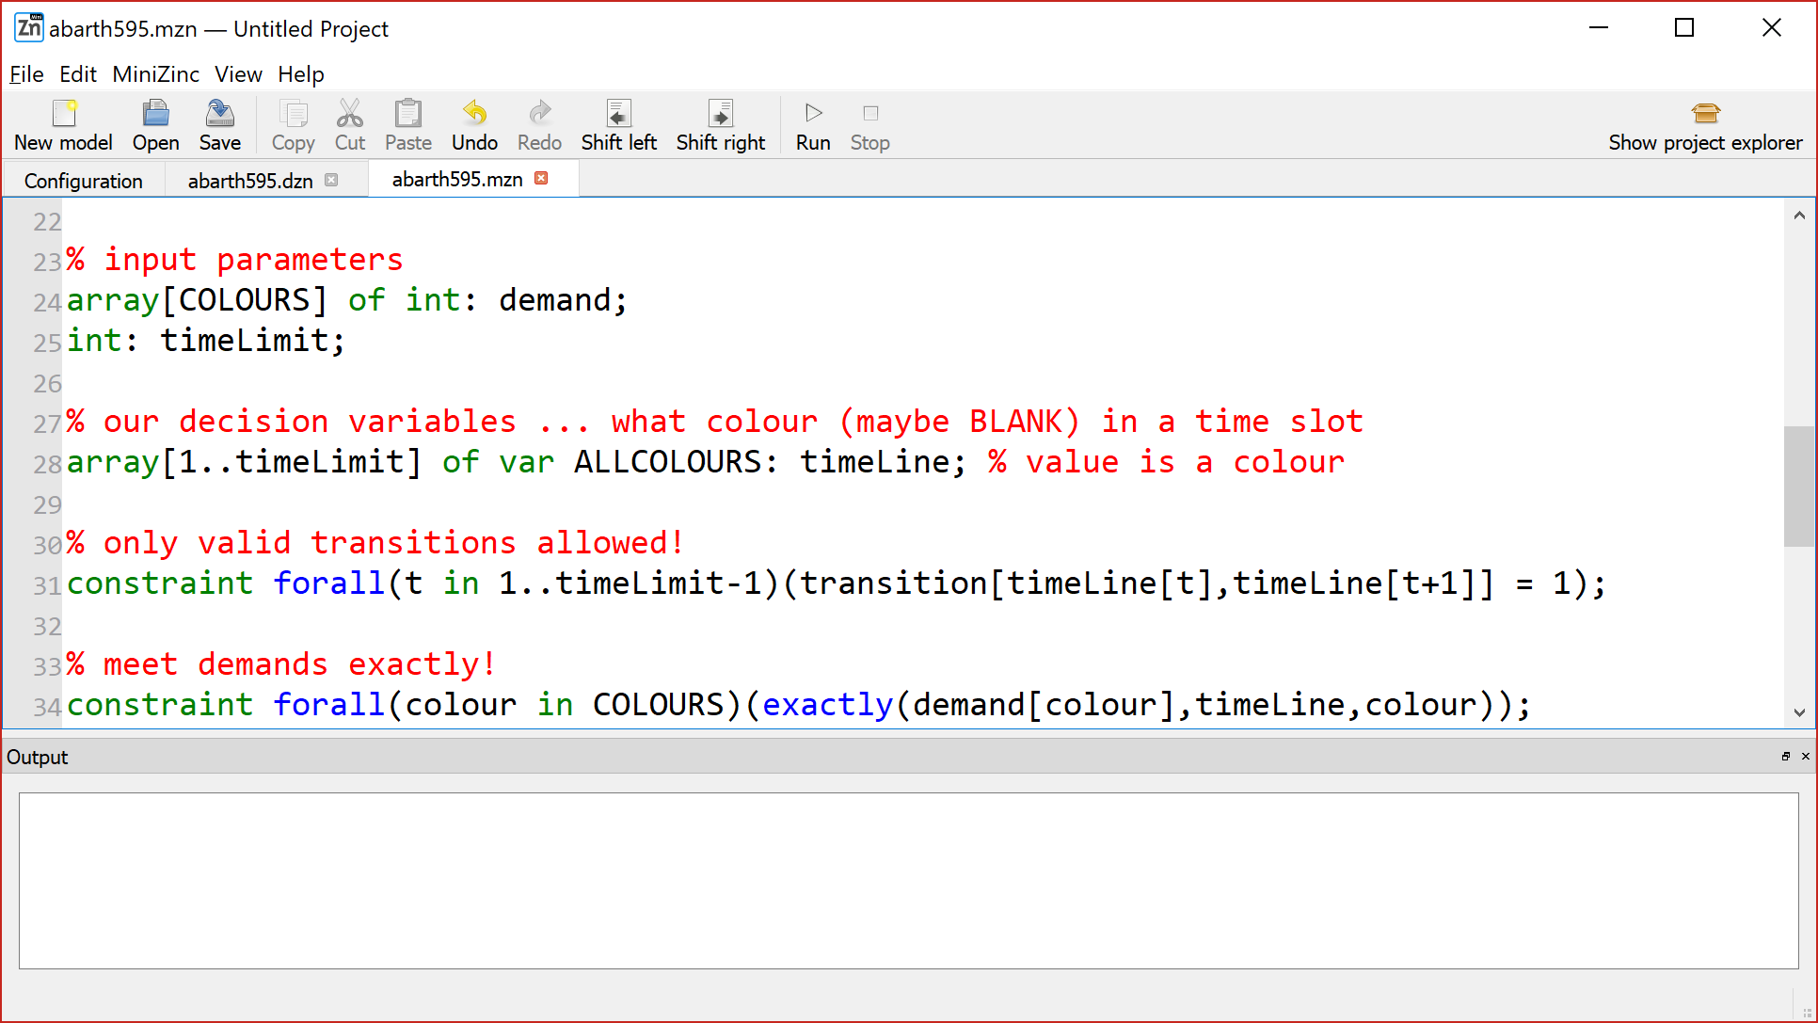
Decision variables …

Slide 18
Decision variables …
timeLine[t] = colour <-> a car of that colour is painted at time t

Slide 20
Colour transitions must be valid …
When we change colours , transitions, they must be valid

Slide 21
Colour transitions must be valid …

Slide 22
Colour transitions must be valid …
Using constrained integer variable as array index!

Slide 23
Colour transitions must be valid …
These are colours!
Using constrained integer variable as array index!

Slide 24
Demand for each colour must be met, exactly !!!!
Meet demand exactly …

Slide 25
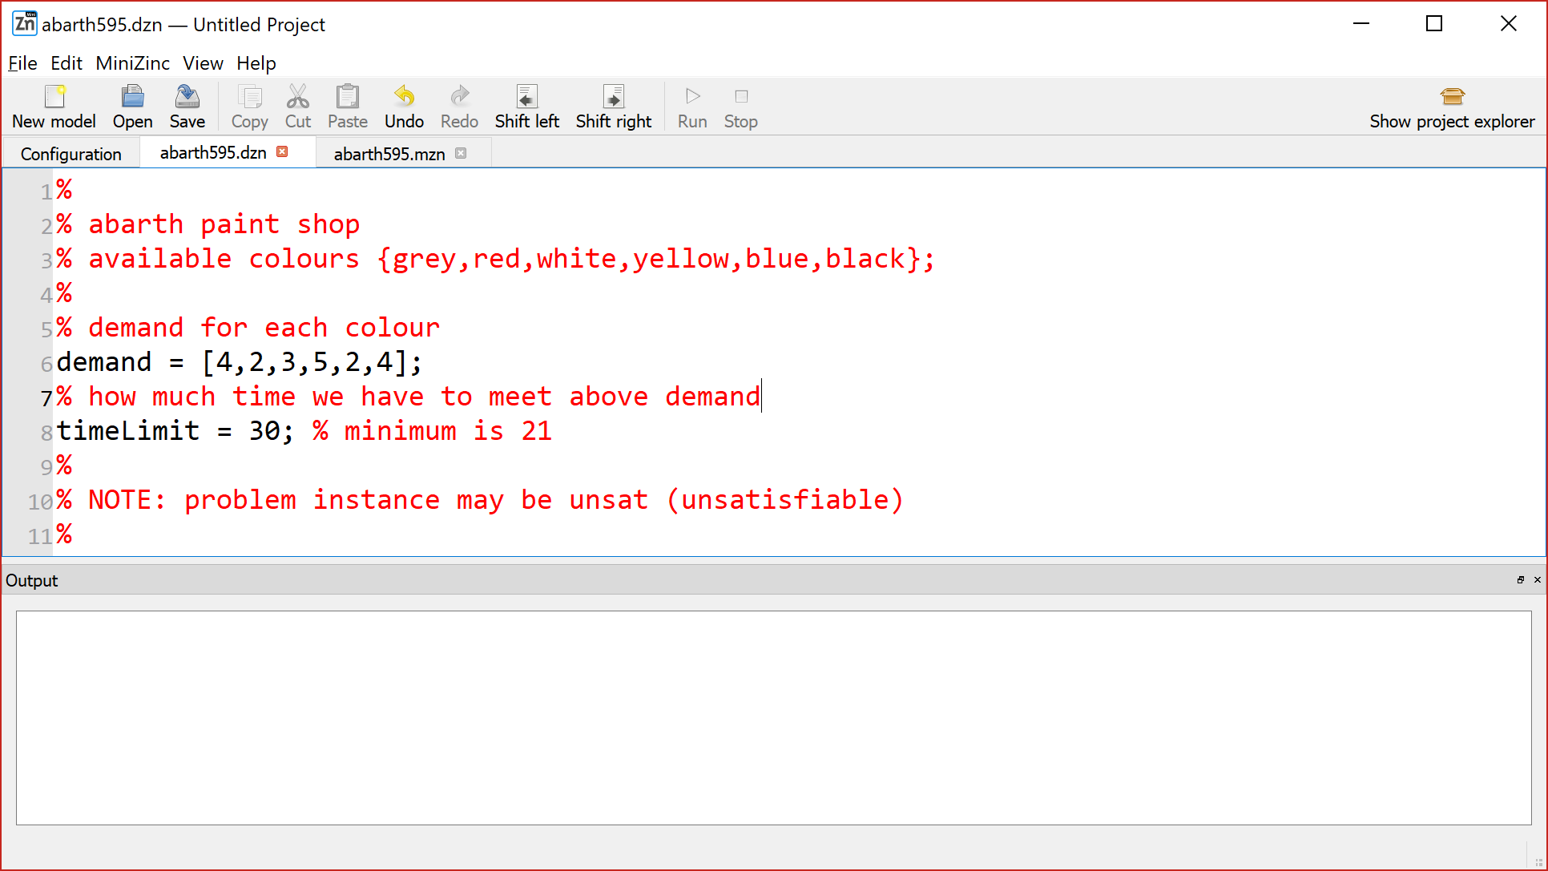
Demand for each colour must be met, exactly !!!!

Slide 26
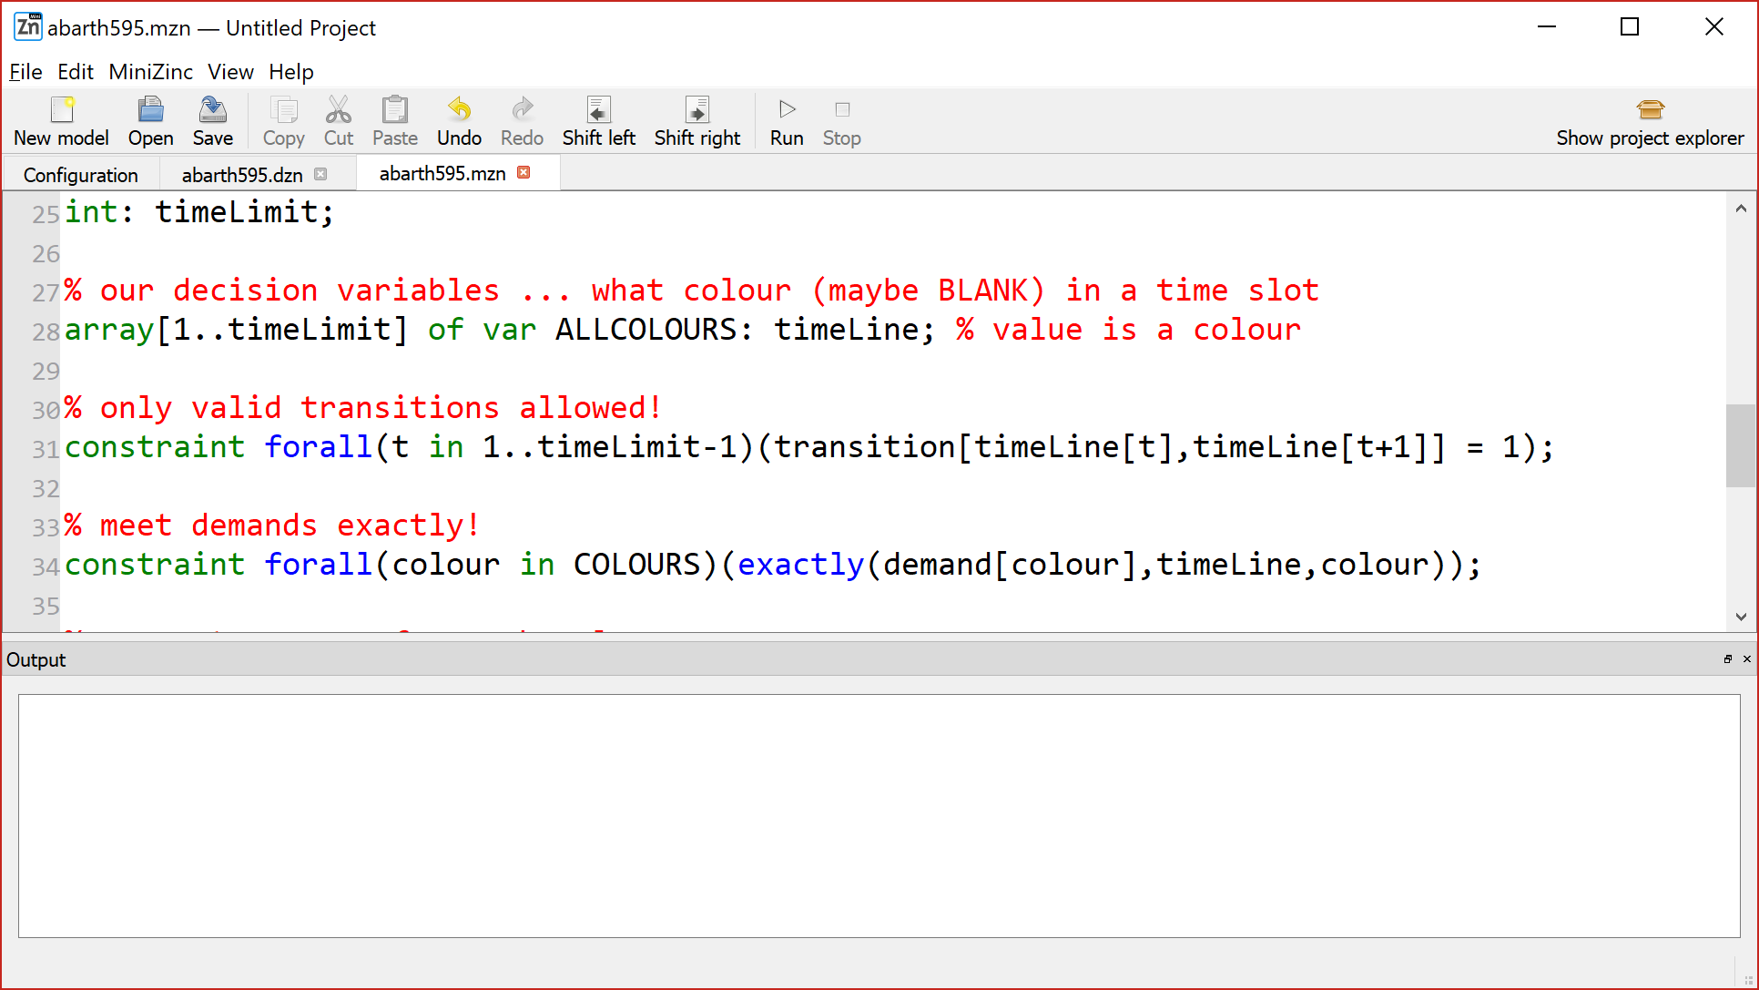
Demand for each colour must be met, exactly !!!!

Slide 27
Demand for each colour must be met, exactly !!!!
NOTE: no demand for BLANK ☺

Slide 28
The maximum run of each colour …

Slide 29
The maximum run of each colour …

Slide 30
The maximum run of each colour …

Slide 31
The maximum run of each colour …

Slide 32
The maximum run of each colour …

Slide 33
The maximum run of each colour …

Slide 34
The maximum run of each colour …

Slide 35
The maximum run of each colour …

Slide 36
The maximum run of each colour …

Slide 37
The maximum run of each colour …

Slide 38
The maximum run of each colour …

Slide 39
The maximum run of each colour …

Slide 40
The maximum run of each colour …

Slide 41
The maximum run of each colour …

Slide 42
The maximum run of each colour …

Slide 43
The maximum run of each colour …

Slide 44
The maximum run of each colour …

Slide 45
The maximum run of each colour …

Slide 46
The maximum run of each colour …

Slide 47
The maximum run of each colour …

Slide 48
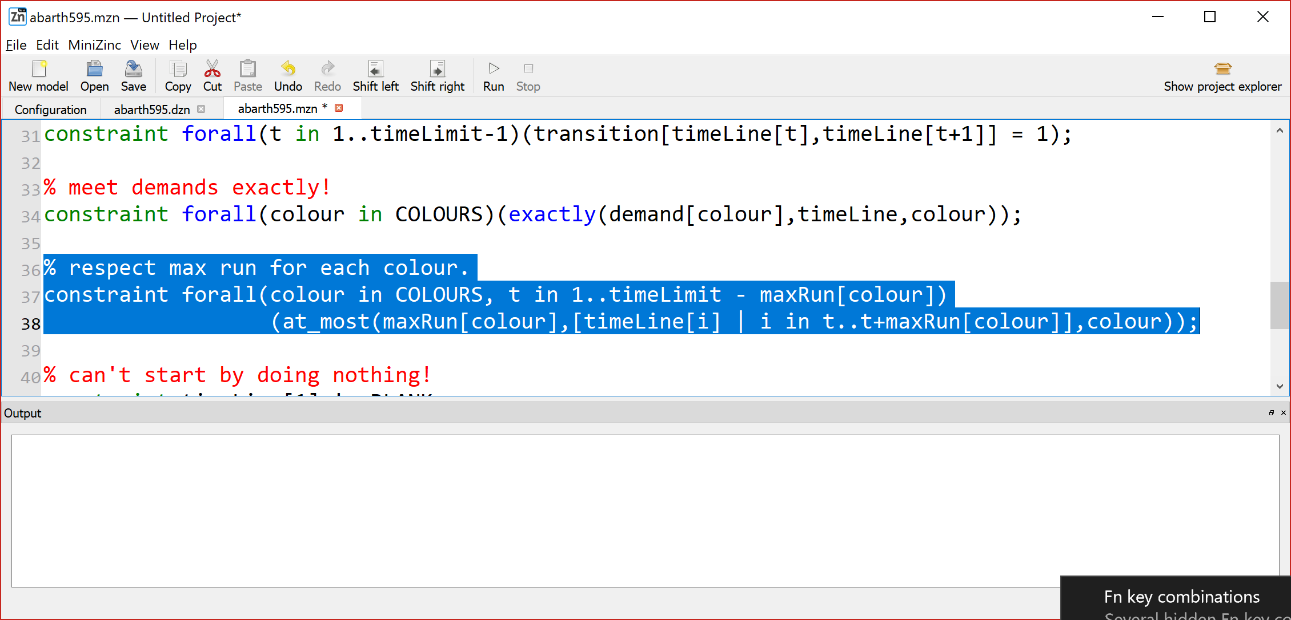
The maximum run of each colour …

Slide 49
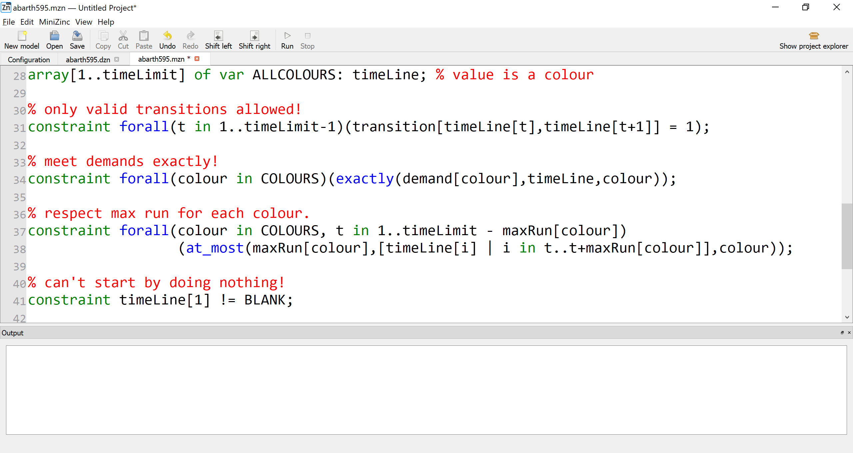
The maximum run of each colour …

Slide 50
The maximum run of each colour …
For each colour, and for each colour the sliding time window …

Slide 51
The maximum run of each colour …
For that colour, and that time window starting at t …
there must be at most maxRun[colour] of that colour!

Slide 52
The maximum run of each colour …
NOTE: on-the-fly array comprehension ☺

Slide 53
Dinnae hing aboot …
Don’t start the day by doing nothing!

Slide 54
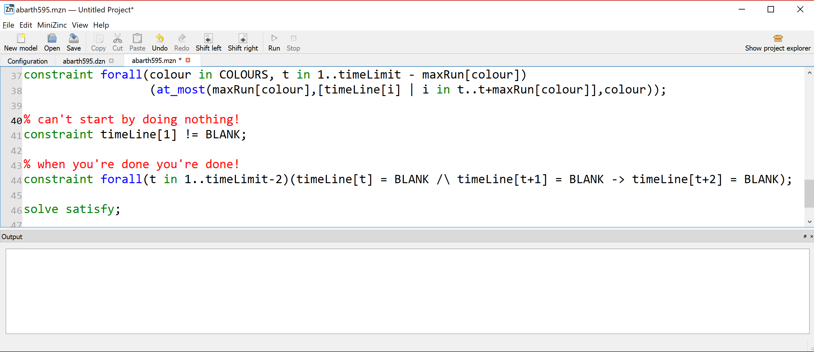
Dinnae hing aboot …

Slide 55
When you’re done you’re done …

Slide 56
When you’re done you’re done …

Slide 58
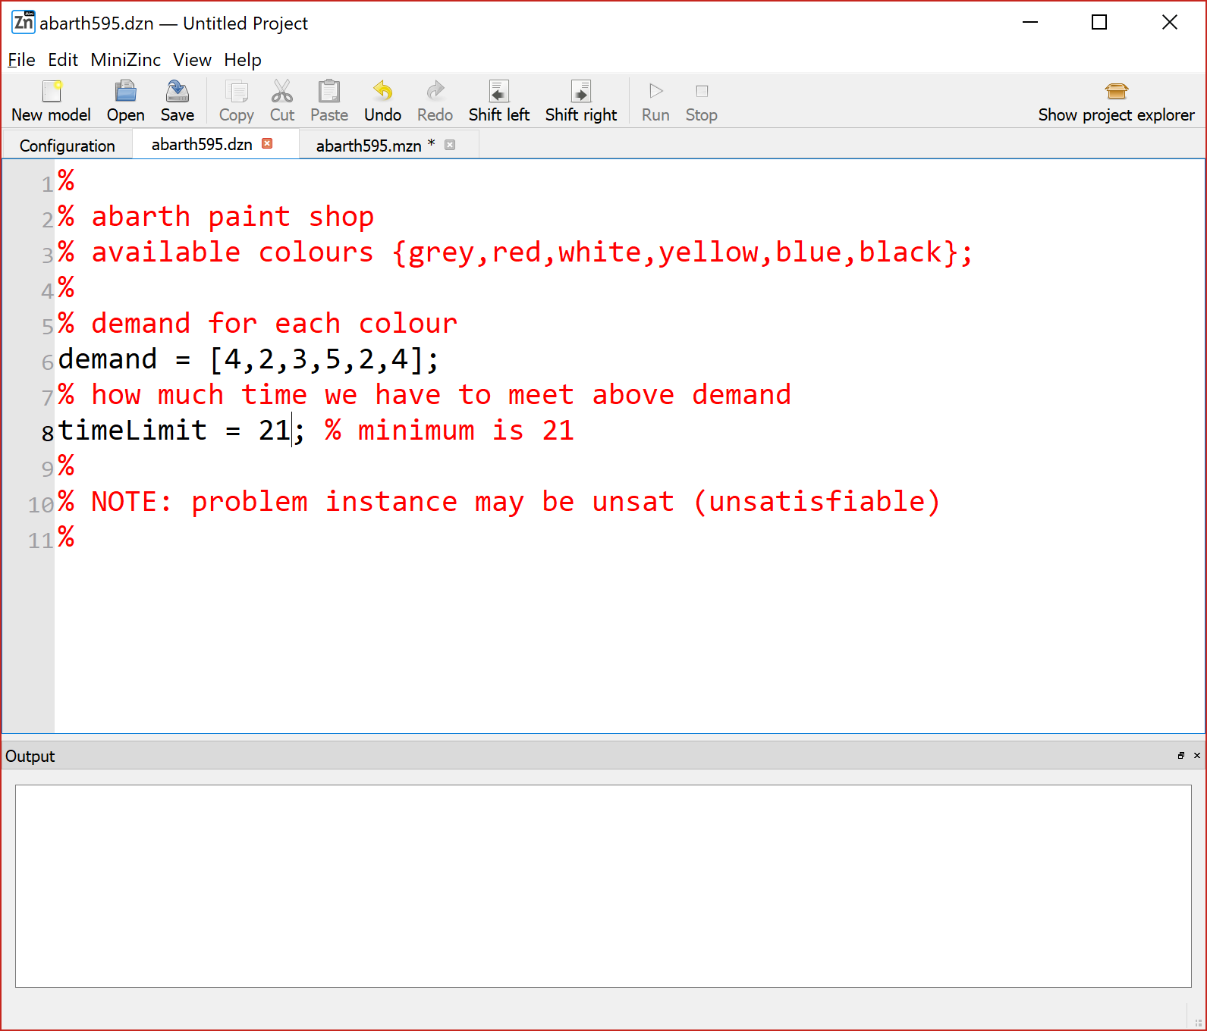

Slide 60
Can you think of a different model?

Slide 61
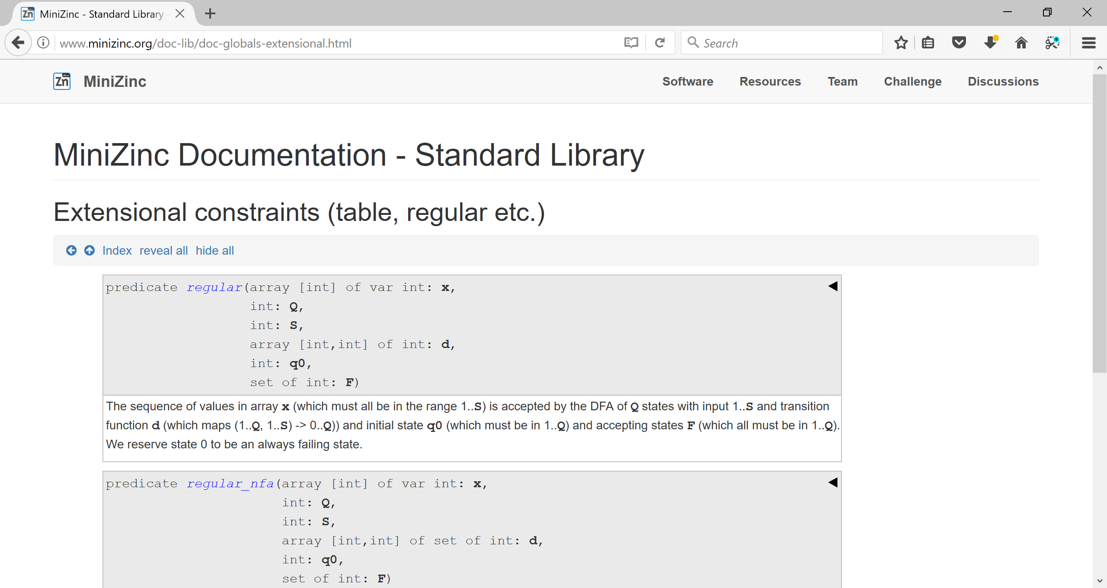

Slide 62
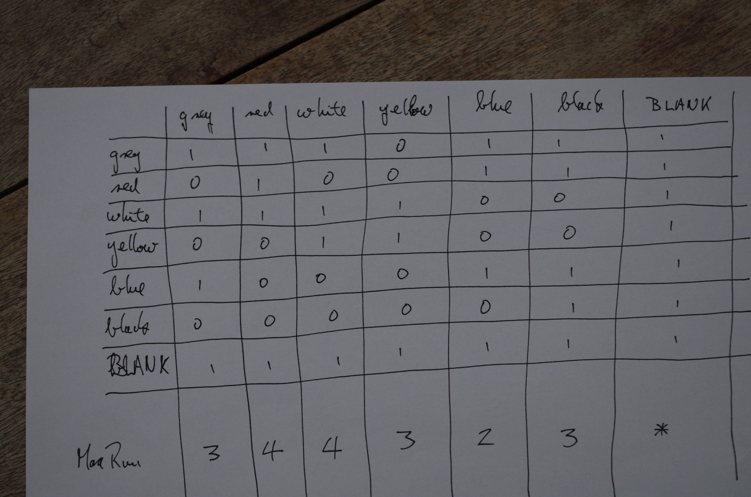

Slide 63
