Slide 1
weeSeepy©
intro

Slide 2
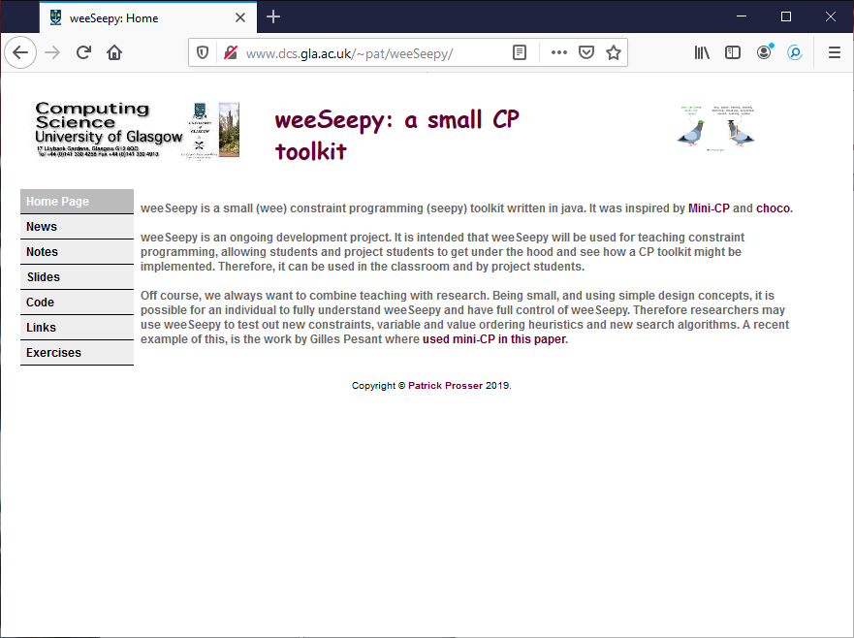

Slide 3
The goal: to implement a small CP toolkit , making the simplest
possible design decisions, and use it for teaching and research

Slide 4
revise
variables
domain
constraints
problem
reversibles
reify
search
propagation
heuristics

Slide 5
Almost feel like you have to implement everything before you even start!
revise
variables
domain
constraints
problem
reversibles
reify
search
propagation
heuristics

Slide 6
Inspired by miniCP and influenced by choco

Slide 8
Where to start?

Slide 9
Domains and reversible integers

