Slide 1
Reversible Domains

Slide 2
First we start with a data structure you might not have heard of …

Slide 3
sparse sets

Slide 4
Consider this:
A variable has a domain of values
This is fixed at the top of search
Going down a branch of search the domain may decrease
Going down a branch in search a domain never increases
On a backtrack (up a branch) deleted values might be returned to the domain
The sparse set goes some way to allowing this

Slide 5
We represent a (unordered) set using two arrays and one pointer

Slide 6
We represent a (unordered) set using two arrays and one pointer
value[i] = x : the i^{th} element of the set is x

Slide 7
We represent a (unordered) set using two arrays and one pointer
value[i] = x : the i^{th} element of the set is x
location[x] = i: x is the i^{th} value in the set

Slide 8
We represent a (unordered) set using two arrays and one pointer
value[i] = x : the i^{th} element of the set is x
location[x] = i: x is the i^{th} value in the set
last: is the position of the last value in the set

Slide 9
We represent a (unordered) set using two arrays and one pointer
value[i] = x : the i^{th} element of the set is x
location[x] = i: x is the i^{th} value in the set
last: is the position of the last value in the set
Values are removed from the set by swapping, and returned by resetting a pointer

Slide 10
last = 4
location
0 | 1 | 2 | 3 | 4
0 | 1 | 2 | 3 | 4
new Domain(pb,0,4)
value

Slide 11
last = 4
location
0 | 1 | 2 | 3 | 4
0 | 1 | 2 | 3 | 4
new Domain(pb,0,4)
value
last = 3
location
0 | 1 | 2 | 4 | 3
0 | 1 | 2 | 4 | 3
remove(3)
value

Slide 12
last = 4
location
0 | 1 | 2 | 3 | 4
0 | 1 | 2 | 3 | 4
new Domain(pb,0,4)
value
last = 3
location
0 | 1 | 2 | 4 | 3
0 | 1 | 2 | 4 | 3
remove(3)
value
We have swapped the values 3 and 4, i.e. the value 3 with the last value in the set
value: 4 goes where 3 was
location: the value 4 is now in the 3d position of the set
location: the value 3 is now in the 4th position of the set
last position in the set is position 3
The value 3 is not in the set!

Slide 13
last = 4
location
0 | 1 | 2 | 3 | 4
0 | 1 | 2 | 3 | 4
new Domain(pb,0,4)
value
last = 3
location
0 | 1 | 2 | 4 | 3
0 | 1 | 2 | 4 | 3
remove(3)
value
last = 2
location
0 | 3 | 2 | 4 | 1
0 | 4 | 2 | 1 | 3
remove(1)
value

Slide 14
last = 4
location
0 | 1 | 2 | 3 | 4
0 | 1 | 2 | 3 | 4
new Domain(pb,0,4)
value
last = 3
location
0 | 1 | 2 | 4 | 3
0 | 1 | 2 | 4 | 3
remove(3)
value
last = 2
location
0 | 3 | 2 | 4 | 1
0 | 4 | 2 | 1 | 3
remove(1)
value
location of value 0 is 0
location of value 1 is 3
location of value 2 is 2
location of value 3 is 4
location of value 4 is 1

Slide 15
last = 4
location
0 | 1 | 2 | 3 | 4
0 | 1 | 2 | 3 | 4
new Domain(pb,0,4)
value
last = 3
location
0 | 1 | 2 | 4 | 3
0 | 1 | 2 | 4 | 3
remove(3)
value
last = 2
location
0 | 3 | 2 | 4 | 1
0 | 4 | 2 | 1 | 3
remove(1)
value
location of value 0 is 0
location of value 1 is 3
location of value 2 is 2
location of value 3 is 4
location of value 4 is 1
last position is 2

Slide 16
last = 4
location
0 | 1 | 2 | 3 | 4
0 | 1 | 2 | 3 | 4
new Domain(pb,0,4)
value
last = 3
location
0 | 1 | 2 | 4 | 3
0 | 1 | 2 | 4 | 3
remove(3)
value
last = 2
location
0 | 3 | 2 | 4 | 1
0 | 4 | 2 | 1 | 3
remove(1)
value
location of value 0 is 0
location of value 1 is 3
location of value 2 is 2
location of value 3 is 4
location of value 4 is 1
last position is 2

Slide 17
last = 4
location
0 | 1 | 2 | 3 | 4
0 | 1 | 2 | 3 | 4
new Domain(pb,0,4)
value
last = 3
location
0 | 1 | 2 | 4 | 3
0 | 1 | 2 | 4 | 3
remove(3)
value
last = 2
location
0 | 3 | 2 | 4 | 1
0 | 4 | 2 | 1 | 3
remove(1)
value
location of value 0 is 0
location of value 1 is 3
location of value 2 is 2
location of value 3 is 4
location of value 4 is 1
last position is 2
Any thing beyond position 2 is not in the set

Slide 18
last = 4
location
0 | 1 | 2 | 3 | 4
0 | 1 | 2 | 3 | 4
new Domain(pb,0,4)
value
last = 3
location
0 | 1 | 2 | 4 | 3
0 | 1 | 2 | 4 | 3
remove(3)
value
last = 2
location
0 | 3 | 2 | 4 | 1
0 | 4 | 2 | 1 | 3
remove(1)
value
last = 1
location
2 | 3 | 0 | 4 | 1
2 | 4 | 0 | 1 | 3
remove(0)
value

Slide 19
Complexity:
remove(x) is O(1)
a swap operation
contains(x) is O(1)
is location[x] <= last?
removeAllBut(x) is O(1)
swap between x and what is in location 0
set last to be 0
used for instantiation of a variable
removeBelow(x) is O(n) (amortised O(1))
removeAbove(x) is O(n) (amortised O(1))
min and max as above …

Slide 20
How could I go back to the way things were … for example back to where we
were before we did all those removals?
last = 1
location
2 | 3 | 0 | 4 | 1
2 | 4 | 0 | 1 | 3
value

Slide 21
How could I go back to the way things were … for example back to where we
were before we did all those removals?
That’s how!
last = 4
location
2 | 3 | 0 | 4 | 1
2 | 4 | 0 | 1 | 3
value

Slide 22
How could I go back to the way things were … for example back to where we
were before we did all those removals?
O(1)
last = 4
location
2 | 3 | 0 | 4 | 1
2 | 4 | 0 | 1 | 3
value

Slide 23
reversible variables

Slide 24
reversible variables
It’s all done with stacks

Slide 25
A reversible variable & a reversible integer

Slide 26
A reversible variable & a reversible integer
A stack of “worlds”

Slide 27
A reversible variable & a reversible integer
A trail (history) of values

Slide 28
A reversible variable & a reversible integer

Slide 29
A reversible variable & a reversible integer
Backtrack ☺

Slide 30
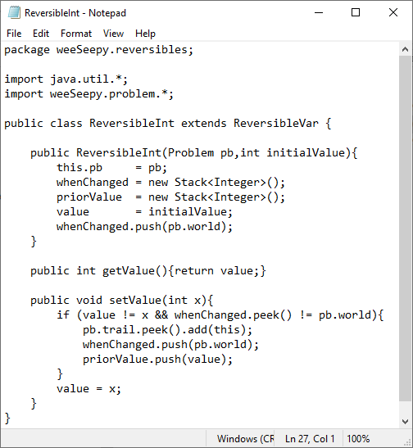
A reversible variable & a reversible integer

Slide 31
A reversible variable & a reversible integer

Slide 32
A reversible variable & a reversible integer

Slide 33
A reversible variable & a reversible integer
pb is a Problem and world is just an integer, nothing fancy.
We might think of “world” as depth in search.
Top of search is world zero.

Slide 34
A reversible variable & a reversible integer

Slide 35
A reversible variable & a reversible integer

Slide 36
A reversible variable & a reversible integer
Is this a new (different) value and is it the first time the value has changed in this “world”?

Slide 37
A reversible variable & a reversible integer
If “yes” … the problem (pb) has a trail (and that’s a stack) push this reversible integer
onto the list that is at the top of the trail (this is the list of reversible that have changed
in this world).

Slide 38
A reversible variable & a reversible integer
If “yes” … on this reversible integer record when (what world) it changed and save of f
the value it had before making the change (yet another stack)

Slide 39
A reversible variable & a reversible integer
Change that value (off coarse)!

Slide 40
A problem is a problem is a problem

Slide 41
A problem (from the point of view of reversibles & worlds)

Slide 42
A problem (from the point of view of reversibles & worlds)

Slide 43
A problem (from the point of view of reversibles & worlds)

Slide 44
A problem (from the point of view of reversibles & worlds)

Slide 45
A problem (from the point of view of reversibles & worlds)
When we are going to try something … that might not work

Slide 46
A problem (from the point of view of reversibles & worlds)
Undoing all changes! Typical use is a backtrack.

Slide 47
A constrained integer variable, IntVar, is then …

Slide 48
A constrained integer variable, IntVar, is then …

Slide 49
A constrained integer variable, IntVar, is then …
But more of that later

Slide 50
Implementation of Domain

Slide 51
d.remove(x)

Slide 52
d.remove(x)

Slide 53
d.remove(x)

Slide 54
d.remove(x)
Amotrized O(1)

Slide 55
d.removeAllBut(x)

Slide 56
d.removeAllBut(x)

Slide 57
d.removeAllBut(x)
O(1)

Slide 58
d.removeBelow(x)

Slide 59
d.removeBelow(x)

Slide 60
d.removeBelow(x)
Amortized O(m)

Slide 61
d.removeAbove(x)
Amortized O(m)

Slide 62
There are only 3 places weeSeepy throws exceptions
In Domain: a domain becomes empty
In Problem: search finds a solution
In IntVar: attempt to get the value of an uninstantiated variable

Slide 64
Code , notes, papers

Slide 65
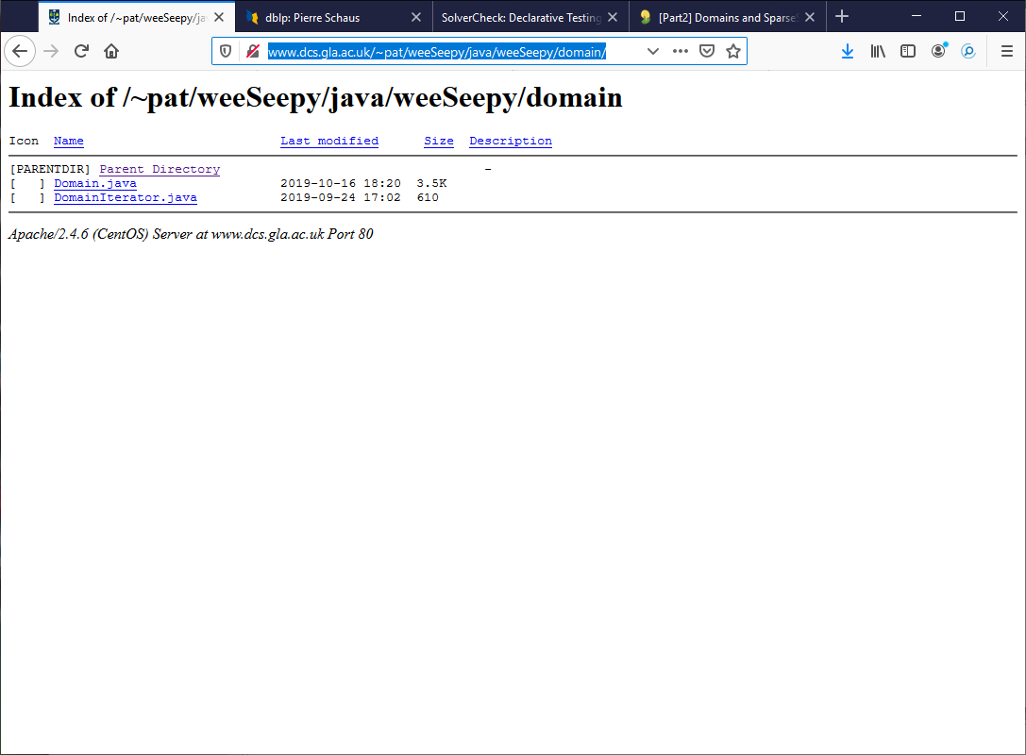

Slide 66
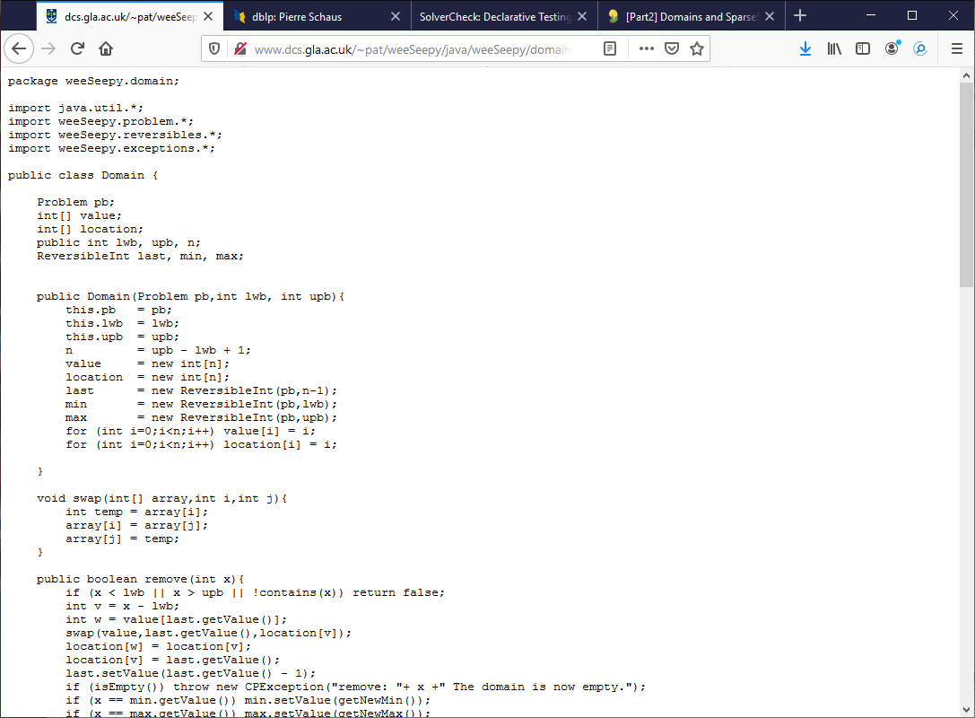

Slide 67
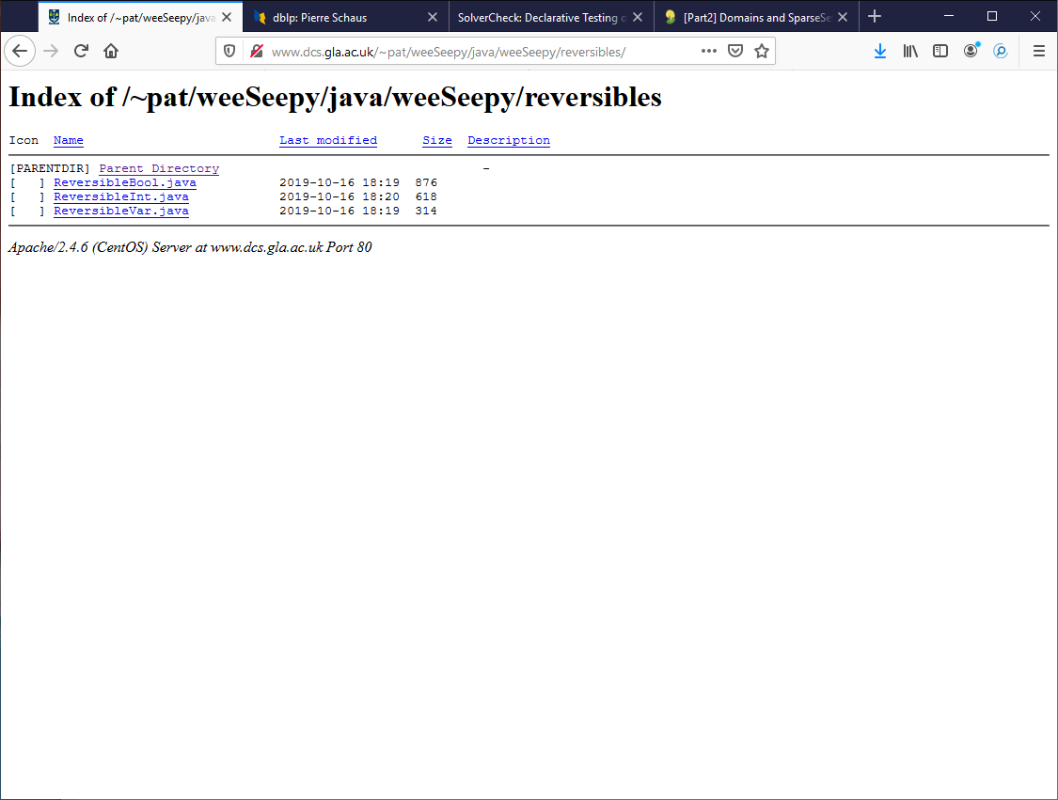

Slide 69
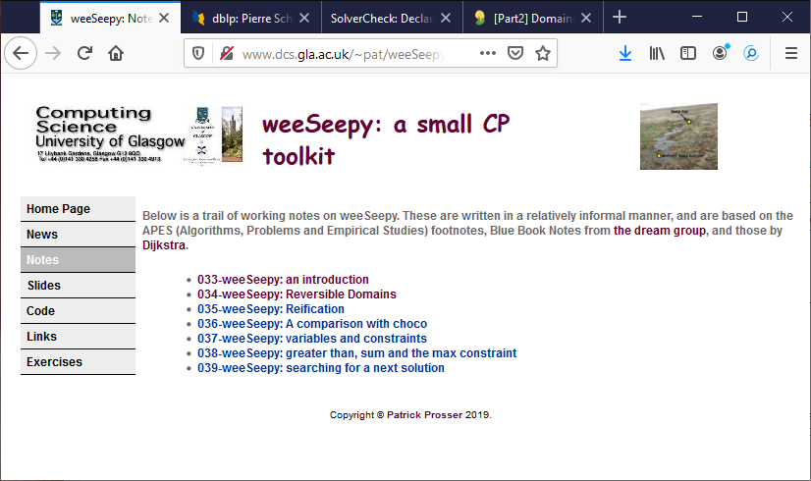
Also see notes 033 and 034

