Slide 1
Variables and Constraints

Slide 2
A constrained integer variable is called an IntVar
It has a domain of values
It has a list of constraints
The variable is in the scope of those constraints

Slide 4
size()
contains(x)
remove(x)
instantiate(x)
min()
max()
removeAbove(x)
removeBelow(x)
getValue()
getLwb()
getUpb()

Slide 6
The only exception in IntVar

Slide 8
change removal

Slide 9
change instantiate

Slide 11
Do we need to describe constraints before variables or variables before constraints?

Slide 12
A quick intro to constraints

Slide 15
Revising a constraint
That is, doing all necessary propagations

Slide 16
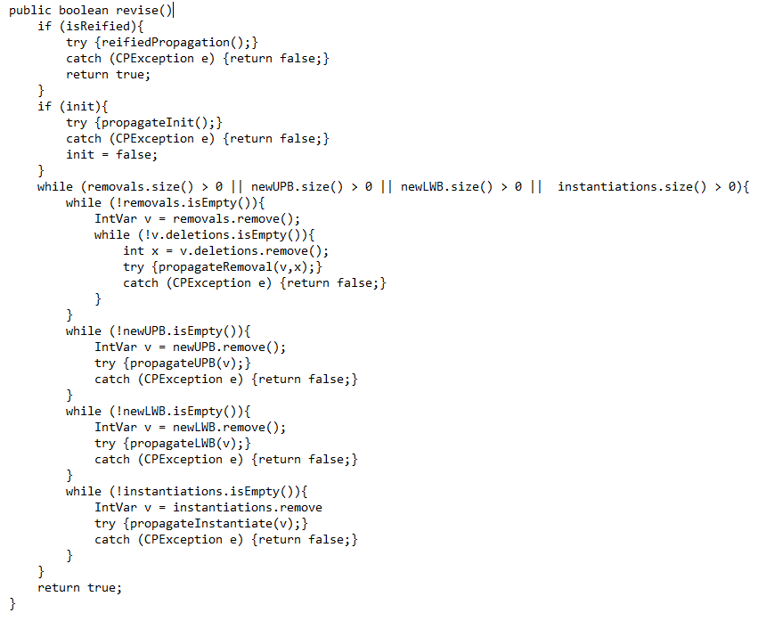

Slide 17
Ignore for time being (the next 2 years?)

Slide 18
First time revised?

Slide 19
While the queues of changes on this constraint are not empty

Slide 20
Propagate all removals from the domains of variables in the scope of this constraint

Slide 21
Propagate all removals from the domains of variables in the scope of this constraint

Slide 22
Propagate all removals from the domains of variables in the scope of this constraint
Remove a variable v from the queue of variables on this constraint that have lost values

Slide 23
Propagate all removals from the domains of variables in the scope of this constraint
Propagate the consequences of the deletions of values from v wrt this constraint

Slide 24
Propagate all decreases in upper bounds of domains of variables in the scope of this constraint

Slide 25
Propagate all increases in lower bounds of domains of variables in the scope of this constraint

Slide 26
Propagate all instantiatons of variables in the scope of this constraint

Slide 27
… and the Problem holds it all together, thus …

Slide 28
… and the Problem holds it all together, thus …

Slide 29
Therefore, it comes together like this …

Slide 30
Therefore, it comes together like this …
A variable’s domain is changed
The constraints of that variable are added to the revision queue
A constraint is taken from the revision queue
The constraint is revised
This may reduce the domains of variables in that constraint
This causes more constraints to be added to the revision queue
If the revision queue is not empty go back to step 3.

Slide 31
Therefore, it comes together like this …
A variable’s domain is changed
The constraints of that variable are added to the revision queue
A constraint is taken from the revision queue
The constraint is revised
This may reduce the domains of variables in that constraint
This causes more constraints to be added to the revision queue
If the revision queue is not empty go back to step 3.
This terminates because domains can only stay the same or reduce in size.
If all domains are non-empty and no change takes place the queue empties
and we are done.
If any domain becomes empty , at step 5, we are done and in a bad world.

Slide 32
This might be thought of as some kind of chaotic iteration

Slide 33
And now, an actual constraint

Slide 34
The NotEquals constraint

Slide 35
A summation constraint

Slide 36
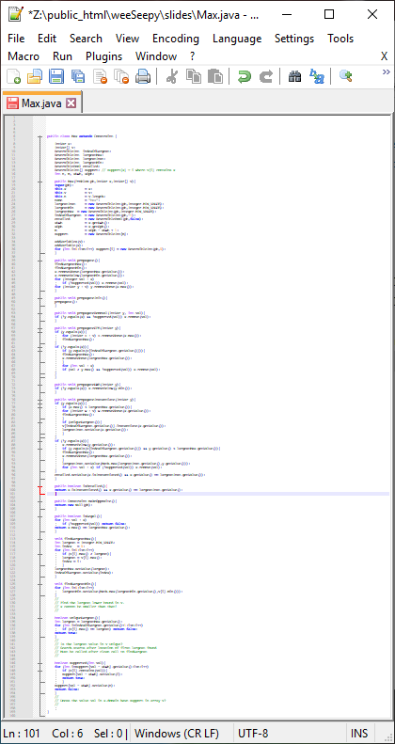
The Max constraint

Slide 37
The Max constraint
About 150 lines of code

Slide 38
… and now we should look quickly at search
(now that everything is in place)

