Slide 1
CP2016

Slide 4
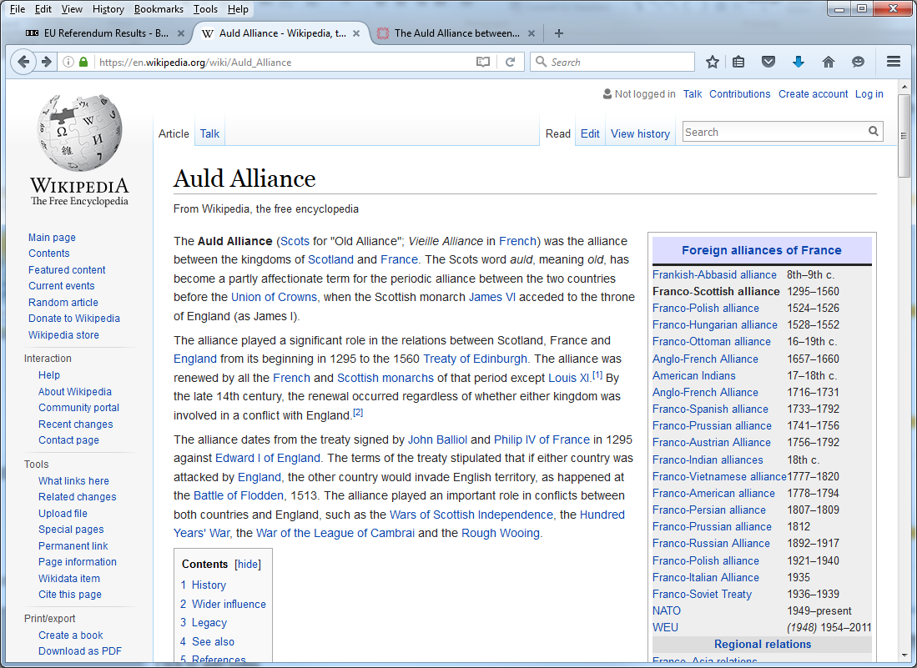

Slide 8
The original alliance that granted dual citizenship in both countries was eventually revoked by the French government in 1903.

