Slide 1
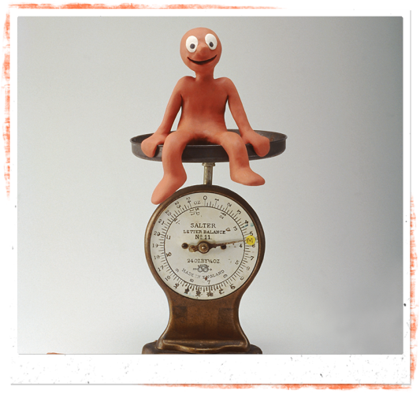
Morphing between SM and SR
What will happen?

Slide 2
SM always has a solution, SR (and SRI) might not

Slide 3
SM always has a solution, SR (and SRI) might not
What happens if we mix SM & SRI?

Slide 4
From a CP perspective SM is a special case of SR.

Slide 5
From a CP perspective SM is a special case of SR.
Given n agents, SM has n/2 men, n/2 women and n.n/4 edges

Slide 6
From a CP perspective SM is a special case of SR.
Given n agents, SM has n/2 men, n/2 women and n.n/4 edges
We can create an instance of SRI with n agents and n.n/4 edges

Slide 7
From a CP perspective SM is a special case of SR.
Given n agents, SM has n/2 men, n/2 women and n.n/4 edges
We can create an instance of SRI with n agents and n.n/4 edges
Solve using the CPAIOR constraint model

Slide 8
From a CP perspective SM is a special case of SR.
Given n agents, SM has n/2 men, n/2 women and n.n/4 edges
We can create an instance of SRI with n agents and n.n/4 edges
Solve using the CPAIOR constraint model
Count number of solutions for each instance

Slide 9
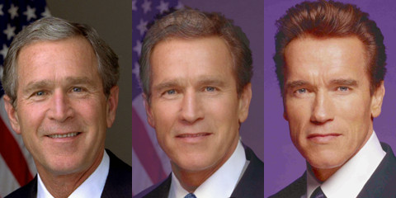
morphing

Slide 10
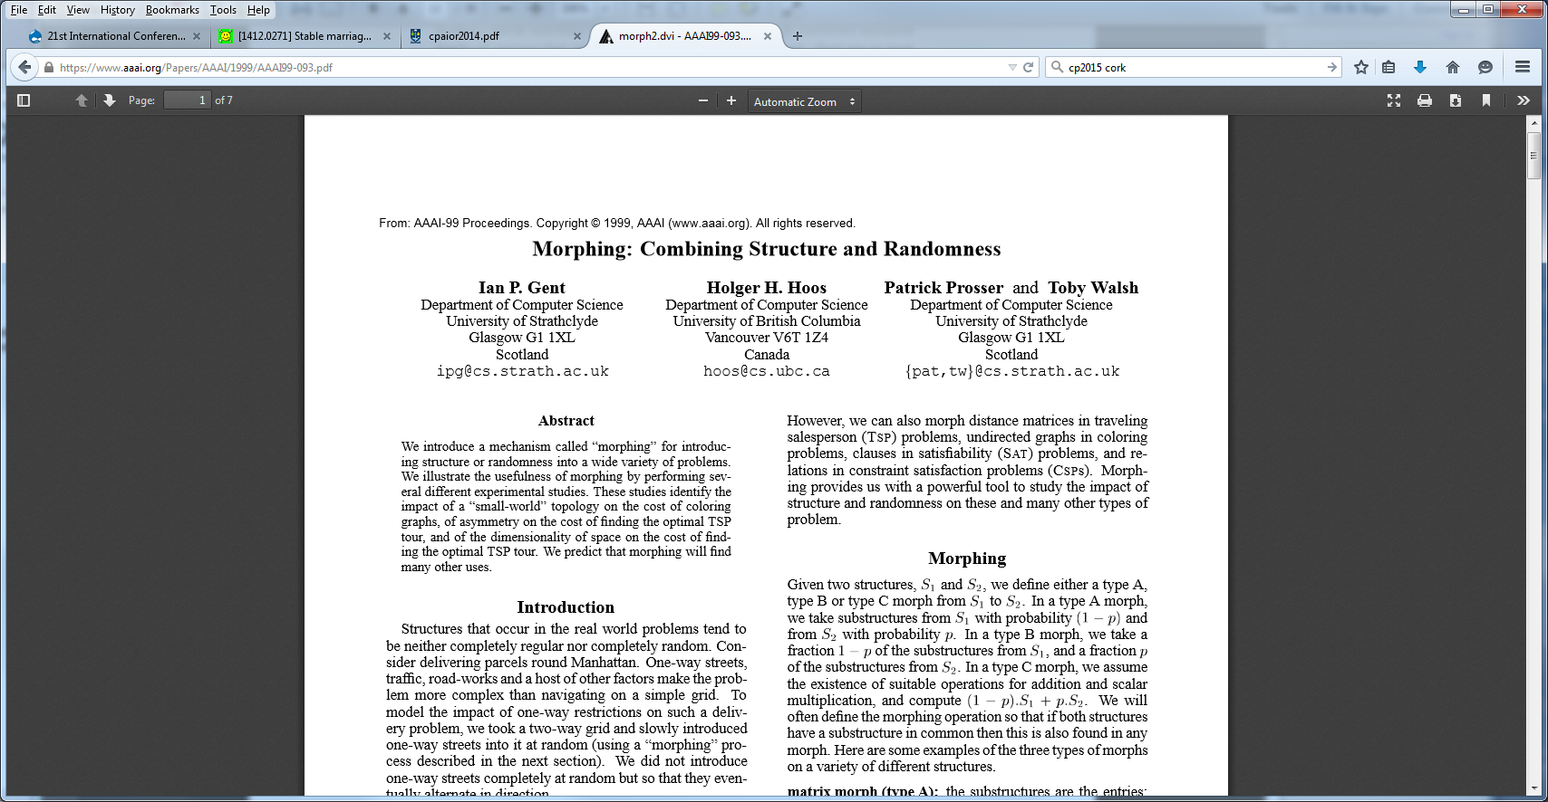

Slide 12
Simple instructions on how to create an SM/SRI morph

Slide 13
Given a clique, Knuth shuffle the edges

Slide 14
Given a clique, Knuth shuffle the edges
Let E1 be the first n.n/4 edges. This is our SRI instance

Slide 15
Given a clique, Knuth shuffle the edges
Let E1 be the first n.n/4 edges. This is our SRI instance
Let E2 be the n.n/4 edges in the complete bipartite graph, the SM instance

Slide 16
Given a clique, Knuth shuffle the edges
Let E1 be the first n.n/4 edges. This is our SRI instance
Let E2 be the n.n/4 edges in the complete bipartite graph, the SM instance
Let Ex be the intersection of E1 and E2

Slide 17
Given a clique, Knuth shuffle the edges
Let E1 be the first n.n/4 edges. This is our SRI instance
Let E2 be the n.n/4 edges in the complete bipartite graph, the SM instance
Let Ex be the intersection of E1 and E2
Let Emix be Ex U select(p,E1-Ex) U select(1-p,E2-Ex)

Slide 18
Given a clique, Knuth shuffle the edges
Let E1 be the first n.n/4 edges. This is our SRI instance
Let E2 be the n.n/4 edges in the complete bipartite graph, the SM instance
Let Ex be the intersection of E1 and E2
Let Emix be Ex U select(p,E1-Ex) U select(1-p,E2-Ex)
Knuth shuffle adjacency lists and print

Slide 19
Given a clique, Knuth shuffle the edges
Let E1 be the first n.n/4 edges. This is our SRI instance
Let E2 be the n.n/4 edges in the complete bipartite graph, the SM instance
Let Ex be the intersection of E1 and E2
Let Emix be Ex U select(p,E1-Ex) U select(1-p,E2-Ex)
Knuth shuffle adjacency lists and print
When p=0 we get SM
When p = 1 we get SRI
When 0<p<1 we get a mix of SM & SRI

Slide 20
So?

Slide 21
Question:
When an SM instances becomes just a wee
bit like SRI will it start to behave a lot like SRI?

Slide 22
Use the CP model for SRI and do experiments

Slide 23
What shape do you expect?
?
% sat
SM
SRI

Slide 24
What shape do you expect?
% sat
SM
SRI

Slide 25
What shape do you expect?
% sat
SM
SRI

Slide 26
What shape do you expect?
% sat
SM
SRI

Slide 27
What shape do you expect?
% sat
SM
SRI

Slide 28
N=100, sample size 100

Slide 29
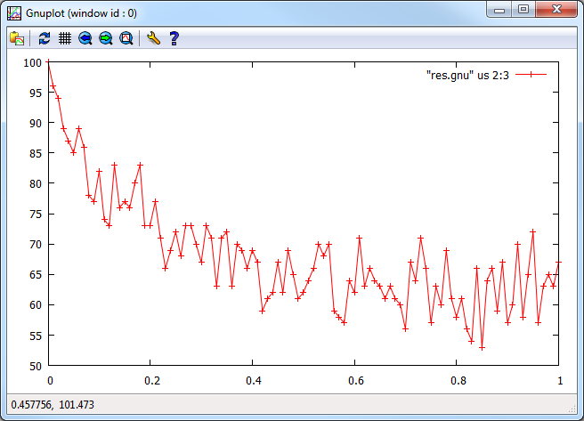
N=100, sample size 100
% sat

Slide 30
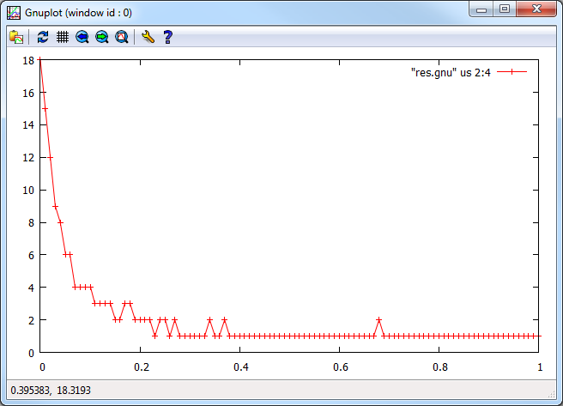
N=100, sample size 100
Mean solutions per instance

Slide 31
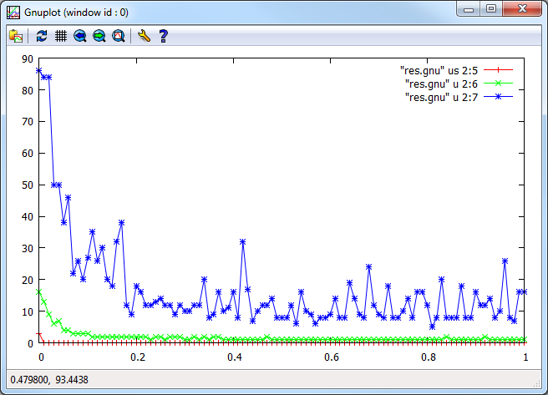
N=100, sample size 100
min/med/max solutions per instance

Slide 32
To do
Vary n
Increase sample size (to 1000)
?

Slide 33
