Slide 1
SM & SR with restricted edges
Empirical Study
(first steps)

Slide 5
CPAIOR: reuse & remodel

Slide 6
SM as instance of SRI

Slide 7
For simplicity, just deal with forbidden edges
SRI & SMI

Slide 8
Problem Generators

Slide 9
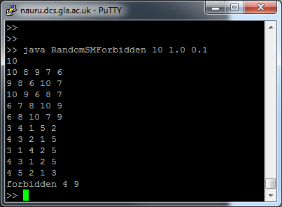
Problem Generators

Slide 10
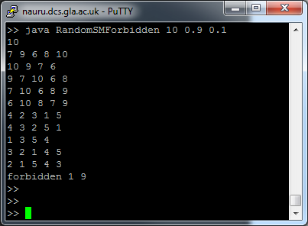
Problem Generators

Slide 11
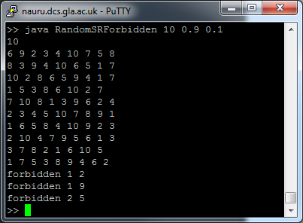
Problem Generators

Slide 12
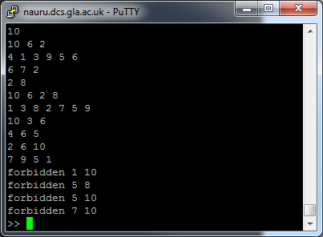
Problem Generators

Slide 13
The Models

Slide 14
SRMinForbidden.java

Slide 15
SRMinForbidden.java

Slide 16
SRMinForbidden.java
Easy coding

Slide 17
SRMinForbidden.java
Efficient constraint

Slide 18
MinBPSRForbidden.java

Slide 19
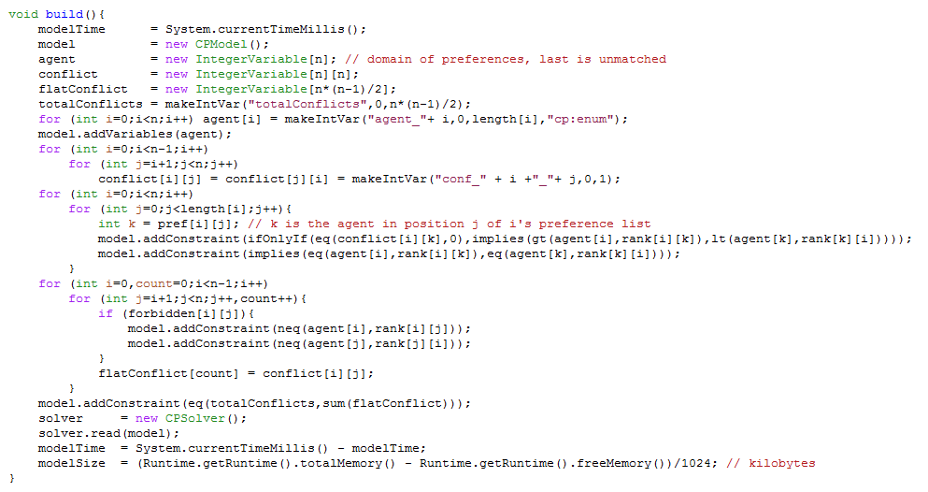
MinBPSRForbidden.java

Slide 20
MinBPSRForbidden.java

Slide 21
MinBPSRForbidden.java
Inefficient constraint

Slide 22
MinBPSRForbidden.java
Forbidden is forbidden!

Slide 23
MinBPSRForbidden.java

Slide 24
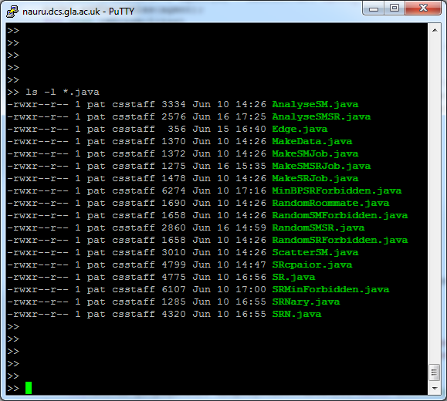
Code to create jobs to create data,
Code to create jobs for experiments,
Code to analyse results from experiments

Slide 25
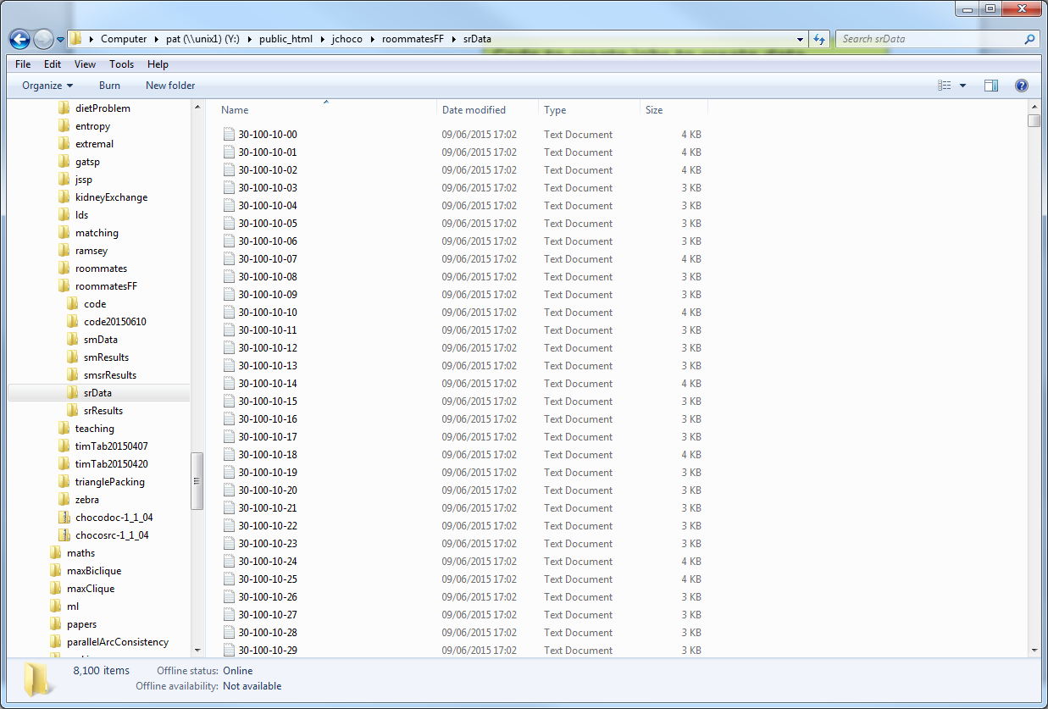

Slide 26
SR instance 30-100-70-60

Slide 27
SR result 30-100-70-60

Slide 28
Summary of Results
Lots more to do, just scratched the surface

Slide 29
Summary of Results
Lots more to do, just scratched the surface
MinBP* is really hard

Slide 30
Summary of Results
Lots more to do, just scratched the surface
MinBP* is really hard
SRMinBP is really easy …

Slide 31
Summary of Results
Lots more to do, just scratched the surface
MinBP* is really hard
SRMinBP is really easy … because instances have few solutions

Slide 32
Summary of Results
Lots more to do, just scratched the surface
MinBP* is really hard
SRMinBP is really easy … because instances have few solutions
Problem generation with forced and forbidden edges is ill defined

Slide 33
Summary of Results
Lots more to do, just scratched the surface
MinBP* is really hard
SRMinBP is really easy … because instances have few solutions
Problem generation with forced and forbidden edges is ill defined
Need to make MinBP* more efficient

Slide 34
Summary of Results
Lots more to do, just scratched the surface
MinBP* is really hard
SRMinBP is really easy … because instances have few solutions
Problem generation with forced and forbidden edges is ill defined
Need to make MinBP* more efficient
Lots more to do, just scratched the surface

