Slide 1
CP2014: Teaching CP

Slide 2
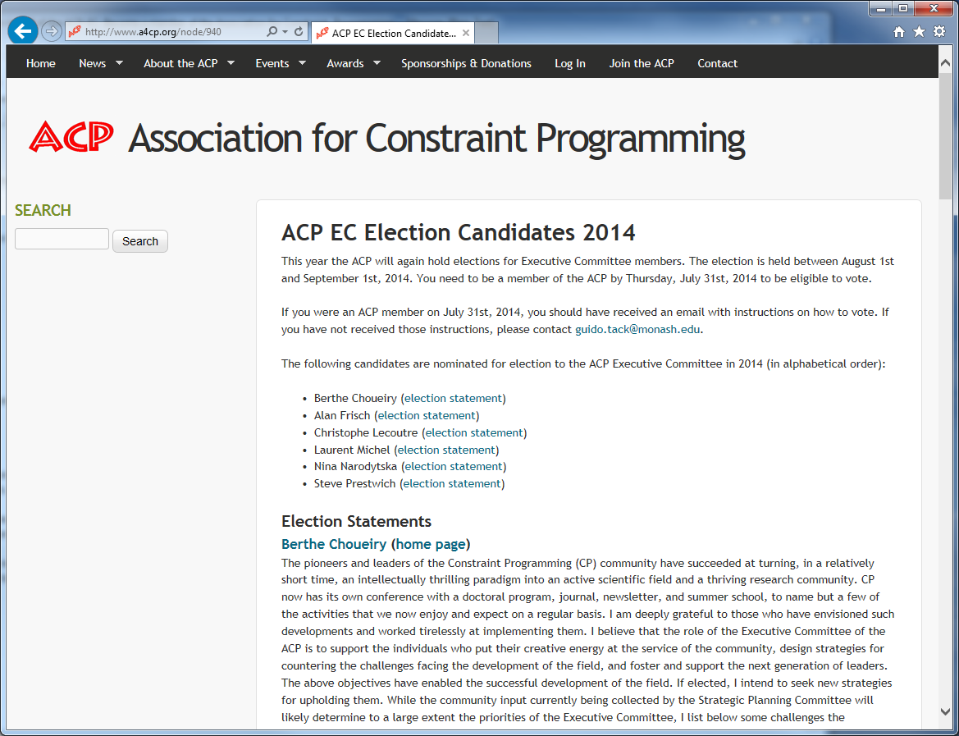

Slide 3
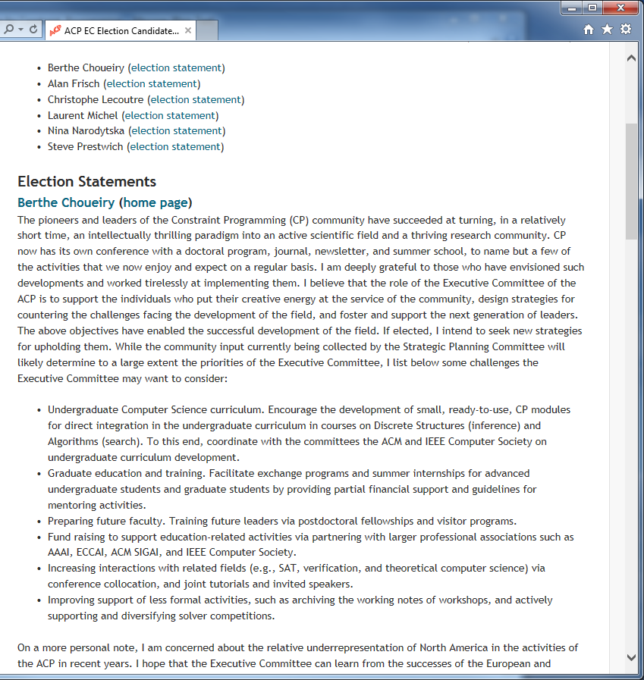

Slide 4
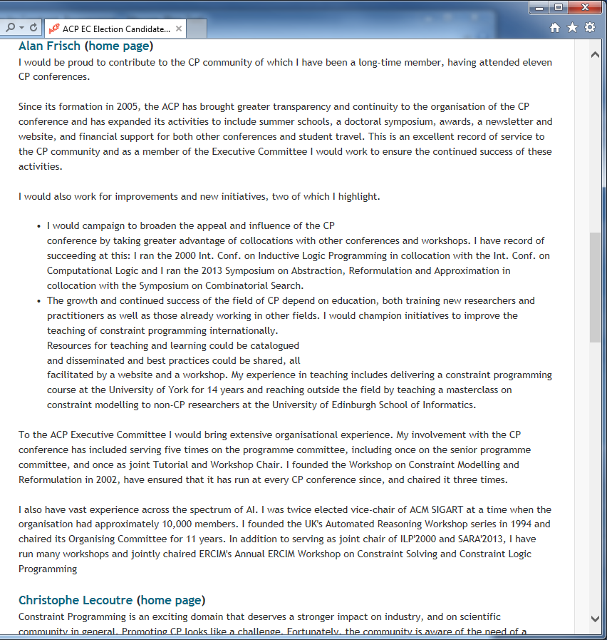

Slide 5
Context
Final Year
120 credits (1 credit approx 10 hours)
30 credit project
4 modules in semester 1
4 modules in semester 2
A module is 10 credits
1 compulsory module on Prof Issues
Students select 4 modules from 8 in each semester
There is competition between staff for students
Students make choice after 2nd week
First lectures have to be as attractive as possible
CP(M)
30 lectures
1 short assessed exercise (5%)
1 long(ish) assessed exercise (15%)
Exam (80%)
Students are motivated by “marks” ☹

Slide 6
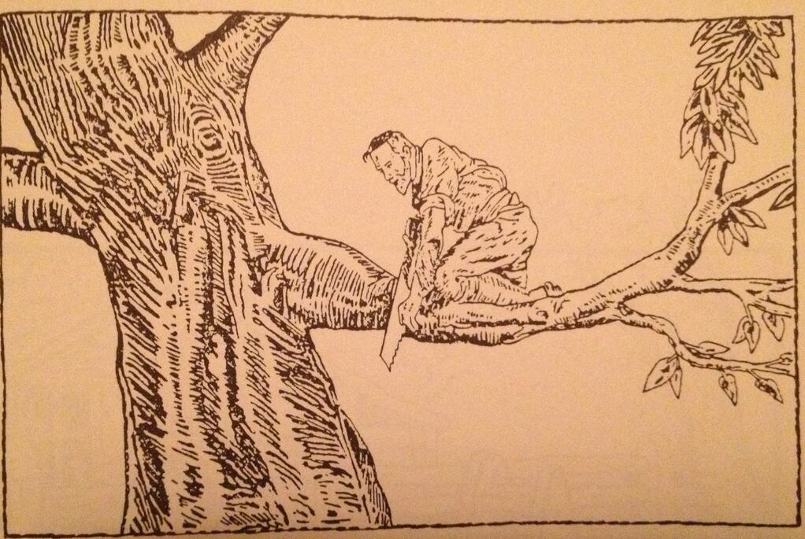
How not to do it

Slide 7
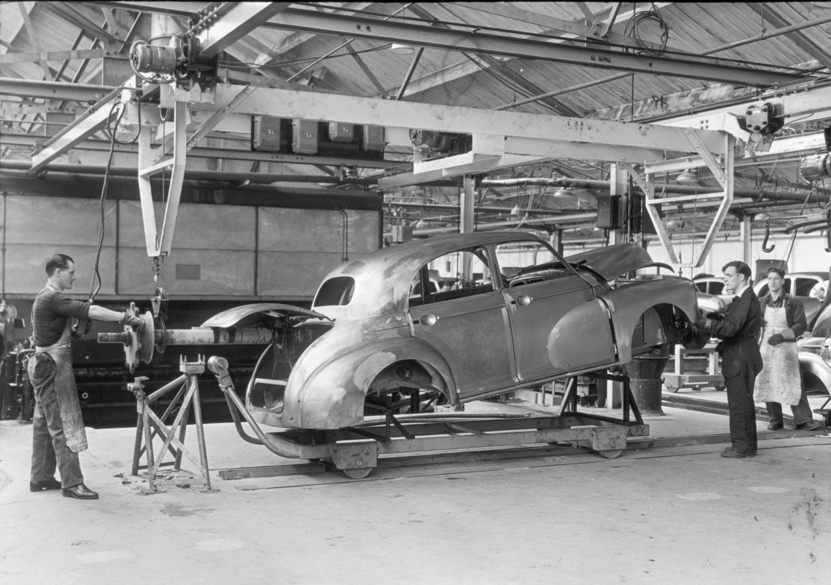
Lecture 1
Course outline

Slide 8
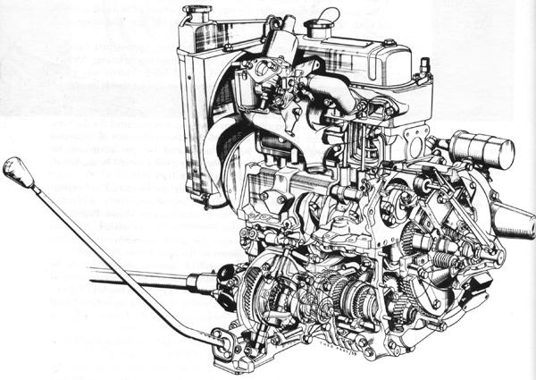
Lecture 2
Variables and constraints, and how to represent them

Slide 9
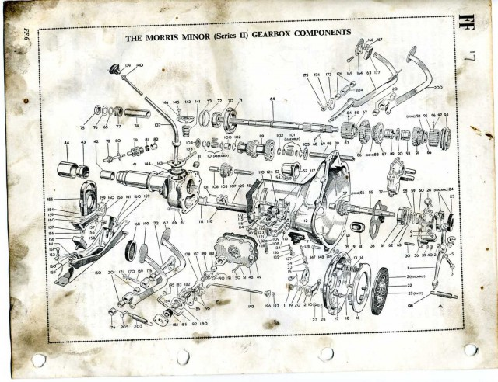
Lectures 3 to 5
Backtracking search, implementation

Slide 10
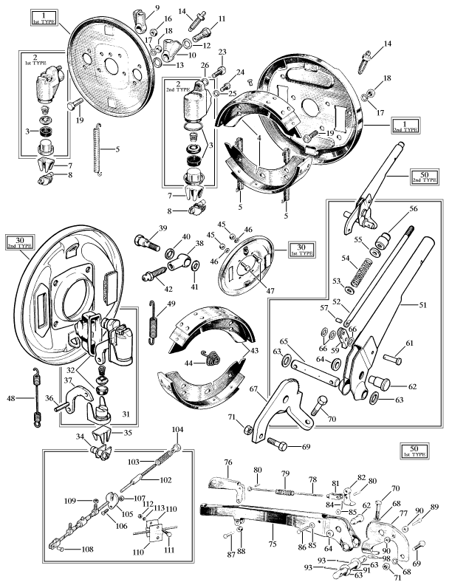
Lecture 6
A bit on heuristics

Slide 11
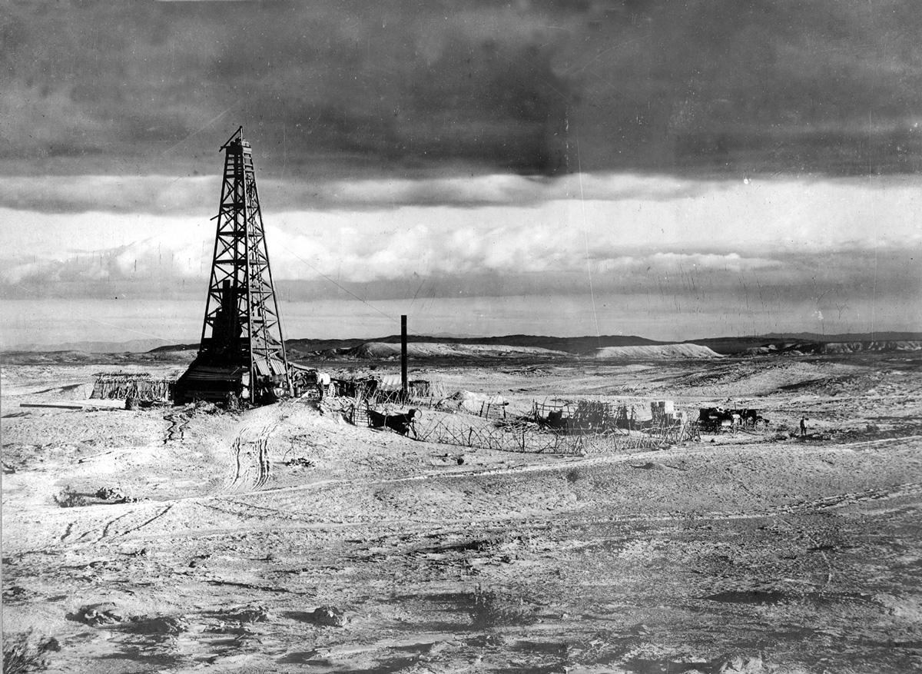
Lecture 7
A wee bit of theory (levels of consistency etc)

Slide 12
Lecture 8
A tiny wee bit more theory (dual and hidden variables)

Slide 13
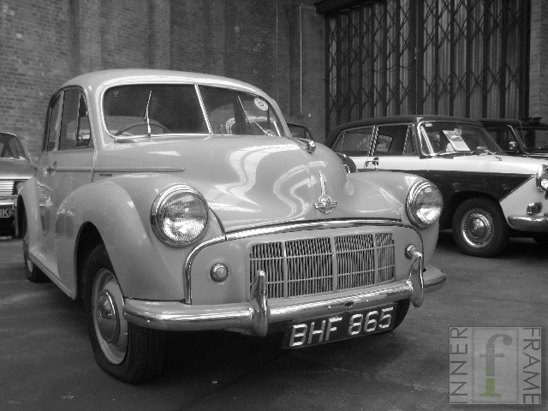
Week 4
Ready to write our 1st constraint program

Slide 14
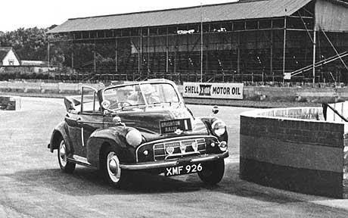
Wooooosh!

Slide 15
… how I do it now

Slide 16
Lecture 1

Slide 17
Lecture 1
Stolen: BMS, TW, JCB

Slide 18
Lecture 1
Handed out on paper, given 8 minutes, discussion …

Slide 19
Lecture 2
Just do it!

Slide 20
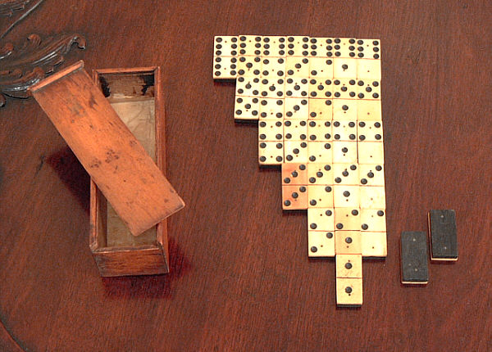
Lecture 2
How many dominos are there?

Slide 21
Lecture 2
How many dominos are there?
How many pairs of numbers are there of the form
0 ≤ x ≤ y ≤ 6

Slide 22
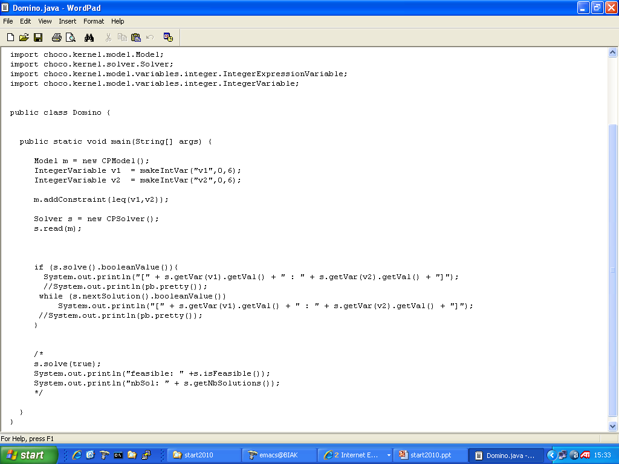
Lecture 2

Slide 23
Lecture 2
Compile & Run

Slide 24
Lecture 2

Slide 25
Lecture 2
Stolen: BMS

Slide 26
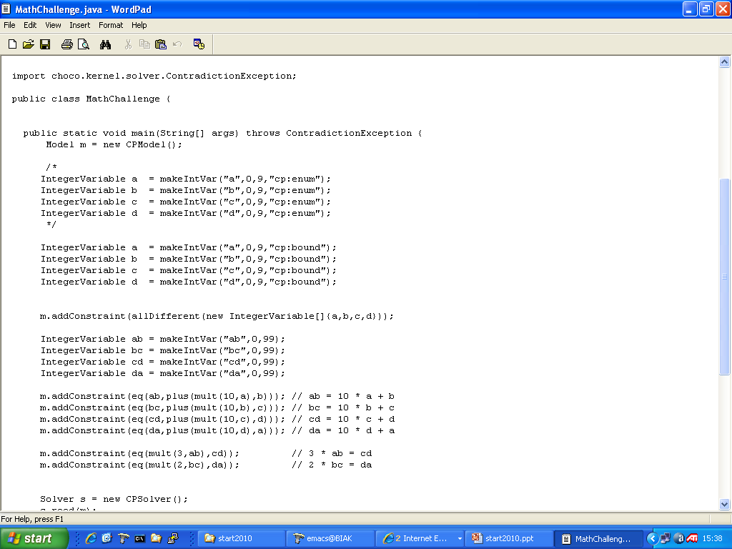
Lecture 2

Slide 27
Lecture 2
Compile & Run

Slide 28
Lecture 2
An exam question from AF2

Slide 29
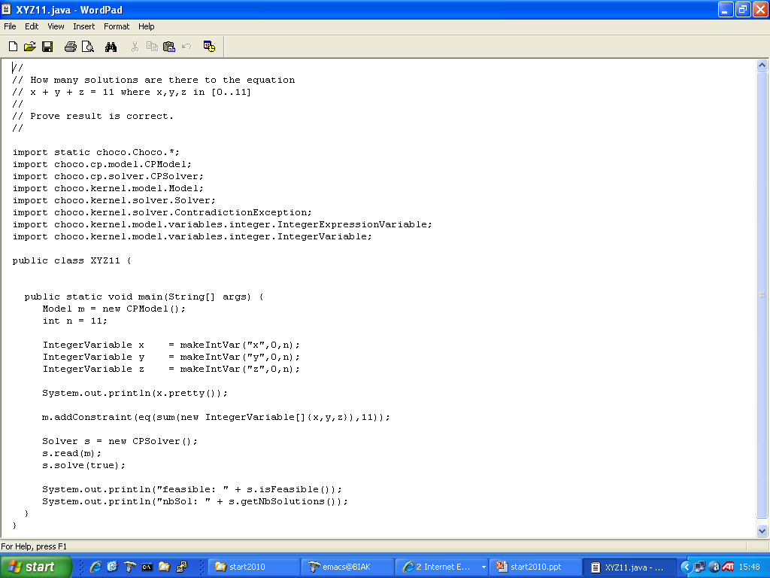
Lecture 2

Slide 30
Lecture 2
Compile & Run

Slide 31
1st observations & questions
How do you know “How not to do it”?
Why are you using choco (jchoco I call it)?
Do you steal everything?
do you tell the students you deal in stolen goods?
have you no sense of shame?
You get students to use technology they don’t understand!
We would NEVER EVER do that!
You write code in the lecture? Edit compile AND run?
what if something goes wrong? You’d look stupid, right?
You put all of the code on the web?

Slide 32
CPM!

Slide 33
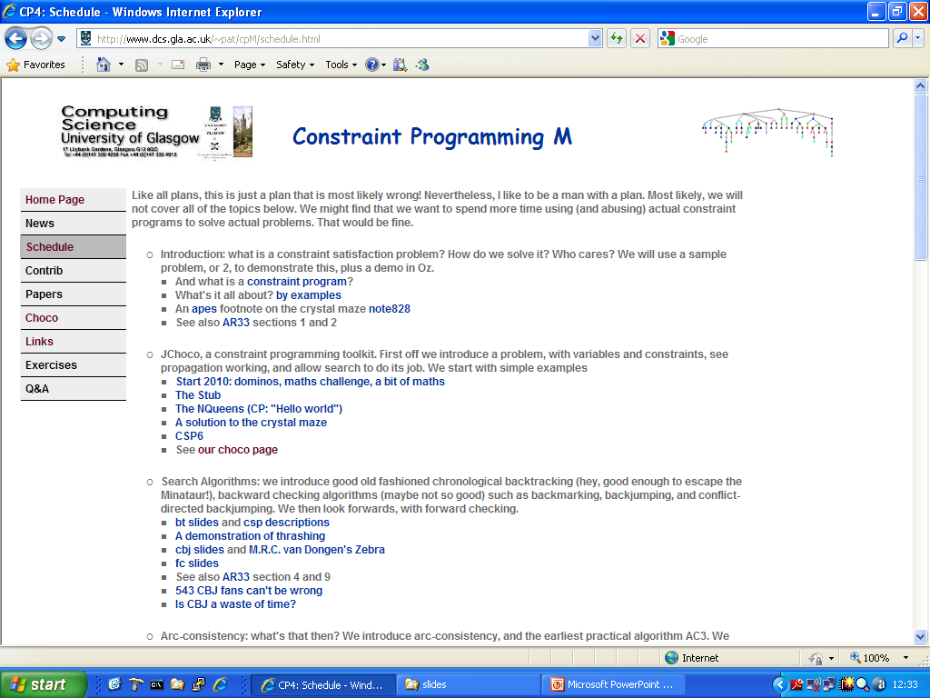

Slide 34
search

Slide 35
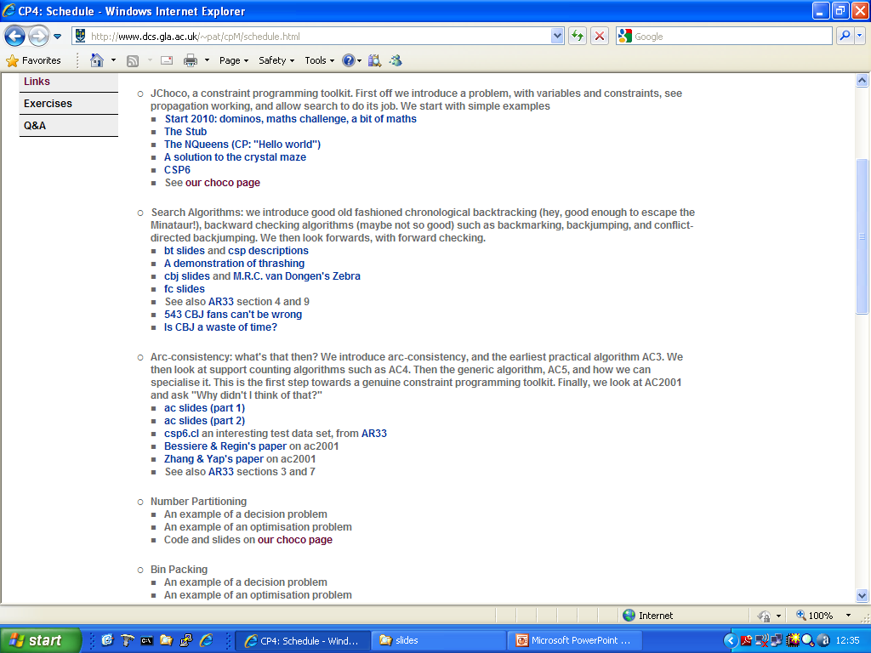

Slide 36
Opening up the hood: part 1, search
So how does CP work?
BT: Chronological BackTracking
Thrashing!
FC: forward checking
Thrashing!
CBJ: Conflict-directed BackJumping
Thrashing!

Slide 37
consistency

Slide 38
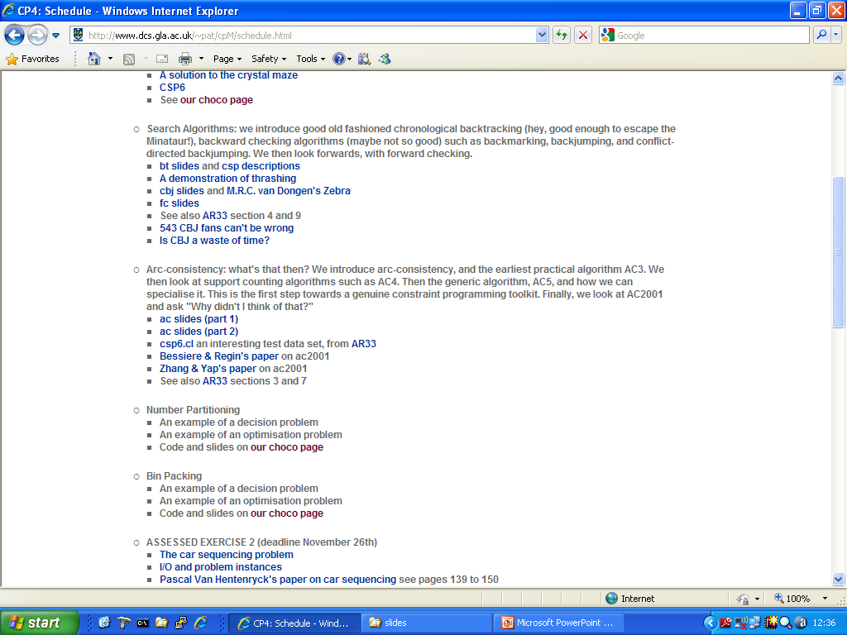

Slide 39
Opening up the hood: part 2, arc-consistency
So how does CP work?
Arc-consistency
Definition (aka 2-consistency)
Covered 1-2-3-Consistency
Algorithms
AC3
AC4/6/2001
AC5
Is AC a decision procedure?

Slide 40
modelling

Slide 41
We modelled some problems
Talent Scheduling
number partitioning
m-queens
magic square
jobshop scheduling
Orthogonal Latin Squares
Crystal Maze
Ramsey number
n-queens
graph colouring
bin packing
knight’s tour
Crossword Puzzle

Slide 42
We modelled some problems
What are the decision variables?
Are there any symmetries?
Dual or Hidden Variable encoding?
How does search go?
Is there a variable/value ordering heuristic?
Redundant constraints?
Is there another model?

Slide 43
phase transition phenomena

Slide 44
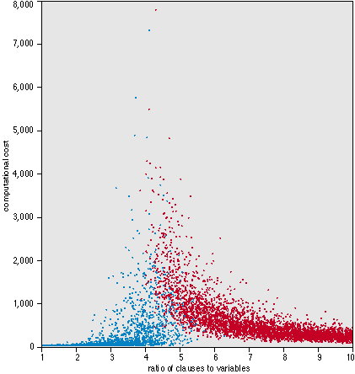
Where are the hard problems?
Constrainedness? Who cares?
In optimisation, as a heuristic, in solving problems

Slide 45
heuristics

Slide 46
Variable and value ordering heuristics
Static, topological properties
Fail-first, and it’s realisation
Constrainedness
Dual viewpoint heuristics
Promise
Regret
Domain Specific (example JSSP slack-based, Warnsdorff)

Slide 47
specialised constraints

Slide 48
specialised constraints
max
sub-tour elimination
Knight’s tour
…
the glass box

Slide 49
local search

Slide 50
Local search (aka neighbourhood search)
Search again
HC, SA, TS, GLS, GA, ACO, …
Why we need them
Problems in using them
incompleteness, move operators,
evaluation/fitness functions,
tuning parameters,
Problems in using them in CP
aka meta-heuristics

Slide 51
Limited Discrepancy Search
Search again
lds
motivation for LDS
when might we use it?
when should we not use it?

Slide 52
change of representation

Slide 53
change of representation
dual and hidden variable encoding

Slide 54
Levels of consistency

Slide 55
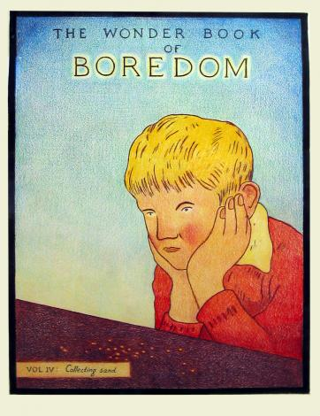
consistency
Node Consistency (NC)
Arc-consistency (AC)
Path Consistency (PC)
Generalised arc-consistency (GAC)
Bounds consistency
Inverse Path Consistency (IPC aka PIC)
Singleton Arc-consistency (SAC)
… and others

Slide 56
Mechanics of choco

Slide 57
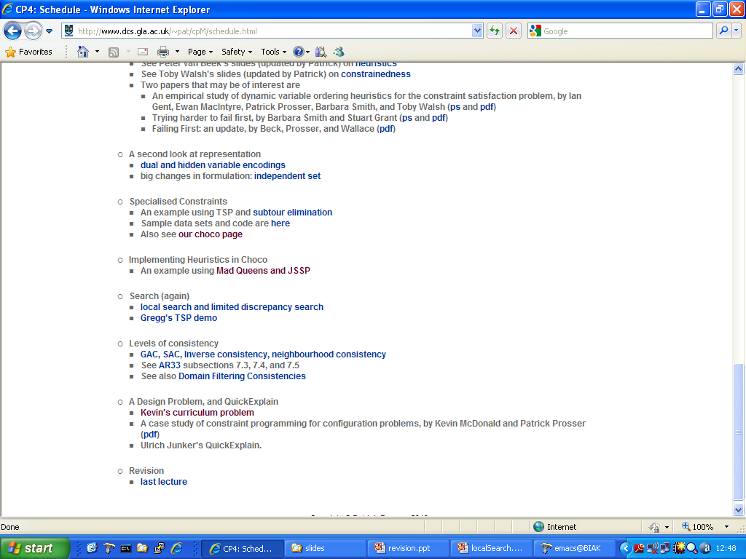
Mechanics of choco

Slide 58
Mechanics of choco

Slide 59
CP for a design problem
Using CP as an intelligent data base
Not solving a problem, but using CP as an “active” representation
Explanations via quickXplain

Slide 60
summary
theory
csp <v,c,d> and it’s complexity
search (bt, fc, cbj, …)
thrashing
arc-consistency
levels of consistency
heuristics
local search & lds
dual & hidden variables
sat
phase transition phenomena & constrainedness

Slide 61
summary
Modelling & Solving Problems
practice
number partitioning
magic square
jobshop scheduling
Crystal Maze
Talent Scheduling
Orthogonal Latin Squares
n-queens
graph colouring
bin packing
knight’s tour

Slide 62
summary
Modelling & Solving Problems
practice
variables (enumerated/bound/setsVar) and their domains
constraints (neq, allDiff, ifOnlyIf, …)
decision variables
what propagation might take place
size of the encoding/model (how it scales with problem size)
heuristics (dynamic/static, variable/value)
size of the search/state space
how search goes (example was knight’s tour)
alternative models (dual? hidden? values as variables?)
optimisation (with maximise/minimise, seqn of decision problems)
dealing with conflicts (soft constraints & penalties)
symmetry breaking (ramsey, bin packing, …)
redundant constraints (magic square, MOLS …)
what will make problems hard to solve and what will make them easy?

Slide 63
Rhythm
Once we are up to speed, an ideal week goes like this
lecture on new theory
a new problem
Model and solve
“Performance CP”
Consider alternative models
Symmetry breaking
When do problems get hard

Slide 64
Where are the really hard problems

Slide 65
Where are the really hard problems
The usual stuff
int x = 3;
int y = 5;
int z = Math.max(x,y);

Slide 66
Where are the really hard problems
The usual stuff
int x = 3;
int y = 5;
int z = Math.max(x,y);
Our stuff
Model model = new CPModel();
IntegerVariable x = makeIntVar(“x”,0,3);
IntegerVariable y = makeIntVar(“y”,0,5);
IntegerVariable z = makeIntVar(“z”,0,4);
model.addConstraint(eq(z,max(x,y)));

Slide 67
Where are the really hard problems
The usual stuff
int x = 3;
int y = 5;
int z = Math.max(x,y);
Our stuff
Model model = new CPModel();
IntegerVariable x = makeIntVar(“x”,0,3);
IntegerVariable y = makeIntVar(“y”,0,5);
IntegerVariable z = makeIntVar(“z”,0,4);
model.addConstraint(eq(z,max(x,y)));
Breaking the mental model of variables in a programming language

Slide 68
Where are the really hard problems
The usual stuff
int x = 3;
int y = 5;
int z = Math.max(x,y);
Our stuff
Model model = new CPModel();
IntegerVariable x = makeIntVar(“x”,0,3);
IntegerVariable y = makeIntVar(“y”,0,5);
IntegerVariable z = makeIntVar(“z”,0,4);
model.addConstraint(eq(z,max(x,y)));
Post x > 0 and propagate
Post z > 0 and propagate
Post z < 3 and propagate

Slide 69
Where are the really hard problems
Almost anything to do with implication is mind blowing (or maybe I am a bad teacher)

Slide 70
arrays
Where are the really hard problems

Slide 71
arrays
Where are the really hard problems
Pick off the ith row: easy

Slide 72
arrays
Where are the really hard problems
Pick off the diagonal: easy

Slide 73
arrays
Where are the really hard problems
Pick off the ith column: hard

Slide 74
arrays
Where are the really hard problems
Pick off the diagonal: hard

Slide 75
Where are the really hard problems
Code comprehension

Slide 76
Code comprehension
Where are the really hard problems
Given n, what does f1 return?
Suggest a name for f1.

Slide 77
Code comprehension
Where are the really hard problems
Given n and r, what does f2 return?
Suggest a name for f2?

Slide 78
Assessed exercises

Slide 79
Assessed exercises
1st exercise is sudoku (5%)
To get them to download and use choco

Slide 80
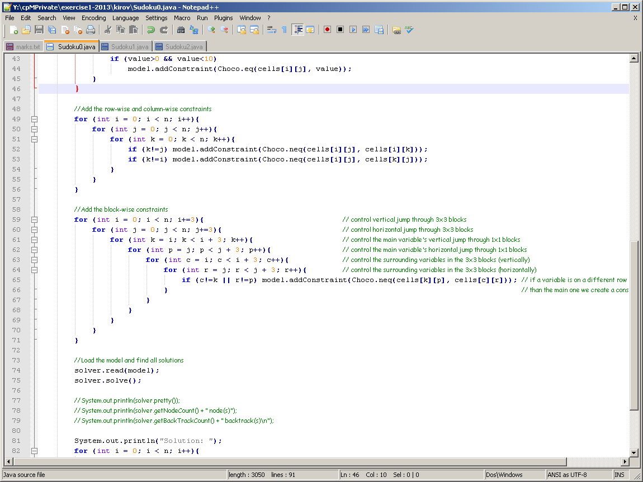

Slide 81
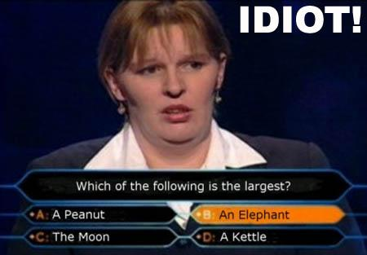
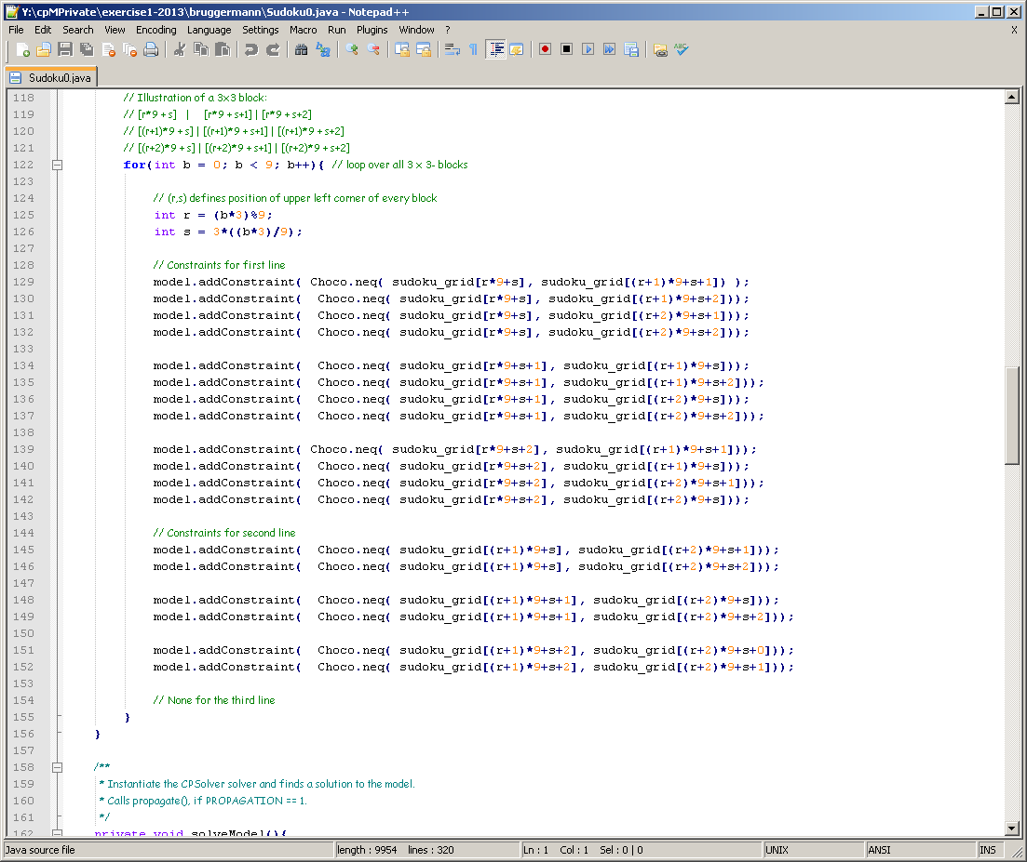

Slide 82
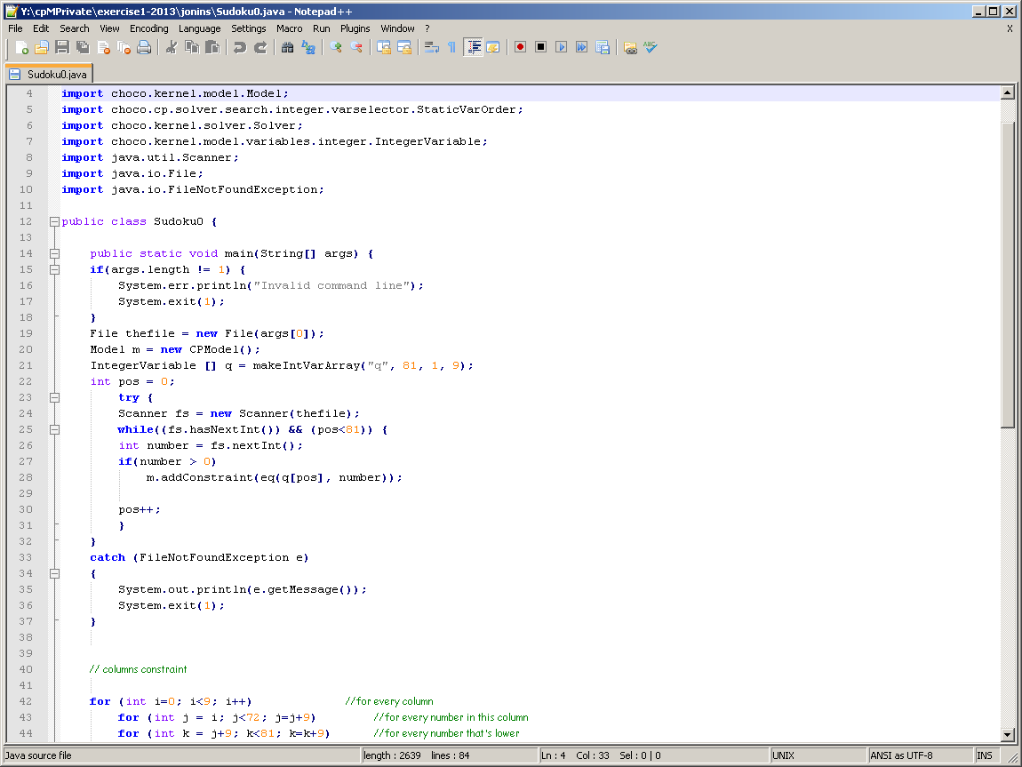
1D Sudoku!

Slide 83
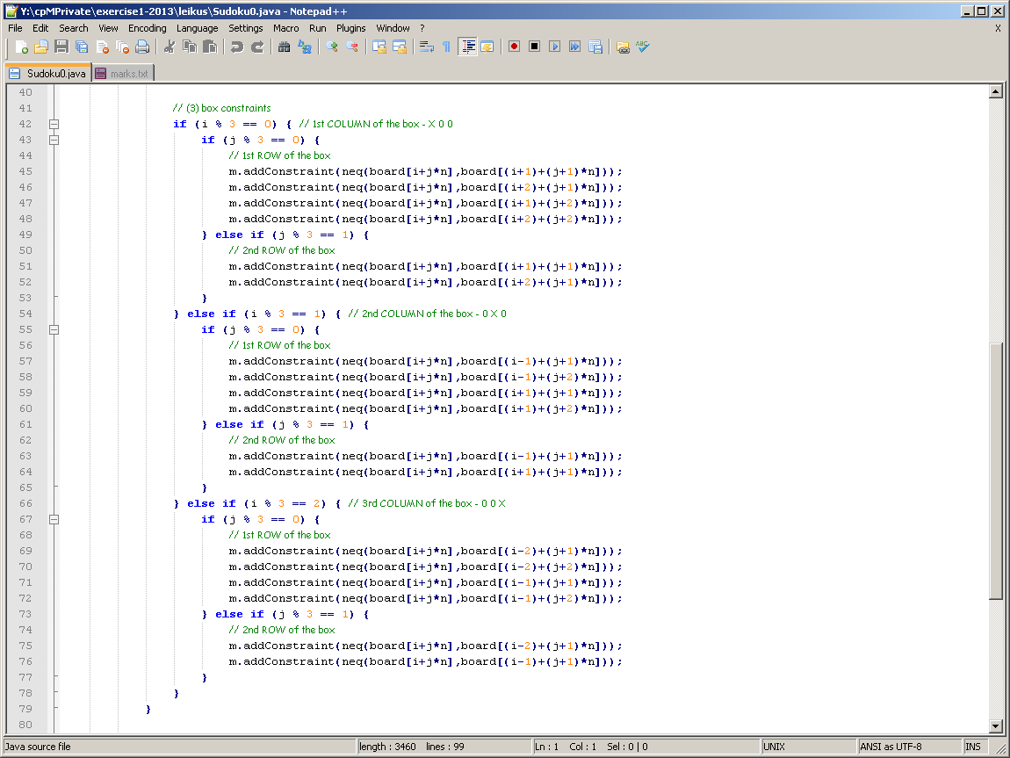
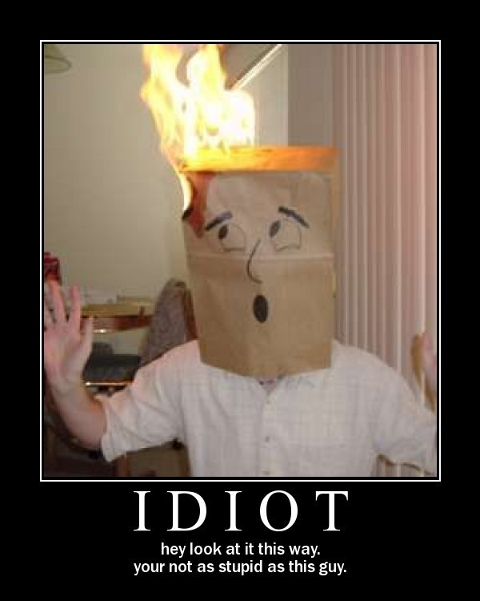

Slide 84
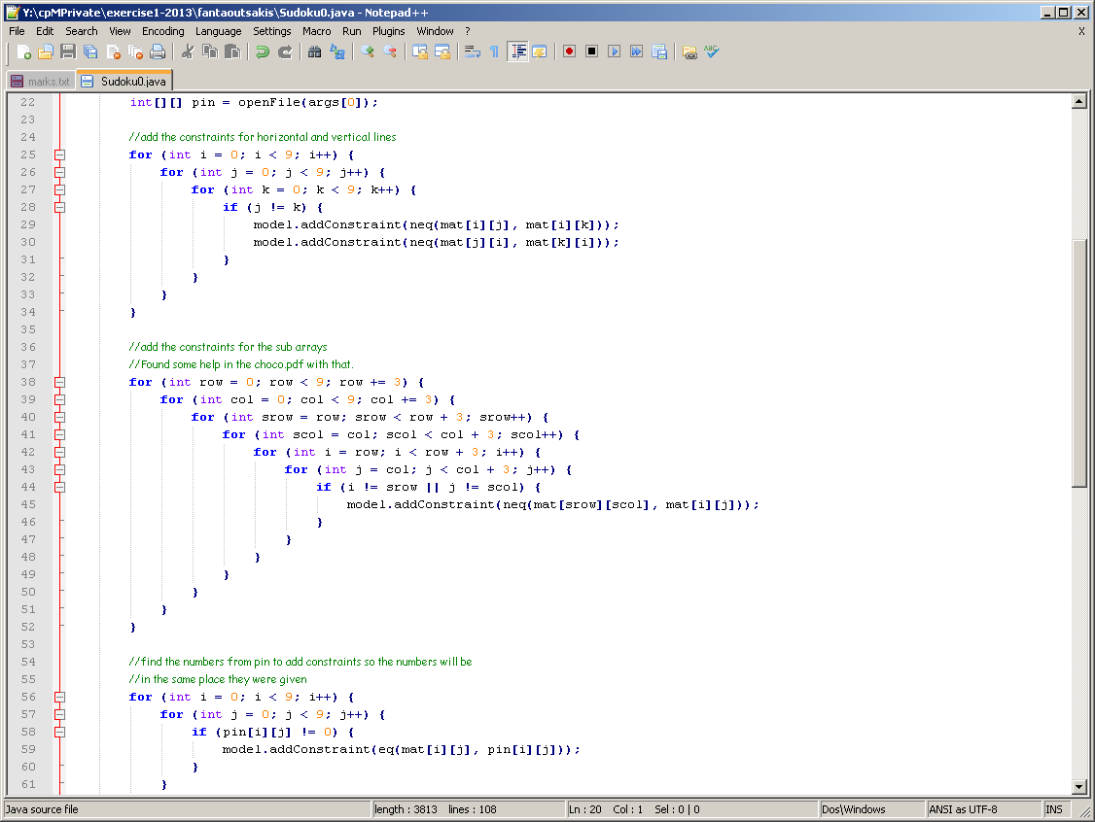

Slide 85
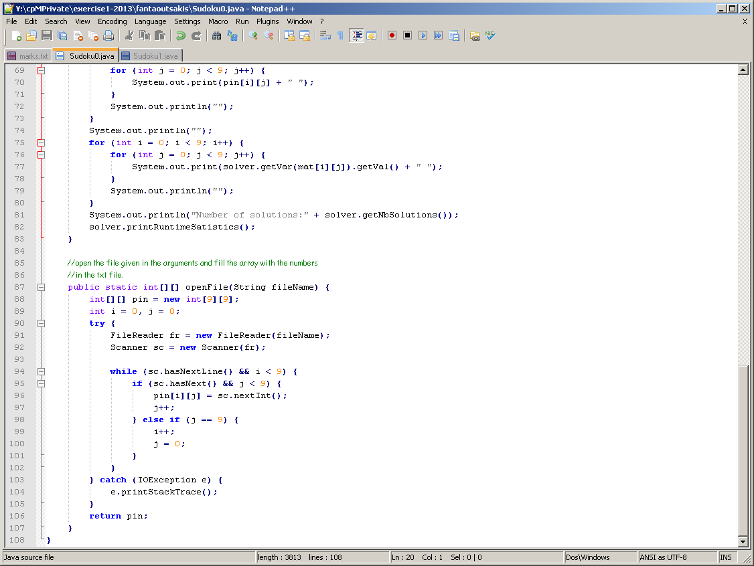
Read in 9 rows of 9 numbers
Jeez. If I knew it was this hard
I never would have attempted it

Slide 86
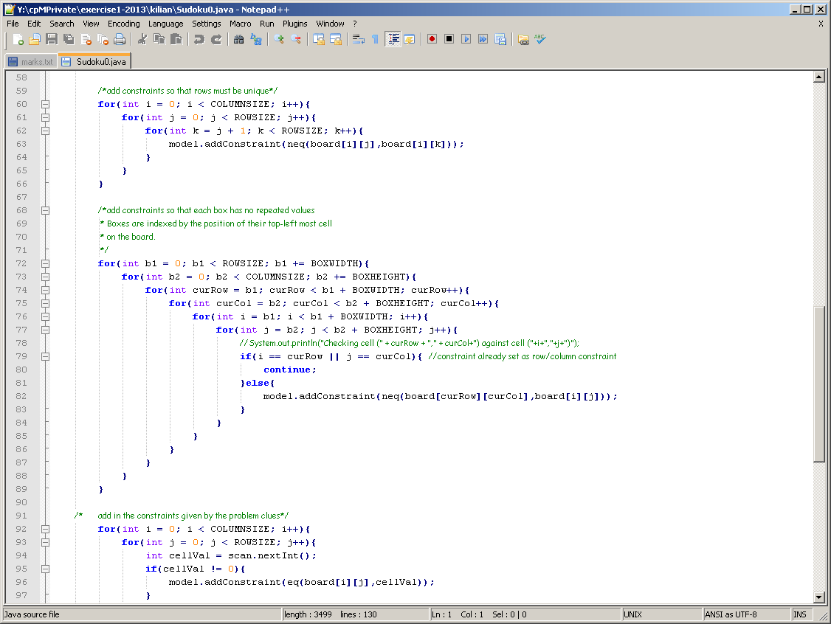

Slide 87
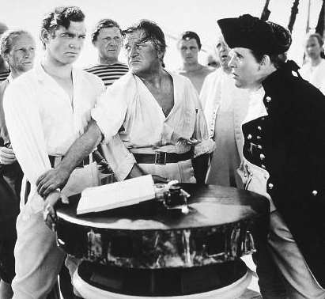
The floggings will continue until morale improves

Slide 88
Assessed exercises
Exercise 2 (15%) has been
Car sequencing
Talent scheduling
Meeting Scheduling
Maximum Clique

Slide 89
Assessed exercises
Exercise 2 (15%) has been
Car sequencing
Talent scheduling
Meeting Scheduling
Maximum Clique
I think that was the best

Slide 90
So?

Slide 91
Jump in!

Slide 92
Steal

Slide 93
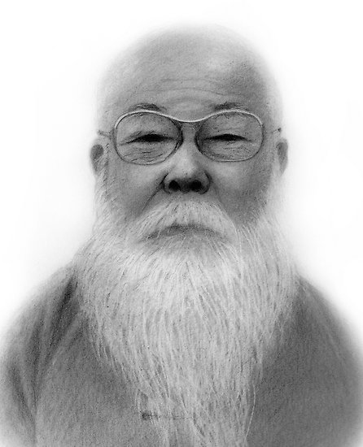
You can’t teach it all

Slide 94
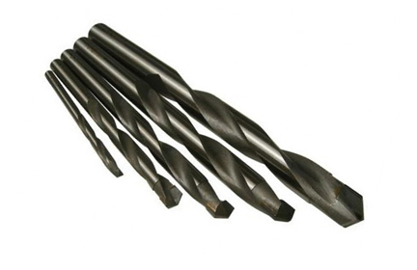
The hard bits might not
be where you expect them to be.

Slide 95
Have fun

Slide 96
… and remember,
your students are not just your students
CP(M)
CP(M)
CP(M)
CP(M)

