Slide 1
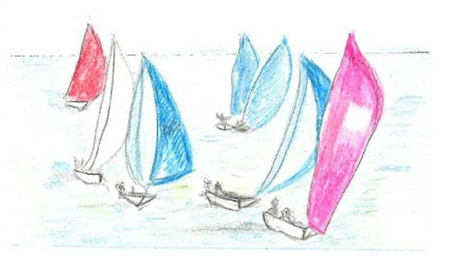
Scene from an imaginary dinghy race

Slide 2
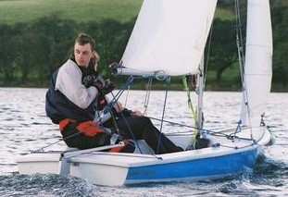
Constructing Sailing Match Race Schedules
Round-Robin Pairing Lists
Craig Macdonald, Ciaran McCreesh, Alice Miller, Patrick Prosser
All @ Computing Science Glasgow

Slide 3
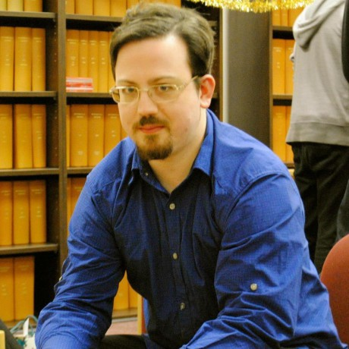
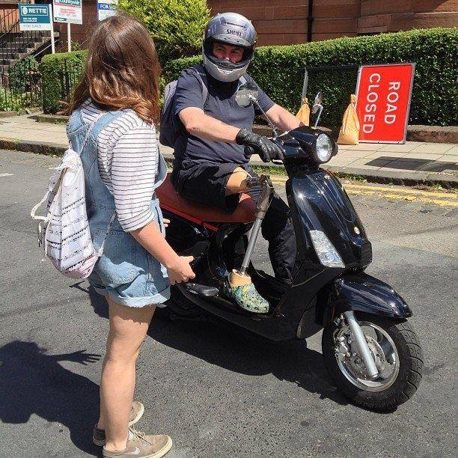
Craig
Ciaran
Patrick
Alice

Slide 8
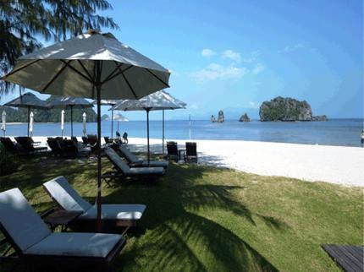
Rhu
This
Not this
Tanjung Rhu Resort Langkawi

Slide 10
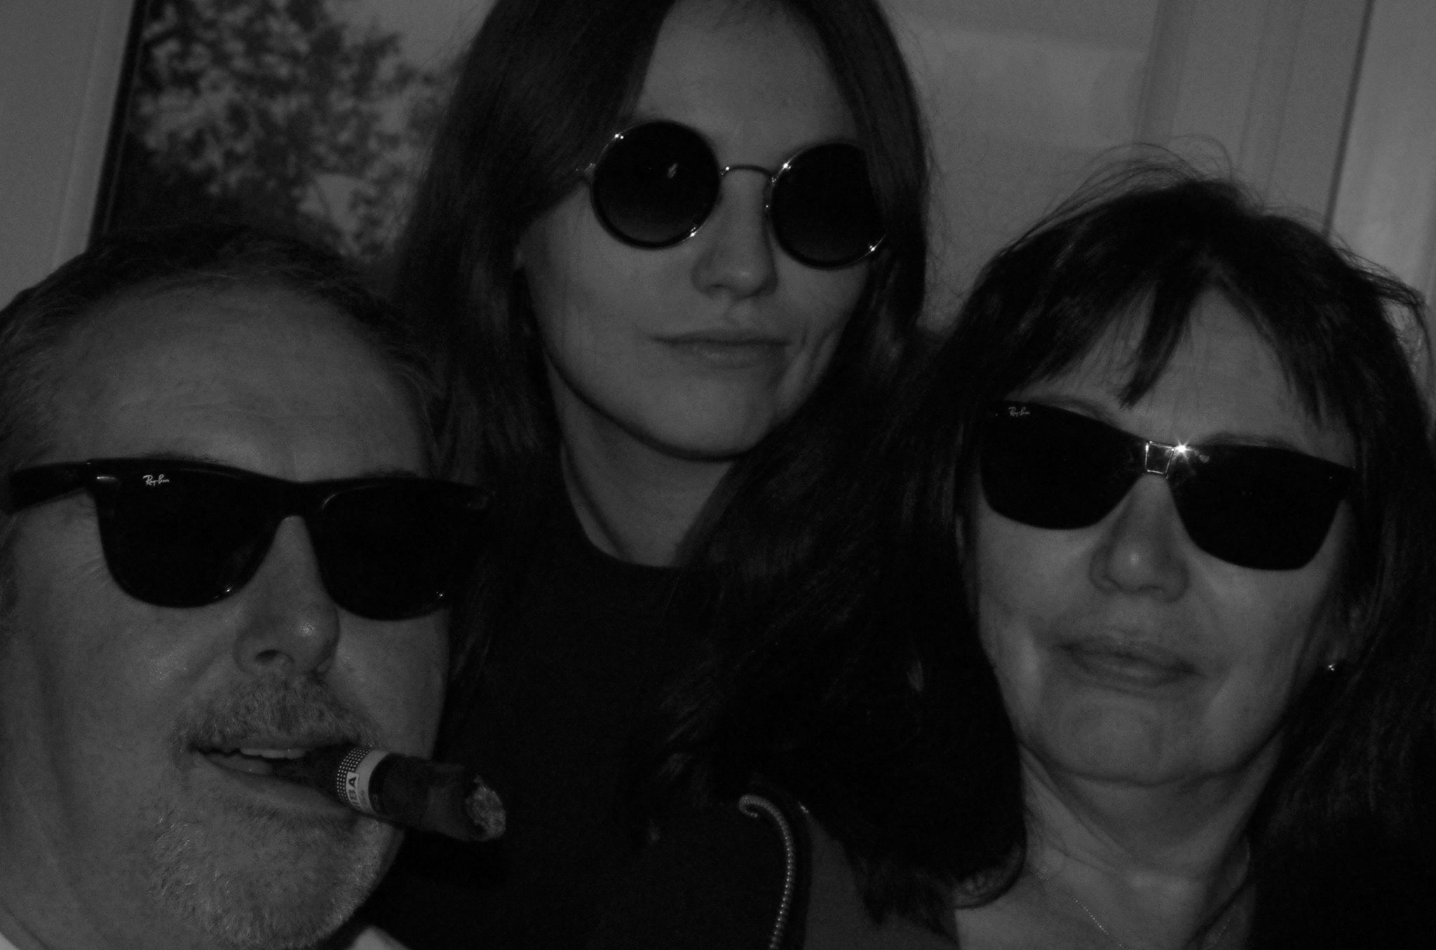

Slide 11
What’s the problem Craig?

Slide 12
We have n skippers and m boats (m ≤ n)
Each skipper has to compete against every other skipper once and once only.
We can send m skippers out together, in pairs (m/2 pairs)
We call this a flight
There are some restrictions to take into consideration

Slide 13
Not a problem.

Slide 14
Leave it with us.

Slide 15
It’s a round robin.

Slide 16
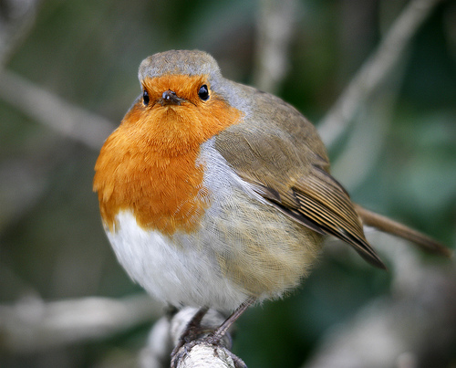

Slide 17
1st Stab
Consider 7 skippers and 6 boats

Slide 18
1st Stab
Consider 7 skippers and 6 boats
We have 7.6/2 = 21 matches

Slide 19
1st Stab
Consider 7 skippers and 6 boats
We have 7.6/2 = 21 matches
Given 6 boats we have 3 matches in each flight

Slide 20
1st Stab
Consider 7 skippers and 6 boats
We have 7.6/2 = 21 matches
Given 6 boats we have 3 matches in each flight
We have 7 flights

Slide 21
1st Stab
Consider 7 skippers and 6 boats
We have 7.6/2 = 21 matches
Given 6 boats we have 3 matches in each flight
We have 7 flights

Slide 22
1st Stab
Consider 7 skippers and 6 boats
We have 7.6/2 = 21 matches
Given 6 boats we have 3 matches in each flight
We have 7 flights
Skipper 0 is in a match with skipper 1 in flight 0

Slide 23
1st Stab
Consider 7 skippers and 6 boats
We have 7.6/2 = 21 matches
Given 6 boats we have 3 matches in each flight
We have 7 flights
Skipper 1 is in a match with skipper 6 in flight 4

Slide 24
1st Stab
 | 0 | 1 | 2 | 3 | 4 | 5 | 6
0
1
2
3
4
5
6

Slide 25
1st Stab
 | 0 | 1 | 2 | 3 | 4 | 5 | 6
0
1
2
3
4
5
6
M[i][j] = flight that match (i,j) takes place

Slide 26
1st Stab
 | 0 | 1 | 2 | 3 | 4 | 5 | 6
0
1
2
3
4
5
6
M[i][j] = flight that match (i,j) takes place
M[i][j] ≡ M[j][i]

Slide 27
1st Stab
 | 0 | 1 | 2 | 3 | 4 | 5 | 6
0
1
2
3
4
5
6
M[i][j] = flight that match (i,j) takes place
M[i][j] ≡ M[j][i]
allDifferent(M[i])

Slide 28
1st Stab
 | 0 | 1 | 2 | 3 | 4 | 5 | 6
0 |  | 0 | 1 | 3 | 5 | 2 | 6
1 |  |  | 6 | 2 | 3 | 1 | 4
2 |  |  |  | 0 | 4 | 5 | 2
3 |  |  |  |  | 6 | 4 | 5
4 |  |  |  |  |  | 0 | 1
5 |  |  |  |  |  |  | 3
6
M[i][j] = flight that match (i,j) takes place
M[i][j] ≡ M[j][i]
allDifferent(M[i])

Slide 29
Another view: vertices are skippers
coloured edge is time of match
4 skippers & 4 boats & 6 matches
1st Stab
1
0
2
3

Slide 30
Another view: vertices are skippers
coloured edge is time of match
4 skippers & 4 boats
1st Stab
1
0
2
3

Slide 31
Another view: vertices are skippers
coloured edge is time of match
4 skippers & 4 boats
1st Stab
1
0
2
3

Slide 32
Another view: vertices are skippers
coloured edge is time of match
4 skippers & 4 boats
1st Stab
1
0
2
3

Slide 33
Another view: vertices are skippers
coloured edge is time of match
4 skippers & 4 boats
1st Stab
1
0
2
3
1-factorisation

Slide 34
Another view: vertices are matches
edge if matches at same time
4 skippers & 4 boats
1st Stab
(0,2)
(0,1)
(0,3)
(2,3)
(1,2)
(1,3)

Slide 35
Another view: vertices are matches
edge if matches at same time
4 skippers & 4 boats
1st Stab
(0,2)
(0,1)
(0,3)
Flight 0
(2,3)
(1,2)
(1,3)

Slide 36
Another view: vertices are matches
edge if matches at same time
4 skippers & 4 boats
1st Stab
(0,2)
(0,1)
(0,3)
Flight 0
Flight 1
(2,3)
(1,2)
(1,3)

Slide 37
Another view: vertices are matches
edge if matches at same time
4 skippers & 4 boats
1st Stab
(0,2)
(0,1)
(0,3)
Flight 0
Flight 1
Flight 2
(2,3)
(1,2)
(1,3)

Slide 38
Another view: vertices are matches
edge if matches at same time
4 skippers & 4 boats
1st Stab
(0,2)
(0,1)
(0,3)
Flight 0
Flight 1
Flight 2
(2,3)
(1,2)
(1,3)
Colouring of the line graph

Slide 39
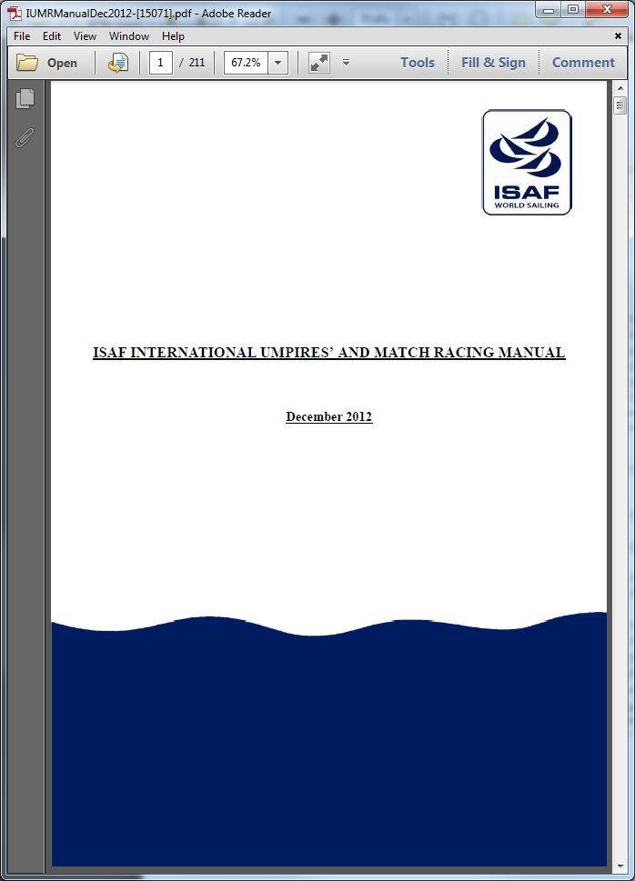
There are some restrictions to take into consideration

Slide 42
For an explanation at this level of detail, read the paper

Slide 43
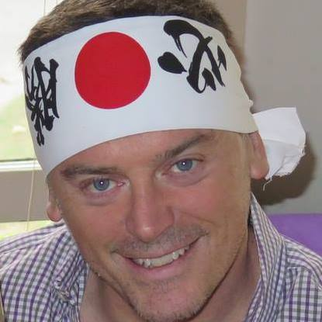
For an explanation at this level of detail, read the paper
Taking Mark Drummond’s point of view (IJCAI93) this presentation is an advertisement for the paper
What follows is a sketch

Slide 44
Phase 1

Slide 45
Stage 1
What is a “boat change”?

Slide 46
Phase 1
What is a “boat change”?
There are fewer boats than skippers and
A skipper gets into a boat for the 1st time ever (and is in a “new” boat) or …
A skipper has had a “bye” and then goes out into a flight (and is in a “new” boat)

Slide 47
Modelling a Skipper
A skipper has
a temporal view of his schedule (who do I race at time t?) and
a state view (where am I racing in flight f?)

Slide 48
Modelling a Skipper

Slide 49
Modelling a Skipper
Schedule for skipper 5

Slide 50
Modelling a Skipper
Schedule for skipper 5

Slide 51
Modelling a Skipper
In flight 0
Competes against skipper 4 in last position

Slide 52
Modelling a Skipper
In flight 1
Competes against skipper 1 in last position

Slide 53
Modelling a Skipper
In flight 2
Competes against skipper 0 in middle position

Slide 54
Modelling a Skipper
In flight 3
Competes against skipper 6 in first position

Slide 55
Modelling a Skipper
In flight 4
Competes against skipper 3 in first position

Slide 56
Modelling a Skipper
In flight 5
Competes against skipper 2 in last position

Slide 57
Modelling a Skipper
Not in flight 6
This is the end

Slide 58
Modelling a Skipper
And yes … (x,y) is different from (y,x)!
(x,y) x is port
(x,y) y is starboard

Slide 59
Modelling a Skipper
And yes … (x,y) is different from (y,x)!
(x,y) x is port
(x,y) y is starboard
There’s no red Port left in the bottle

Slide 60
Modelling a Skipper
0 1 2 3 4 5 6 7 8 9 10 11 12 13 14 15 16 17 18 19 20
Time slots, in this case divide by 3 to find out flight

Slide 61
Modelling a Skipper
0 1 2 3 4 5 6 7 8 9 10 11 12 13 14 15 16 17 18 19 20
Value in timeslot is the skipper we compete against

Slide 62
Modelling a Skipper
Skipper 5 is in Last place in flight 0 and competes with skipper 4

Slide 63
Modelling a Skipper
Skipper 5 is in Middle place in flight 2 and competes with skipper 0

Slide 64
Modelling a Skipper
Skipper 5 is in the End state in flight 6

Slide 65
Modelling a Skipper
Channel between timeslots and state!

Slide 66
Modelling a Skipper
Channel between timeslots and state!
state is Last, First, Mid, Bye or End, i.e. position in flight

Slide 67
Modelling a Skipper
Finite Automata to describe criteria 4, 11 and 12
Regular constraint acts on skipper’s state

Slide 68
Modelling a Skipper
Skipper is last in flight 0 (green) and can move in next flight to states Last, Mid or End
i.e. cannot go into a Bye or go First

Slide 69
We also have
array match[i][j] = timeslot for match (i,j)
time[t] is a pair (i,j), where match (i,j) is in timeslot t
These are channelled into skippers
Time is decision variable (what do we do now?)

Slide 70
7 Skippers and 6 Boats: phase 1

Slide 71
7 Skippers and 6 Boats: phase 1
modMatch converts timeslots in match into flights, forces skipper’s matches into different flights

Slide 72
7 Skippers and 6 Boats: phase 1
Symmetry break at top of search … first flight contains matches (0,1), (2,3), (4,5)
Phase 1, minimise boat changes (total or worst case skipper)
Output the integer … number of boat changes, as input to Phase 2

Slide 73
Phase 2
Minimise imbalance

Slide 74
Phase 2
Given the number of boat changes, produce a schedule that is “balanced” and
has at most the given number of boat changes.
Balance of a skipper is balance between … number of times first, number of
times middle, number of times last
Balance for schedule, is balance of worst skipper

Slide 75
Phase 2
Given the number of boat changes, produce a schedule that is “balanced” and
has at most the given number of boat changes.
Balance of a skipper is balance between … number of times first, number of
times middle, number of times last
Balance for schedule, is balance of worst skipper
Read the paper for details (I’m running out of time)

Slide 76
Phase 3
Renumbering

Slide 77
Phase 3

Slide 78
Phase 3
Skippers 0 and 1 are in a match in the last flight
In the above, swap all 0’s with 0’s and swap all 6’s with 1’s so last match is (0,1)
NOT A CP STEP

Slide 79
Phase 4
Orientation
(port/starboard)

Slide 80
Ortientation
Phase 4

Slide 81
Phase 4
Reads in the renumbered schedule and …
orient[i][j] = 0 iff skipper i is on port side in his jth match
orient[i][j] = 1 iff skipper i is on starboard side in his jth match

Slide 82
Phase 4
orient[i][j] = 0 iff skipper i is on port side in his jth match
orient[i][j] = 1 iff skipper i is on starboard side in his jth match
Skipper 2 meets skippers in the order 3,0,1,4,5,6
Skipper 3 meets skippers in the order 2,6,0,5,1,4
Skipper 5 meets skippers in the order 4,6,0,1,3,2

Slide 83
Phase 4
orient[i][j] = 0 iff skipper i is on port side in his jth match
orient[i][j] = 1 iff skipper i is on starboard side in his jth match
Skipper 2 meets skippers in the order 3,0,1,4,5,6
Skipper 3 meets skippers in the order 2,6,0,5,1,4
Skipper 5 meets skippers in the order 4,6,0,1,3,2

Slide 84
Phase 4
orient[i][j] = 0 iff skipper i is on port side in his jth match
orient[i][j] = 1 iff skipper i is on starboard side in his jth match
Skipper 2 meets skippers in the order 3,0,1,4,5,6
Skipper 3 meets skippers in the order 2,6,0,5,1,4
Skipper 5 meets skippers in the order 4,6,0,1,3,2

Slide 85
Phase 4
orient[i][j] = 0 iff skipper i is on port side in his jth match
orient[i][j] = 1 iff skipper i is on starboard side in his jth match
Skipper 2 meets skippers in the order 3,0,1,4,5,6
Skipper 3 meets skippers in the order 2,6,0,5,1,4
Skipper 5 meets skippers in the order 4,6,0,1,3,2

Slide 86
Phase 4
orient[i][j] = 0 iff skipper i is on port side in his jth match
orient[i][j] = 1 iff skipper i is on starboard side in his jth match
Skipper 2 meets skippers in the order 3,0,1,4,5,6
Skipper 3 meets skippers in the order 2,6,0,5,1,4
Skipper 5 meets skippers in the order 4,6,0,1,3,2

Slide 87
Phase 4
orient[i][j] = 0 iff skipper i is on port side in his jth match
orient[i][j] = 1 iff skipper i is on starboard side in his jth match
Skipper 2 meets skippers in the order 3,0,1,4,5,6
Skipper 3 meets skippers in the order 2,6,0,5,1,4
Skipper 5 meets skippers in the order 4,6,0,1,3,2

Slide 88
Phase 4
orient[i][j] = 0 iff skipper i is on port side in his jth match
orient[i][j] = 1 iff skipper i is on starboard side in his jth match
Skipper 2 meets skippers in the order 3,0,1,4,5,6
Skipper 3 meets skippers in the order 2,6,0,5,1,4
Skipper 5 meets skippers in the order 4,6,0,1,3,2

Slide 89
Phase 4
Reads in the renumbered schedule
orient[i][j] = 0 iff skipper i is on port side in his jth match
orient[i][j] = 1 iff skipper i is on starboard side in his jth match
Skipper 2 meets skippers in the order 3,0,1,4,5,6
Skipper 3 meets skippers in the order 2,6,0,5,1,4
Skipper 5 meets skippers in the order 4,6,0,1,3,2
Therefore
orient[2][0] = 1 and orient[3][0] = 0 (starboard when meeting nearest lowest ranked skipper)
orient[2][4] ≠ orient[5][5] (match between 2 and 5)
orient[3][3] ≠ orient[5][4] (match between 3 and 5)

Slide 90
Phase 4
Reads in the renumbered schedule
orient[i][j] = 0 iff skipper i is on port side in his jth match
orient[i][j] = 1 iff skipper i is on starboard side in his jth match
Skipper 2 meets skippers in the order 3,0,1,4,5,6
Skipper 3 meets skippers in the order 2,6,0,5,1,4
Skipper 5 meets skippers in the order 4,6,0,1,3,2
Therefore
orient[2][0] = 1 and orient[3][0] = 0 (starboard when meeting nearest lowest ranked skipper)
orient[2][4] ≠ orient[5][5] (match between 2 and 5)
orient[3][3] ≠ orient[5][4] (match between 3 and 5)

Slide 91
Phase 4
Reads in the renumbered schedule
orient[i][j] = 0 iff skipper i is on port side in his jth match
orient[i][j] = 1 iff skipper i is on starboard side in his jth match
Skipper 2 meets skippers in the order 3,0,1,4,5,6
Skipper 3 meets skippers in the order 2,6,0,5,1,4
Skipper 5 meets skippers in the order 4,6,0,1,3,2
Therefore
orient[2][0] = 1 and orient[3][0] = 0 (starboard when meeting nearest lowest ranked skipper)
orient[2][4] ≠ orient[5][5] (match between 2 and 5)
orient[3][3] ≠ orient[5][4] (match between 3 and 5)

Slide 92
Phase 4
Regular constraint for a skipper (row of array orient)

Slide 93
Phase 4
(x,y) x is port
(x,y) y is starboard

Slide 94
So?

Slide 95
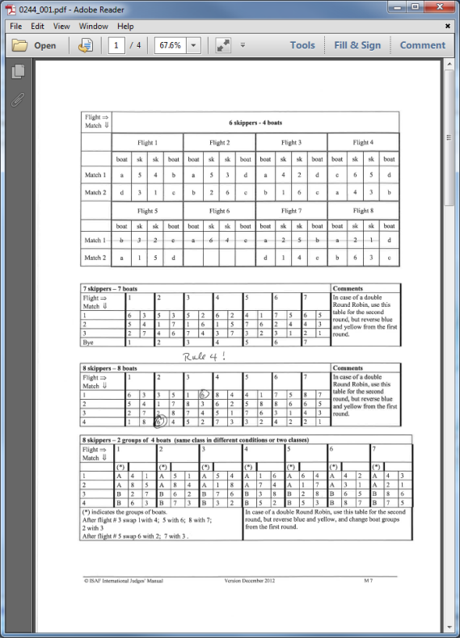
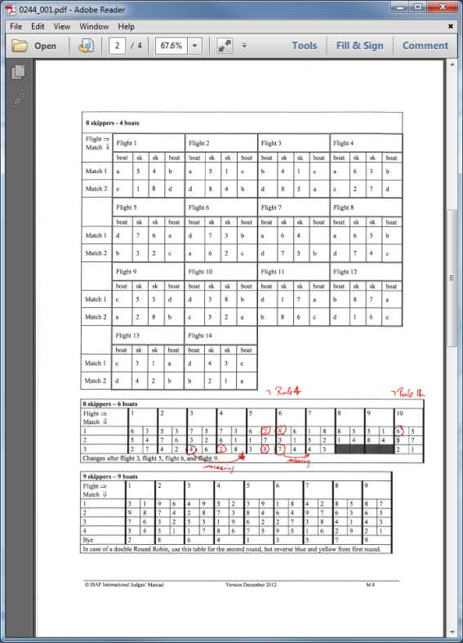
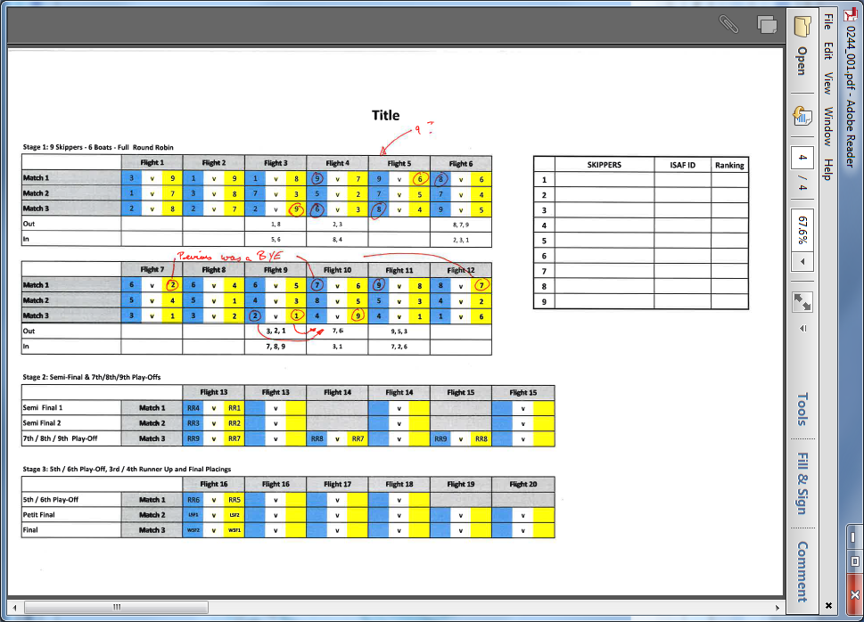
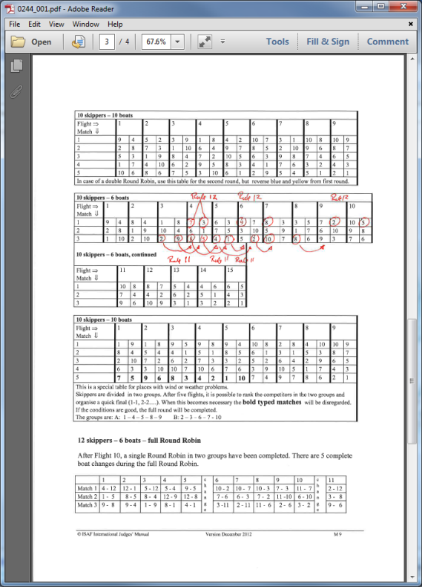
Published Schedules
So?
Many schedules violate the published criteria.
Many schedules are missing.
Many schedules are very poor (wrt boat changes)

Slide 96
So?
Our schedules are
Good (generally better than published)
Legal!
Take a long time to produce (allow days for optimisation, why not)

Slide 97
So?
Our schedules are
Good (generally better than published)
Legal!
Take a long time to produce (allow days for optimisation, why not)
Technical Issues
Modelling was not easy, we had communications problems, diagrams and DFA helped greatly
CP allowed nice incremental development
Phase 4 (orientation) is always easy and we don’t know why
Implemented a separate system to validate schedules, recognising criteria violations
Implemented non-CP for phase 1 to validate CP and test out heuristics and symmetry breaking

Slide 98
So?
Our schedules are
Good (generally better than published)
Legal!
Take a long time to produce (allow days for optimisation, why not)
Technical Issues
Modelling was not easy, we had communications problems, diagrams and DFA helped greatly
CP allowed nice incremental development
Phase 4 (orientation) is always easy and we don’t know why
Implemented a separate system to validate schedules, recognising criteria violations
Implemented non-CP for phase 1 to validate CP and test out heuristics and symmetry breaking
Practical Application
Schedules will be used in West of Scotland
Liaising with international umpires, accept schedules nationally and internationally
May be able to investigate interaction between criteria

Slide 99
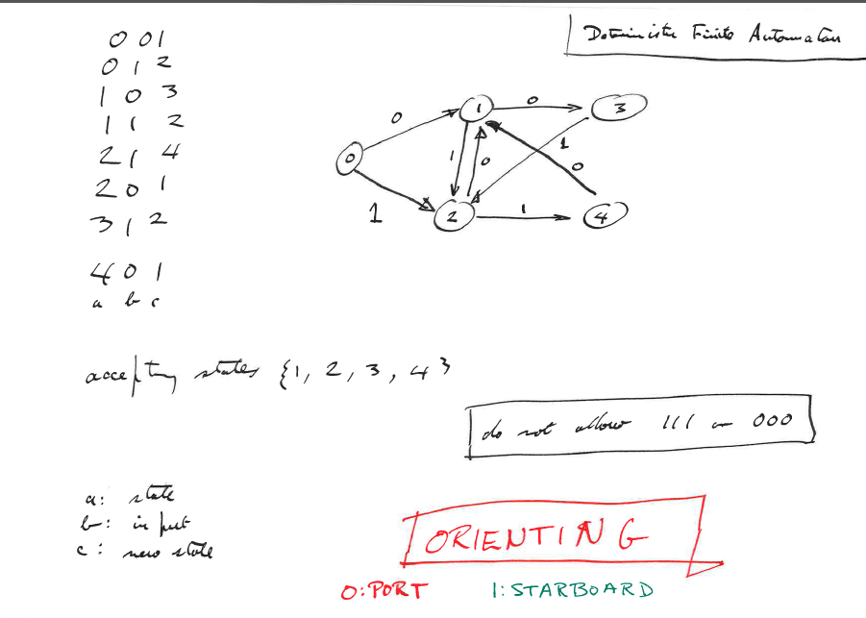
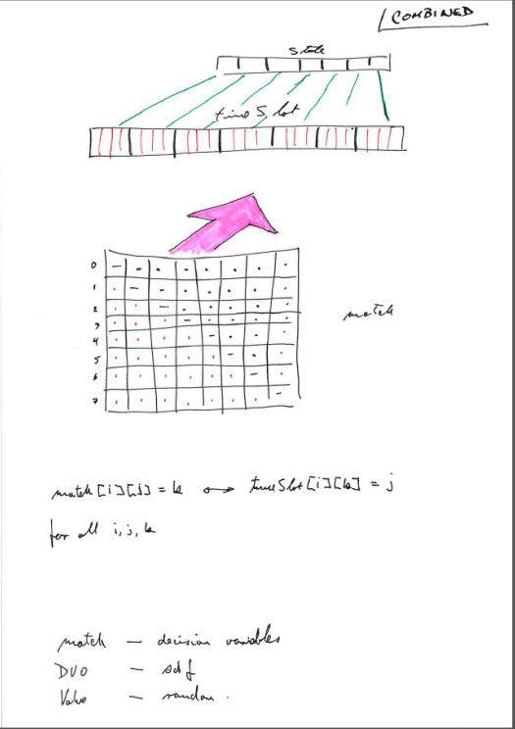
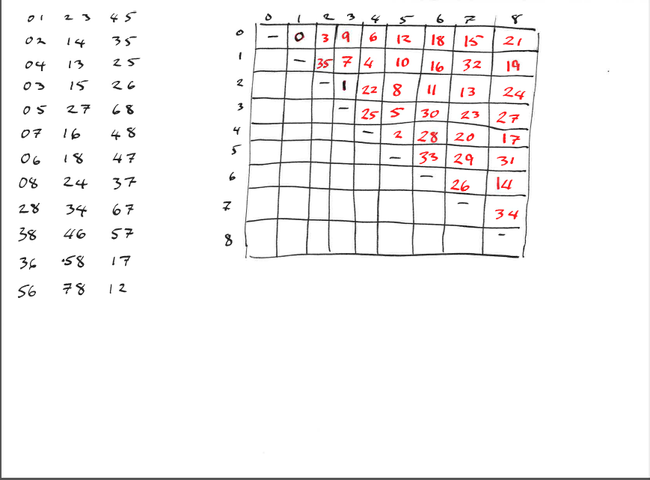

Slide 101
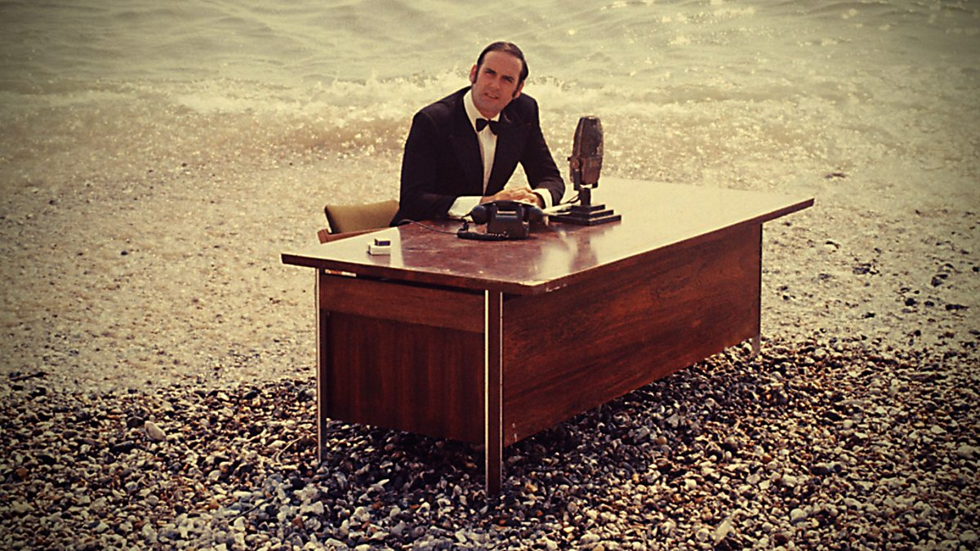

Slide 102
A matching problem
1
A
B
2
C
3
D
4

Slide 103
A matching problem
1
A
B
2
C
3
D
4
(A,4) (B,3) (C,2) (D,1)

Slide 104
Scene from an imaginary dinghy race

