Slide 1
A simple assessed exercise
Ciaran McCreesh & Patrick Prosser + 21

Slide 2
Simple assessed exercise
10 credit course
10 weeks
30 lectures
Equivalent to 100 hours in total
30 lectures
20% coursework
Self study

Slide 3
Simple assessed exercise
Simple exercise is 5% (about 1 day’s effort)
Handed out 2nd week of course
Get students using CP (get hands dirty)
Students have a rough idea about how CP works

Slide 4
Simple assessed exercise
Goals
Must be easy to make progress
Must be interesting
Should be fun
students want to solve this problem
Google-proof

Slide 5
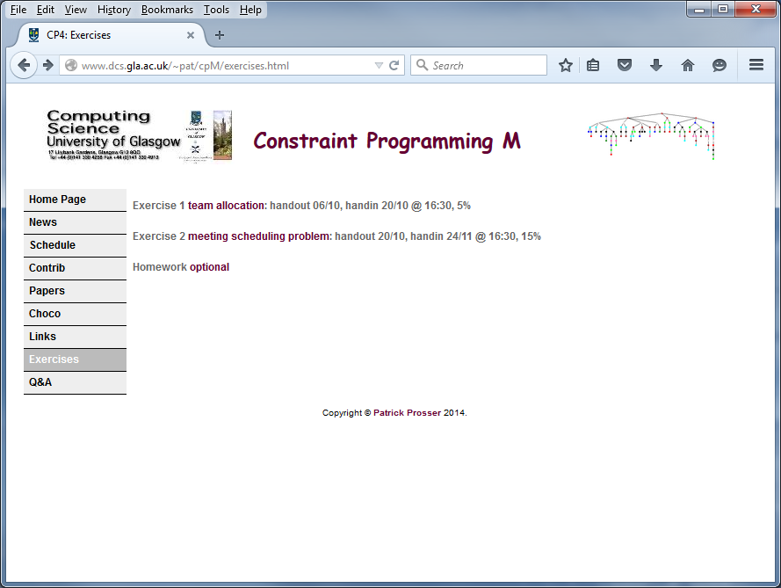
Simple assessed exercise

Slide 6
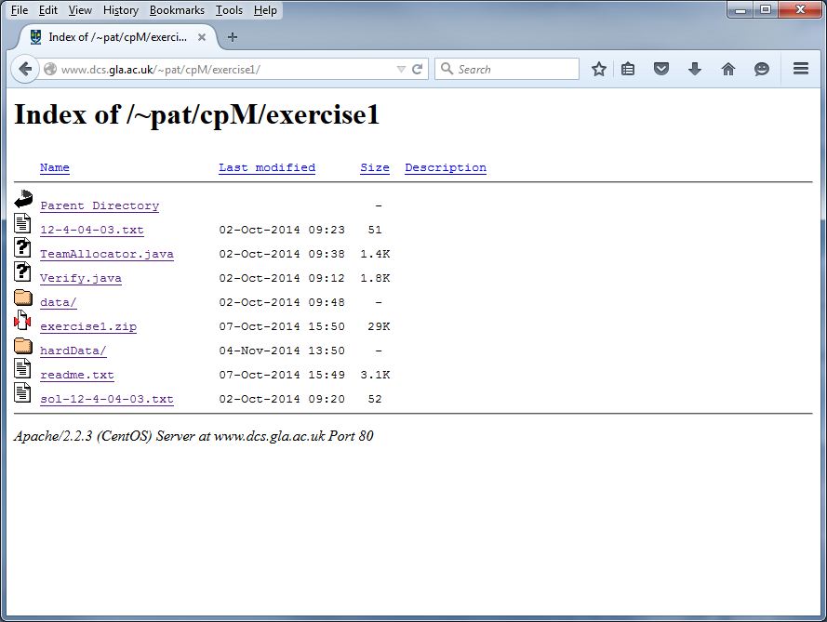
Simple assessed exercise

Slide 7
Team Allocator
Simple assessed exercise
You are given n players to be allocated to m teams (where n % m = 0).
There are constraints of the form together(i,j) and apart(i,j) where
together(i,j) means that players i and j must be in the same team
apart(i,j) that players i and j must be in different teams.
By default, players can be in any team with any other player.

Slide 8
Team Allocator
Simple assessed exercise
You are given n players to be allocated to m teams (where n % m = 0).
There are constraints of the form together(i,j) and apart(i,j) where
together(i,j) means that players i and j must be in the same team
apart(i,j) that players i and j must be in different teams.
By default, players can be in any team with any other player.
12 4
together 3 9
together 5 9
apart 2 8
apart 6 8

Slide 9
Team Allocator
Simple assessed exercise
You are given n players to be allocated to m teams (where n % m = 0).
There are constraints of the form together(i,j) and apart(i,j) where
together(i,j) means that players i and j must be in the same team
apart(i,j) that players i and j must be in different teams.
By default, players can be in any team with any other player.
12 4
together 3 9
together 5 9
apart 2 8
apart 6 8
12 players split into 4 teams (each of 3 players)

Slide 10
Team Allocator
Simple assessed exercise
You are given n players to be allocated to m teams (where n % m = 0).
There are constraints of the form together(i,j) and apart(i,j) where
together(i,j) means that players i and j must be in the same team
apart(i,j) that players i and j must be in different teams.
By default, players can be in any team with any other player.
12 4
together 3 9
together 5 9
apart 2 8
apart 6 8
Players 3 and 9 in same team
Players 5 and 9 in same team

Slide 11
Team Allocator
Simple assessed exercise
You are given n players to be allocated to m teams (where n % m = 0).
There are constraints of the form together(i,j) and apart(i,j) where
together(i,j) means that players i and j must be in the same team
apart(i,j) that players i and j must be in different teams.
By default, players can be in any team with any other player.
12 4
together 3 9
together 5 9
apart 2 8
apart 6 8
Players 2 and 8 in different teams
Players 6 and 8 in different teams

Slide 12
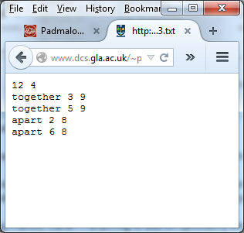
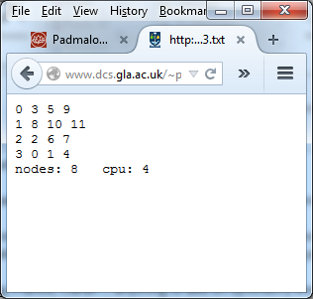
Team Allocator
Simple assessed exercise
You are given n players to be allocated to m teams (where n % m = 0).
There are constraints of the form together(i,j) and apart(i,j) where
together(i,j) means that players i and j must be in the same team
apart(i,j) that players i and j must be in different teams.
By default, players can be in any team with any other player.

Slide 13
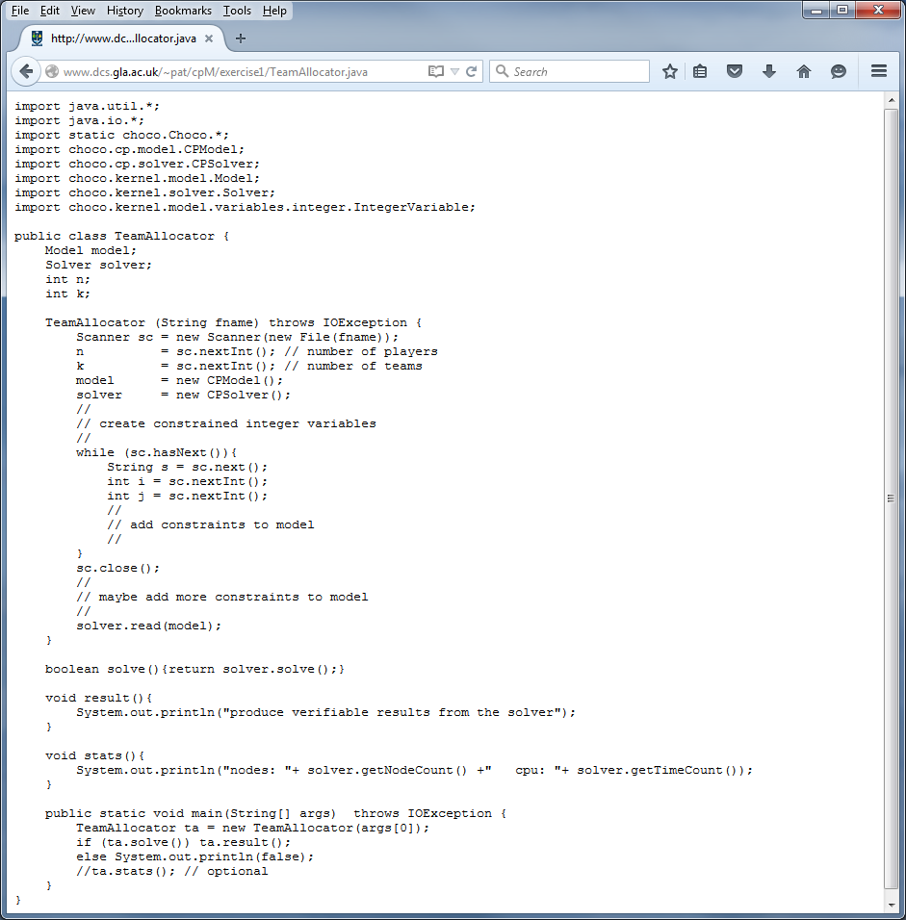
They are given code

Slide 14
They have to add code

Slide 15
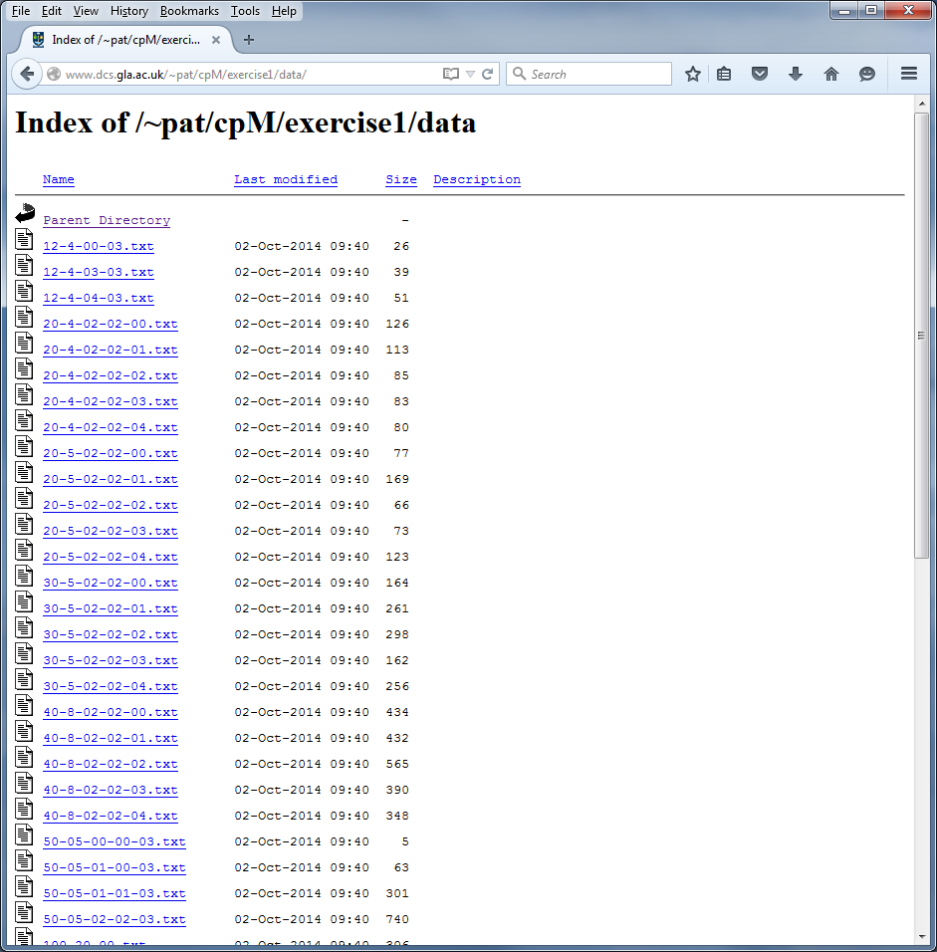
They are given problem instances

Slide 16
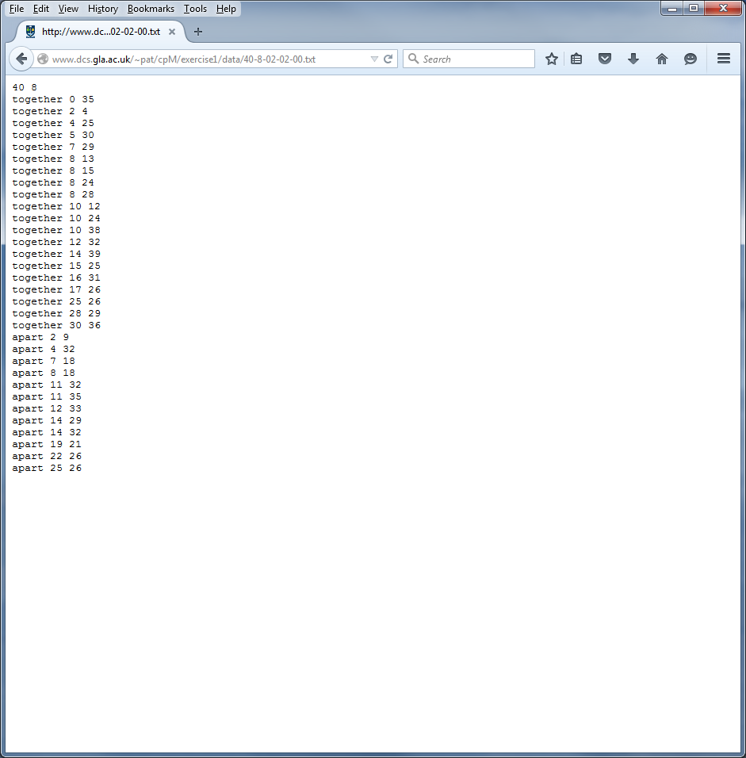
An example: 40-8-02-00.txt

Slide 17
Simple solution (and an instance)
Create an array of constrained integer variables player[0] to player[11]
Each has a domain {1..4}, the teams they can be in
For apart(i,j) post constraint player[i] ≠ player[j]
For together(i,j) post constraint player[i] = player[j]
Use occurrence or cardinality constraint to ensure that each team
occurs n/m times (i.e. number of players per team is satisfied)
Easy to get hands dirty

Slide 18
Simple solution (and an instance)
Create an array of constrained integer variables player[0] to player[11]
Each has a domain {1..4}, the teams they can be in
For apart(i,j) post constraint player[i] ≠ player[j]
For together(i,j) post constraint player[i] = player[j]
Use occurrence or cardinality constraint to ensure that each team
occurs n/m times (i.e. number of players per team is satisfied)
A variant of equitable graph colouring
Easy to get hands dirty

Slide 19
Alternatives & richness
Use a 0/1 model, 2D array, row for team, column for player
Use set variables, a set for each team
Pre-processing
Symmetry breaking
Variable ordering heuristics
We have hard instances (>12 hours to solve)
Devoted 1 lecture to discussing problem after deadline

Slide 20
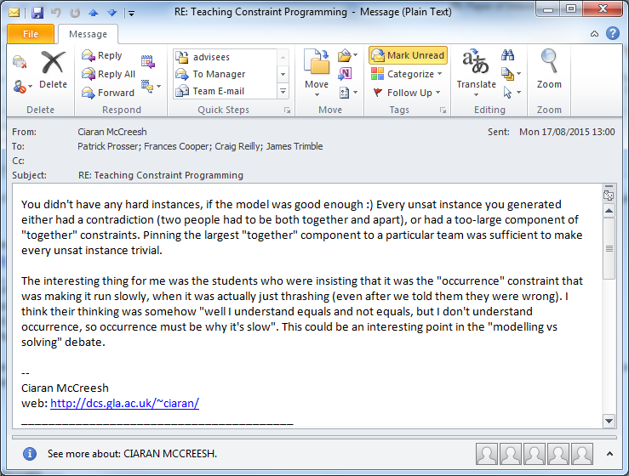
The dark side of ex01
Alternatives & richness

Slide 21
The dark side of ex01
Alternatives & richness

Slide 22
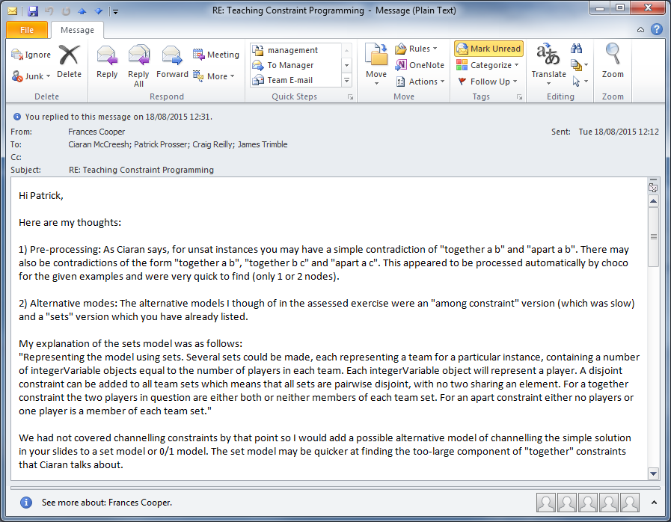

Slide 24
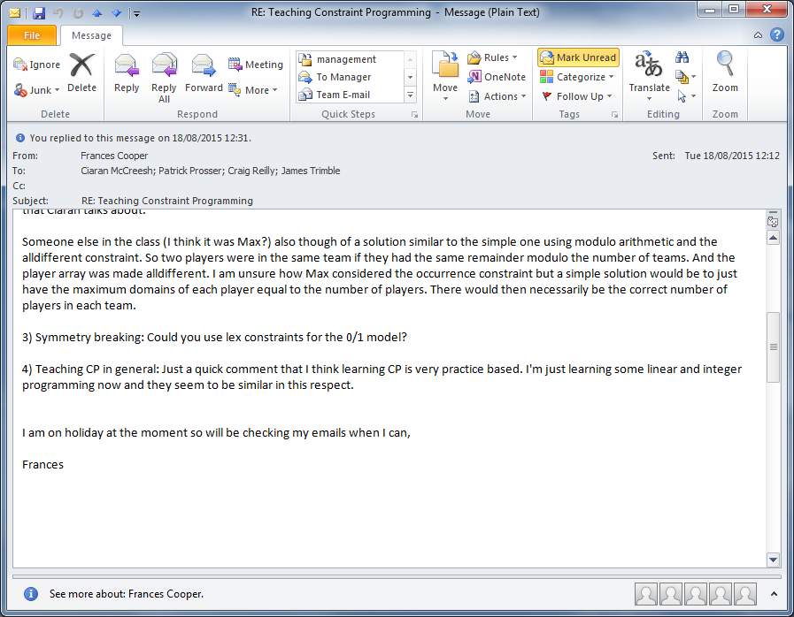

Slide 27
Google-proof?
20 animals escape from the zoo
We have 5 cages to put them in
Each cage can take at most 4 animals
The following animals cannot be in the same cage
The rabbit and the fox
The spider and the fly
The worm and the robin
…

Slide 28
Simple assessed exercise
It does take some effort to make an exercise

Slide 29
conclusion
This went surprisingly well
I think they liked the problem
Generated a lot of discussion & interaction
I think they got the idea of CP and the problems we can solve
Not just mashing up data

Slide 30
… with a little help from my friends

