Slide 1
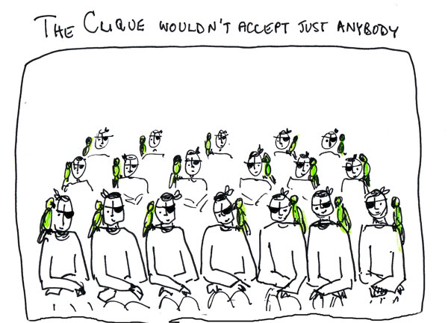
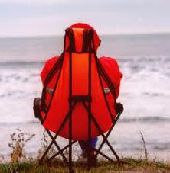
When intuition is wrong
Heuristics for clique and maximum clique
Patrick Prosser esq.

Slide 3
You have a set of people
You have to produce the largest group of people such
that everyone in the group knows each other
How would you do that?

Slide 4
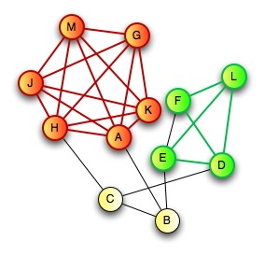

Slide 7
Solve it!
To a man with a hammer everything looks like a nail

Slide 8
lovely lovely java

Slide 9
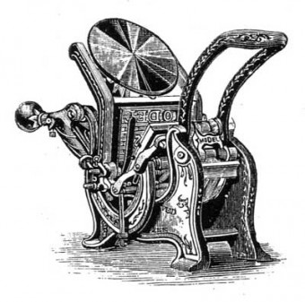
Model 3

Slide 10
Model 3
colouring lower bound

Slide 11
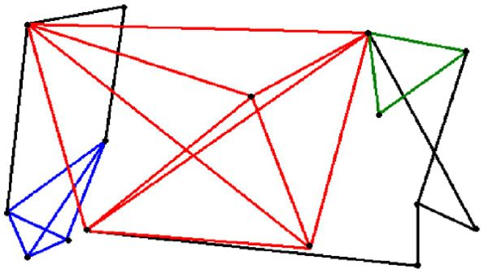
GT[19]
clique(n,p,k)
Given a random graph G(n,p) is there a clique of size k or more?

Slide 12
GT[19]
clique(n,p,k)
Given a random graph G(n,p) is there a clique of size k or more?
A “decision problem”, NP-complete

Slide 13
GT[19]
clique(n,p,k)
Given a random graph G(n,p) is there a clique of size k or more?
A “decision problem”, NP-complete
What we did:
Generate 100 instances of G(50,0.9)
Vary k from 1 to 50
apply Model 1 with max-degree heuristic
measure search cost of clique(G(50,0.9), k)
determine if sat or unsat
Analyse results (5,000 points)

Slide 14
Search effort (decisions)

Slide 15
Search effort (decisions)
max
mean
scatter
med
Vary that

Slide 16
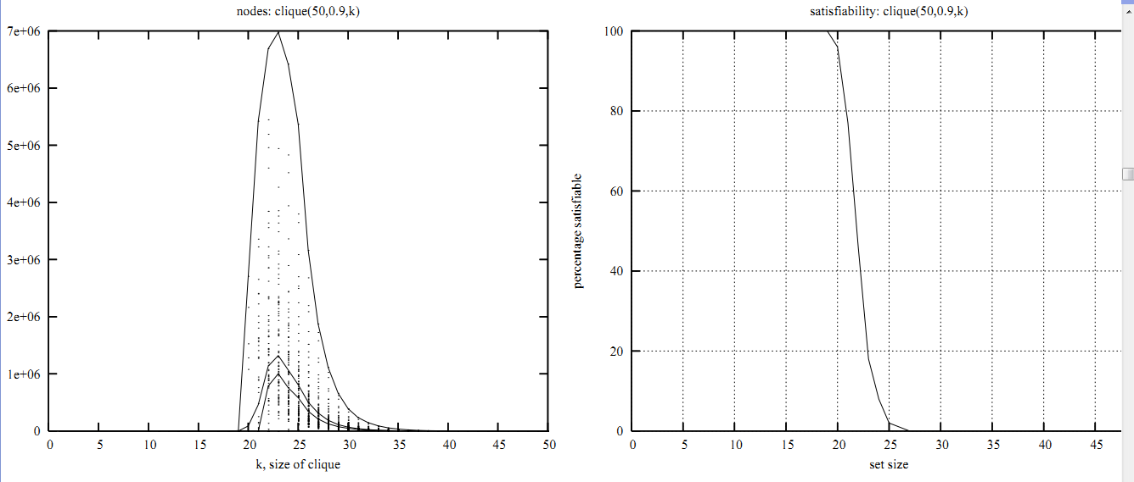
Complexity peak coincide with crossover point

Slide 17
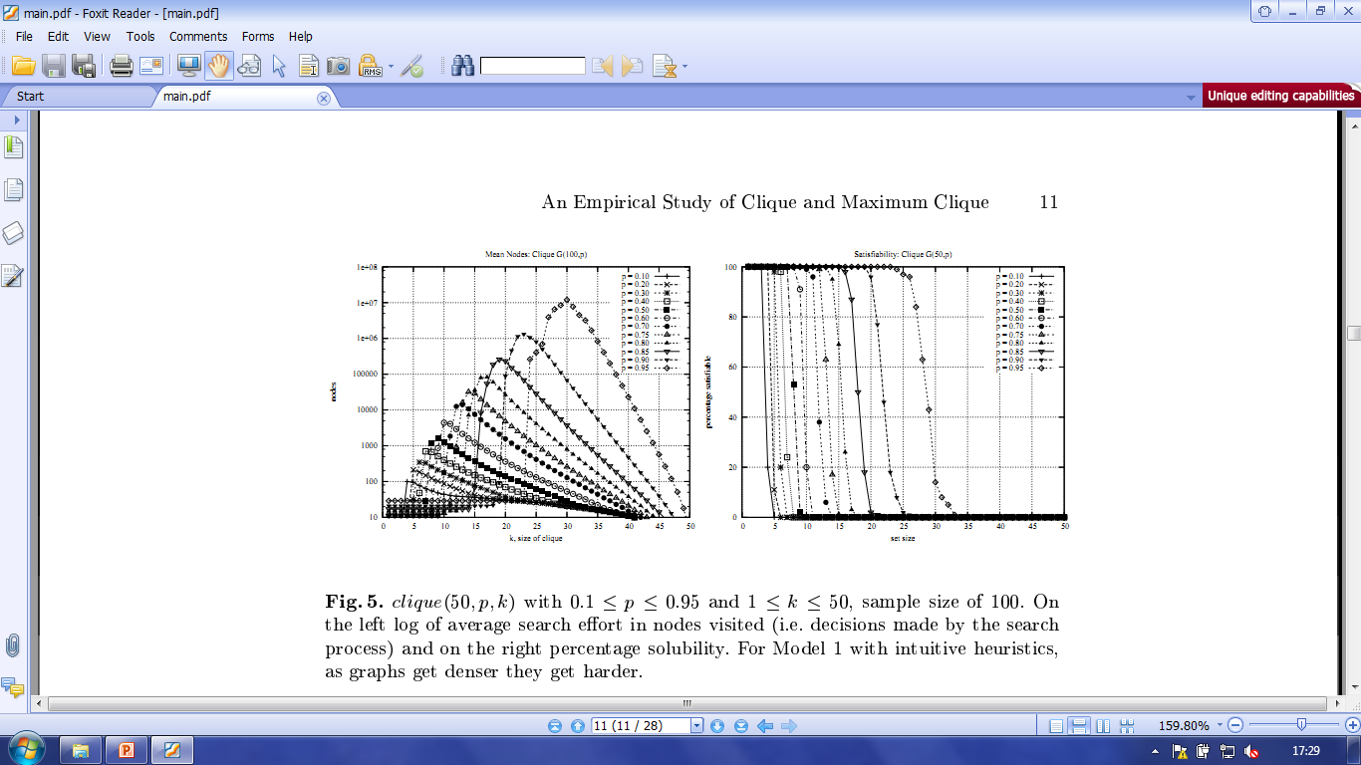
vary p

Slide 18
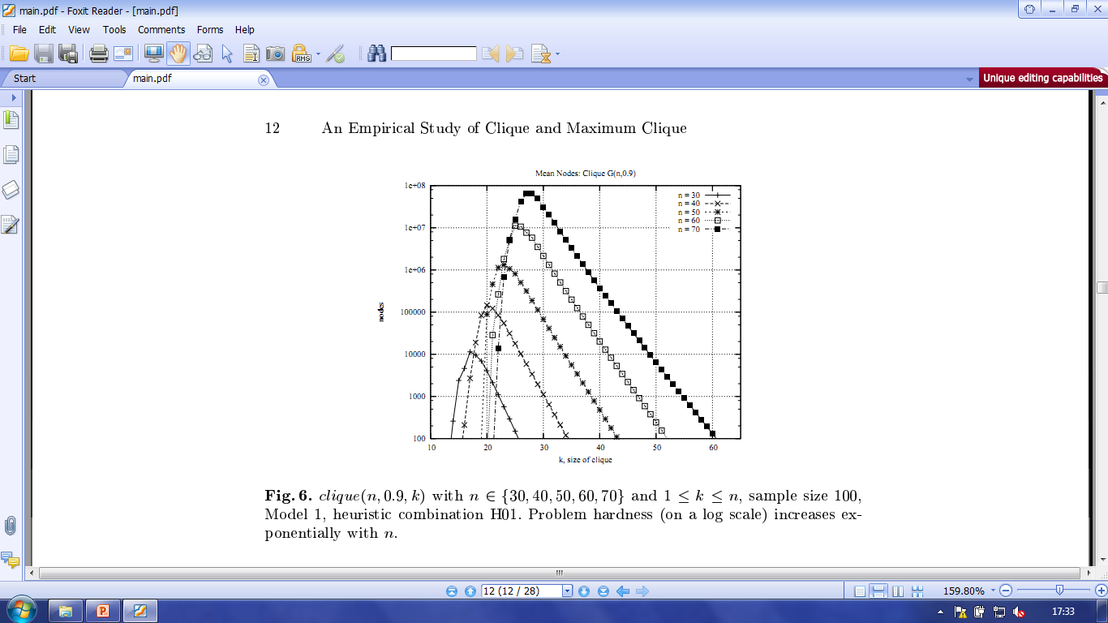
vary n

Slide 19
clique(50,0.9,k) for four heuristics

Slide 21
Search is on a log scale!

Slide 22
What are those heuristics?!

Slide 23
H00: choose max degree and reject
H01: choose max degree and accept
H10: choose min degree and reject
H11: choose min degree and accept

Slide 24
H00: choose max degree and reject
H01: choose max degree and accept
H10: choose min degree and reject
H11: choose min degree and accept
H1*

Slide 25
WHY?
H1*

Slide 26
SoCS-TV

Slide 27
Normal service will soon be resumed
SoCS-TV

Slide 28
… but just to build tension, here’s what happens when
we compare models (normal service will soon be resumed)

Slide 29
… and we are back
SoCS-TV

Slide 31
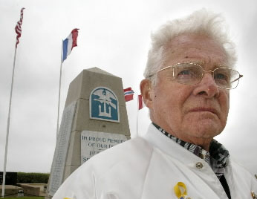
What’s all that “phase transition” malarkey?

Slide 32
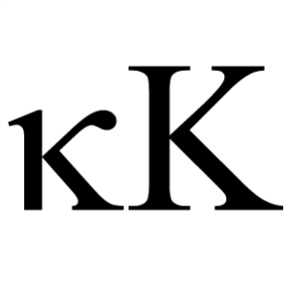
Constrainedness (circa 1996)

Slide 33
kappa for clique

Slide 34
kappa for clique
kappa seems to work … it fits the empirical results reasonably well

Slide 35
minimise kappa

Slide 36
minimise kappa
When you make a decision make sure it drives you into the easy soluble region … capiche?
easy
soluble

Slide 37
minimise kappa

Slide 38
minimise kappa

Slide 39
minimise kappa

Slide 40
minimise kappa

Slide 41
minimise kappa

Slide 42
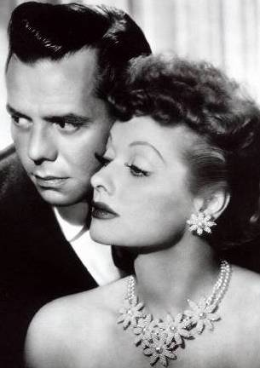
I wonder if kappa can predict heuristic behaviour?

Slide 43
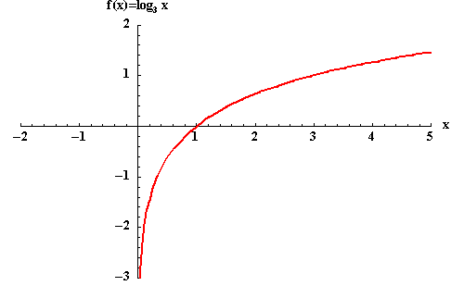

Slide 44
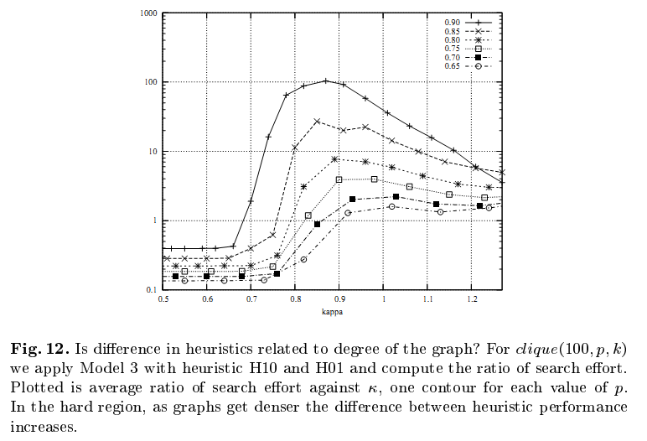

Slide 45
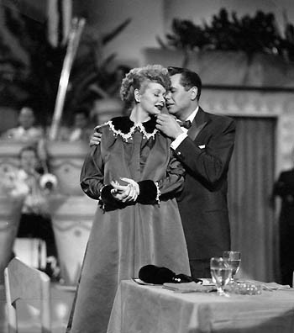
If a heuristic is good for the decision problem, will it be good for optimisation?

Slide 46
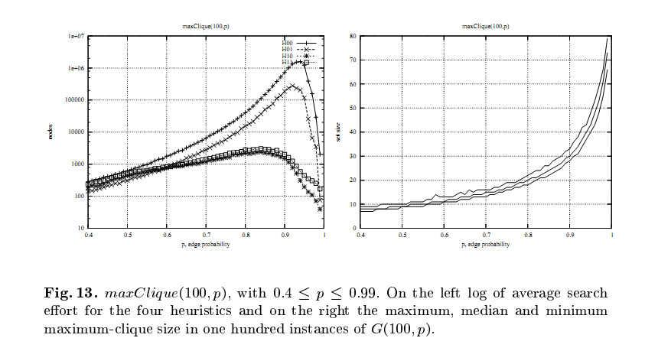
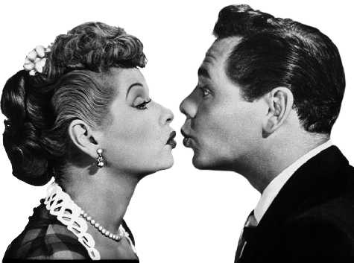
optimisation

Slide 47
What about the DIMACS benchmarks?

Slide 48
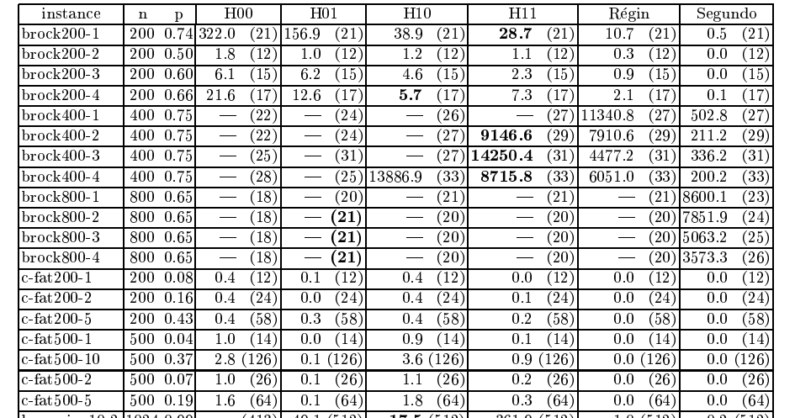
DIMACS

Slide 49
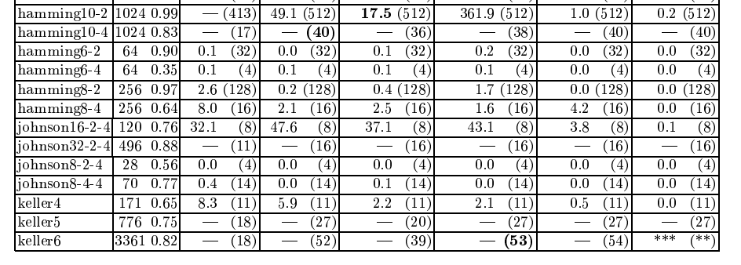
DIMACS

Slide 50
DIMACS
?

Slide 51
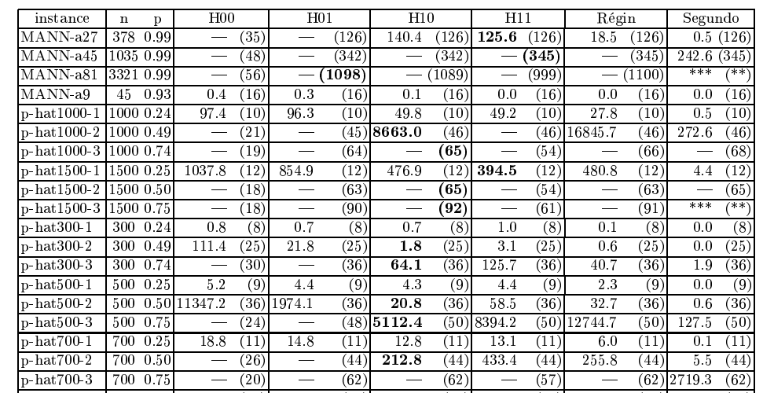
DIMACS

Slide 52
DIMACS

Slide 53
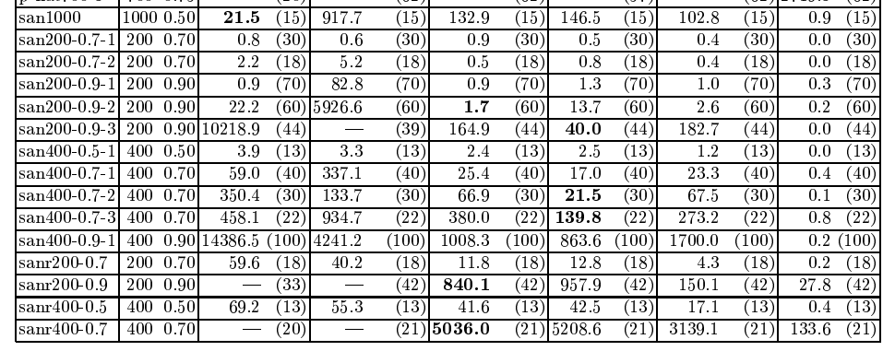
DIMACS

Slide 54
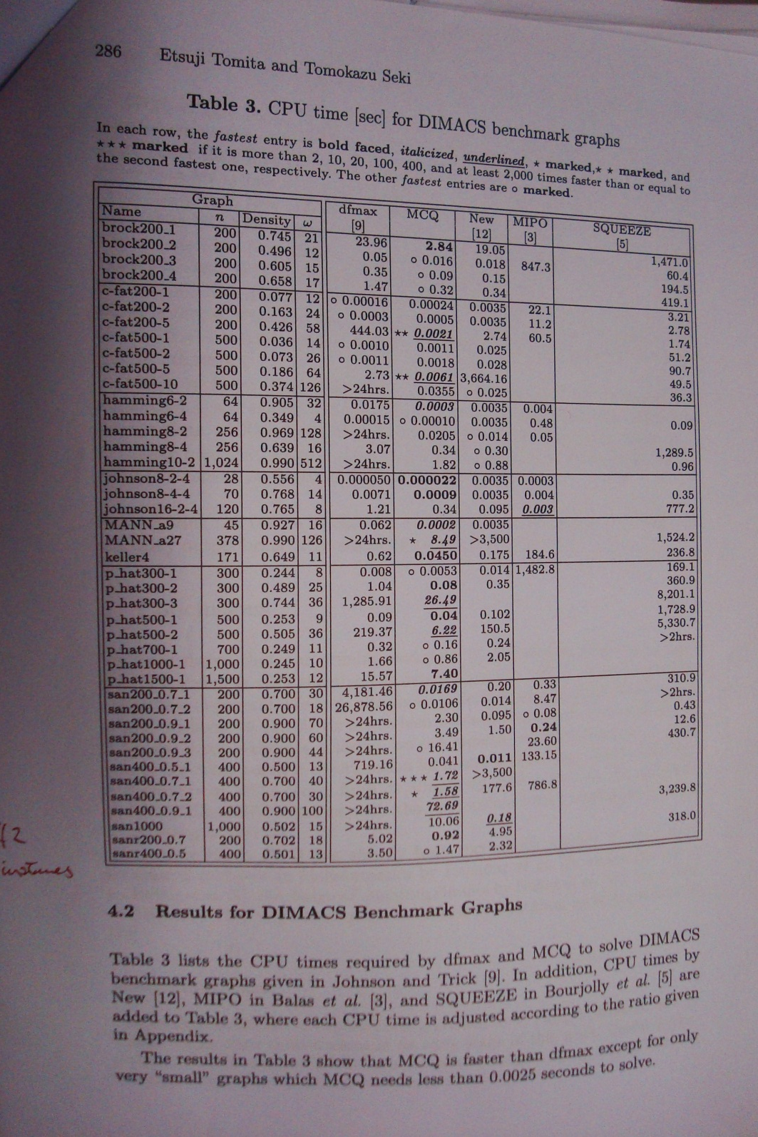
How not to do it

Slide 55
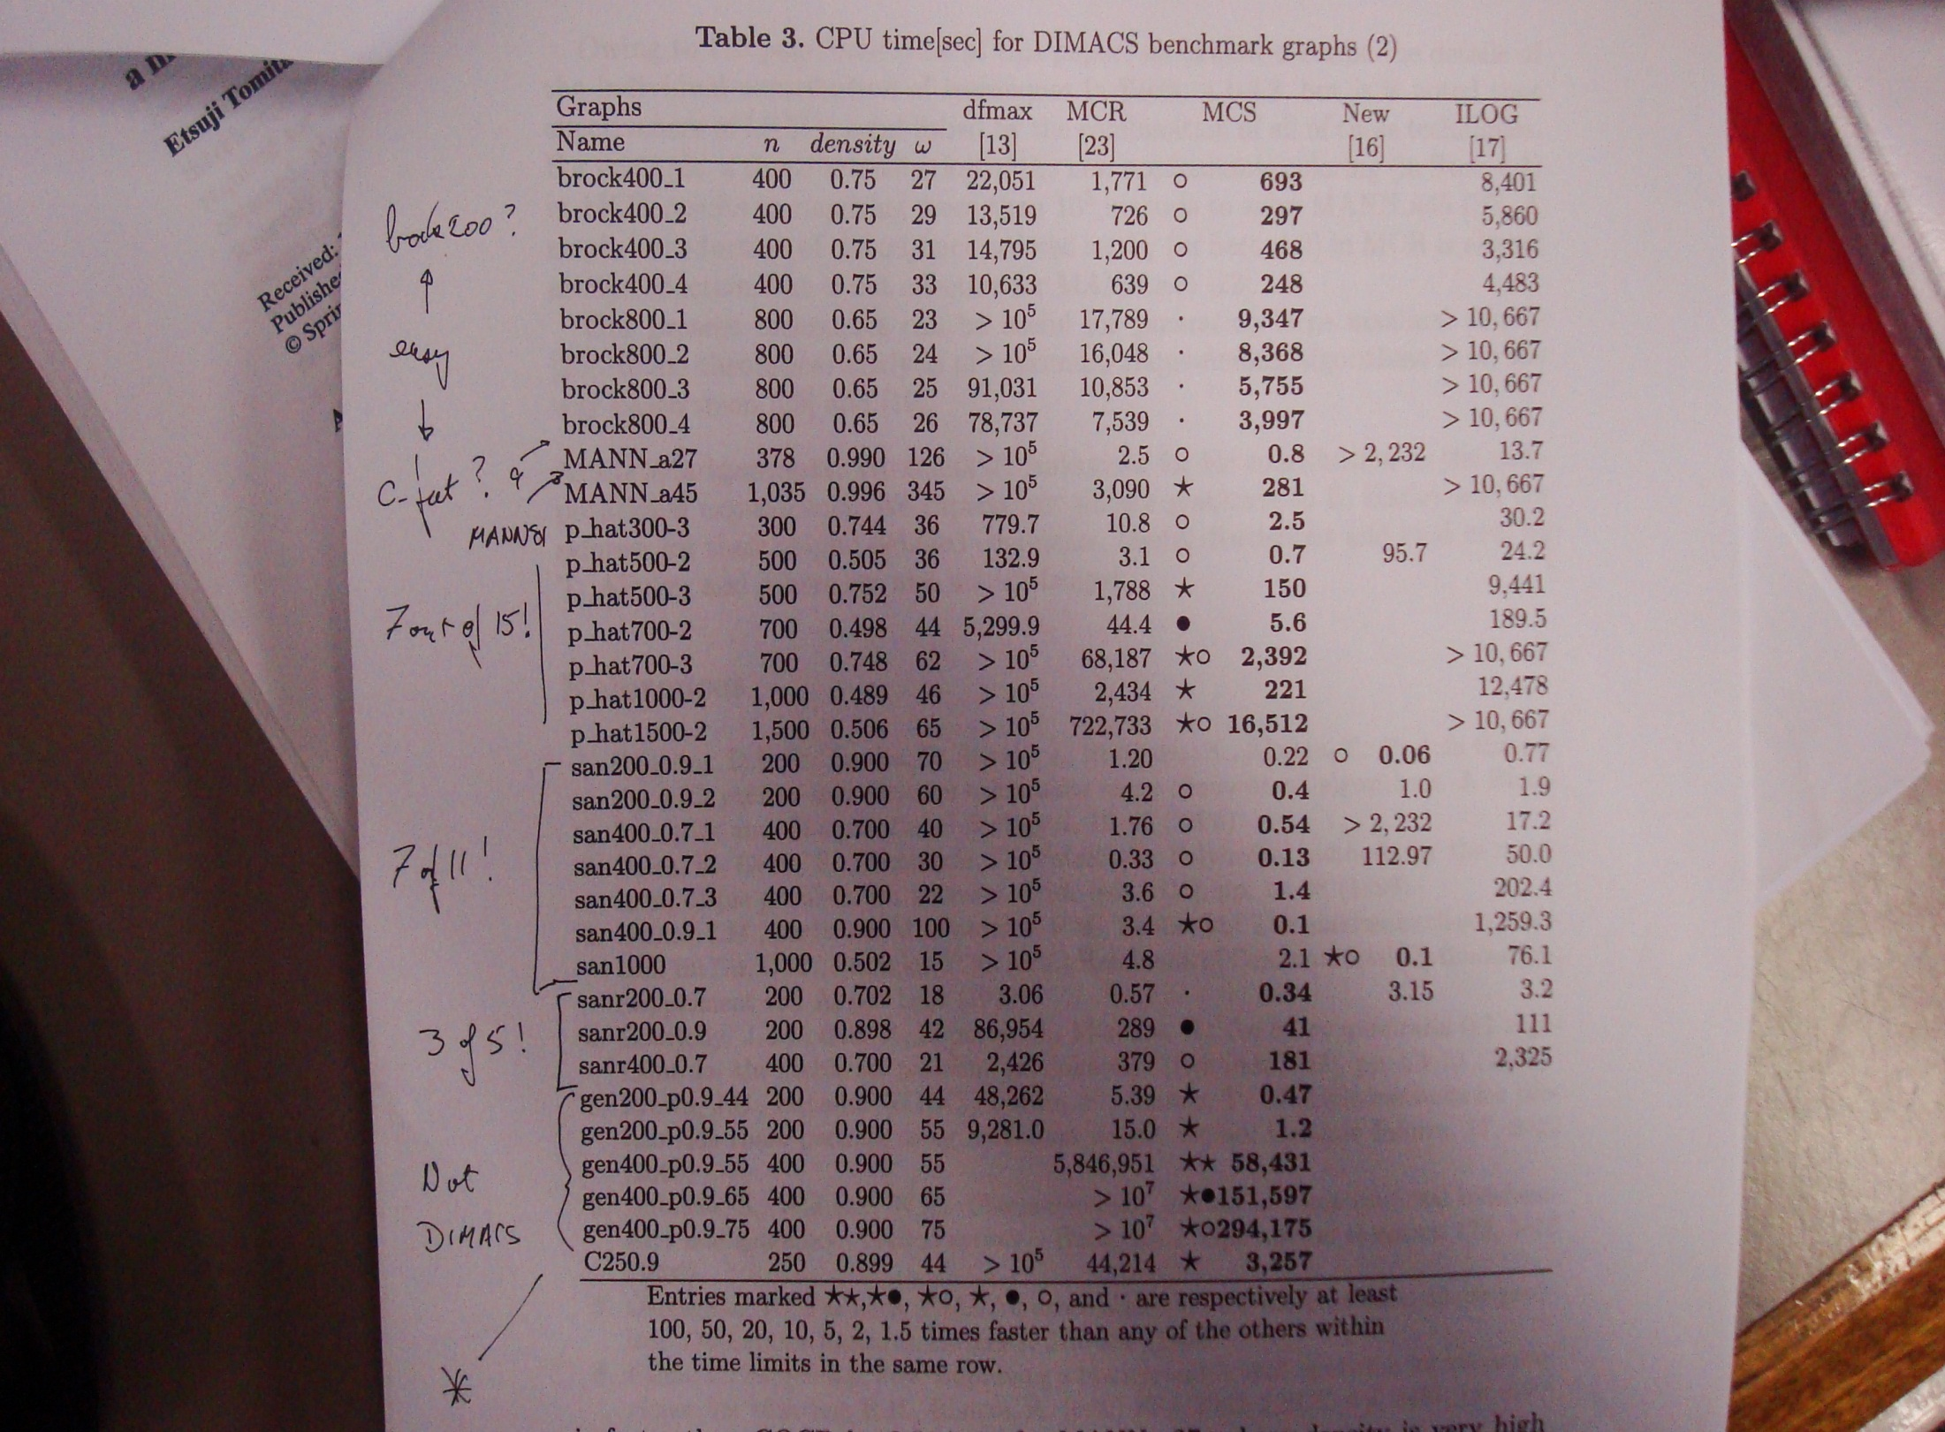
How not to do it

Slide 56
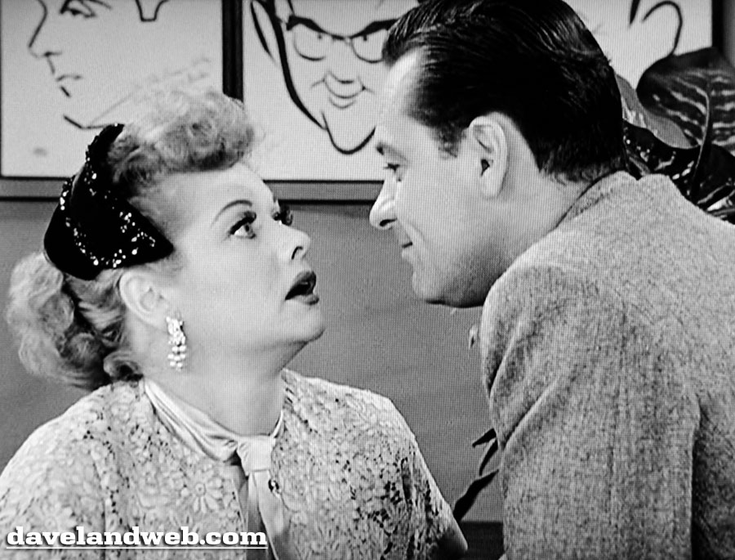
Could we predict the size of the largest clique?

Slide 57
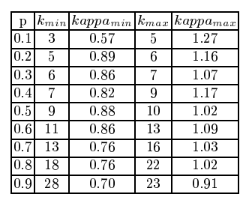

Slide 58
But we must apply this with caution … we cannot always assume that the graph is random.

Slide 59
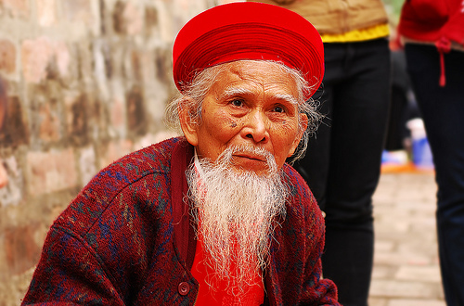
What lessons have I learned?

Slide 60
What lessons have I learned?
If ethical approval is not required, go wild!

Slide 61
What lessons have I learned?
Try and explain why things are the way they are.

Slide 62
What lessons have I learned?
If there is theory … use it!

Slide 63
What lessons have I learned?
Be honest … report all of your results

Slide 64
What lessons have I learned?
And finally … never lend anyone any books

Slide 65
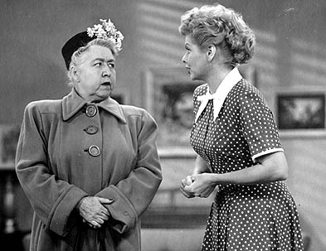
But what about Michaela Regneri’s dinner?

Slide 66
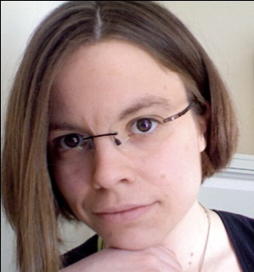

Slide 67
FATA-TV

