Slide 1
Subgraph Isomorphism Problem
Simple algorithms

Slide 2
Given two graphs G = (V,E) and H = (W,F)
is there a subgraph of H that is isomorphic to G?

Slide 3
Given two graphs G = (V,E) and H = (W,F)
is there a subgraph of H that is isomorphic to G?
“Is there a copy of the pattern graph (G) in the target graph (H)”

Slide 4
Given two graphs G = (V,E) and H = (W,F)
is there a subgraph of H that is isomorphic to G?
“Is there a copy of the pattern graph (G) in the target graph (H)”
NP-hard in general

Slide 5
1
a
4
b
c
3
2
G
H

Slide 6
1
a
4
b
c
3
2
G
H
One of many mappings

Slide 7
1
a
4
b
c
3
2
G
H
Note: varieties of interpretation (induced, non-induced)

Slide 8
1
a
4
b
c
3
2
G
H
Here:
map a pattern vertex i (in G) to a target vertex v (in H) iff
degree(i) ≤ degree(v)
map pattern vertices i and j to target vertices v and w iff
adjacent(G,i,j) → adjacent(H,v,w)
mapping is injective

Slide 9
1
map a pattern vertex i (in G) to a target vertex v (in H) iff
degree(i) ≤ degree(v)
map pattern vertices i and j to target vertices v and w iff
adjacent(G,i,j) → adjacent(H,v,w)
mapping is injective
a
4
b
c
3
2
G
H

Slide 10
1
map a pattern vertex i (in G) to a target vertex v (in H) iff
degree(i) ≤ degree(v)
map pattern vertices i and j to target vertices v and w iff
adjacent(G,i,j) → adjacent(H,v,w)
mapping is injective
a
4
b
c
3
2
G
H
Model/Algorithm
Create a set of variable v₁ to v_{n} corresponding to pattern vertices (those in G)
Each variable has as a domain the vertices in the target graph (H)
Using a backtracking search, instantiate the variables respecting the constraints above

Slide 11
1
map a pattern vertex i (in G) to a target vertex v (in H) iff
degree(i) ≤ degree(v)
map pattern vertices i and j to target vertices v and w iff
adjacent(G,i,j) → adjacent(H,v,w)
mapping is injective
a
4
b
c
3
2
G
H
Model/Algorithm
Create a set of variable v₁ to v_{n} corresponding to pattern vertices (those in G)
Each variable has as a domain the vertices in the target graph (H)
Using a backtracking search, instantiate the variables respecting the constraints above
Remove from domain of v_{i} target vertices with insufficient degree

Slide 12
1
map a pattern vertex i (in G) to a target vertex v (in H) iff
degree(i) ≤ degree(v)
map pattern vertices i and j to target vertices v and w iff
adjacent(G,i,j) → adjacent(H,v,w)
mapping is injective
a
4
b
c
3
2
G
H
Model/Algorithm
Create a set of variable v₁ to v_{n} corresponding to pattern vertices (those in G)
Each variable has as a domain the vertices in the target graph (H)
Using a backtracking search, instantiate the variables respecting the constraints above
Remove from domain of v_{i} target vertices with insufficient degree
Remove from domain of v_{i} target vertices with insufficient neighbourhood degree sequence

Slide 13
1
map a pattern vertex i (in G) to a target vertex v (in H) iff
degree(i) ≤ degree(v)
map pattern vertices i and j to target vertices v and w iff
adjacent(G,i,j) → adjacent(H,v,w)
mapping is injective
a
4
b
c
3
2
G
H
Model/Algorithm
Create a set of variable v₁ to v_{n} corresponding to pattern vertices (those in G)
Each variable has as a domain the vertices in the target graph (H)
Using a backtracking search, instantiate the variables respecting the constraints above
Remove from domain of v_{i} target vertices with insufficient degree
Remove from domain of v_{i} target vertices with insufficient neighbourhood degree sequence
Label vertices with some invariant, and filter

Slide 15
Neighbourhood degree sequence

Slide 16
Domains of variables

Slide 17
Domains of variables
NOTE: vertex G can be removed and labels updated …

Slide 18
In CP-speak, this is 1-consistency

Slide 19
Simple algorithm (0)

Slide 20
Simple algorithm (SIP0)
At top of search, filter domains wrt vertex labels
In a backtracking search
Select a variable v_{i}
Assign v_{i} a value x from its domain
For all uninstantiated variables
Remove x from domain of v_{j}
If adjacent(G,i,j)
Then remove from domain of v_{j} all values y
where ¬adjacent(H,x,y)
If domain wipeout
Then try next value in domain of v_{i}
and if no more values, backtrack

Slide 21
Simple algorithm: implementation
Adjacency matrices are arrays of bitsets
adj[A] is 0111100
adj(F) is 0101001
Variable domains are bitsets
dom(1) is 1010110
dom(4) is 1001000
If adjacent(G,i,j) and v_{i} ← x
Then dom(j) ← dom(j) ˄ adj(x)
Else dom(j).unset(x)

Slide 22
Simple algorithm: implementation
Adjacency matrices are arrays of bitsets
adj[A] is 0111100
adj(F) is 0101001
Variable domains are bitsets
dom(1) is 1010110
dom(4) is 1001000
If adjacent(G,i,j) and v_{i} ← x
Then dom(j) ← dom(j) ˄ adj(x)
Else dom(j).unset(x)
Exploit parallelism in the hardware

Slide 23
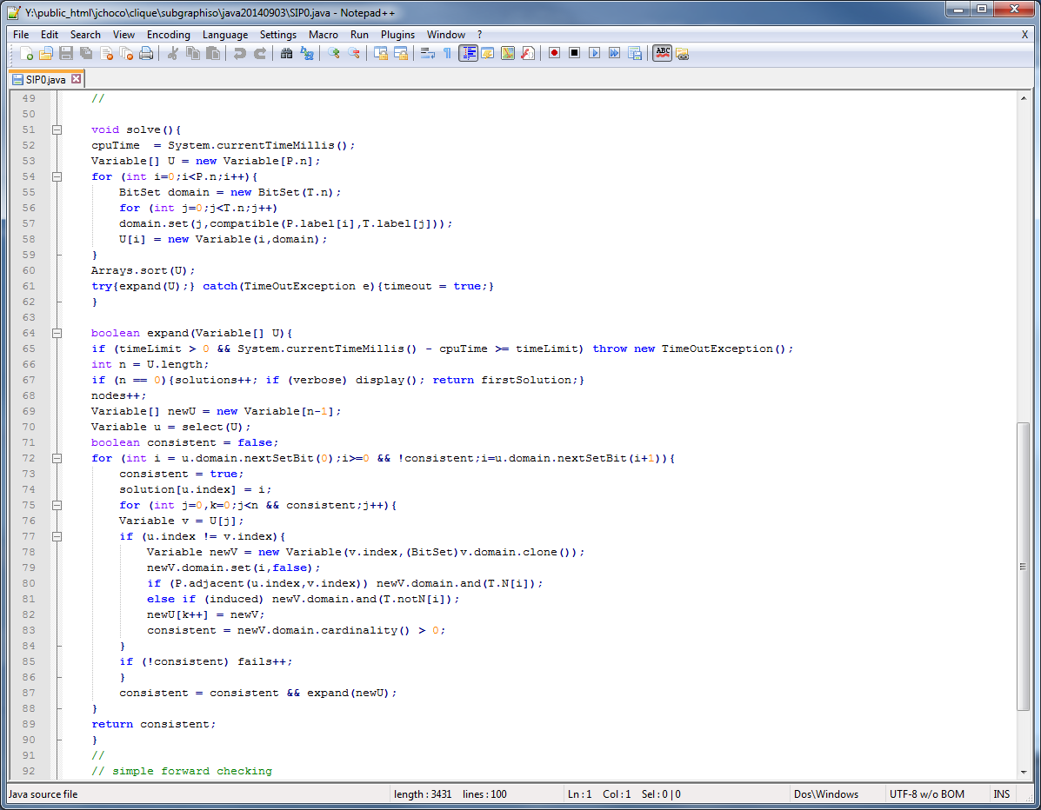

Slide 26
In CP-speak, this is forward checking (fc)

Slide 27
Simple algorithm (SIPcbj)
Jump!

Slide 28
Simple algorithm (SIPcbj)
Associate with each variable a conflict set confSet_{i}
If the instantiation of v_{i} with value x removes values from the domain of v_{j}
Then confSet_{j}.set(i,true)
If domain wipeout on v_{j}
Then confSet_{i} ← confSet_{i} ˅ confSet_{j}
dom(i).unset(x)

Slide 29
Simple algorithm (SIPcbj)
Associate with each variable a conflict set confSet_{i}
If the instantiation of v_{i} with value x removes values from the domain of v_{j}
Then confSet_{j}.set(i,true)
If domain wipeout on v_{j}
Then confSet_{i} ← confSet_{i} ˅ confSet_{j}
dom(i).unset(x)
If domain wipeout on v_{i}
Then return confSet_{i}
Else new confSet ← expand({v_{i+1} … v_{n}})

Slide 30
Simple algorithm (SIPcbj)
Associate with each variable a conflict set confSet_{i}
If the instantiation of v_{i} with value x removes values from the domain of v_{j}
Then confSet_{j}.set(i,true)
If domain wipeout on v_{j}
Then confSet_{i} ← confSet_{i} ˅ confSet_{j}
dom(i).unset(x)
If domain wipeout on v_{i}
Then return confSet_{i}
Else new confSet ← expand({v_{i+1} … v_{n}})
If consistent and ¬confSet.get(i)
Then return confSet

Slide 31
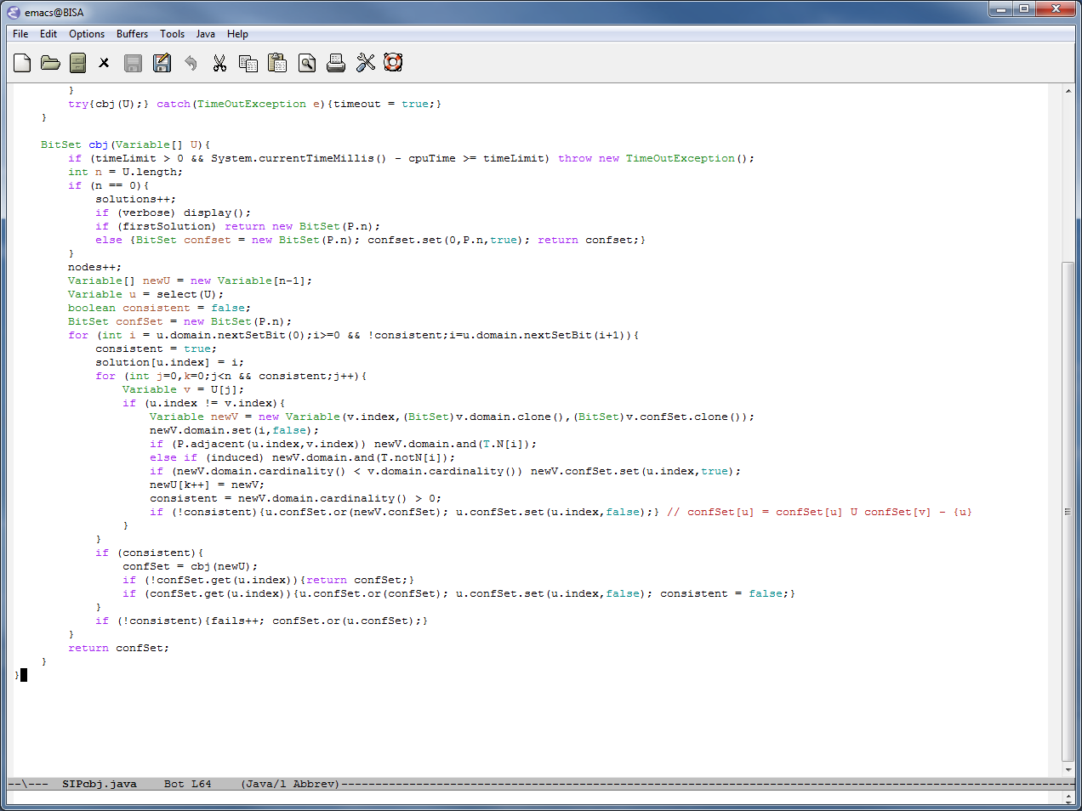

Slide 41
Simple algorithm (SIPcbj)
In CP-speak, this is forward checking
with conflict directed backjumping (fc-cbj)

Slide 42
Simple algorithm (SIP1)
v_{i} ← x
Neighbourhood domain nebDom ← Ө
Number of neighbours neb ← 0
For all uninstantiated variables j
If adjacent(G,i,j)
Then dom(j) ← dom(j) ˄ adj(x)
nebDom ← nebDom ˅ dom(j)
neb++
If |nebDom| < neb
Then fail

Slide 43
Simple algorithm (SIP1)
v_{i} ← x
Neighbourhood domain nebDom ← Ө
Number of neighbours neb ← 0
For all uninstantiated variables j
If adjacent(G,i,j)
Then dom(j) ← dom(j) ˄ adj(x)
nebDom ← nebDom ˅ dom(j)
neb++
If |nebDom| < neb
Then fail
If there are insufficient target vertices in
the domains of vertices adjacent to the
current vertex … fail!

Slide 44
Simple algorithm (SIP1)
v_{i} ← x
Neighbourhood domain nebDom ← Ө
Number of neighbours neb ← 0
For all uninstantiated variables j
If adjacent(G,i,j)
Then dom(j) ← dom(j) ˄ adj(x)
nebDom ← nebDom ˅ dom(j)
neb++
If |nebDom| < neb
Then fail
If there are insufficient target vertices in
the domains of vertices adjacent to the
current vertex … fail!
LV2002

Slide 45
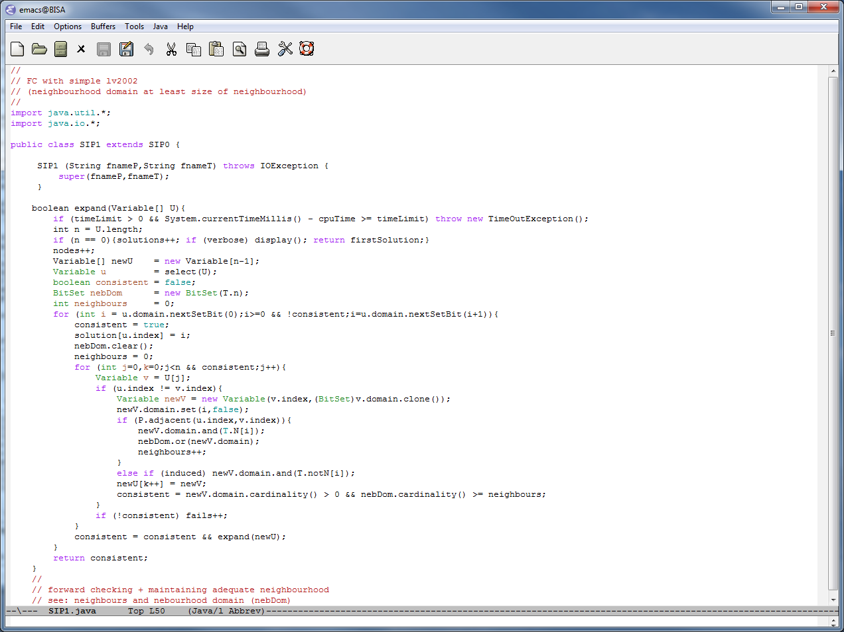

Slide 49
Simple algorithm (SIP2)
Given variables v_{i} and v_{j} where adjacent(G,i,j)
For x in dom(i)
supported ← false
For y in dom(j) while ¬supported
supported ← adjacent(H,x,y)
If ¬supported
Then remove x from dom(i)

Slide 50
Simple algorithm (SIP2)
Given variables v_{i} and v_{j} where adjacent(G,i,j)
For x in dom(i)
supported ← false
For y in dom(j) while ¬supported
supported ← adjacent(H,x,y)
If ¬supported
Then remove x from dom(i)
This is revise

Slide 51
Simple algorithm (SIP2)
Given variables v_{i} and v_{j} where adjacent(G,i,j)
For x in dom(i)
supported ← false
For y in dom(j) while ¬supported
supported ← adjacent(H,x,y)
If ¬supported
Then remove x from dom(i)
This is revise
Do this until we reach a fixed point (no removals)
Do this at top of search

Slide 52
Simple algorithm (SIP2)
Given variables v_{i} and v_{j} where adjacent(G,i,j)
For x in dom(i)
supported ← false
For y in dom(j) while ¬supported
supported ← adjacent(H,x,y)
If ¬supported
Then remove x from dom(i)
This is revise
Do this until we reach a fixed point (no removals)
Do this at top of search
This is edge arc-consistency

Slide 53
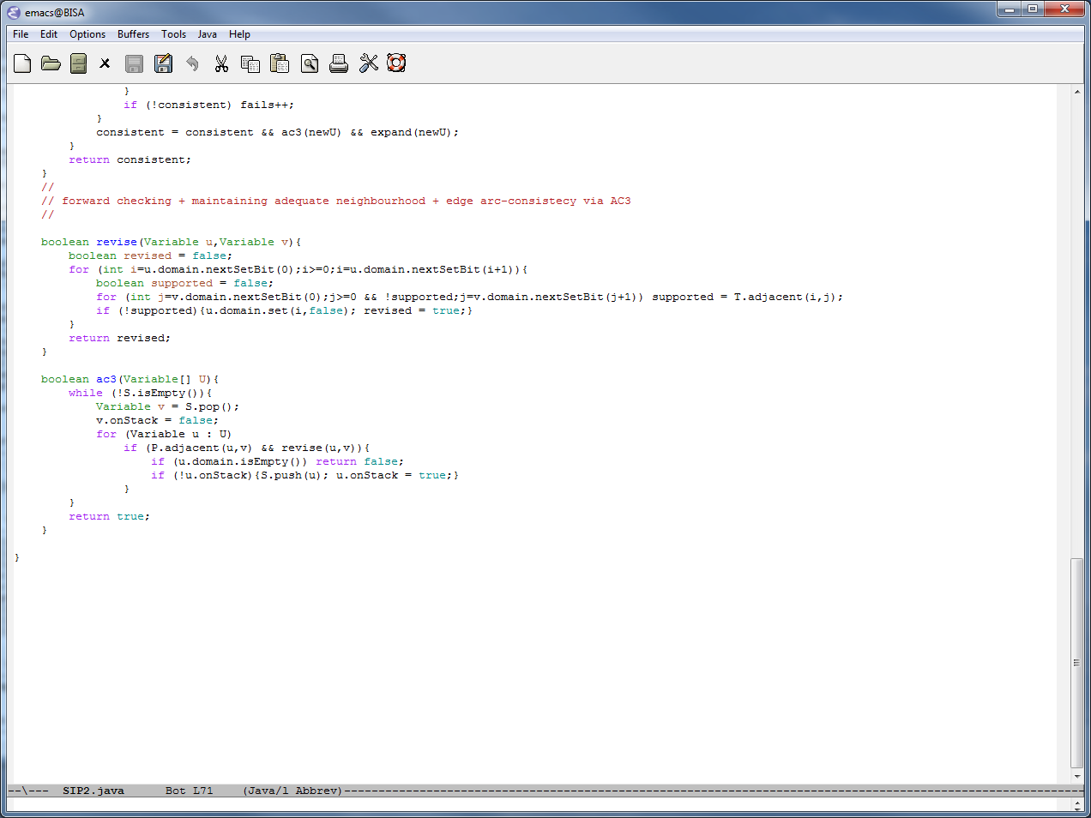

Slide 56
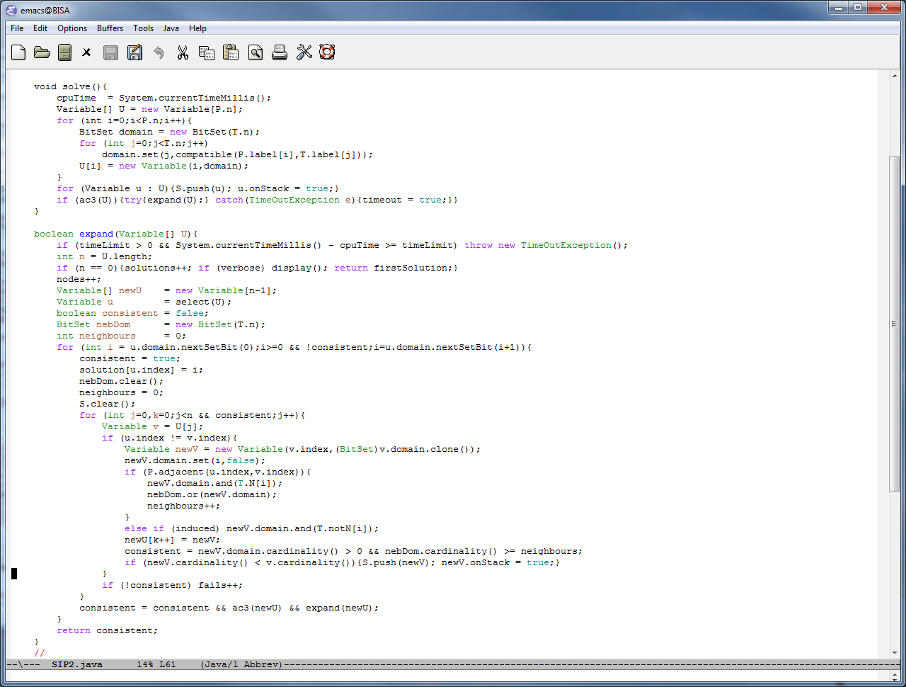

Slide 58
ac3 making better use of BitSet (algorithm SIP2b)

Slide 59
Simple algorithm (SIP3)
Sort variables in non-decreasing order of domain size
totalDomain ← Ө
nbVars ← 0
for i in 1 .. n
totalDomain ← totalDomain ˅ dom(i)
nbVars++
If |totalDomain| < nbVars
Then return false
If |totalDomain| = nbVars
Then return true
return true

Slide 60
Simple algorithm (SIP3)
Sort variables in non-decreasing order of domain size
totalDomain ← Ө
nbVars ← 0
for i in 1 .. n
totalDomain ← totalDomain ˅ dom(i)
nbVars++
If |totalDomain| < nbVars
Then return false
If |totalDomain| = nbVars
Then return true
return true
Do this at top of search
Do this inside search before a recursive call
NOTE: sorted variables then exploited as a
variable ordering heuristic

Slide 62
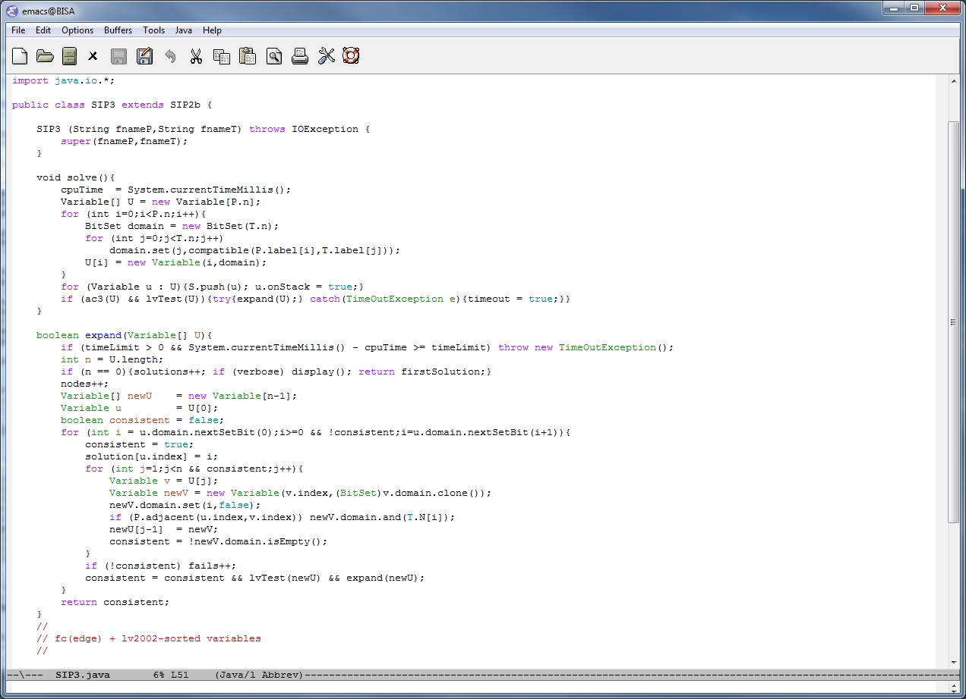

Slide 65
Simple algorithm (SIP4/5)
Compute the shortest distance between all pairs of vertices in G
Compute the shortest distance between all pairs of vertices in H
For all pairs of vertices i and j in G
For all pair of vertices x and y in H
If minDistance(G,i,j) < minDistance(H,x,y)
Then disallow pair of assignments v_{i} ← x and v_{j} ← y

Slide 66
Simple algorithm (SIP4/5)
Compute the shortest distance between all pairs of vertices in G
Compute the shortest distance between all pairs of vertices in H
For all pairs of vertices i and j in G
For all pair of vertices x and y in H
If minDistance(G,i,j) < minDistance(H,x,y)
Then disallow pair of assignments v_{i} ← x and v_{j} ← y
Replace ac(edge) with ac(minDistance)

Slide 67
Simple algorithm (SIP4/5)
Compute the shortest distance between all pairs of vertices in G
Compute the shortest distance between all pairs of vertices in H
For all pairs of vertices i and j in G
For all pair of vertices x and y in H
If minDistance(G,i,j) < minDistance(H,x,y)
Then disallow pair of assignments v_{i} ← x and v_{j} ← y
Replace ac(edge) with ac(minDistance)
Identify “Hall sets” in lvTest

Slide 68
Conclusions
There is a long history of algorithms for SIP, dating from Ullmann (1972),
J.J. McGregor (1979), Jean-Charles Regin, up to state of the art by Larrosa & Valiente,
Solnon et al and most recently Christophe Lecoutre et al (CP2014)

Slide 69
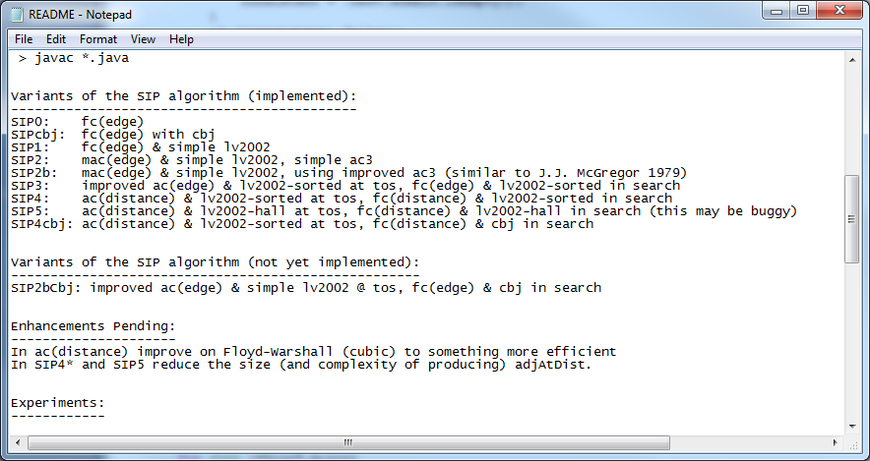
Conclusions
So far I have about 9 variations on the basic algorithm with
the bitset encoding. I need to identify just how many variations there
might be and perform a full set of experiments on the benchmarks

Slide 70
Conclusions
So far I have about 9 variations on the basic algorithm with
the bitset encoding. I need to identify just how many variations there
might be and perform a full set of experiments on the benchmarks
We have variants for induced SIP and directed graphs with weighted edges

Slide 71
That’s all … thanks.

