Slide 1
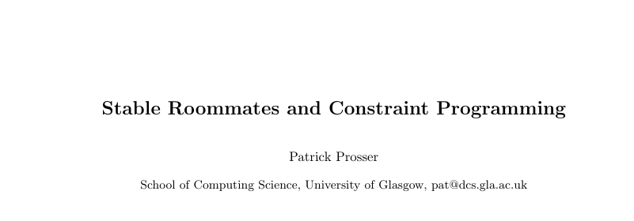


Slide 2
What’s the problem?
Something like stable marriage problem … but without sex.

Slide 3
Stable Marriage Problem (SM)
What’s the problem?
Ant: Bea, Ann, Cat
Ann: Bob, Ant, Cal
Bob: Bea, Cat, Ann
Bea: Cal, Ant, Bob
Cal: Ann, Bea, Cat
Cat: Cal, Bob, Ant
Men rank women,
Women rank men
Match men to women in a matching M such that
there is no incentive for a (m,w) pair not in M
to divorce and elope
- i.e. it is stable, there are no blocking pairs
Order n squared

Slide 4
Stable Marriage Problem (SM)
What’s the problem?
Ant: Bea, Ann, Cat
Ann: Bob, Ant, Cal
Bob: Bea, Cat, Ann
Bea: Cal, Ant, Bob
Cal: Ann, Bea, Cat
Cat: Cal, Bob, Ant
Men rank women,
Women rank men
Match men to women in a matching M such that
there is no incentive for a (m,w) pair not in M
to divorce and elope
- i.e. it is stable, there are no blocking pairs
Order n squared

Slide 5
Stable Marriage Problem (SM)
What’s the problem?
Ant: Bea, Ann, Cat
Ann: Bob, Ant, Cal
Bob: Bea, Cat, Ann
Bea: Cal, Ant, Bob
Cal: Ann, Bea, Cat
Cat: Cal, Bob, Ant
Men rank women,
Women rank men
Match men to women in a matching M such that
there is no incentive for a (m,w) pair not in M
to divorce and elope
- i.e. it is stable, there are no blocking pairs
Order n squared

Slide 6
Stable Marriage Problem (SM)
What’s the problem?
Ant: Bea, Ann, Cat
Ann: Bob, Ant, Cal
Bob: Bea, Cat, Ann
Bea: Cal, Ant, Bob
Cal: Ann, Bea, Cat
Cat: Cal, Bob, Ant
Men rank women,
Women rank men
Match men to women in a matching M such that
there is no incentive for a (m,w) pair not in M
to divorce and elope
- i.e. it is stable, there are no blocking pairs
Order n squared

Slide 7
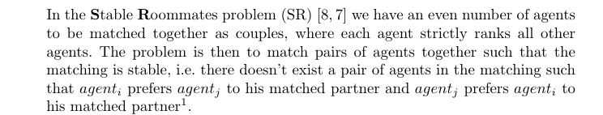
Stable Roommates (SR)
What’s the problem?

Slide 8
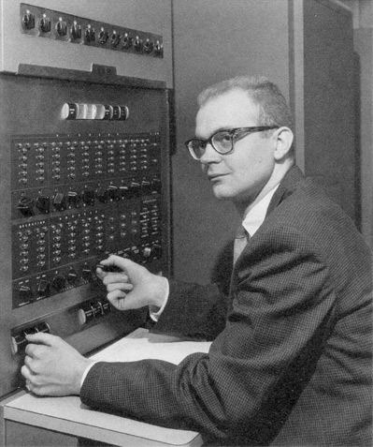
Stable Roommates (SR)
What’s the problem?
Order n squared
(Knuth thought not)

Slide 9
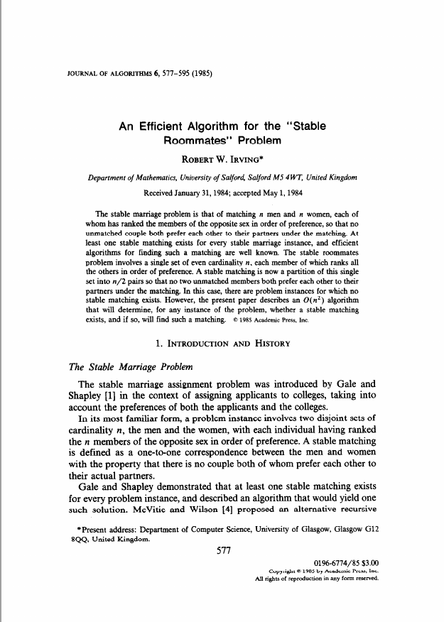

Stable Roommates (SR)
What’s the problem?
Order n squared
(Rob thought so)

Slide 10
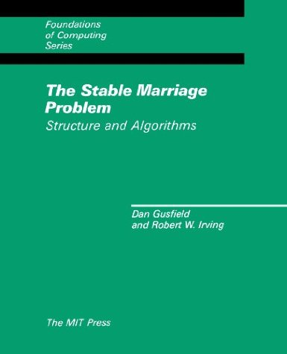
Stable Roommates (SR)
What’s the problem?
The green book

Slide 11
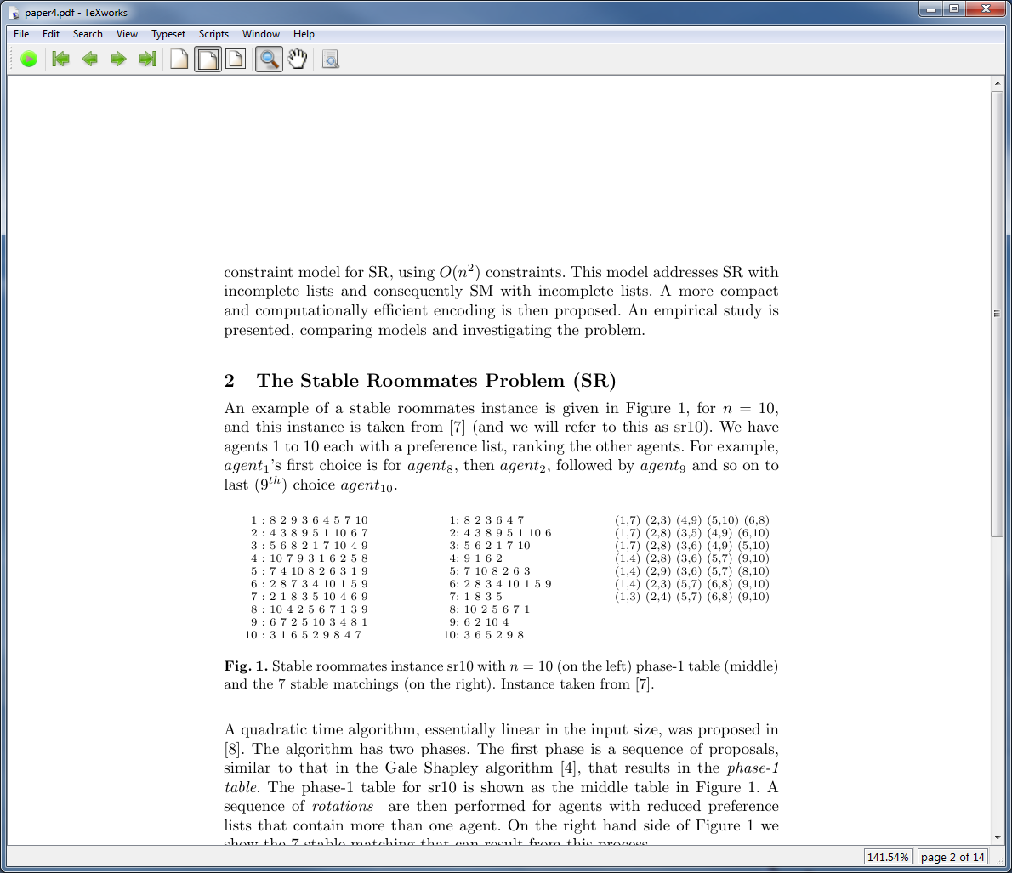
Stable Roommates (SR)
What’s the problem?
Taken from “The green book”
10 agents, each ranks 9 others, gender-free
(n=10, n should be even)

Slide 12
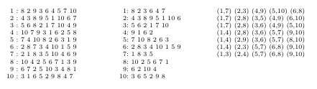
Stable Roommates (SR)
What’s the problem?
7 stable matchings
Taken from “The green book”

Slide 13
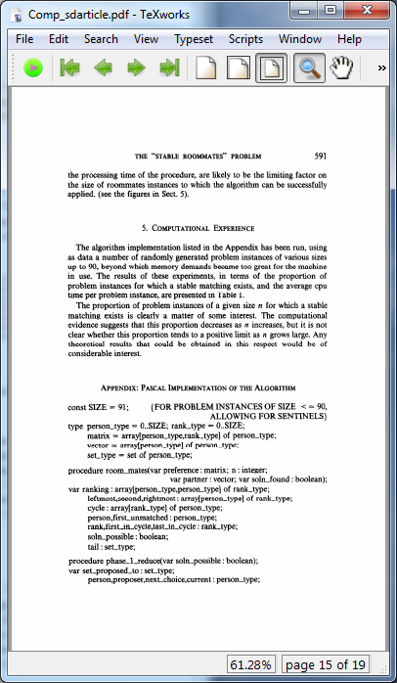
Stable Roommates (SR)
What’s the problem?
1985
Code
The Algorithm (Pascal)

Slide 14
Stable Roommates (SR)
What’s the problem?
1985
Code
The Algorithm (Pascal)

Slide 15
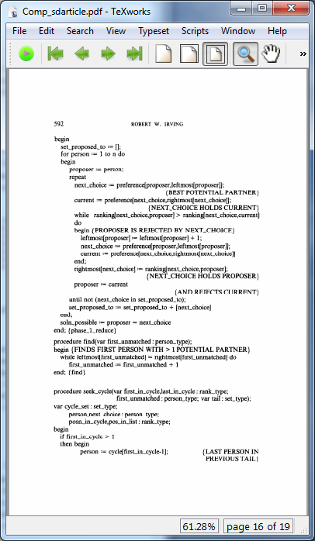
Stable Roommates (SR)
What’s the problem?
The Algorithm (Pascal)

Slide 16
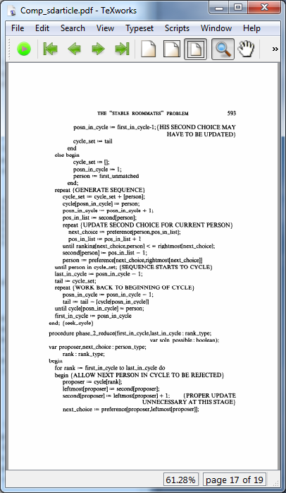
Stable Roommates (SR)
What’s the problem?
The Algorithm (Pascal)

Slide 17
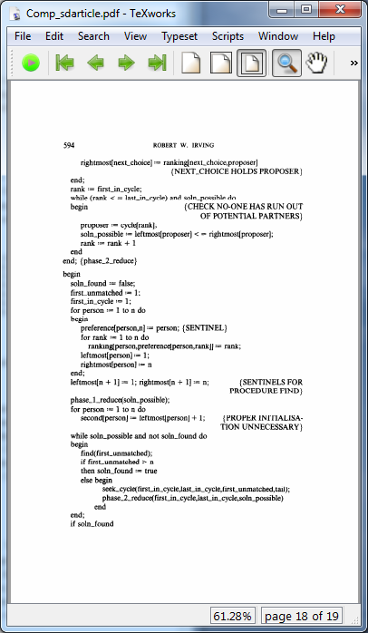
Stable Roommates (SR)
What’s the problem?
The Algorithm (Pascal)

Slide 18
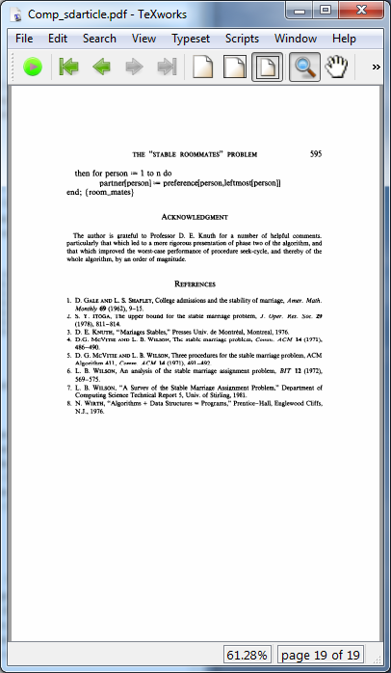
Stable Roommates (SR)
What’s the problem?
The Algorithm (Pascal)

Slide 19


Stephan & Ciaran spotted something!

Slide 20
Stable Roommates (SR)
A simple constraint model

Slide 21

Stable Roommates (SR)
A simple constraint model
$${pref}_{i}$$
Preference list for agent i

Slide 22

Stable Roommates (SR)
A simple constraint model
$${pref}_{i}$$
Preference list for agent i
$${pref}_{i,k}=j$$
agent j is agent i’s kth choice

Slide 23

Stable Roommates (SR)
A simple constraint model
$${pref}_{i}$$
Preference list for agent i
$${pref}_{3}=5,6,8,2,1,7,10,4,9$$

Slide 24

Stable Roommates (SR)
A simple constraint model
$${pref}_{i}$$
Preference list for agent i
$${pref}_{3,5}=1$$
The 5th preference of agent 3 is agent 1

Slide 25

Stable Roommates (SR)
A simple constraint model
$${pref}_{i}$$
Preference list for agent i
$${pref}_{i,k}=j$$
agent j is agent i’s kth choice
$${rank}_{i,j}=k$$
agent j is agent i’s kth choice

Slide 26

Stable Roommates (SR)
A simple constraint model
$${pref}_{i}$$
Preference list for agent i
$${pref}_{i,k}=j$$
agent j is agent i’s kth choice
$${rank}_{i,j}=k$$
agent j is agent i’s kth choice
NOTE: a rank value that is low is a preferred choice (large numbers are bad)

Slide 27

Stable Roommates (SR)
A simple constraint model
$${pref}_{i}$$
Preference list for agent i
$${pref}_{i,k}=j$$
agent j is agent i’s kth choice
$${rank}_{3,5}=1$$
agent 5 is agent 3’s 1st choice

Slide 28


Stable Roommates (SR)
A simple constraint model
$${pref}_{i}$$
Preference list for agent i
$${pref}_{i,k}=j$$
agent j is agent i’s kth choice
$${rank}_{3,5}=1$$
agent j is agent i’s kth choice
$$a_{i}∈\{1..n−1\}$$
constrained integer variable agent i with a domain of ranks

Slide 29

Stable Roommates (SR)
A simple constraint model
$${pref}_{i}$$
Preference list for agent i
$${pref}_{i,k}=j$$
agent j is agent i’s kth choice
$${rank}_{3,5}=1$$
agent j is agent i’s kth choice
$$a_{7}=6$$
agent 7 gets 6th choice and that is agent 10

Slide 30
Stable Roommates (SR)
A simple constraint model
Given two agents, i and j,
if agent i is matched to an agent he prefers less than agent j
then agent j must match up with an agent he prefers to agent i

Slide 31
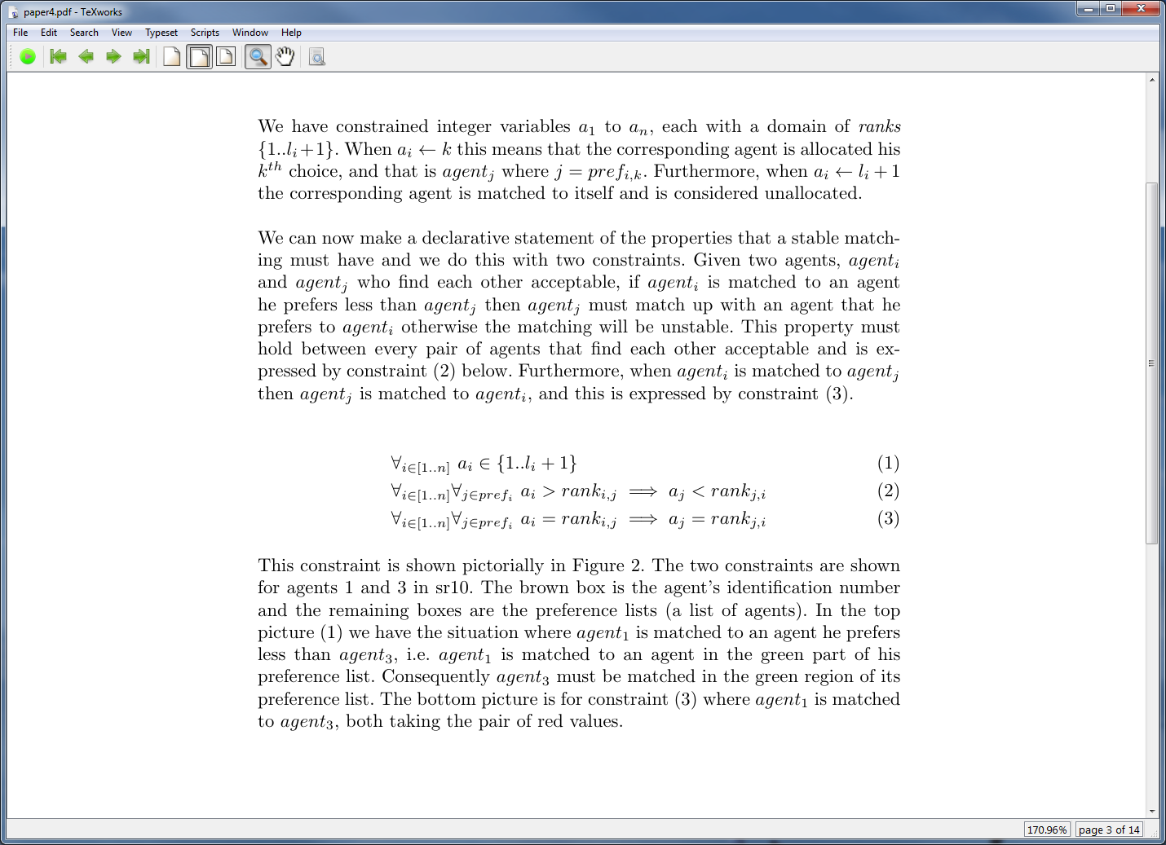
Stable Roommates (SR)
A simple constraint model
Given two agents, i and j,
if agent i is matched to an agent he prefers less than agent j
then agent j must match up with an agent he prefers to agent i

Slide 32
Stable Roommates (SR)
A simple constraint model
Given two agents, i and j,
if agent i is matched to an agent he prefers less than agent j
then agent j must match up with an agent he prefers to agent i
(1) agent variables, actually we allow incomplete lists!

Slide 33
Stable Roommates (SR)
A simple constraint model
Given two agents, i and j,
if agent i is matched to an agent he prefers less than agent j
then agent j must match up with an agent he prefers to agent i
agent variables, actually we allow incomplete lists!
If agent i is matched to agent he prefers less than agent j
then agent j must match with someone better than agent i

Slide 34
Stable Roommates (SR)
A simple constraint model
Given two agents, i and j,
if agent i is matched to an agent he prefers less than agent j
then agent j must match up with an agent he prefers to agent i
agent variables, actually we allow incomplete lists!
If agent i is matched to agent he prefers less than agent j
then agent j must match with someone better than agent i
(3) If agent i is matched to agent j
then agent j is matched to agent i

Slide 35
Given two agents, 1 and 3,
if agent 1 is matched to an agent he prefers less than agent 3
then agent 3 must match with an agent he prefers to agent 1
1: | 8 | 2 | 9 | 3 | 6 | 4 | 5 | 7 | 10
(2)
3: | 5 | 6 | 8 | 2 | 1 | 7 | 10 | 4 | 9

Slide 36
Given two agents, 1 and 3,
if agent 1 is matched to agent 3
then agent 3 is matched to agent 1
1: | 8 | 2 | 9 | 3 | 6 | 4 | 5 | 7 | 10
(3)
3: | 5 | 6 | 8 | 2 | 1 | 7 | 10 | 4 | 9

Slide 37
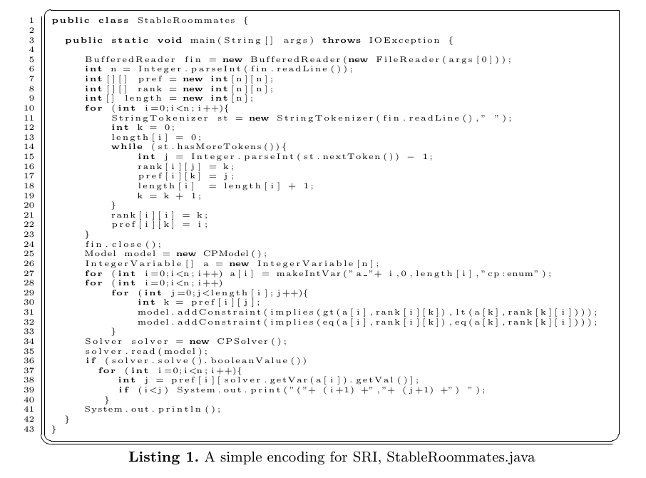
choco

Slide 38
choco
Read in the problem

Slide 39
choco
Build the model

Slide 40
choco
Find and print first matching

Slide 41
Neat
☺

Slide 42
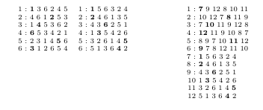
Can model SMI as SRI
Ant: Bea, Ann, Cat
Bob: Bea, Cat, Ann
Cal: Ann, Bea, Cat
Ann: Bob, Ant, Cal
SM
SRI
Bea: Cal, Ant, Bob
men
women
women+6
Cat: Cal, Bob, Ant

Slide 43

Yes, but what’s new here?

Slide 44
Yes, but what’s new here?
Model appeared twice in workshops
Applied to SM but not SR!
(two sets of variables, more complicated)
One model for SM, SMI, SR & SRI
Simple & elegant

Slide 45

Yes, but what’s new here?
Model appeared twice in workshops
Applied to SM but not SR!
(two sets of variables, more complicated)
One model for SM, SMI, SR & SRI
Simple & elegant
But this is hard to believe … it is slower than Rob’s 1985 results!

Slide 46

Yes, but what’s new here?
Model appeared twice in workshops
Applied to SM but not SR!
(two sets of variables, more complicated)
One model for SM, SMI, SR & SRI
Simple & elegant
But this is hard to believe … it is slower than Rob’s 1985 results!

Slide 47
Cubic to achieve phase-1 table
Not so neat
☹

Slide 48
A specialised constraint
When an agent’s domain is filtered AC revises all constraints that involve that variable.

Slide 49
A specialised constraint
When an agent’s domain is filtered AC revises all constraints that involve that variable.
In this case that is n constraints

Slide 50
A specialised constraint
When an agent’s domain is filtered AC revises all constraints that involve that variable.
In this case that is n constraints
We can do better than this, reducing complexity of model by O(n)

Slide 51
A specialised constraint
I implemented a specialised binary SR constraint and an n-ary SR constraint
This deals with incomplete lists
This is presented in the paper
You can also download and run this

Slide 52
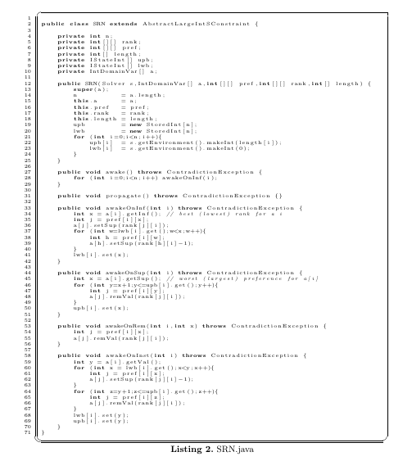
A specialised constraint
Here’s the code.
Not much to it ☺

Slide 53
A specialised constraint
Constructor

Slide 54
A specialised constraint
awakening

Slide 55
A specialised constraint
lower bound changes

Slide 56
A specialised constraint
upper bound changes

Slide 57
A specialised constraint
removal of a value

Slide 58
A specialised constraint
instantiate

Slide 59
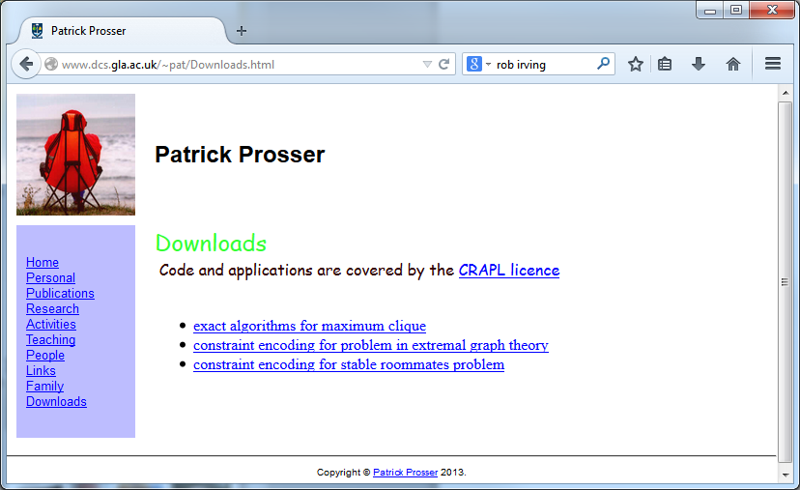

Slide 60
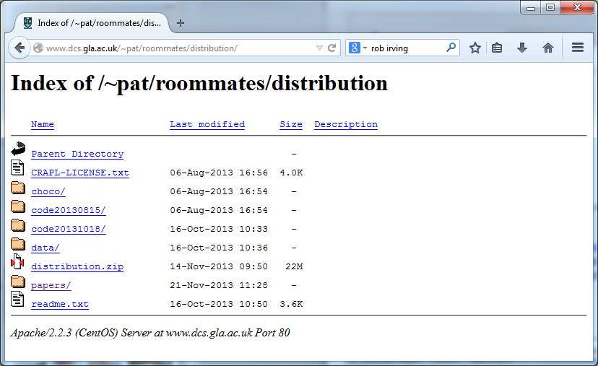

Slide 61

Empirical study
When I was younger, my mother did things to annoy me

Slide 62
Empirical study
SR: simple constraint model, enumerated domains
SRB: simple constraint model, bound domains
SRN: specialised n-ary constraint, enumerated domains

Slide 63
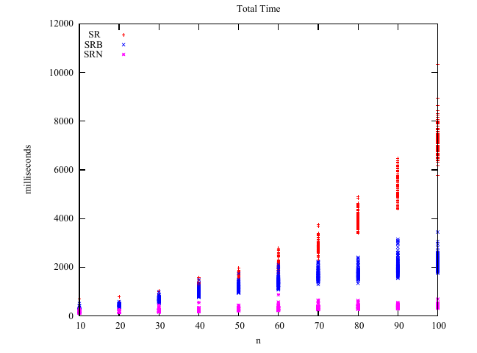
10 < n < 100: read, build, find all stable matchings

Slide 64
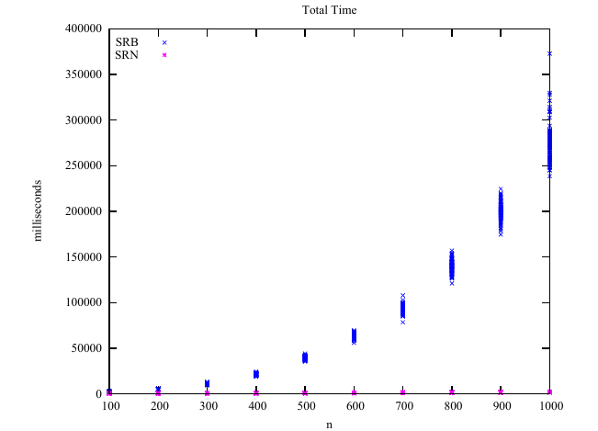
100 < n < 1000: read, build, find all stable matchings

Slide 65
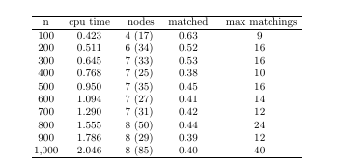
This is new (so says Rob and David)
n, average run time, nodes (maximum), proportion with matchings, maximum number of matchings

Slide 66

So?

Slide 67
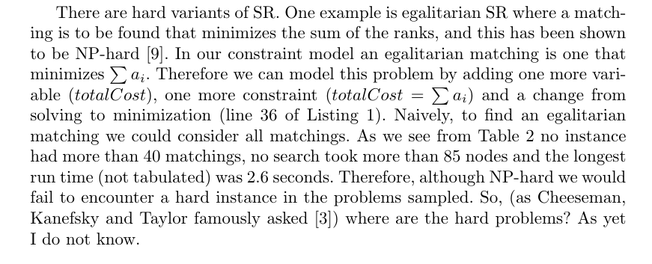
Well, think on this …

Slide 68
What’s still to do?
Prove that the model finds a stable matching in quadratic time …

Slide 69
This was all my own work …

Slide 70
… well, with some help from
David Manlove
Rob Irving,
Jeremy Singer
Ian Gent
Chris Unsworth
Stephan Mertens
Ciaran McCreesh
Paul Cockshott
Joe Sventek
Augustine Kwanashie
Andrea

Slide 71
